Slide 1


PERCEPTUAL ROBOTICS
VC Investment Memo: Wind Turbine Inspection
Gerald Velas

Slide 2
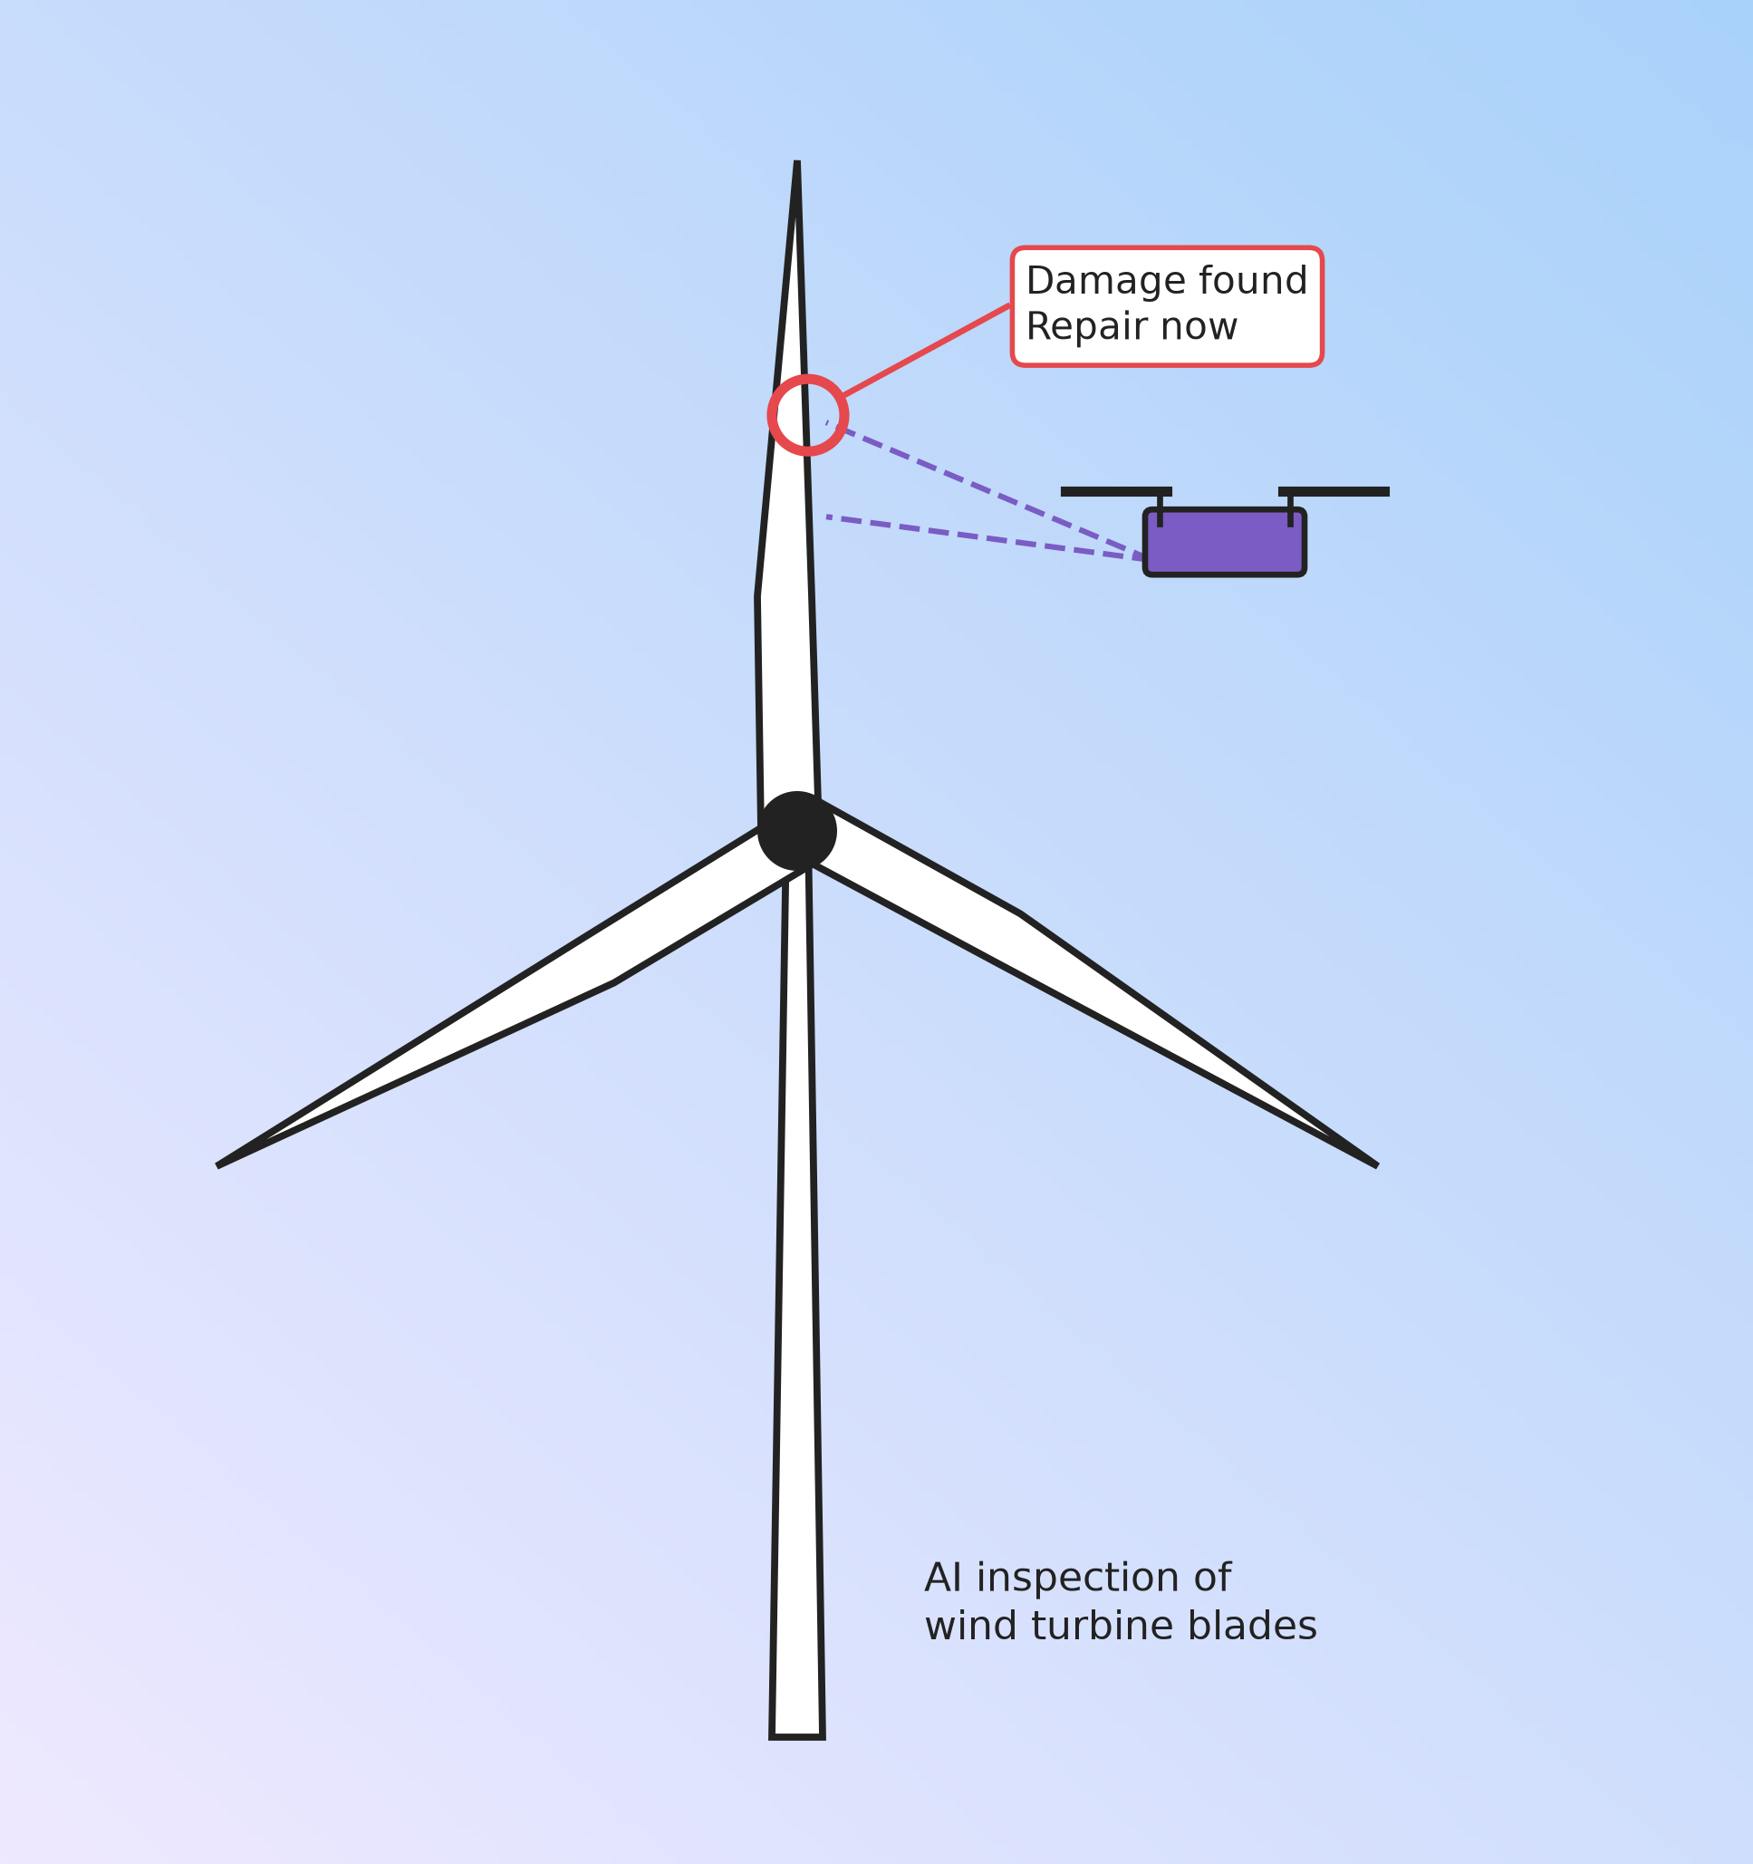
PERCEPTUAL ROBOTICS AT A GLANCE
Autonomous drones and AI for wind turbine blade inspection
Bristol and Athens, founded 2016
More than £4M raised in 2026; valuation undisclosed
Call: track, not invest yet
A University of Bristol spin-out with Greek backers
Gerald Velas

Slide 3
PROBLEM AND SOLUTION
THE PROBLEM
Blades erode and crack. Manual checks are slow and inconsistent, so damage is found late and repairs cost more
THE SOLUTION
Dhalion drones capture blade images, and AI grades the damage and ranks repairs with a “Repair Now Ratio”
Gerald Velas

Slide 4
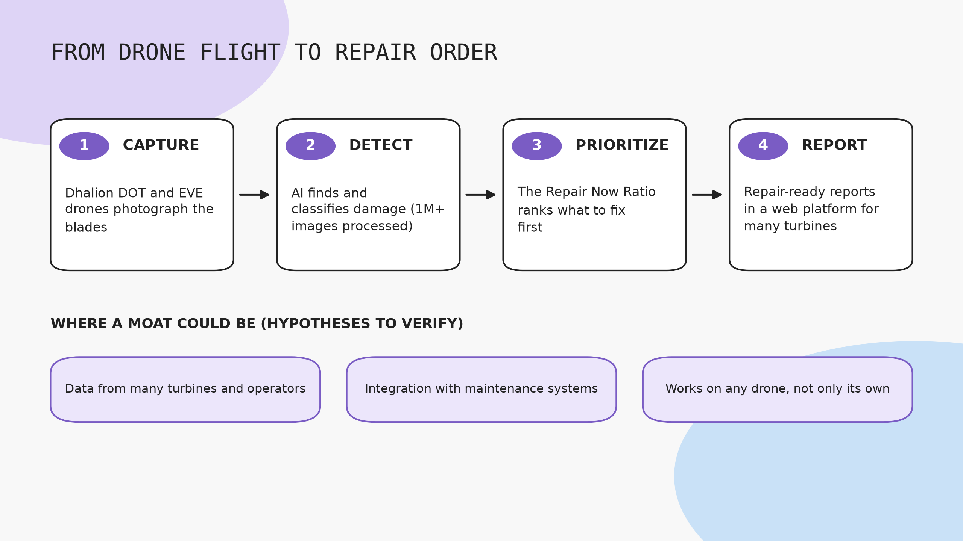
Sources: company site and press. Moat points are my hypotheses.
Gerald Velas

Slide 5
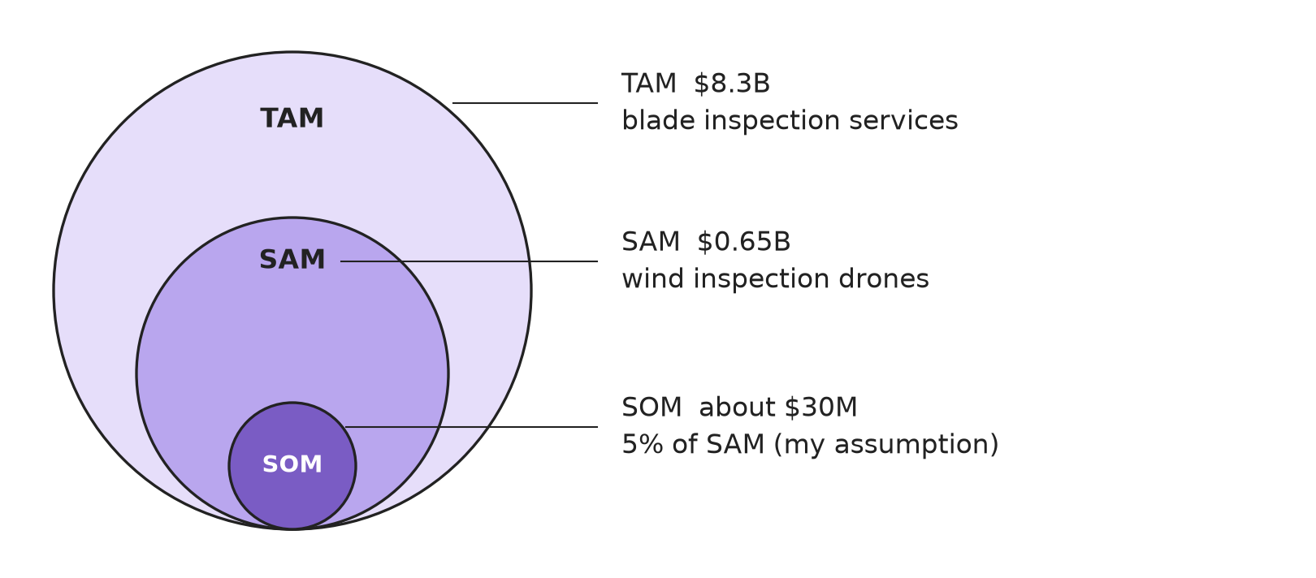
MARKET SIZE
LAYER | SIZE | BASIS
TAM | $8.3B | Blade inspection services
SAM | $0.65B | Wind inspection drones
SOM | ~$30M | 5% of SAM
SCOPE
SOM
Services market is 13x the drone market
My assumption, not company data. Validate with operator calls
Sources: NextMSC, 360iResearch via GII. Estimates differ by definition; do not add them up
Gerald Velas

Slide 6
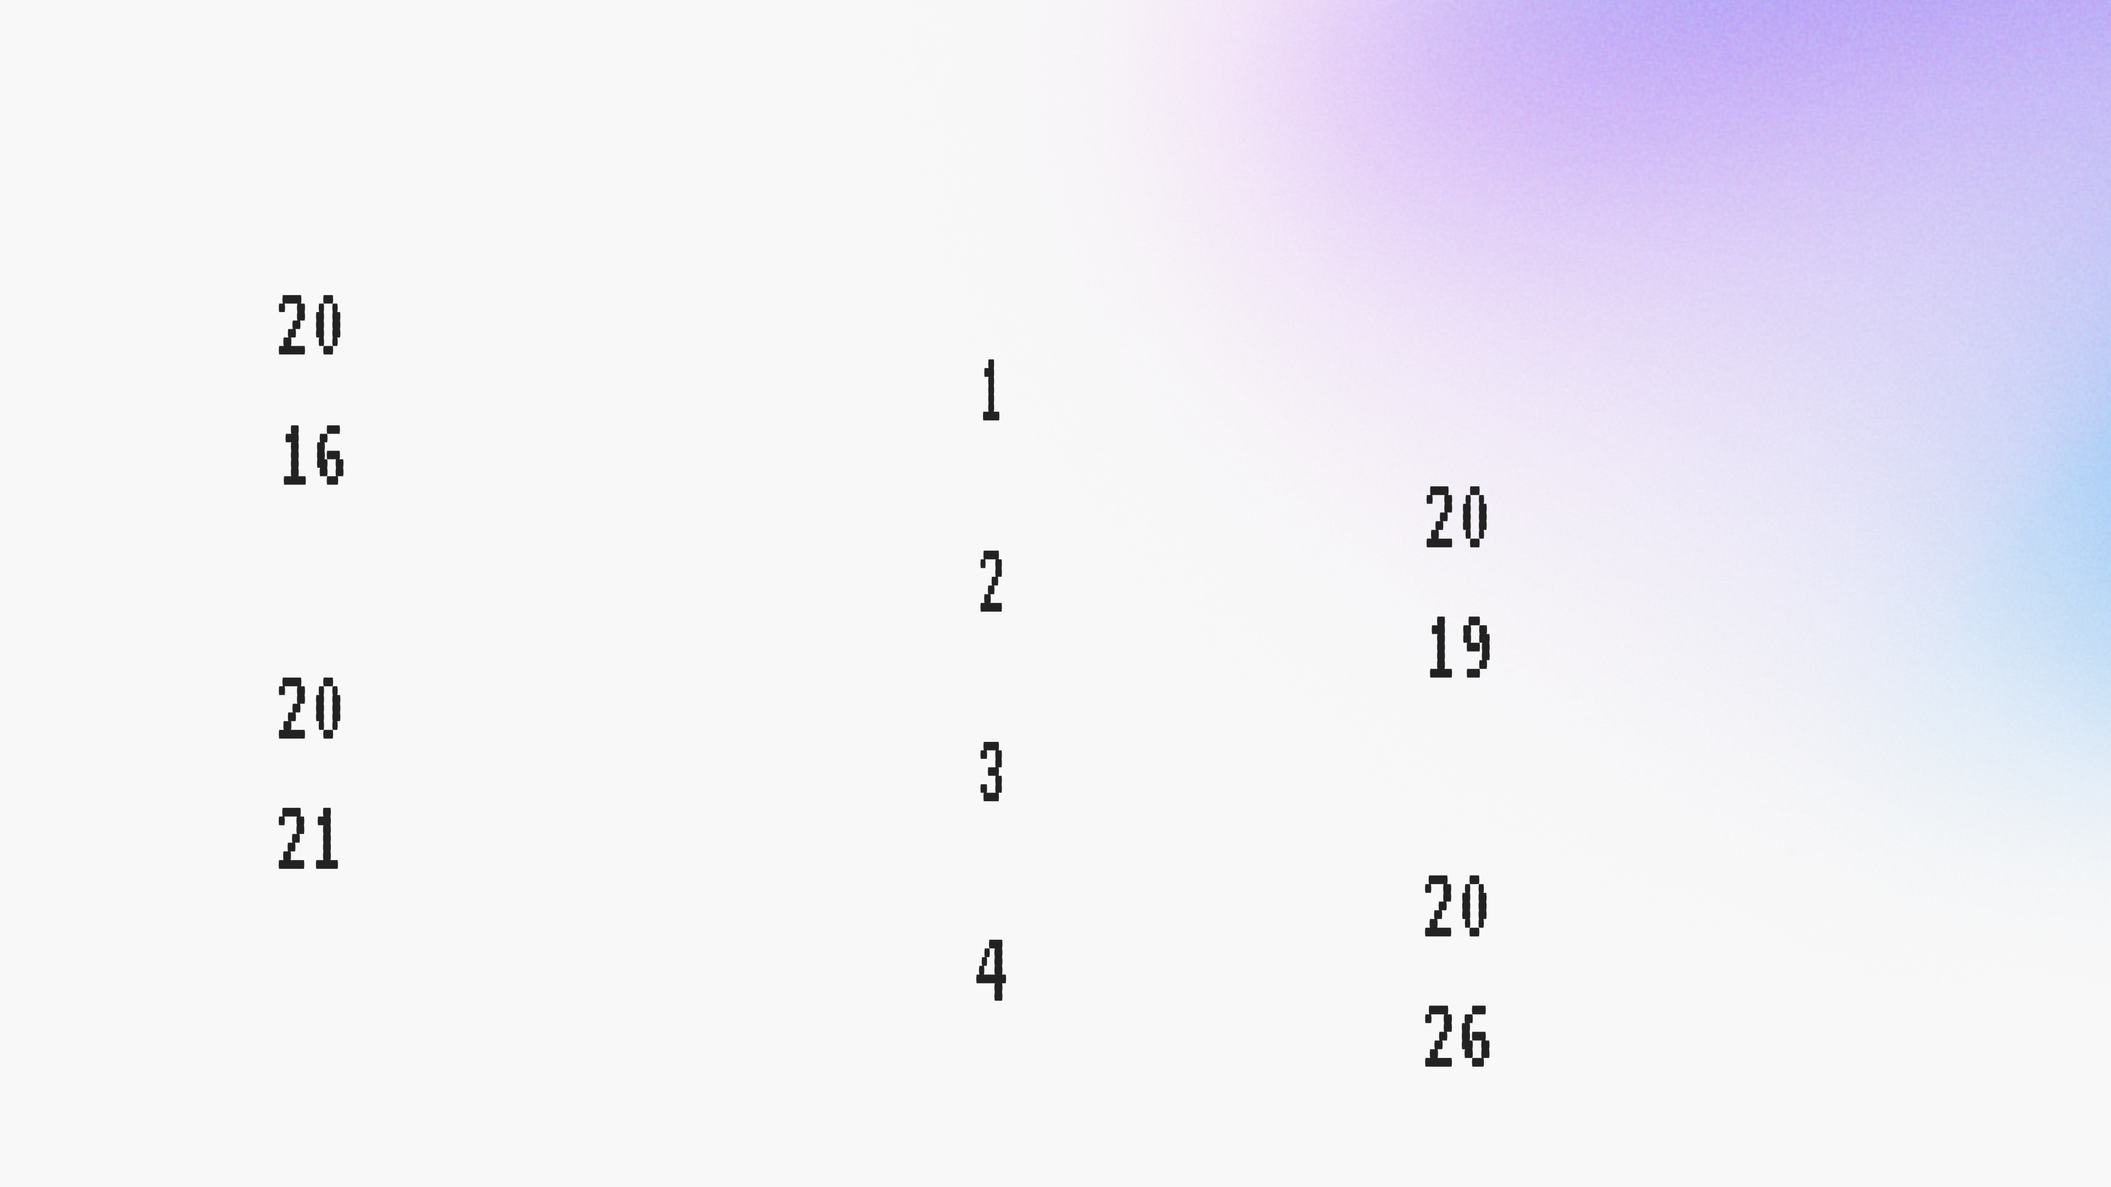
TRACTION AND FUNDING
Founded by three University of Bristol engineering students
Athens base opens; €0.6M from Metavallon VC
£1.6M led by TSP Ventures; Brookstreet and Susten follow in 2023
£4M+ from Loggerhead, One Planet Capital and Investing for Purpose. 18+ countries, 1M+ images (company-reported)
Gerald Velas

Slide 7
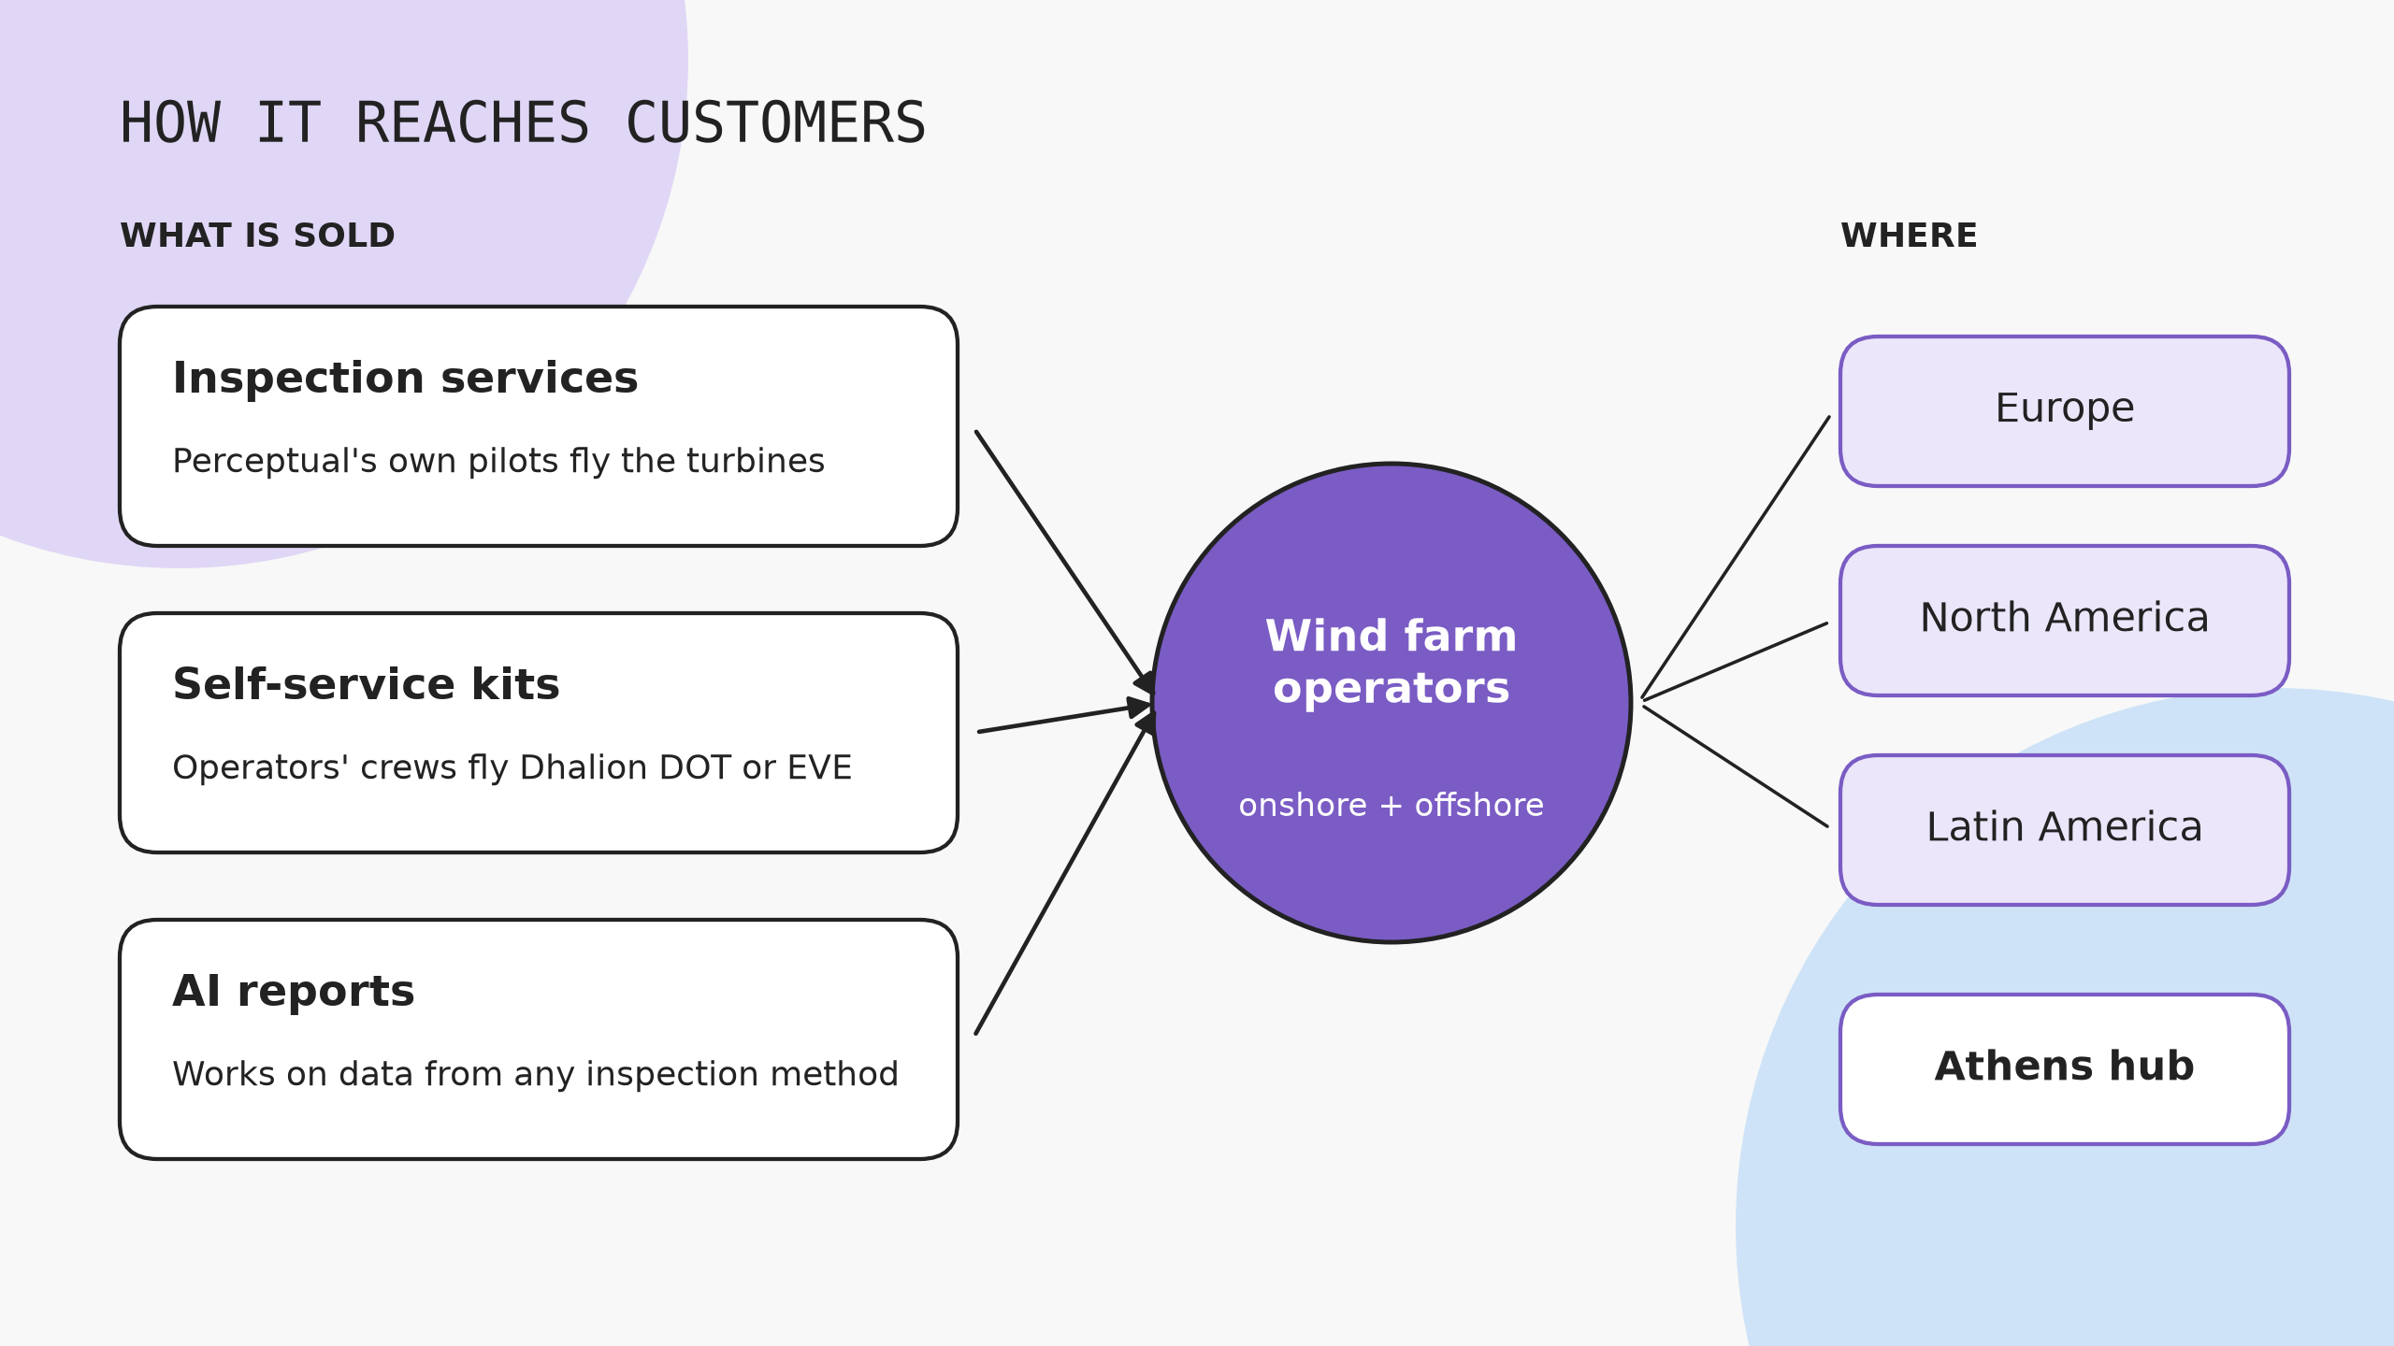
Sources: company site and press coverage
Gerald Velas

Slide 8
COMPETITIVE LANDSCAPE
COMPANY | APPROACH | FUNDING | THREAT
SkySpecs (US) | Drones plus Horizon software | $140M total | High
Aerones (Latvia) | Robots that inspect, clean, repair | $174.5M total | Medium
BladeBUG (UK) | Crawler robot on the blade | Not checked | Low to medium
Nearthlab, ProDrone, Clobotics | Drone and AI inspection | Not checked | Medium
Perceptual | Drones, AI, services | £4M+ in 2026 | Subject
Funding from CB Insights and company claims, not verified. Rivals marked “not checked” were not researched
Gerald Velas

Slide 9
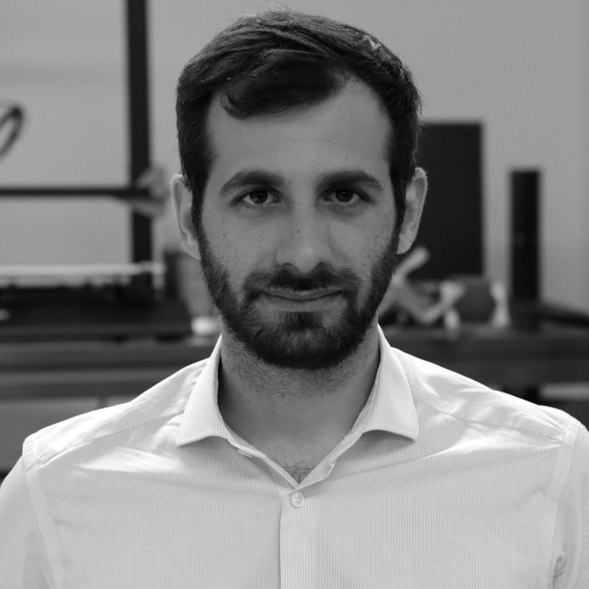
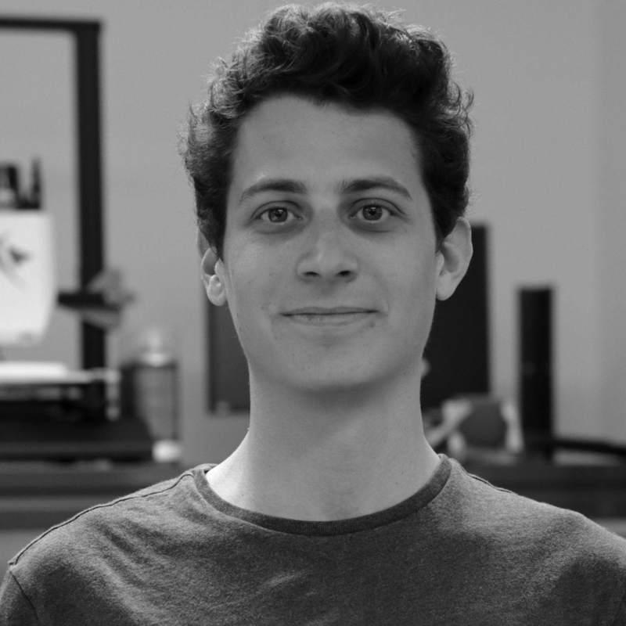
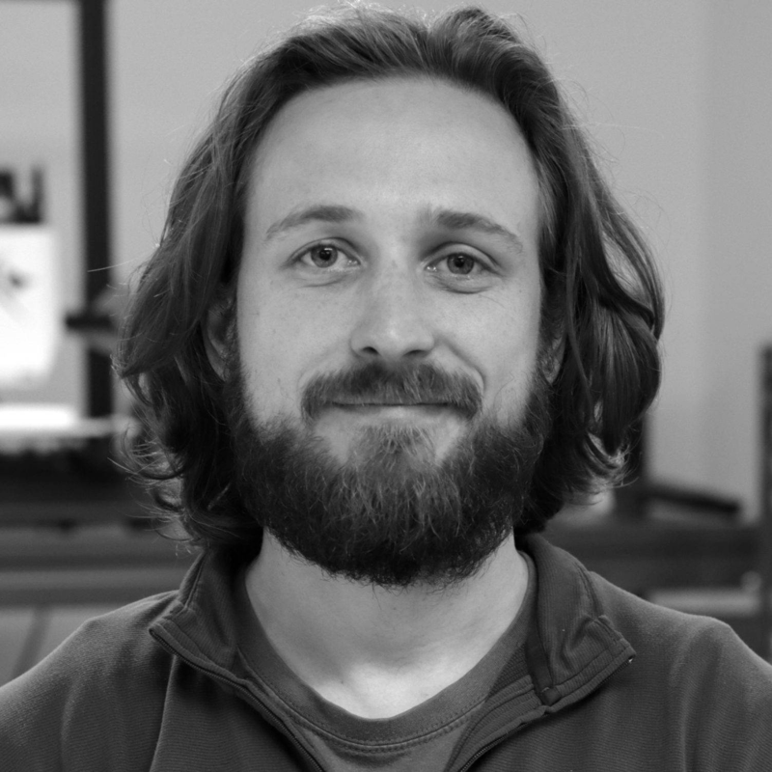
THE TEAM
KOSTAS KARACHALIOS
DIMITRIS NIKOLAIDIS
KEVIN LIND
CEO and co-founder
COO and co-founder
CTO and co-founder
Backers: Metavallon VC, TSP Ventures, Loggerhead, One Planet Capital, Investing for Purpose. Susten sits on the board. Gap: no named sales or ML lead.
Photos: Perceptual Robotics
Gerald Velas

Slide 10
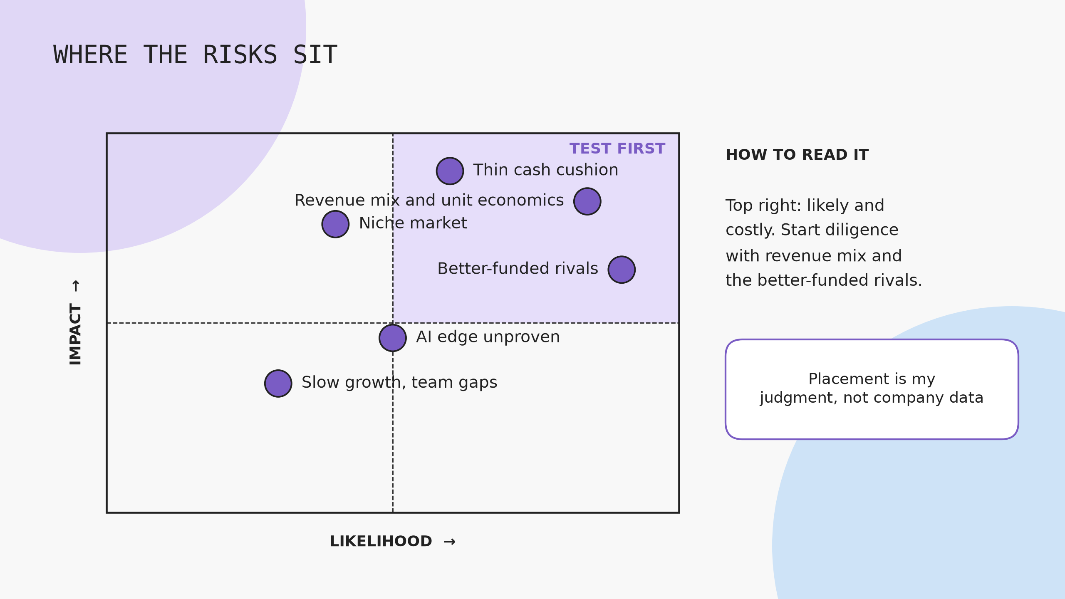
Placement is my judgment, not company data
Gerald Velas

Slide 11
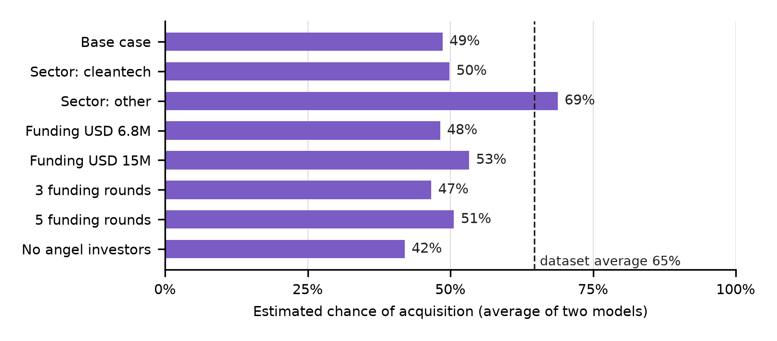
SCREENING MODEL SCORES
MODEL | LOGIT | FOREST
ACCURACY | 71% | 69%
AUC | 0.70 | 0.70
BASE CASE | 38% | 59%
RANGE | 29%-68% | 55%-70%
SCORE
TRUST
Base case averages 49%, below the 65% dataset average
Close to guessing: sector alone moves it from 49% to 69%
Source: Perceptual_Robotics_Screening_Model.ipynb. 923 US startups; inputs estimated from public sources
Gerald Velas

Slide 12
DECISION: TRACK
Track, don’t invest yet. Illustrative return on $3M at a $25M valuation: 0.6x bear, 3.0x base, 12x bull. Three gaps decide it: revenue and margin by line, proof the AI works on any drone, and a valuation.
Next: call 3 to 5 wind operators, benchmark its detection against SkySpecs, and request the cap table and runway.
Gerald Velas

Slide 13
THANK YOU
Questions and feedback welcome
Gerald Velas
g.vela@acg.edu
/geraldvelas

