Slide 1
Venture
Signal Science
Decoding the Metrics That Drive Early Success
INTRO TO DATA SCIENCE
GERALD VELAS
244017
PROF. VASILEIOS VLASEROS

Slide 2
A Data Science approach to early-stage
Venture Capital screening
This project uses data science to uncover early signals of start-up success.
By analysing venture data with machine learning, we reveal how factors like funding size, funding rounds, company age, and investor backing influence whether a start-up succeeds or closes.
Potanin et al. (2023)

Slide 3
01
Why Seed-Stage Signals Matter in VC

Slide 4
Early-stage venture decisions are high-risk, with over 80% of startups failing before Series A
VCs rely on “signals” / data-driven indicators of potential
$10.23
Using data science, we can detect patterns that separate successful from unsuccessful start-ups
02
Gompers et al. (2020)

Slide 5
Dataset Description
Source
Target variable
Key features
Kaggle Startup Success
Prediction dataset
(923 start-ups, 49 columns)
Success = 1 (acquired / operating / IPO)
0 = closed
funding_rounds, log_funding, age_proxy, category_code, state_code, has_VC, has_angel, is_top500
Potanin et al. (2023)

Slide 6
Data cleaning &
Preprocessing
1
2
3
4
5
Selected 11 of 49 columns, built binary target
Encoded categorical variables
(sector, state)
Created new features: log_funding, age_proxy
Scaled numeric variables (StandardScaler)
Stratified 70/30 train-test split
Razaghzadeh Bidgoli et al. (2024)

Slide 7
Exploratory Data Analysis
Success is the majority class: 597 acquired vs 326 closed start-ups, so models learn successes better and failures are harder to detect
Success
65%
Closed
35%
Total
923
Own analysis

Slide 8
Funding by Outcome
Successful start-ups raised about twice as much: average funding is $31.0M vs $15.1M for closed ones, and they completed more rounds (2.5 vs 1.9)
Total funding is highly skewed by a few very large raises, so the models use log funding to reduce the effect of outliers
Own analysis

Slide 9
Model Performance
Model | Accuracy | Precision (Closed) | Recall (Closed) | F1 (Closed) | Precision (Success) | Recall (Success) | F1 (Success)
Logistic Regression | 0.71 | 0.62 | 0.50 | 0.55 | 0.75 | 0.83 | 0.79
Random Forest | 0.70 | 0.60 | 0.50 | 0.54 | 0.75 | 0.82 | 0.78
Own analysis

Slide 10
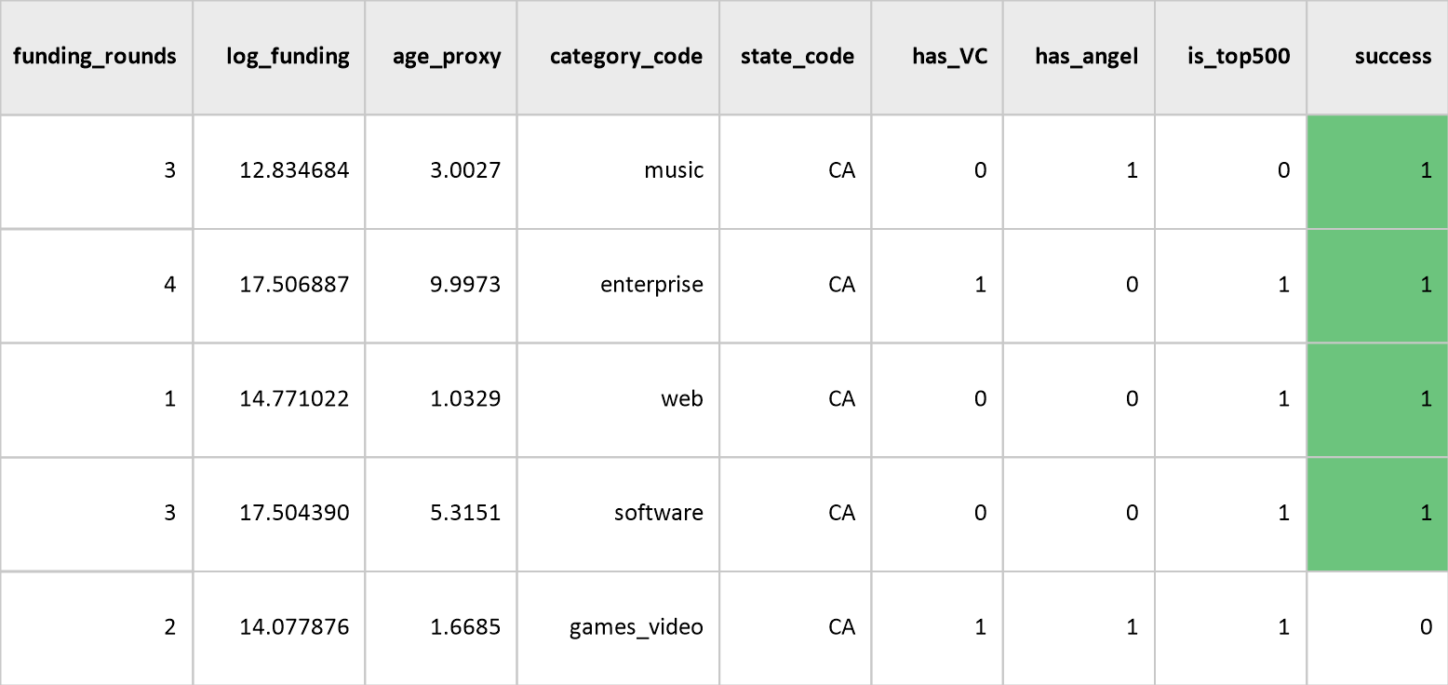
Startup Success (Binary)
Classifies each start-up as :
1 = success (acquired / operating / IPO)
or
0 = closed, using funding, age, sector, state and VC/angel features
This model should be used for decision support, not certainty.
Logistic Regression + Random Forest
Own analysis

Slide 11
Feature Importance & Key Insights for VCs
Age at Last Funding
Total Funding
1
2
Top predictor in the Random Forest, with 22.7% importance
Log funding (22.2%) is a close second
Top-500 & VC
Rounds
4
3
Smaller effects: is_top500 5.0%, has_VC 3.5%
Number of rounds ranks third, at 8.4% importance
Own analysis

Slide 12
Limitations & Caveats
01
02
03
04
Regional
Bias
Proxy Limitation
Dataset covers U.S. start-ups only (state-level location)
‘Success’ ≠ profitability (limited proxy)
Data
Gaps
Ethical
Bias
Small sample (923 start-ups), no qualitative data (e.g., market sentiment)
Ethical issues: bias in data and funding access
Gompers et al. (2020)

Slide 13
Analysis Conclusion
Data-Driven Decisions
Data-driven approaches enhance VC decision-making by revealing objective patterns in past investments, reducing bias, and helping allocate capital more effectively
Predictive Insight
Predictive analytics complements intuition by using data patterns to validate instincts and highlight risks: Logistic Regression reached ~71% and Random Forest ~70% test accuracy
Gompers et al. (2020)

Slide 14

Future Work
Do you know what shapes the future of VC analysis?
Add investor-level variables to capture how fund experience, portfolio diversity, and network strength influence start-up outcomesYou can organize your ideas
Build an interactive “VC Signal Dashboard” to visualize predictive indicators and allow real-time exploration of investment insightsAnd the most important thing: the audience won’t miss the point of your presentation
Include sentiment and macro trends to account for market confidence, funding cycles, and broader economic signals that affect venture performance.
Gompers et al. (2020)

Slide 15
References
Razaghzadeh Bidgoli, M., Raeesi Vanani, I., & Goodarzi, M. (2024). Predicting the success of startups using a machine learning approach. Journal of Innovation and Entrepreneurship, 13(80). https://doi.org/10.1186/s13731-024-00436-x
Zeng, B. (2023). Venture Capital Research—Investor Preferences and Success Factors for Startups. Open Journal of Business and Management, 11, 2743–2762. https://doi.org/10.4236/ojbm.2023.116149
Potanin, M., Chertok, A., Zorin, K., & Shtabtsovsky, C. (2023). Startup success prediction and VC portfolio simulation using CrunchBase data. arXiv. https://arxiv.org/abs/2309.15552
Gompers, P. A., Gornall, W., Kaplan, S. A., & Strebulaev, I. A. (2020). How do venture capitalists make decisions? Journal of Financial Economics, 135(1), 169–190.

Slide 16
Thanks!
Do you have any questions?
g.vela@acg.edu
GERALD VELAS
DATA SCIENCE

