Slide 1
Docker/Kubernetes Intro
Hot Fix Roll Out Demo
September, 2015

Slide 2
Intro
Docker/Kubernetes intro, and the project description
Docker and Google Container engine quick overview
Docker - shipping container
Google Container Engine - Kubernetes
What the demo will be about:
Application
Problem statement: ETag
Hot fix roll out demo
Q&A

Slide 3
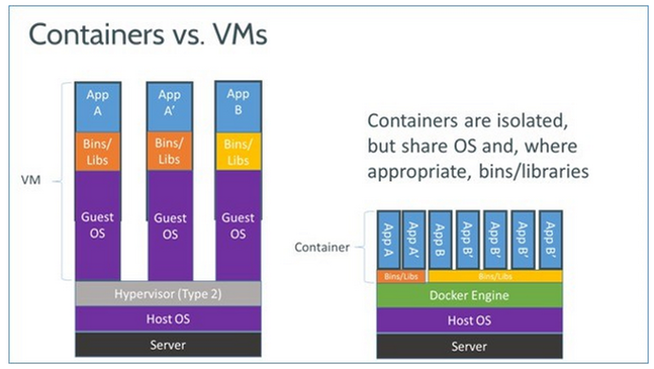
1. Docker

Slide 4
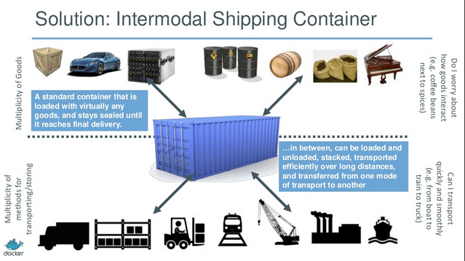
1a. Docker continued

Slide 5
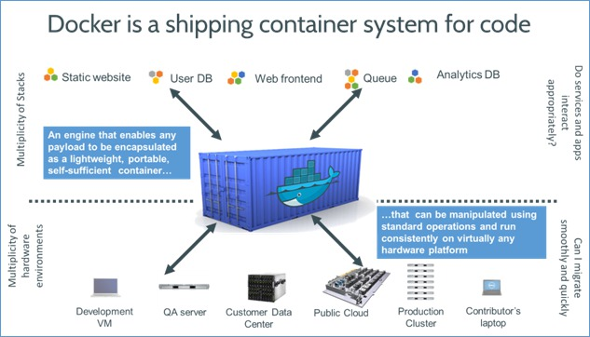
1b. Docker continued

Slide 6
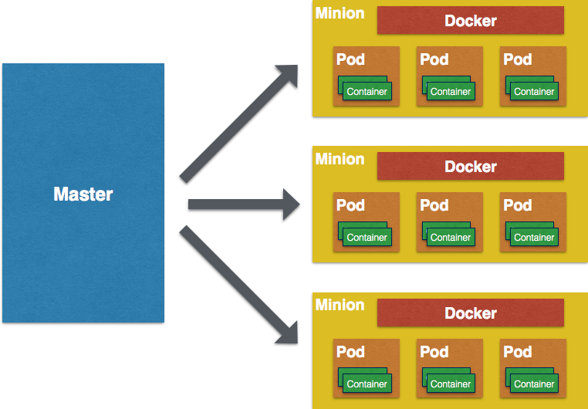
2. Kubernetes

Slide 7
3. The Demo Project

Slide 8
Appendix
Demo video:
https://rovicorp.webex.com/rovicorp/ldr.php?RCID=3e312c59d07a15c6b59277c60daf0c24
Docker video:
https://www.youtube.com/watch?v=Q5POuMHxW-0
Docker slides:
http://slides.com/krak3n/docker/fullscreen#/1
REST CRUD services in the Google Cloud:
http://104.197.141.51/subscriber?id=12
Website in the Google Cloud:
http://104.197.108.224/subscribers/dynamicsubscribers
Git repository for the source code, ppt, Docker and Kubernetes files and more:
https://github.com/gevgev/subscribers.git

