Slide 1
Docker/Kubernetes Intro
Initial Deployment Demo
September, 2015
Notes:
Start recording

Slide 2
Intro
Docker/Kubernetes intro, and the project description
Docker and Google Container engine quick overview
Docker - shipping container
Google Container Engine - Kubernetes
What the demo will be about:
Google Cloud Project Setup
Google tools install and setup
Build, test, push Docker images
Launch of the App in the Google Cloud
Q&A
Notes:
Has recording started yet?

Slide 3
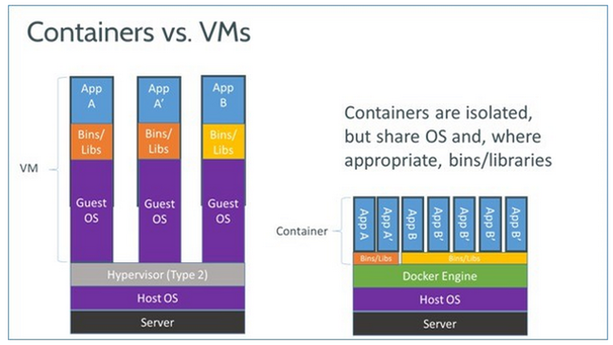
1. Docker
Notes:
How about now? Recording yet?

Slide 4
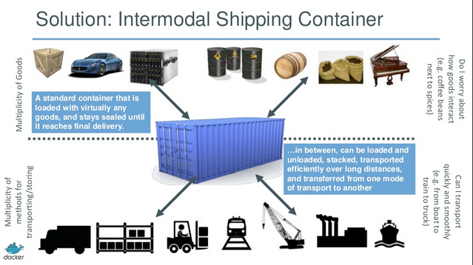
1a. Docker continued

Slide 5
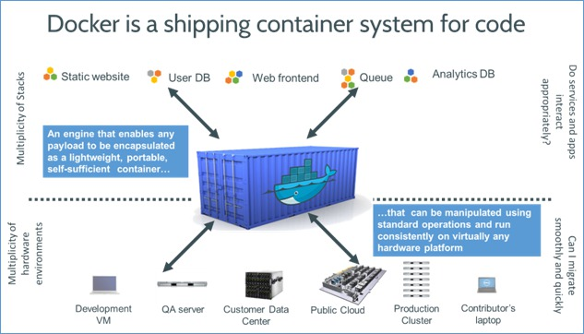
1b. Docker continued

Slide 6
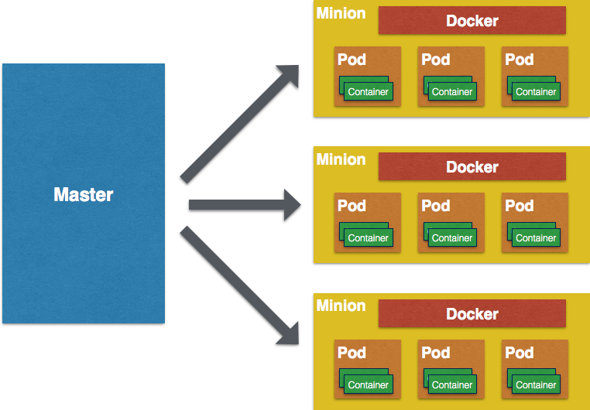
2. Kubernetes

Slide 7
3. The Demo Project

Slide 8
Google Cloud SQL Access Configuration
Before our apps can do anything we will need a SQL instance in Google Cloud
Create a new instance of Cloud SQL, and get it’s IP
Whitelist your machine’s IP with this instance, use this tool to find out your Proxy IP:
http://www.lagado.com/proxy-test
Now you can launch your MySQLWorkbench, and connect to this instance in Google Cloud (using it’s IP)
Next, load your DB DDL file, and run it against the Google Cloud
The database is up and running in the cloud
Notes:
MySQLWorkbench DB code, SQL server in the cloud

Slide 9
Build the Applications – Artifacts
Source code for webservices and for website (STS)
Configure your app/code to use the Google Cloud SQL, by setting up the correct connection string, i.e:
jdbc:mysql://173.194.110.154:3306/Subscriptions?user=testuser&password=usertestpsw01.
Environment VAR for website to point to webservices
Build services jar
$ mvn package
Copy the services.jar to deployment/Services
Create war file for website (STS -> Export -> War)
Copy the war file, is not there yet
The code for both applications is now ready to be deployed
Notes:
Services subscriber REST controller
Dynamic servlet
Common/Models/Subscriber POJO
Properties and configurations

Slide 10
Google Cloud Project and your Machine Env Setup
Starting a new project in Google Cloud
First install all tools:
Install Docker:
https://docs.docker.com/installation/mac/
Google Account exists
Billing enabled
gcloud CLI installed, for Linux/Mac OS X:
$ curl https://sdk.cloud.google.com | bash
$ exec -l $SHELL
$ gcloud init
kubectl installed, for Linux/Mac OS X:
$ gcloud components update kubectl
Create a new project in Google Cloud
Enable Container Engine API
Set your gcloud defaults:
$ gcloud config set project PROJECTID
Usually it is a good idea to run this command before doing anything:
$ gcloud components update

Slide 11
Create your Cluster(s) and initialize Docker
Create a new cluster, where our app will be running
For this app we could create two clusters, one for webservices, one for website
But for the purposes of this demo we will work with a single cluster for both
$ gcloud container clusters create subscribers \
--num-nodes 3 \
--machine-type g1-small // we will not use parameter to get the standard size VMs
We can now see our instances:
$ gcloud compute instances list
Before we can start building our images, start Docker machine (Mac OS X):
$ docker-machine start default
$ eval "$(docker-machine env default)”

Slide 12
Cloud SQL Access Control management
Now, whitelist the IP’s for the server nodes of our cluster with Cloud SQL, which we created before, i.e:
gke-subscribers-82c58720-node-fah8 : 104.197.107.63
gke-subscribers-82c58720-node-l4s1 : 104.197.9.246
gke-subscribers-82c58720-node-qrtx : 104.154.92.187

Slide 13
Preparation before we build images
Get the Project Id from Google Cloud, and set that as an ENV variable
we will need that for names of images, as it should match the project name to be pushed to Google Cloud Repository:
$ export PROJECT_ID="xxx-xxx-xxx”
The name format for images is:
gcr.io/<projectId>/<imagename>:<tag>
Additional configuration, where needed, to allow the nodes to discover each other, i.e. website nodes to discover webservices nodes
DNS
Or ENV variables
Now we can start building the images

Slide 14
Build images: webservices
Build webservices image:
$ docker build -t gcr.io/${PROJECT_ID}/webservices-node:v0.1 .
List your images:
$ docker images
Test it locally:
$ docker run -d -P gcr.io/${PROJECT_ID}/webservices-node:v0.1
$ docker ps -- to check if container is up and running, and to get the port number
$ docker-machine IP default – to get the IP for docker machine, and test the webservices locally
Push it to Google Cloud
Check if our settings point to the right project
$ gcloud config list
Push the image
$ gcloud docker push gcr.io/${PROJECT_ID}/webservices-node:v0.1
Check the Google Dev Portal if it shows the image in the repository
Container Engine/ Container Registry
Notes:
Folder: deployment/Services

Slide 15
Build images: website
Build website image:
$ docker build -t gcr.io/${PROJECT_ID}/website-node:v0.1 .
List your images:
$ docker images
Test it locally – (if webservices are already in the cloud, it will work – by IP)
$ docker run -d -P gcr.io/${PROJECT_ID}/website-node:v0.1
$ docker ps -- to check if container is up and running, and to get the port number
$ docker-machine IP default – to get the IP for docker machine, and test the website locally
Push it to Google Cloud
Check if our settings point to the right project
$ gcloud config list
Push the image
$ gcloud docker push gcr.io/${PROJECT_ID}/website-node:v0.1
Check the Google Dev Portal if it shows the image in the repository
Container Engine/ Container Registry
Notes:
Folder: deployment/Website

Slide 16
Deployment
Now, when we have all our images built and tested locally, we can start the deployment to Google cloud
The process will be:
Launch nodes (pods) with our webservices nodes
Launch load balancer for webservices (service)
Get the IP for webservices load balancer to be used to configure the website nodes (ENV variable here, but usually DNS)
Launch nodes (pods) with our website nodes
Launch load balancer (service) for website
Test

Slide 17
Deployment process visualized:
1.
3.
4
2.

Slide 18
1. Creating Replication Controller for Webservices
All kubernetes controllers and services files are in deployment/replication-controller-config-files folder
Create webservices app replication controller
File: subscriber-webservice-controller.json:
Update the controller file to have the correct image name (no more ${PROJECT_ID}):
“gcr.io/subscribers-XXXX/webservices-node:v0.1”
Ensure the image name has the appropriate tag, if it was build with the tag, or omit “latest” default tag here
Command:
$ kubectl create -f subscriber-webservices-controller.json
View nodes:
$ kubectl get pods
Notes:
Folder: deployment/replication-controller-config-files

Slide 19
2. Creating Services (Load balancer) for Webservices
All kubernetes controllers and services files are in deployment/replication-controller-config-files folder
Create services (LoadBalancer) for webservices app nodes (pods):
File: subscriber-webservice-service.json
Command:
$ kubectl create -f subscriber-webservice-service.json
View service:
$ kubectl get services
Get IP address for the load balancer for website App Service (load balancer):
$ kubectl get services
i.e.: 104.197.141.51
Test services, i.e.:
http://104.197.141.51/subscriber
Notes:
Folder: deployment/replication-controller-config-files

Slide 20
3. Creating Replication Controller for Website
All kubernetes controllers and services files are in deployment/replication-controller-config-files folder
Create website app replication controller
File: subscriber-website-controller.json
Update the controller file to have the correct image name (no more ${PROJECT_ID}):
“gcr.io/subscribers-XXXX/website-node:v0.1”
Ensure the image name has the appropriate tag, if it was build with the tag, or omit “latest” default tag here
Pass the IP address for the web services Services Load Balancer into Pods images as Env Var
Command:
$ kubectl create -f subscriber-website-controller.json
View nodes:
$ kubectl get pods
Notes:
Folder: deployment/replication-controller-config-files

Slide 21
4. Creating Services (Load Balancer) for Website
All kubernetes controllers and services files are in deployment/replication-controller-config-files folder
Create services (LoadBalancer) for website app:
File: subscriber-website-service.json
Command:
$ kubectl create -f subscriber-website-service.json
View service:
$ kubectl get services
Get IP address for the load balancer for website App Service (load balancer):
$ kubectl get services
i.e.: 104.197.141.51
Test website, i.e.:
http://104.197.141.51/subscribers/dynamicsubscribers
Notes:
Folder: deployment/replication-controller-config-files

Slide 22
Rolling updates revisited
After the initial deployment the normal lifecycle of any product assumes upcoming updates sooner or later, be it new versions, or hot fixes
Rolling updates by kubernetes handle the production updates seamlessly
Required steps:
Prepare the required artifacts
build the applications, jar, was, whatever
Build new images, assigning appropriate tags (versions)
$ docker build –t gcr.io/<projectId>/<imagename>:<versionTag>
Push the new images to Google Cloud
$ docker push gcr.io/<projectId>/<imagename>:<versionTag>
Perform rolling update:
$ kubectl rolling-update website --image=gcr.io/subscribers-1072/website-node:v2
Roll back to previous version is also very simple. Simply run the above command with the previous image version:
$ kubectl rolling-update website --image=gcr.io/subscribers-1072/website-node:v1

Slide 23
Scaling the controllers
Scaling the pods is also easy.
Two levels here:
The VM cluster, our replication controller (Pods with containers) is running on
The actual number of pods
Resizing the VM Cluster:
To manage the size of VM cluster, first get the name of the cluster group:
$ gcloud container clusters describe subscribers --format yaml | grep -A 1 instanceGroupUrls
instanceGroupUrls:
- https://www.googleapis.com/replicapool/v1beta2/projects/subscribers-1084/zones/us-central1-f/instanceGroupManagers/gke-subscribers-fefe8aac-group
To resize (depending on the value of size param we can add or remove VM’s to the group):
$ gcloud compute instance-groups managed resize gke-subscribers-fefe8aac-group --zone us-central1-f --size 5
Resizing VM Cluster will require adding new IP’s to SQL whitelist.
We can make the VM Cluster auto scaling, but this will require SQL access special management
Resizing number of Pods:
It is one command only, be it scaling up, or down, just by providing the number of replicas:
$ kubectl scale --replicas=5 replicationcontroller website

Slide 24
Test, and Q&A

Slide 25
Appendix
Video of the demo:
https://rovicorp.webex.com/rovicorp/ldr.php?RCID=6b112a99f921ad760d843cd826098838
Docker video:
https://www.youtube.com/watch?v=Q5POuMHxW-0
Docker slides:
http://slides.com/krak3n/docker/fullscreen#/1
REST CRUD services in the Google Cloud:
http://104.197.141.51/subscriber?id=12
Website in the Google Cloud:
http://104.197.108.224/subscribers/dynamicsubscribers
Git repository for the source code, ppt, Docker and Kubernetes files and more:
https://github.com/gevgev/subscribers.git

