Slide 1
Docker/Kubernetes Intro
Demo
September, 2015

Slide 2
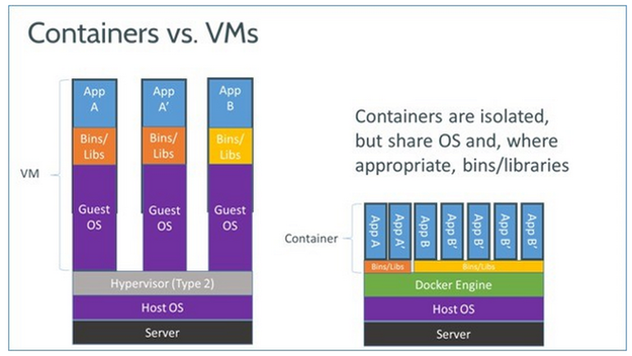
1. Docker

Slide 3
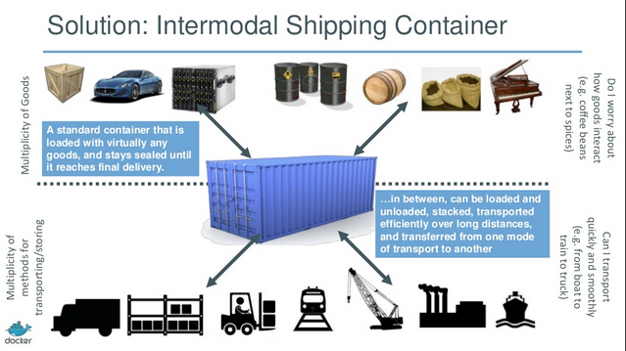
1a. Docker continued

Slide 4
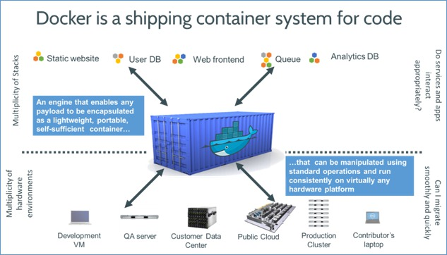
1b. Docker continued

Slide 5
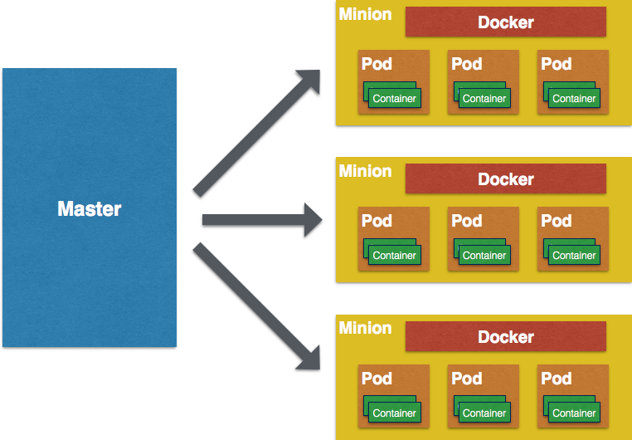
2. Kubernetes

Slide 6
3. The Demo Project

Slide 7
Appendix
Docker video:
https://www.youtube.com/watch?v=Q5POuMHxW-0
Docker slides:
http://slides.com/krak3n/docker/fullscreen#/1

