Slide 1
Angular 2+ Interview Questions

Slide 2
What is the latest version of Angular ? What is the difference between AngularJS and Angular
Angular 1 version
called as AngularJS
Uses javascript as language
Angular 2 to Angular 9
Called as Angular
Uses Typescript language

Slide 3
Angular Concepts
Part -1
Single Page Application
Angular CLI
Component
Module
Service and HTTP
Template
Binding
Directive
Routing
Route Guards
Forms (Template and Reactive)
Template variable
Dependency Injection
Data Sharing between Components
Pipes
Angular Material
Lazy Loading
Ivy engine
Resolver
Observable (RXJS)
What’s new in each version

Slide 4
What is Single Page Application (SPA) ?
A single-page application is an app (or webapp) that doesn't need to reload the page during its use and works within a browser.
Think of the apps we use daily: Facebook, Google Maps, Gmail, Twitter, Google Drive, or even GitHub. All these are examples of a SPA

Slide 5
What is Angular CLI ?
Angular Command Line Interface is a command line tool which is used to create and manage the whole angular application
To install Angular CLI package
npm install -g @angular/cli
Angular CLI commands
ng new <application name>
ng serve
ng serve –o
ng serve –port 4300
ng build

Slide 6
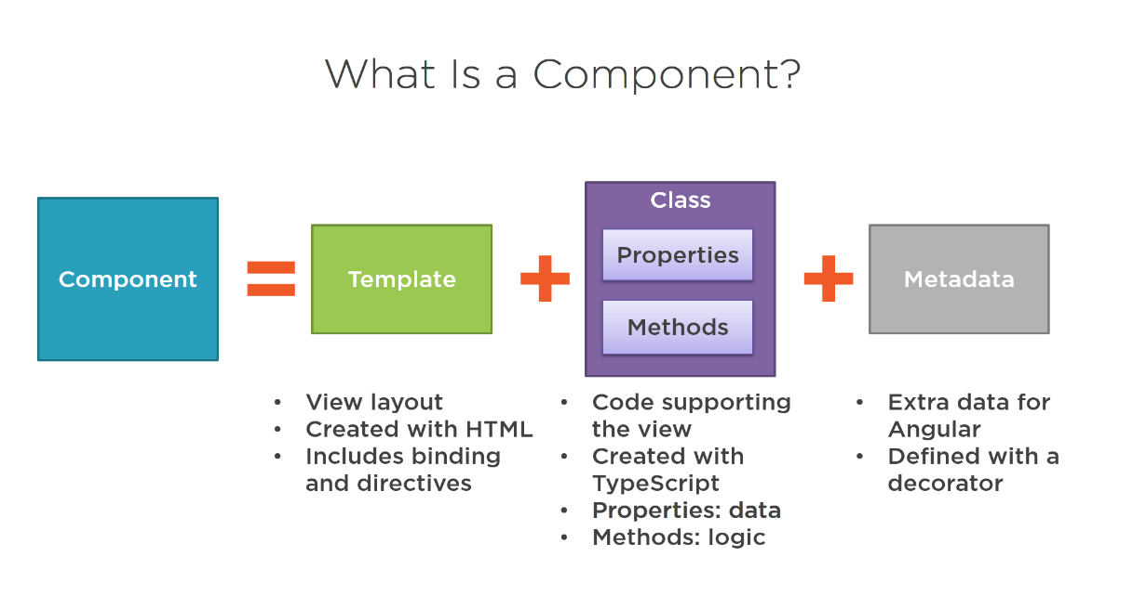
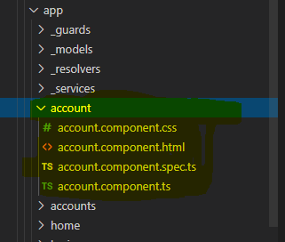
What is Component ? What is template ?
Components are the basic building block of an Angular application.
An Angular component mainly contains a template, class, and metadata
Template is the html file or html code in a component
import{ Component } from'@angular/core';
@Component({
selector: 'my-app',
template: `<h1>{{ message }}</h1>`,
styleUrls: ['./app.component.css']
})
Export class AppComponent {
message = "Hello From Angular";
}

Slide 7
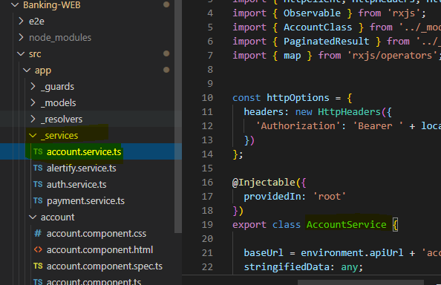
What is Service ?
We need to change or manipulate data constantly, and in order to work with data, we need to use service, which is used to call the API via HTTP protocol
import{ Injectable } from '@angular/core';
@Injectable({
providedIn:'root'
})
Export class AccountService{
constructor() { }
}

Slide 8
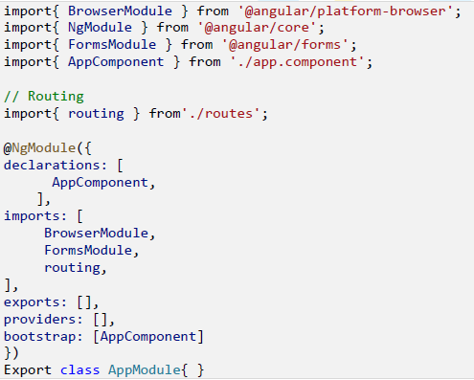
What is Module ?
Module in Angular is used to organize our angular app into a distributive manner
Each Angular application must have one parent module which is called app module and it contains the list of different items which are listed below.
Components
Custom modules
Routing modules
Service providers
Pipes

Slide 9



What is Binding ?
Data binding is used to share data between component and view
Four types
1. Event binding
2. One way binding / Property binding
3. Two way binding
4. Interpolation

Slide 10
What is Directive ?
The directive in Angular basically a class with the (@) decorator and duty of the directive is to modify the JavaScript classes.
Generally, @Decorator changes the DOM whenever any kind of actions happen and it also appears within the element tag.
The 3 types of directives in Angular are:
Components
directives with a template
Structural Directive
change the DOM layout by adding and removing DOM elements.
ngIf, ngFor are examples
Attribute Directive
change the appearance or behaviour of an element, component, or another directive

