Slide 1
10 SQL Tricky Queries Interview Questions
- CHERRY ACADEMY

Slide 2

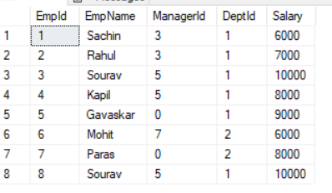

Two SQL tables – taken for study

Slide 3
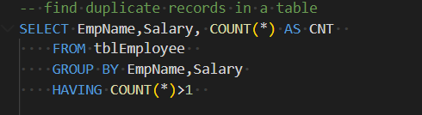
1. Find duplicate records in a table
Tip : Use Count(*), Group by, having

Slide 4
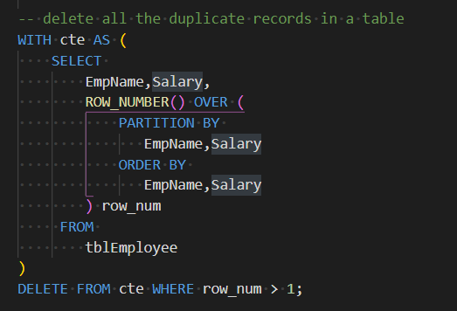
2. Delete all the duplicate records in a table
Tip : CTE, ROW_NUMBER(), PARTITION

Slide 5
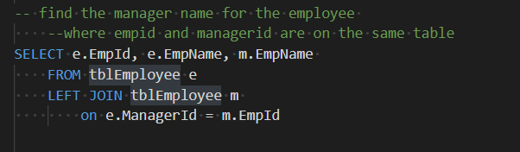
3. Find the manager name for the employee where empid and managerid are in the same table
Tip : Use self join with alias

Slide 6
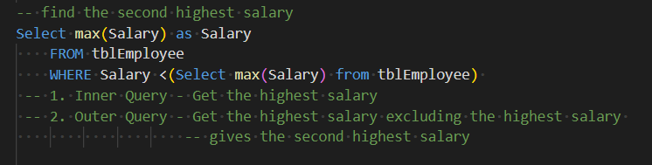
4. Find the second highest salary
Tip : Use max() function, subquery

Slide 7
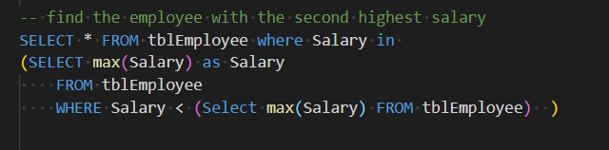
5. Find the employee with the second highest salary
Tip : Use max() function, subquery, outer query

Slide 8
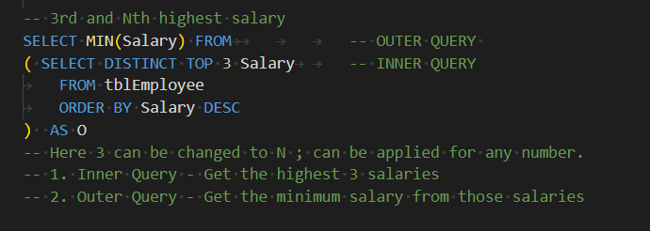
6. Find 3rd and N^{th} highest salary
Tip : inner query, outer query

Slide 9
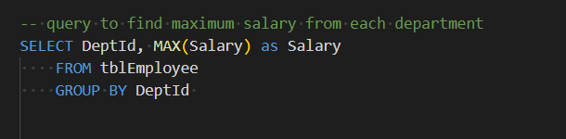
7. Find maximum salary from each department
Tip : Use max() function, group by

Slide 10
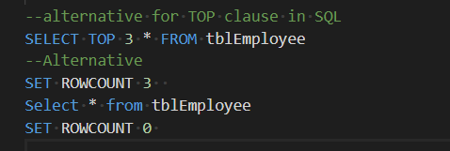
8. Alternative for TOP clause in SQL
Tip : Use ROWCOUNT

Slide 11
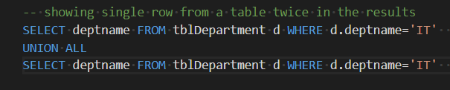
9. Show single or same row from a table twice in the results
Tip : Use UNION ALL

Slide 12
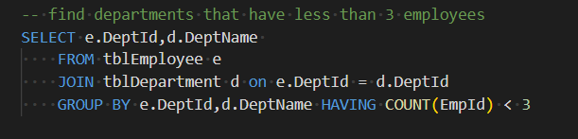
10. Find departments that have less than 3 employees
Tip : Use max() function, subquery

Slide 13
Thank you ☺

