Slide 1
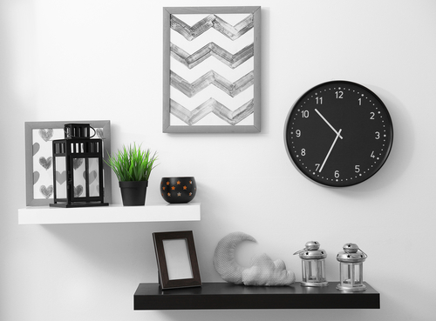
Time Reader
Introduction to Computational and Biological Vision
Alon Arbel – 205730849
Gev Keren – 315719906

Slide 2
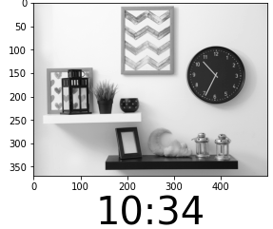
Project’s goal
Reading the time of an analog clock

Slide 3
App’s Benefits
Matching pictures with the time being taken from a video or CCTV if consisting a clock in the background. The app can help organize the pictures in a chronological order and therefore, help the officers, or whoever in need, to be more efficient.
Find irregularities in CCTV videos, and detect if the camera was being tampered.
Kids nowadays are not exposed to analog clocks, and therefore lack the skill of reading an analog clock. With the app, kids will be able to read time.
The app can be used as an educational resource for people to self educate how to read an analog clock.
Helping people with dysgraphia to read time.

Slide 4

So… how does it works ?

Slide 5
calculation steps:
Image processing
Clock detection
Image cropping & resizing
Hands detection
Hands filtering and classifying
Time calculation

Slide 6
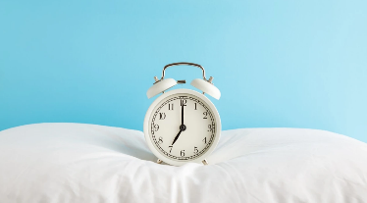
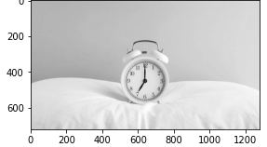
Image processing
Reading an image, and converting it to a grayscale representation.

Slide 7
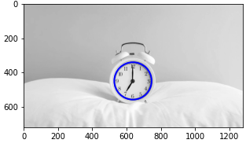
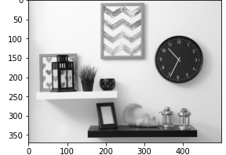
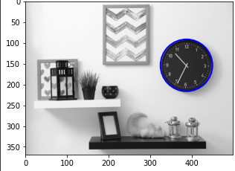
Clock detection
Detecting the frame of the clock.

Slide 8
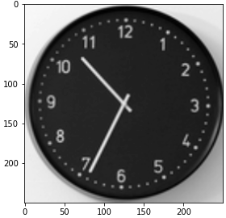
Image Cropping & resizing
Centralize the middle of the clock to be the middle of the image, and resize it to a uniform size

Slide 9
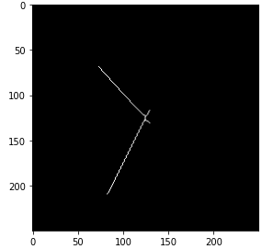
Hands detection
Extracting the hands contours of the clock

Slide 10
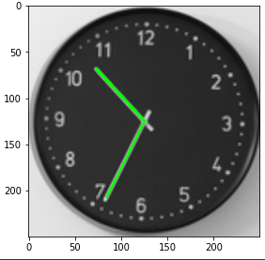
Hands filtering and classifying
Centralize the lines.
Filtering lines by angle and size.
Classifying and matching the hours, minutes and seconds hands to the appropriate line.

Slide 11
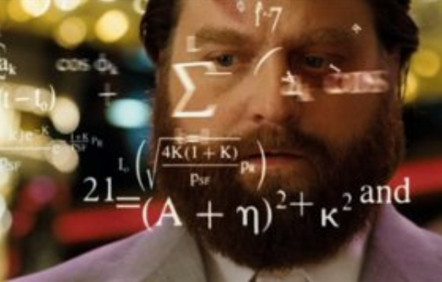
Time calculation

Slide 12
Difficulties and solutions
Why not using only the hours hand? Given that the whole information is theoretically represented in the hour hand by itself.

Slide 13
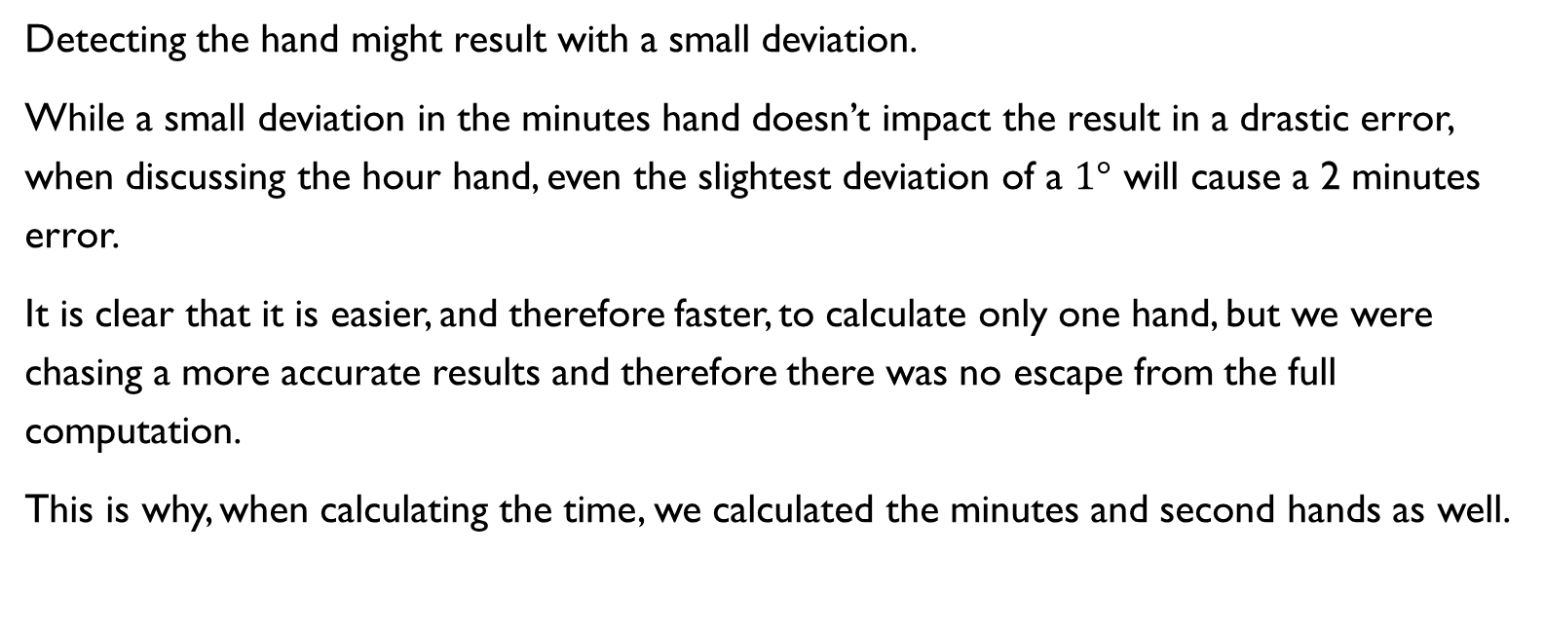
Number of hands solution
Detecting the hand might result with a small deviation.
While a small deviation in the minutes hand doesn’t impact the result in a drastic error, when discussing the hour hand, even the slightest deviation of a $1°$ will cause a 2 minutes error.
It is clear that it is easier, and therefore faster, to calculate only one hand, but we were chasing a more accurate results and therefore there was no escape from the full computation.
This is why, when calculating the time, we calculated the minutes and second hands as well.

Slide 14
Difficulties and solutions
Why not using only the hours hand? Given that the whole information is theoretically represented in the hour hand by itself.
How to deal with a deviation that causes the minutes hand to occur on the wrong side of the ‘12’ spot?

Slide 15
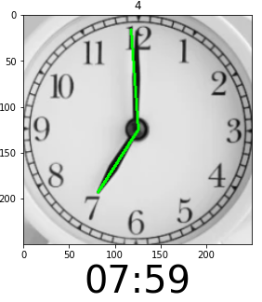
For example

Slide 16
Deviation solution
HoughLinesP method can result with a small deviation. Usually, when considering the minutes hand as well, the deviation is negligible. But there is a case when the minutes hand might appear on the ‘wrong’ side of the ‘12’ spot.
Like the human brain when we read the time, we can tell if there is a mistake or not according to the hour hand’s angle. We therefore added a case for this situation that considers the angle of the hours as well for computing the minutes and not just the hours.

Slide 17
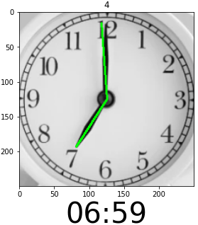

Slide 18
Difficulties and solutions
Why not using only the hours hand? Given that the whole information is theoretically represented in the hour hand by itself.
How to deal with a deviation that causes the minutes hand to occur on the wrong side of the ‘12’ spot?
How to read time of a clock with a different number of hands? And what if one is on top of another?

Slide 19
Number Of hands solution
As calculated, the clock’s hands are represented by lines. For every clock we detected the number of lines and therefore we used a different method for time calculation. When the clock has 3 hands, we computed the seconds hand as well.
When there is only one hand in the picture, we assume that the minutes and the hours are on top of one another, and therefore we calculate the same angle for both.

Slide 20
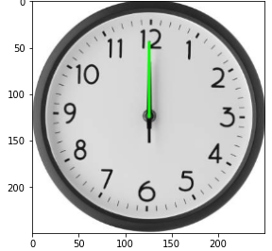
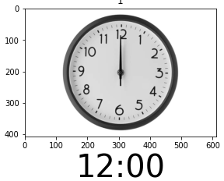

Slide 21
Results and conclusions
We managed to read time from a diverse variety of images:
Wall, hand & pocket clocks.
Clocks with 2 or 3 hands.
Clocks with one hand above the other.
Clocks that are in the background of the image, which consists of other objects as well.
Different sizes of clocks.
Different sizes of images.
Clocks with or without numbers.

Slide 22
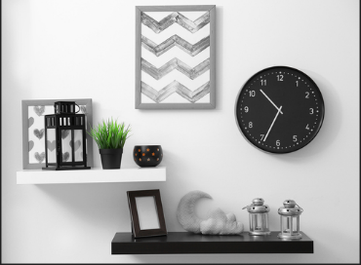
examples

Slide 23
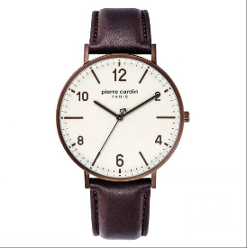
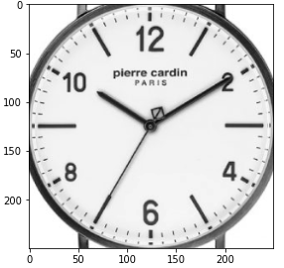
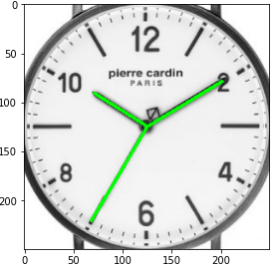
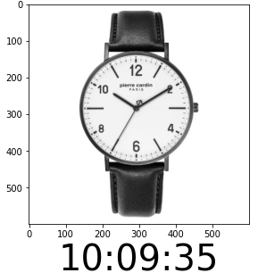
examples

Slide 24
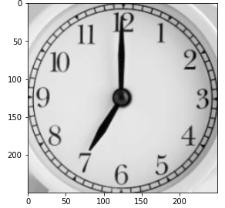
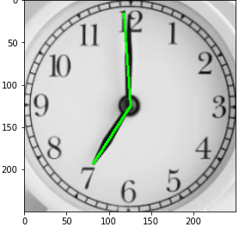
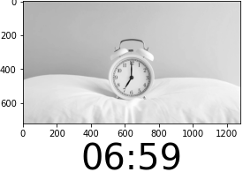
examples

Slide 25
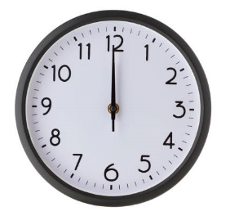
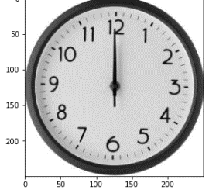
examples

Slide 26
questions ?

