Slide 1

Data Visualization Pitch
Student Individual Assignment
Prison Overcrowding
Student name: Giorgio Evola
Student ID: 932861
Student e-mail address: g.evola2@campus.unimib.it
Image source: Factual America. (s.d.). 8 Eye-Opening Documentaries on Prison Overcrowding - https://images.squarespace-cdn.com/content/v1/62fbfbed423b4f1bb8caed31/057f9c75-101a-42c9-befe-d1097d1a02a2/3.jpg?format=2500w

Slide 2
Research questions
Which are the European countries with the highest prison overcrowding in the 2022, and how has their occupancy rate evolved over time?
​
                How many European countries exceed 100% prison occupancy rate in the 2022?
                Which countries have been most successful in keeping occupancy below capacity in the 2022?
                What are the regional differences (North vs South Europe) in prison overcrowding?
                Are their trends improving, stable, or worsening over the 2014–2022 period, compared to the overall European average?

Slide 3
About Data
Dataset
Eurostat Prison capacity and number of persons held (link Eurostat, code crim_pris_cap)
https://ec.europa.eu/eurostat/databrowser/view/crim_pris_cap/default/table?lang=en
It is reused in accordance with Eurostat's licence policy: free reuse for commercial or non-commercial purposes, subject to acknowledgement of the source ("Eurostat") and indication of any modifications.
Full policy: https://ec.europa.eu/eurostat/help/copyright-notice or https://ec.europa.eu/eurostat/statistics-explained/index.php/Copyright/licence_policy

Slide 4
About Data
Temporal coverage: 2014–2022 (9 years)
Geographic scope: 37 European countries (EU27 + Balkans + Nordic countries)
Total records: 1,454 observations
Known issues
Some small countries (Liechtenstein, Cyprus, Malta) have volatile year-to-year variations due to small prison population
Missing data for a few countries in specific years (e.g. North Macedonia: only 2016–2023)
The year 2022 best balances recency and data completeness across countries, so it serves as the reference for analyses

Slide 5
Methodology
Software & Libraries
Python 3.12 (Jupyter Notebook environment)
pandas (data manipulation, pivot tables, filtering)
plotly (interactive visualization)
Methodology
Built a Jupyter notebook to read, standardize, and normalize prison data from CSV files using pandas
Created reusable Python functions in dedicated modules. Each outputs intermediate CSVs for visualization and analysis.
Generated charts directly from intermediate CSVs using Plotly
Created a European prison overcrowding map (2022) using Data Wrapper Choropleth
Processing Steps
Read CSV, standardized column names, and pivoted data by country/year
Calculated occupancy rate: (prisoners/capacity) × 100; normalized as percentages
Identified top 10 overcrowded countries (2022) exceeding 100% capacity
Segmented North/South regions with stats (mean, min, max, count)
Created time series for low-occupancy countries (Iceland, Malta, Cyprus, Liechtenstein)
Generated charts from intermediate CSV outputs
Used LLM Copilot (VS Code) for code review and validation
Github repository
https://github.com/gevola-dev/FDS02Q001

Slide 6
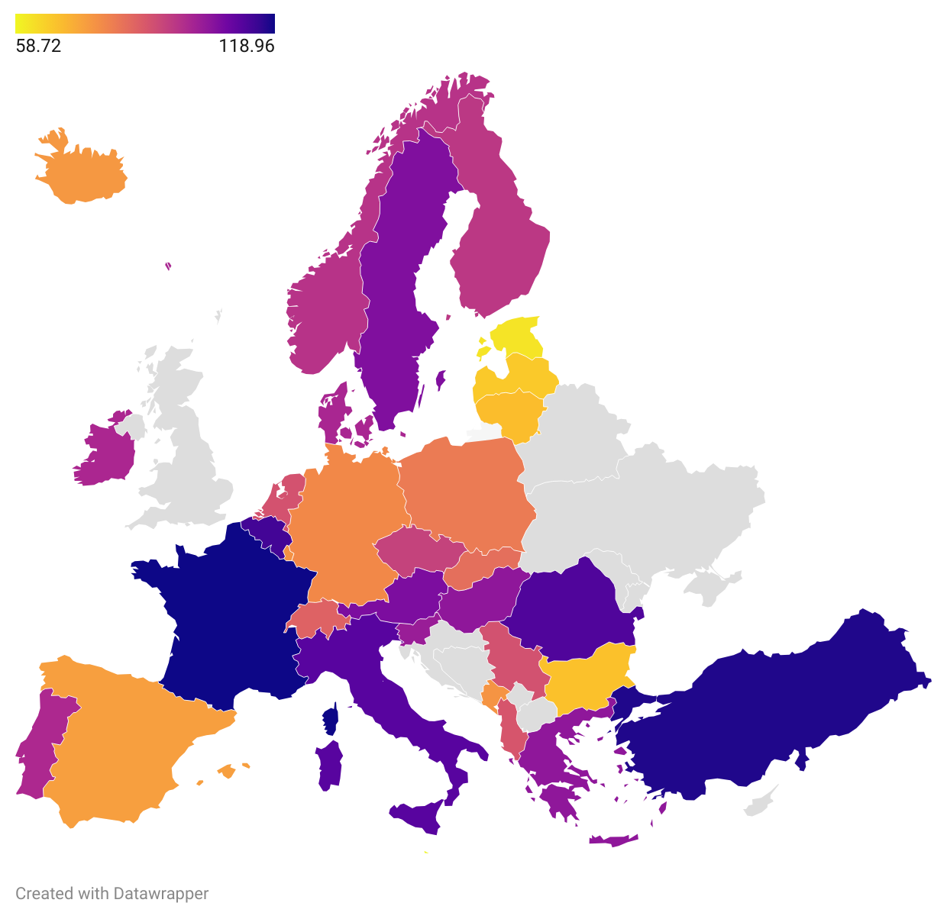
European prison overcrowding map in 2022
Color scheme
Orange: <80% (good, below capacity)
Pink: 80–100% (acceptable, at capacity)
Violet: 100–110% (overcrowded, critical)
Blue: >110% (severe overcrowding, emergency)
What the map shows
13 countries highlighted in violet/blue: Exceeding 100% capacity
Top 3 worst: France (118.96%), Turkey (117.70%), Romania (112.21%)
EU27 average: 95.7%
Best performers: Estonia, Malta, Latvia, Bulgaria, Ireland (62–75%)
Key insight
Prison overcrowding is concentrated in Southern and Central Europe, not uniformly distributed. Northern European countries successfully maintain capacity well below 100%, suggesting policy/system differences.

Slide 7
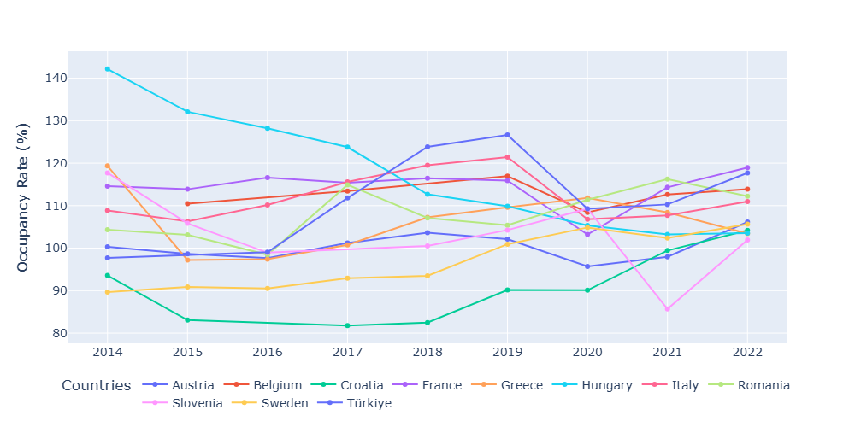
European countries exceed 100% prison occupancy in 2022
Time series line chart (2014–2022) showing prison occupancy rate evolution across European countries exceeding 100% capacity, excluding smaller countries.
Key Insights
10-year horizon: overcrowding is not temporary, it's a structural issue in Southern Europe
Regional patterns: countries like France, Belgium, Italy and Romania show sustained overcrowding, indicating systemic capacity deficits rather than cyclical pressures
Divergent trajectories
    Hungary displays a consistent downward trend, declining from 142% (2014) to 104% (2022), suggesting successful prison decongestion policies
Croatia shows the opposite pattern, rising from 94% (2014) to 104% (2022), indicating worsening overcrowding despite initial lower capacity pressure

Slide 8
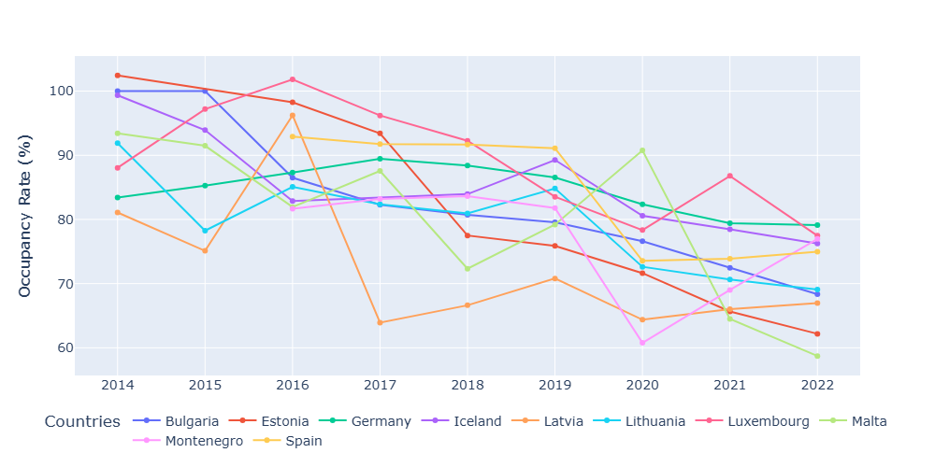
Prison capacity management success across Europe in 2022
Time series line chart (2014–2022) showing prison occupancy rates for 10 European countries consistently maintaining capacity below 100%, demonstrating effective prison management systems.
Key Insights
Consistent capacity management: countries like Estonia, Bulgaria, Malta, and Lithuania have achieved sustained occupancy rates well below 100%, with rates ranging from 58–79% in 2022
Diverse starting points: while Estonia started above 100% (102.43% in 2014), it successfully decongested to 62.18% by 2022—demonstrating that capacity reform is achievable
Stable trajectories: Germany and Spain maintain steady, moderate occupancy rates (79% and 75% respectively), reflecting long-term prison management sustainability
Policy success model: These countries represent best-practice examples of prison system organization, particularly through strategic decongestion policies (visible in Estonia and Bulgaria)

Slide 9
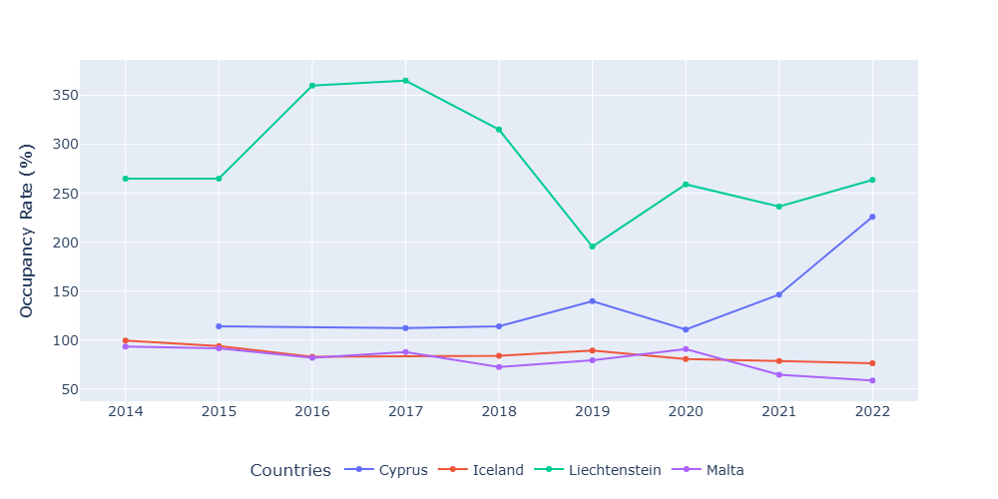
Prison population trends in smaller European systems (2014–2022)
Time series line chart (2014–2022) tracking prison occupancy rates in Europe's smallest prison systems: Cyprus, Iceland, Liechtenstein, and Malta.
Key Insights
Extreme volatility in small populations: with absolute prison populations under 1,000, these micro-systems exhibit dramatic occupancy fluctuations. A single admission or release represents a significant percentage change in system capacity
Cyprus: climbs from 114% (2018) to 226% (2022)—a 99-point surge driven by minimal absolute population changes
Liechtenstein: Oscillates between 195–365% occupancy across the decade—reflecting its ultra-small prison population (typically <200 inmates)
Malta & Iceland: Show more moderate volatility, with Malta achieving decongestion (93% → 59%) and Iceland maintaining steady efficiency (99% → 76%)

Slide 10
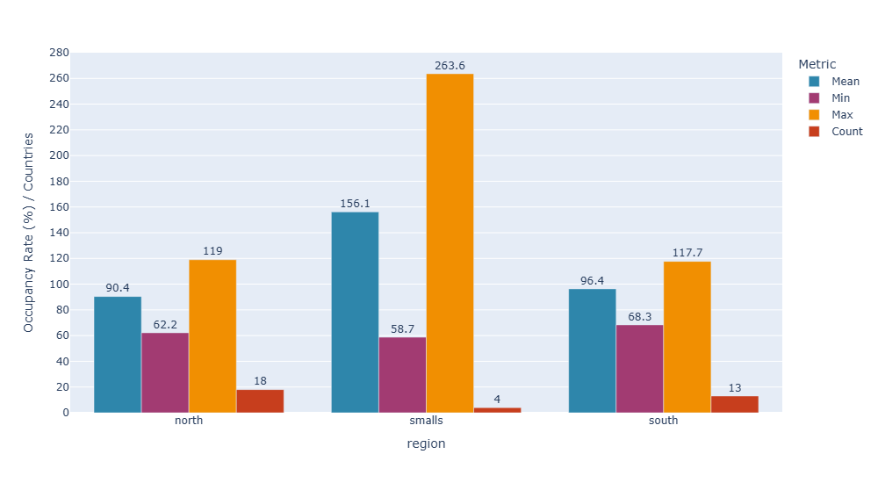
Prison capacity divides Europe: North vs South divergence in 2022
Bar chart comparison (2022) analyzing regional prison capacity patterns across 35 European countries, segmented into Northern Europe (18), Southern Europe (13) and smaller systems (4).
Key Insights
Northern Europe leads in capacity management: mean occupancy of 90.40% indicates systematic efficiency, with controlled variance (min 62.20%, max 119%)
Southern Europe approaches threshold: mean occupancy of 96.40% remains below 100% at aggregate level, yet proximity to capacity threshold signals structural strain, with ceiling at 117.70%
Micro-countries exhibit extreme volatility and are therefore analyzed separately
Regional disparity is structural: the 6-point gap between North (90.39%) and South (96.35%)

Slide 11
European Prison Overcrowding: Key Findings
Structural overcrowding persists: 11+ European countries exceed 100% occupancy consistently across the 2014–2022 decade, indicating systemic rather than cyclical patterns
North-South capacity buffer disparity: Northern systems operate with ~10% capacity margin above current occupancy; Southern systems operate with ~4% margin—creating differential structural resilience
Hungary's downward trajectory: prison occupancy declined from 142.16% (2014) to 103.51% (2022) a 38.65-point reduction demonstrates long-term trend reversal is empirically possible
Croatia's inverse pattern: prison occupancy rose from 93.56% (2014) to 104.18% (2022), indicating divergent regional trajectories despite similar geographic proximity
Micro-systems show extreme volatility: smaller jurisdictions (Cyprus, Iceland, Liechtenstein, Malta) exhibit 50–205 percentage-point swings across the decade, reflecting the amplified impact of population-scale variations

Slide 12
“Prison overcrowding”
by Giorgio Evola
Developed using data from the Eurostat database, with charts and analyses produced in Python.
Dataset: Eurostat Prison capacity and number of persons held (last update 23/04/2025 11:00).
Slides are shared with the following license:
Prison overcrowding © 2025 by Giorgio Evola is licensed under CC BY-SA 4.0. To view a copy of this license, visit https://creativecommons.org/licenses/by-sa/4.0/

