Slide 1
Data Management Project
Student name: Giorgio Evola
Student ID: 932861
Student e-mail address: g.evola2@campus.unimib.it

Slide 2
Agenda
Description
About data
Technologies
Architecture
Insights
Next steps

Slide 3
Article ETL Pipeline with DQ Validation
Objective: Production ETL pipeline integrating GFG csv + Medium RSS with comprehensive data quality validation
Pipeline: Staging → Pandera Validation → Quarantine/Clean Split → Dimensional Loading
Key Components:
Multi-source ingestion (csv + RSS)
Non-blocking DQ validation with error tracking
Incremental processing with processed flags
SQLite dimensional model (dim_articles)
Outcomes: DQ metrics by source, quarantine analysis, validation effectiveness measurement

Slide 4
About Data
List of GeeksforGeeks articles from Kaggle via CSV file
(link https://www.kaggle.com/datasets/ashishjangra27/geeksforgeeks-articles)
RSS feed of articles published on the Medium.com website
(docs link https://help.medium.com/hc/en-us/articles/214874118-Using-RSS-feeds-of-profiles-publications-and-topics)
RSS type used in the project: medium.com/feed/publication-name/tagged/[tag-name]

Slide 5
Technologies
Category | Tools
Language | Python 3.x
Data Processing | Pandas, JSON
Data Quality | Pandera (schema validation), Regex
Database | SQLite3, SQL (DDL/DML)
Architecture | Modular Python modules, Transaction management (ACID)
Web Scraping (optional) | BeautifulSoup4, Requests, Feedparser

Slide 6
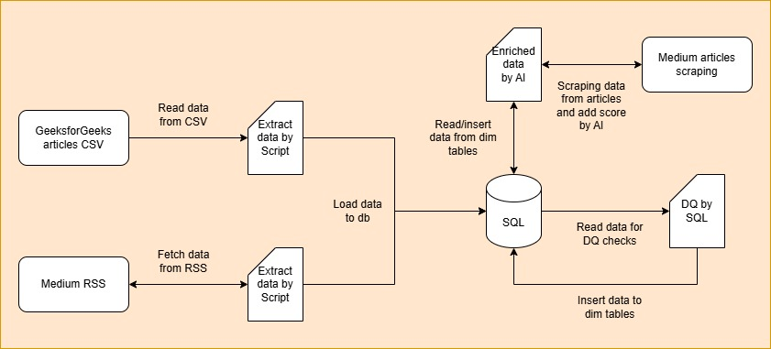
Architecture

Slide 7
Insights
Source heterogeneity drives DQ complexity (structured HTML vs nested JSON)
Early validation saves downstream remediation costs
Non-blocking quarantine maintains throughput while isolating failures
Processed flags enable safe incremental loading and retry logic
Multi-source ID strategy unifies heterogeneous article identifiers
      Temporal tracking provides full audit trail (created_at, updated_at, ingestion_timestamp)
Modular architecture supports easy addition of new sources
Transaction management ensures data integrity at scale

Slide 8
Next steps
Web scraping for full article text and storage of unstructured data in NoSQL database
OpenAI/Anthropic API integration for automated summaries and utility article scoring
Development and integration of unit tests and integration tests
Real-time quality monitoring dashboard
Trend analytics and insights

