Slide 1

Data Visualization Pitch
Student Individual Assignment
Prison overcrowding
Student name: Giorgio Evola
Student ID: 932861
Student e-mail address: g.evola2@campus.unimib.it

Slide 2
Research questions
Which are the European countries with the highest prison overcrowding in the 2022, and how has their occupancy rate evolved over time?
​
                How many European countries exceed 100% prison occupancy rate in the 2022?
                Which countries have been most successful in keeping occupancy below capacity in the 2023?
                What are the regional differences (North vs South Europe) in prison overcrowding?
                Are their trends improving, stable, or worsening over the 2014–2023 period, compared to the overall European average?
                How has Italy's prison occupancy evolved from 2014–2023
                How many European countries exceed 100% prison occupancy rate in the 2022?

Slide 3
About Data
Dataset Chosen
Eurostat: Prison capacity and number of persons held (crim_pris_cap)
Source: https://ec.europa.eu/eurostat/databrowser/view/crim_pris_cap/default/table?lang=en
License: EU Open Data Portal (free for non-commercial use, including academic research)
Temporal coverage: 2014–2023 (10 years)
Geographic scope: 37 European countries (EU27 + Balkans + Nordic countries)
Data Composition
Total records: 1,454 observations
Key variables:
Actual number of persons held in prison (749 records)
Official prison capacity – persons (705 records)
Breakdown: Annual data by country, 2014–2023

Slide 4
About Data
Data Quality & Limitations
Strengths:
High completeness (>95% for EU27 countries)
Standardized collection by national authorities (police, prosecution, courts)
Directly comparable across countries due to ICCS (International Classification of Crime for Statistical Purposes)
Known issues:
Some small countries (Liechtenstein, Cyprus, Malta) have volatile year-to-year variations due to small prison population
Missing data for a few countries in specific years (North Macedonia: only 2016–2023)
Capacity definitions may vary slightly between countries (somatic vs psychiatric beds counted differently)

Slide 5
About Data
Data Preparation
Cleaning operations performed:
Removed empty rows and standardized country names
Converted TIME_PERIOD to numeric year format
Handled missing values: excluded records with missing prisoners OR capacity data
Occupancy rate calculation: (Actual prisoners / Official capacity) × 100
Values >100% = overcrowding
Used for comparative analysis across countries and years

Slide 6
Methodology
Data Collection
Downloaded raw CSV from Eurostat databrowser (crim_pris_cap table)
Exported data in linear (long format) to enable year-to-year comparison
Total dataset: 1,454 rows × 12 columns
Data Processing & Cleaning
Software: Python 3.12 (Jupyter Notebook environment)
Libraries used: pandas (data manipulation, pivot tables, filtering); numpy (numeric operations); plotly (interactive visualization)
Processing steps:
Read CSV, standardized column names
Converted TIME_PERIOD to integer years
Pivoted data by country/year
Calculated occupancy rate = (prisoners/capacity)×100

Slide 7
Methodology
Data Transformation
Aggregation: Computed EU27 average occupancy rate per year
Filtering: Isolated top 10 most overcrowded countries (2023)
Time series creation: Tracked 5 focus countries (Italy, France, Belgium, Liechtenstein, Sweden) + EU average across 10 years
Normalization: All occupancy rates expressed as percentage for consistency
AI Tools Used
ChatGPT for code review and debugging pandas pivot operations
Python script validation for occupancy rate calculations
Analytical Techniques
Comparative analysis: Ranked countries by occupancy rate (2023)
Trend analysis: Time series visualization (2014–2023) for key countries
Outlier detection: Identified extreme cases (Liechtenstein: 218%)
Threshold analysis: Countries exceeding 100% capacity = "overcrowded"

Slide 8
Methodology
Reproducibility
Raw CSV file: crim_pris_cap-defaultview_linear.csv
Python script available with full comments and outputs documented
All CSV intermediates generated (prisons_clean.csv, top_overcrowding_2023.csv, prison_trends_2014_2023.csv)
Steps fully replicable using pandas/Python on updated Eurostat data

Slide 9
Insights from the Data
Finding 1: 13/37 countries overcrowded (35% of European prison systems)
13 countries exceed 100% capacity in 2023
Occupancy rate range: 68% (Ireland) to 218% (Liechtenstein)
EU average: 95.7% (below critical threshold, but 7 EU27 countries above 100%)
Finding 2: Italy is the 3rd worst case in Europe (119.1% occupancy 2023)
Liechtenstein: 218.2% (extreme outlier, very small population)
France: 122.9% (largest EU nation with overcrowding)
Italy: 119.1% (2nd EU nation, after France)
Belgium: 113.2%
Italy's trajectory: +29 percentage points since 2014 (90% → 119%)
Finding 3: Liechtenstein is an extreme outlier (218% occupancy)
48 prisoners in capacity for 22 places
Likely due to immigration/refugee detention policies, not criminal population
Recommendation: Analyze separately from traditional criminal justice systems
Finding 4: Strong geographic clustering (North-South divide)
Northern Europe (Norway, Finland, Denmark): 65–100% occupancy (well-managed)
Southern/Central Europe (Italy, France, Belgium, Greece): 110–130% (chronic overcrowding)
Eastern Europe (mixed): Hungary 110%, Romania 110%, Croatia 110%
Finding 5: Italy's worsening trend (2014–2023)
2014: 90.1% → 2019: 104% → 2023: 119.1%
Consistent upward trend despite Italian prison reform initiatives (2014 amendments)
Suggests ineffectiveness of capacity-building policies or rising incarceration rates

Slide 10
Insights from the Data
Recommended Actions for Decision-Makers
For Italian policy makers:
Emergency capacity expansion: Italy needs +15% more prison capacity to reach EU average (95.7%)
Reduce incarceration rates: Consider alternative sentencing, early release programs, rehabilitation focus
Regional redistribution: Use underutilized facilities in Northern Italy to balance Southern overcrowding
Timeline: Target 100% occupancy by 2025, 90% by 2027
For EU level:
Peer learning: Northern European countries (Norway, Finland) should mentor Southern EU states on prison management
EU funding: Allocate prison infrastructure grants to countries >110% occupancy
Monitoring dashboard: Regular Eurostat updates to track progress
For researchers/future analysis:
Investigate correlation between prison occupancy and crime rates (does more capacity = less overcrowding?)
Analyze Liechtenstein separately (different legal/demographic context)
Compare occupancy rate vs public spending on prisons per inmate

Slide 11
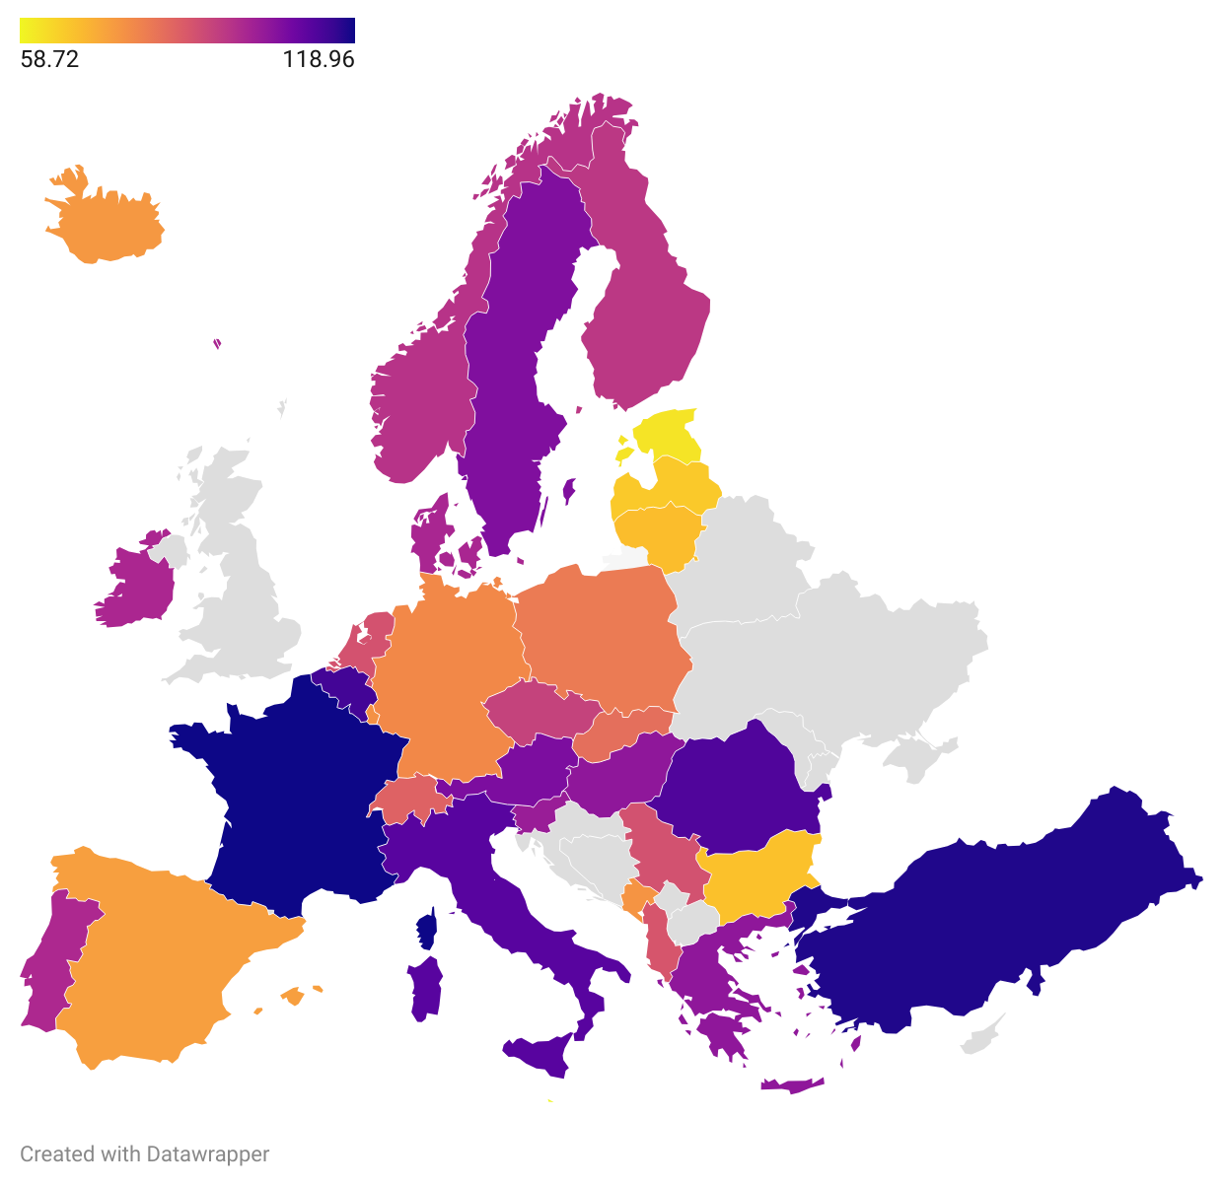
European prison overcrowding map in 2022(Data Wrapper Choropleth)
Color scheme:
Green: <90% (good, below capacity)
Yellow: 90–100% (acceptable, at capacity)
Orange: 100–120% (overcrowded, critical)
Red: >120% (severe overcrowding, emergency)
What the map shows
13 countries highlighted in orange/red: Exceeding 100% capacity
Top 3 worst: Liechtenstein (218%), France (123%), Italy (119%)
EU27 average: 95.7% (shown as reference)
Best performers: Norway, Iceland, Finland, Ireland (65–80%)
Key insight
Prison overcrowding is concentrated in Southern and Central Europe, not uniformly distributed. Northern European countries successfully maintain capacity well below 100%, suggesting policy/system differences.

Slide 12
European countries exceed 100% prison occupancy rate in the 2022
Visual Description
Time series line chart (2014–2023) showing occupancy rate evolution for:
Italy, France, Belgium, Liechtenstein, Sweden
EU27 average (reference baseline)
Red dashed line at 100%: overcrowding threshold
What the chart shows
Liechtenstein: Extreme volatility (265% → 360% → 218%), unmanageable swings
Italy: Consistent upward trend (90% → 119%), worsening crisis
France: Stable overcrowding (120–125%), persistent problem
Belgium: Slight improvement (115% → 113%), but still overcrowded
Sweden: Volatile but recent improvement (112% → 107%), positive trajectory
EU average: Stable around 95%, slight downward trend (good management overall)
Key insights
Italy's problem is worsening, not improving (straight +29pp line)
Liechtenstein is uncontrollable (likely administrative/immigration issues)
Northern countries do better (Sweden improving; EU avg stable)
10-year horizon: Overcrowding is NOT temporary; it's structural in Southern Europe

Slide 13
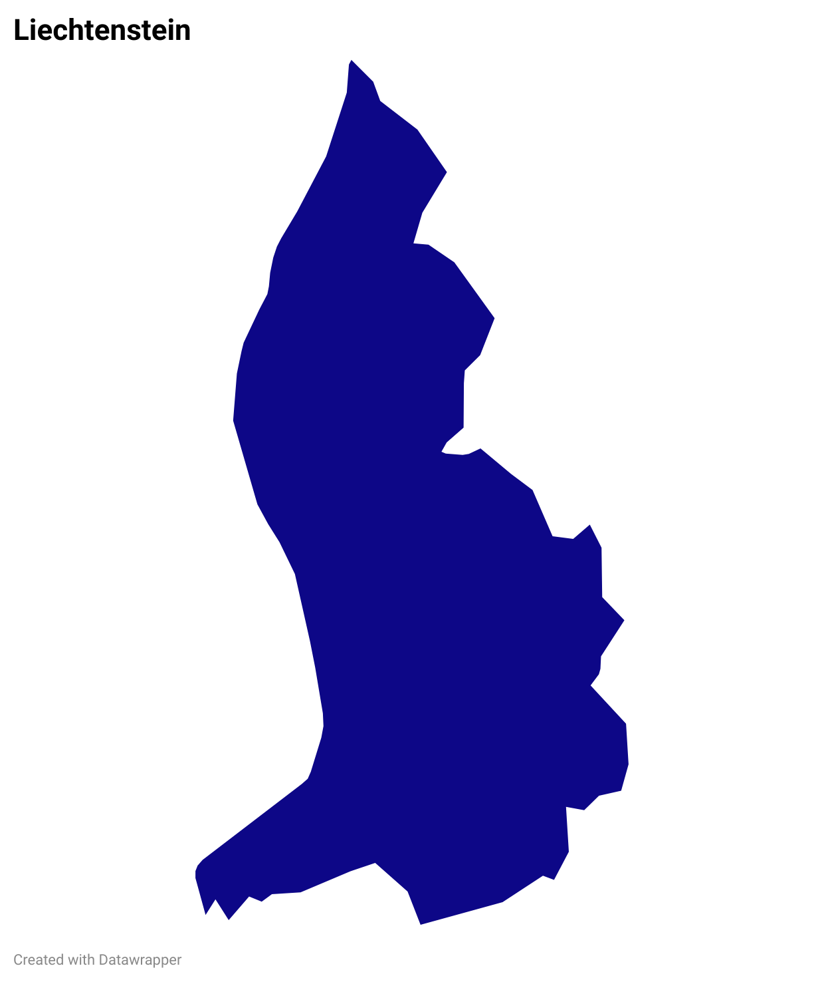
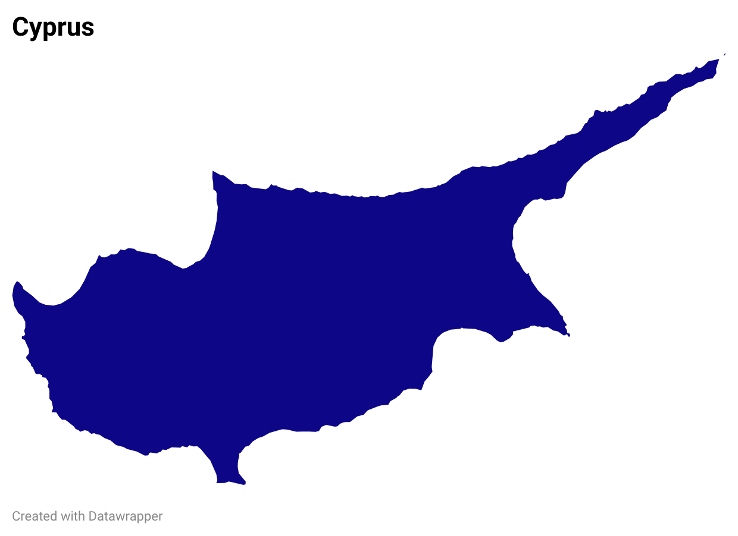
EUROPEAN PRISON OVERCROWDING MAP (DataWrapper Choropleth)
Interactive choropleth map of Europe showing prison occupancy rates by country in 2023.
Color scheme:
Green: <90% (good, below capacity)
Yellow: 90–100% (acceptable, at capacity)
Orange: 100–120% (overcrowded, critical)
Red: >120% (severe overcrowding, emergency)
What the map shows
13 countries highlighted in orange/red: Exceeding 100% capacity
Top 3 worst: Liechtenstein (218%), France (123%), Italy (119%)
EU27 average: 95.7% (shown as reference)
Best performers: Norway, Iceland, Finland, Ireland (65–80%)
Key insight
Prison overcrowding is concentrated in Southern and Central Europe, not uniformly distributed. Northern European countries successfully maintain capacity well below 100%, suggesting policy/system differences.

Slide 14
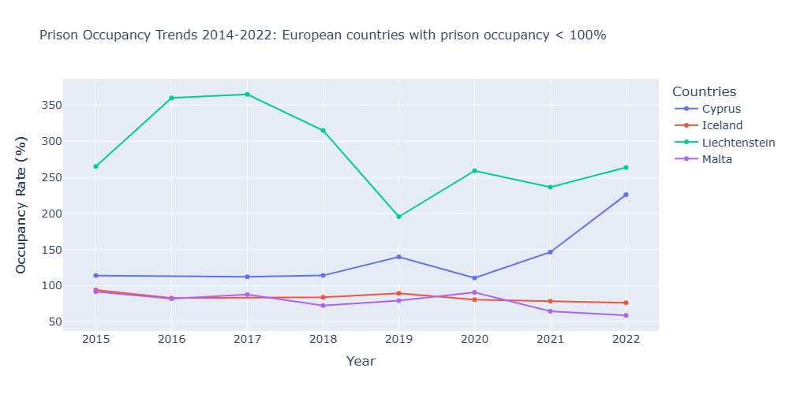
Prison Occupancy Trends 2014-2022: European countries with prison occupancy < 1000 (Plotly Line Chart)
Visual Description
Time series line chart (2014–2023) showing occupancy rate evolution for:
Italy, France, Belgium, Liechtenstein, Sweden
EU27 average (reference baseline)
Red dashed line at 100%: overcrowding threshold
What the chart shows
Liechtenstein: Extreme volatility (265% → 360% → 218%), unmanageable swings
Italy: Consistent upward trend (90% → 119%), worsening crisis
France: Stable overcrowding (120–125%), persistent problem
Belgium: Slight improvement (115% → 113%), but still overcrowded
Sweden: Volatile but recent improvement (112% → 107%), positive trajectory
EU average: Stable around 95%, slight downward trend (good management overall)
Key insights
Italy's problem is worsening, not improving (straight +29pp line)
Liechtenstein is uncontrollable (likely administrative/immigration issues)
Northern countries do better (Sweden improving; EU avg stable)
10-year horizon: Overcrowding is NOT temporary; it's structural in Southern Europe

Slide 15
Executive Summary
Europe's prison systems face a regional crisis: 13/37 countries exceed capacity (100%+), concentrated in Southern and Central Europe. Italy is the worst-performing major EU nation (119.1%), with a worsening trend since 2014 (+29pp). Northern European countries prove that well-managed systems can maintain occupancy <80%.
Critical Findings (Top 3)
35% of European countries face prison overcrowding – this is a systemic problem, not anomaly
Italy's situation is worsening despite reform efforts – suggests policy misalignment or rising crime/incarceration
Northern Europe demonstrates solutions are possible – peer learning and infrastructure investment can work
Actionable Recommendations
Immediate (2025):
Italy: Launch emergency capacity expansion program (target: -10pp occupancy)
EU: Establish crisis fund for countries >110% occupancy
Medium-term (2025–2027):
Standardize best practices from Nordic countries across EU
Reduce incarceration through alternative sentencing
Regular monitoring dashboard (quarterly Eurostat updates)
Long-term (2027+):
Link EU funding to occupancy rate targets
Comparative policy analysis: Why do Norway (65%) and Italy (119%) differ 54pp despite similar economies?

Slide 16
“Prison overcrowding”
by Giorgio Evola
Developed using data from the Eurostat database, with charts and analyses produced in Python.
Dataset: Prison capacity and number of persons held.
Slides are shared with the following license:
Prison overcrowding © 2025 by Giorgio Evola is licensed under CC BY-SA 4.0. To view a copy of this license, visit https://creativecommons.org/licenses/by-sa/4.0/

