Slide 1

VSC-A Project – System Update
June 17, 2009

Slide 2

VSC-A Project
3 year project - December 2006 to December 2009
Collaborative effort between 5 OEMs ( Ford, GM, Honda, Mercedes & Toyota) and US DOT
Goal: Determine if DSRC @5.9 GHz & vehicle positioning can improve upon autonomous vehicle-based safety systems and/or enable new communication-based safety applications
Follow-on project to CAMP/US DOT VSC I (2002-2004) project and CAMP internal Emergency Electronic Brake Lights (EEBL) project
Strong emphasis on resolving current communication and vehicle positioning issues so that interoperable future deployment of DSRC+Positioning based safety systems will be enabled

Slide 3
VSC-A Main Objectives
Develop scalable, common vehicle safety communication architecture, protocols, and messaging framework necessary to achieve interoperability and cohesiveness among different vehicle manufacturers
  Standardize this messaging framework and the communication protocols (including message sets) to facilitate future deployment
Develop accurate and commercially feasible relative vehicle positioning technology needed, in conjunction with the 5.9 GHz DSRC, to support most of the safety applications with high potential benefits
Develop and verify (on VSC-A system test bed) a set of objective test procedures for the selected vehicle safety communications applications

Slide 4
VSC-A Research Activities and Timeline
2007
2008
2009
Crash scenarios
& safety apps. selection
DSRC+Positioning and autonomous
Sensing safety system analysis
April 2009
June 2008
Level II test bed
implementation
DSRC+Positioning safety system conops,
requirements and minimum perf. specs.
Level I test bed
implementation
Vehicle safety system test bed
System design, algorithms (path prediction, threat, warning) & in-vehicle integration
Relative vehicle positioning development
Message composition, standardization, security and communication protocols
Objective test procedures development
System testing and objective test procedures
Coordination with standards development activities and other USDOT programs
SAE, IEEE DSRC, CICAS-V, VII, Europe Car2Car, Japan ASV
Benefit analysis support to USDOT, Volpe & Noblis

Slide 5
VSC-A System Development
Selection of Safety Applications
Selection of the VSC-A safety applications based on a US DOT crash scenarios study¹
Selection process of the applications also considered:
  Taking advantage of 5.9 GHz DSRC omnidirectionality & range to build system with set of safety applications running simultaneously
  Including currently challenging scenarios (for radar & vision) such as intersecting and oncoming direction paths
The VSC-A Team and USDOT jointly “mapped” the proposed safety applications to the recommended crash scenarios
¹ “VSC-A Applications_NHTSA - CAMP Comparison v2” document, USDOT, May 2 2007

Slide 6
Safety Applications vs. Crash Scenarios Mapping
 | V2V Safety Applications Crash Scenarios | EEBL | FCW | BSW | LCW | DNPW | IMA | CLW
1 | Lead Vehicle Stopped |  | ✓
2 | Control Loss without Prior Vehicle Action |  |  |  |  |  |  | ✓
3 | Vehicle(s) Turning at Non-Signalized Junctions |  |  |  |  |  | ✓
4 | Straight Crossing Paths at Non-Signalized Junctions |  |  |  |  |  | ✓
5 | Lead Vehicle Decelerating | ✓ | ✓
6 | Vehicle(s) Not Making a Maneuver – Opposite Direction |  |  |  |  | ✓
7 | Vehicle(s) Changing Lanes – Same Direction |  |  | ✓ | ✓
8 | LTAP/OD at Non-Signalized Junctions |  |  |  |  |  | ✓
Note: Crash Scenario reference: “VSC-A Applications_NHTSA-CAMP Comparison v2” document, USDOT, May 2 2007. Selected based on 2004 General Estimates System (GES) data and Top Composite Ranking (High Freq., High Cost and High Functional Years lost).
EEBL: Emergency Electronic Brake Lights
FCW: Forward Collision Warning
BSW: Blind Spot Warning
LCW: Lane Change Warning
IMA: Intersection Movement Assist
DNPW: Do Not Pass Warning

Slide 7
VSC-A System Test Bed
B
OBE
Basic Threat Arbitration
Security
Verification
DVI Notifier
A
V-V Safety Applications
Cameras / Audio in
CICAS-V
EEBL
FCW
IMA
BSW+LCW
DNPW
CLW
[From other
Modules]
Data Logger
& Visualization Tools
Target
Classification
ENET
Data Logger
Relative
Positioning
Platform
Eng. GUI
VGA
Display
Host Vehicle
Path Prediction
Path History
Security
OTA Messages
ENET
GPS
unit
Sensor Data
Handler
Wireless
Message Handler
Serial
DSRC
Dual Radios
A
CAN
CAN
B
Color Legend
Vehicle Sensors
(Non Production)
Vehicle
CAN to OBE Interface
Engineering
DVI
Interface Modules
Core Modules
Positioning & Security
Vehicle CAN Bus
Safety Applications
Vehicle Signals (Production)
Threat Process & Report
OEM Specific Modules
Data Analysis

Slide 8
VSC-A Interoperable Communication:
The SAE Basic Safety Message
VSC-A communication:
Single safety message format supports all safety applications
Periodic safety message broadcast (10 times per second)
Event-driven safety message broadcast (immediate on event occurrence)
J2735 Basic Safety Message
Basic Vehicle State
(Veh. ID, Seq. #, time,
position, motion, control, veh. size)
Part I is mandatory in Basic Safety message
Part I
Vehicle Safety Extension
Event Flags
Path History
Path Prediction
RTCM Corrections
Part II
Required for V-V safety applications,
but not in every message
Other optional safety-related data

Slide 9
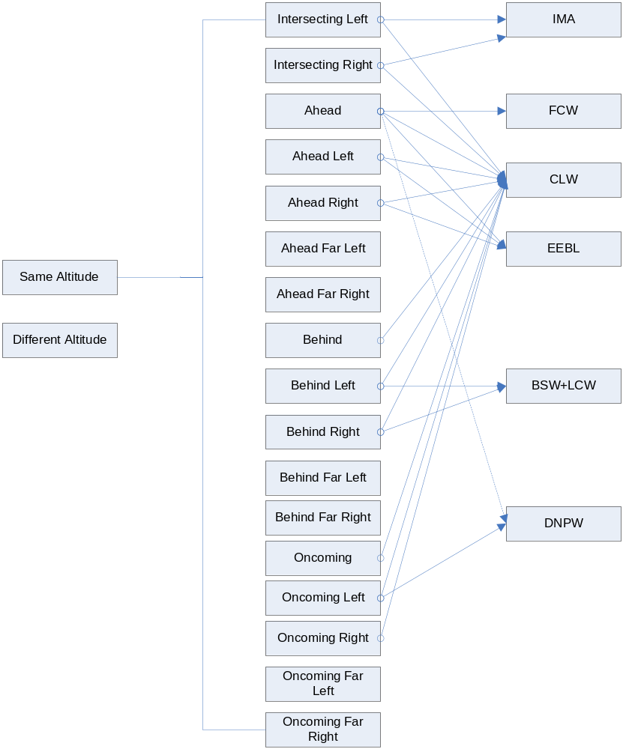
Target Classification (TC) Subsystem
The TC module provides “360 degree” relative classification of the locations of communicating remote vehicles relative to the host vehicle
Possible classifications of remote vehicles that would meet the classification requirements for the safety applications are shown
TC also provides the lateral offset, longitudinal offset, Relative Speed, Range, Range Rate, Azimuth, etc. of communicating remote vehicles relative to the local host vehicle

Slide 10
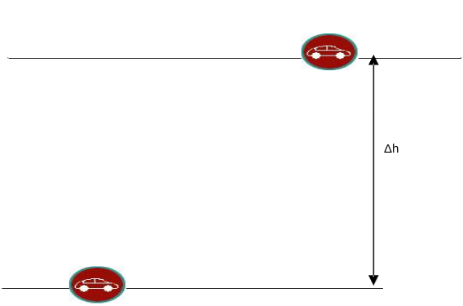
Target Classification Locations (1)
Ahead
Far
Left
Ahead
Left
Ahead
Ahead
Far
Right
Ahead
Right
Illustration of Same Direction
Behind
Far
Left
Behind
Left
Behind
Right
Behind
Far
Right
Behind
Illustration of Different Altitude

Slide 11
Target Classification Locations(2)
Illustration of remote vehicle Ahead Right
Illustration of remote vehicle Oncoming Right
Based on the sign and magnitude of Lateral Offset, RV Location can be classified as:
Ahead
Ahead_Right
Ahead_Left
Ahead_Far_Right
Ahead_Far_Left
X-axis
Y-axis

Slide 12
Target Classification Locations (3)
Illustration of remote vehicle Intersecting from Right
IntersectionPoint
X-axis
Based on the intersection scenario, RV Location can be classified as:
Intersecting_Left
Intersecting_Right
Y-axis

Slide 13
Target Classification Locations(4)
Illustration of remote vehicle Oncoming Right
Illustration of remote vehicle Oncoming Left
Based on the sign and magnitude of Lateral Offset, RV Location can be classified as:
Oncoming
Oncoming_Right
Oncoming_Left
Oncoming_Far_Right
Oncoming_Far_Left
X-axis
Y-axis

Slide 14
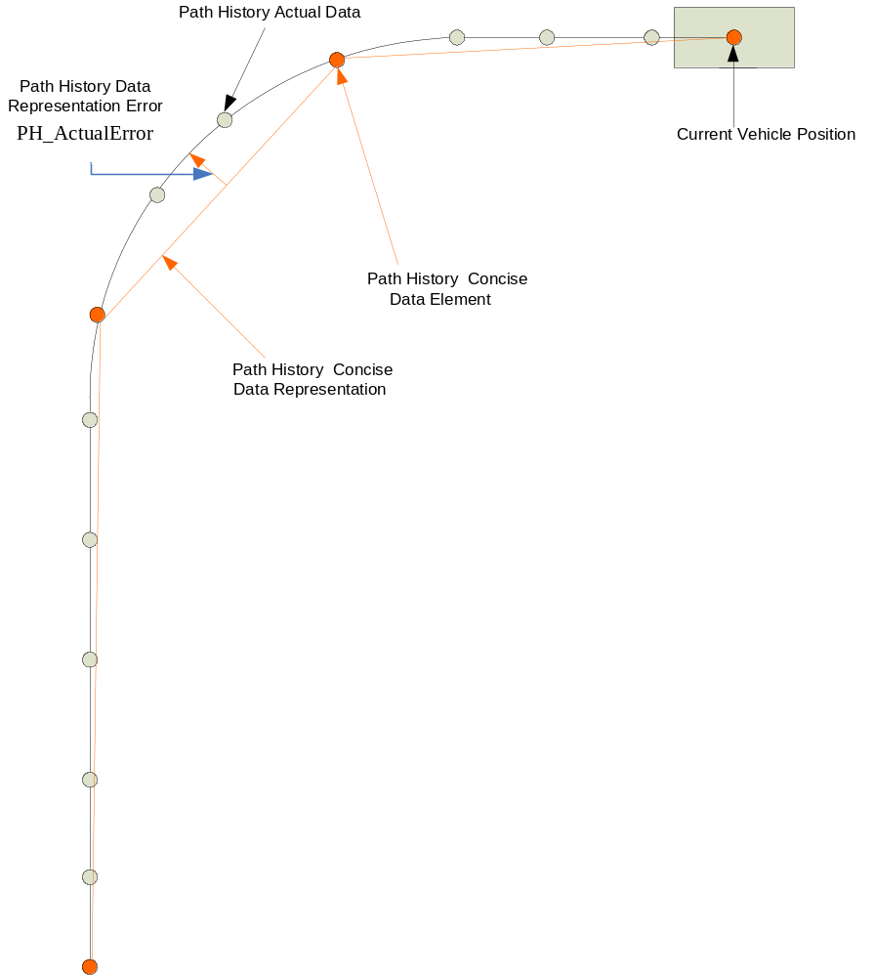
Path History
3 methods of generating vehicle path history for VSC-A system have been implemented and evaluated

Slide 15
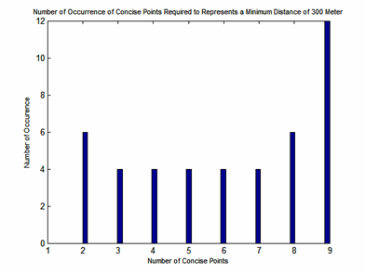
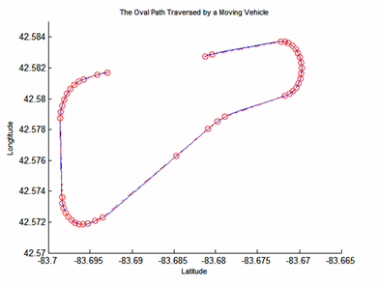
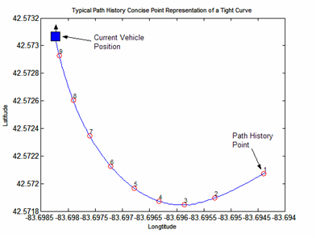
Path History: Oval Track with One Meter Allowable Error
The oval track consists of straight paths, tight and wide curves
Tight curves have an average estimated radius of 278.0 meters
Minimum of 2 points and a maximum of 9 points needed to represent a minimum distance of 300 meters of the oval path

Slide 16
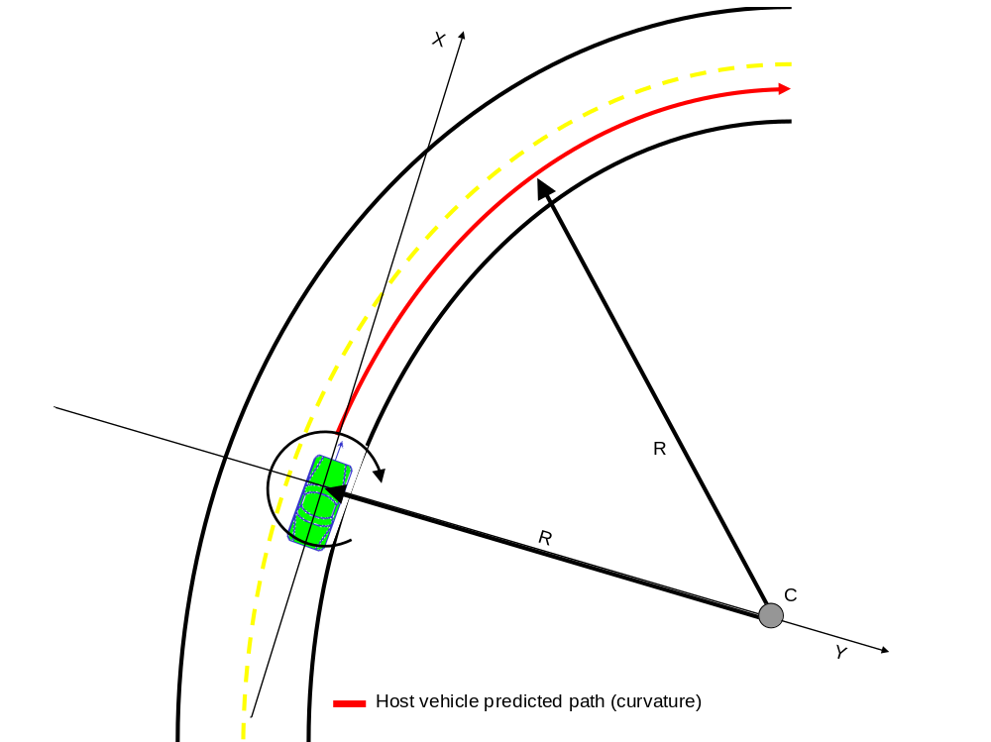
Host Vehicle Path Prediction Subsystem
Computes path radius using
  Vehicle Speed
  Yaw Rate
Computes path radius center point
  GPS Lat/Long coordinate for potential OTA transmission to other vehicles
Computes confidence
  of the predicted path

Slide 17
VSC-A Relative Positioning Methods
LatLon
DSRC
GPS Raw
Data
VSC-A Over-the-Air Positioning Message
DSRC
Vehicle-to-Vehicle Relative Vector
Vehicles share two data types for relative positioning
  Latitude, Longitude, Height (LatLon)
  Raw GPS Data
Primary focus is to establish the relative position vector (i.e., distance and orientation)
VSC-A Positioning System is capable of using two relative positioning methods:
  Using LatLon reported by two vehicles
  Using GPS raw data and Real-Time Kinematic (RTK) positioning

Slide 18
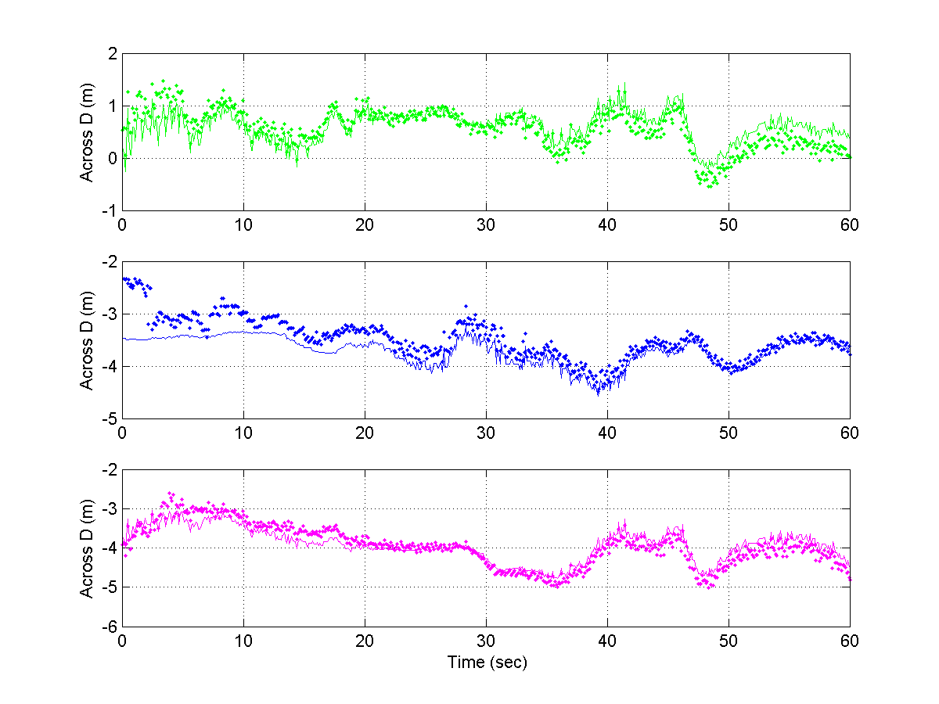
Test Bed Relative Positioning Performance (1/2)
Across and Along distance estimated in the Host vehicle system shown
  Three target vehicles: Target 1: Same Lane Target 2 & 3: Adjacent Lane
Estimated using two methods:
  GPS LatLon
  GPS Real-Time Kinematic Positioning (RTK)
Target 1
Lane 1
Host
Lane 2
Lane 3
Target 2
Target 3
Across Distance to Each Target
  GPS LatLon
  GPS (RTK)

Slide 19
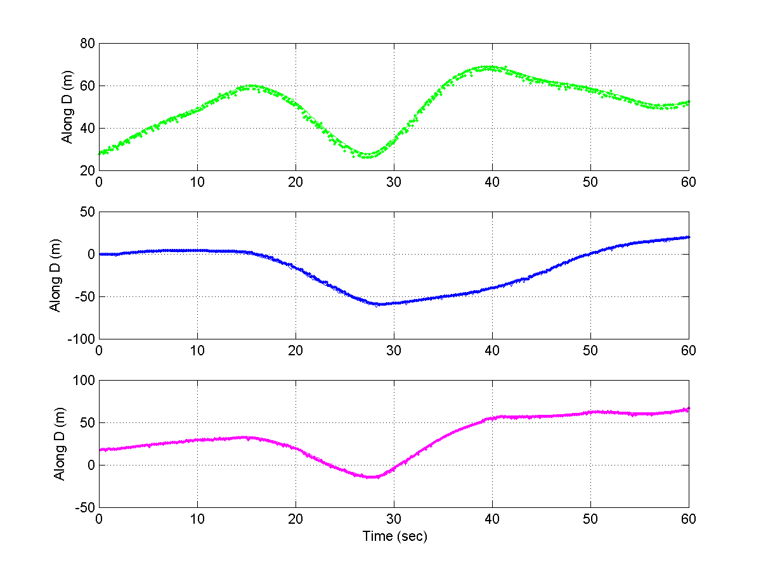
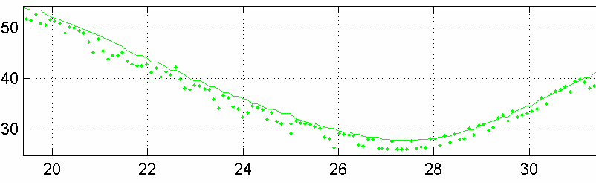
Test Bed Relative Positioning Performance (2/2)
RTK method improves the relative positioning quality by:
  Reducing the noise (LatLon methods introduces meter-level noise)
  Better solution continuity after RTK convergence
  GPS blunder detection (presence of multipath and other errors) is more reliable
  Relative accuracy is improved (Specially when GPS receiver mode, sky visibility is different)
  GPS LatLon
  GPS (RTK)

Slide 20
Security Protocols
Implemented four potential security protocols
  ECDSA Verify-on-Demand (IEEE 1609.2 based)
  TESLA (Timed Efficient Stream Loss-tolerant Authentication)
  TADS (TESLA Authentication and Digital Signatures)
Defined one example privacy mechanism to run on the OBE (WSU)
  Change all identities (MAC address, sender ID, security certificates) simultaneously
  Change periodically with some randomness included
  Do not change identities if safety applications would be influenced
Protocols were adapted to run on board of the WSU (400 MHz industry computing platform)

Slide 21




FCW
+ Seat Vibration
+ “Caution”, “Warning”
Lead Vehicle
Host Vehicle

Slide 22
BSW+LCW
Engineering GUI
Scenario
30 MPH
On
Off
Left Turn Indicator
Right Turn Indicator
Behind Left
Behind Right
Blind Zone
Left
Blind Zone
Right
Warn
Note: Turn signals are only used in VSC-A Test Bed as a simplified approach to infer driver lane change intention

Slide 23
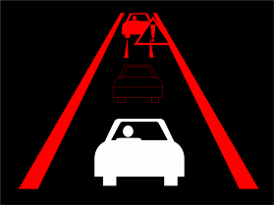

EEBL
Brake
Brake
EEBL Ahead
EEBL Ahead-Left

Slide 24
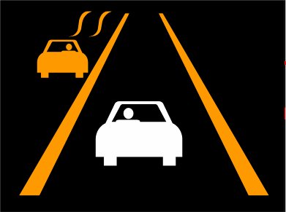
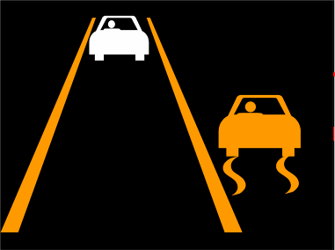
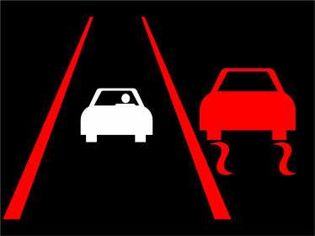
CLW
CLW
CLW
CLW
CLW Oncoming
CLW Behind-Right
CLW Side-Right

Slide 25
IMA
  Scenario One
WARN
INFORM

Slide 26
DNPW
Host following remote, left turn signal engaged, pass attempt, WARN
WARN (visual+audible alert)
Note: Turn signals are only used in VSC-A Test Bed as a simplified approach to infer driver lane change intention

Slide 27
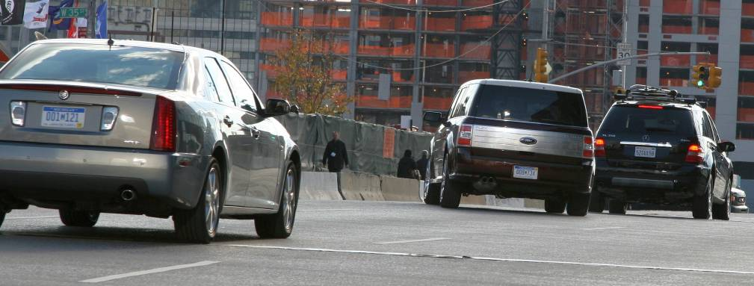
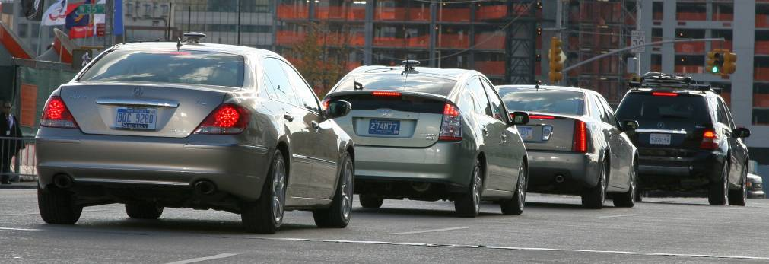
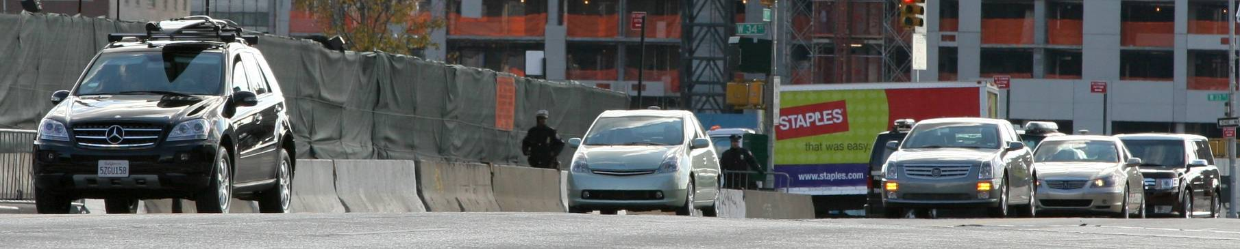
VSC-A Major Accomplishment to Date
Completion of the VSC-A Milestone Test Bed implementation in August 2008 demonstrating V2V interoperability between OEMs
Demonstration of the Level I VSC-A Test Bed at NYC 15th ITS WC in November ’08
Serving as the main tool for developing and verifying safety applications functionality, including sub-systems:
  Communication protocols (message composition & security)
  Relative positioning (LatLong and RTK approaches)
Completion of Objective Test Procedures at TRC, Ohio in June 2009
FCW Scenario
EEBL Scenario
BSW/LCW Scenario

Slide 28
Summary and Next Steps
Objective testing conducted in June 2009 verified that VSC-A Safety Applications perform according to specified performance requirements
The BSM proposed in current version of J2735 is a messaging framework necessary to achieve application performance, interoperability and cohesiveness among different vehicle manufacturers
Single safety message format (BSM) supports all implemented VSC-A safety applications
VSC-A test-bed uses periodic safety message broadcast (10 times per second) with event-driven safety message broadcast (immediate on event occurrence)
VSC-A Team is determining the sensitivity of applications to rates for Part I, Path History, Path Prediction, and RTCM Corrections

Slide 29
Summary and Next Steps - continued
VSC-A Team has also integrated precise RTK positioning capability in the VSC-A test-bed, and is conducting performance evaluation with multiple vehicles
Current implementation uses one GPS receiver type and relative positioning performance is being evaluated with different GPS receiver types
Team is currently evaluating relative positioning performance in challenging GPS environments, and is conducting a detailed study on GPS service availability
Team is currently finishing security network simulations, and evaluating the real-world performance testing of security implementations. This will help us decide on the on-board security protocol most appropriate for VSC-A safety applications
VSC-A plans to write a white Paper for OTA V2V Safety Minimum Performance Specification based on VSC-A Test Bed implementation

