Slide 1
DSRC (Dedicated Short Range Communication)
IEEE 1609 + IEEE 802.11p

Slide 2
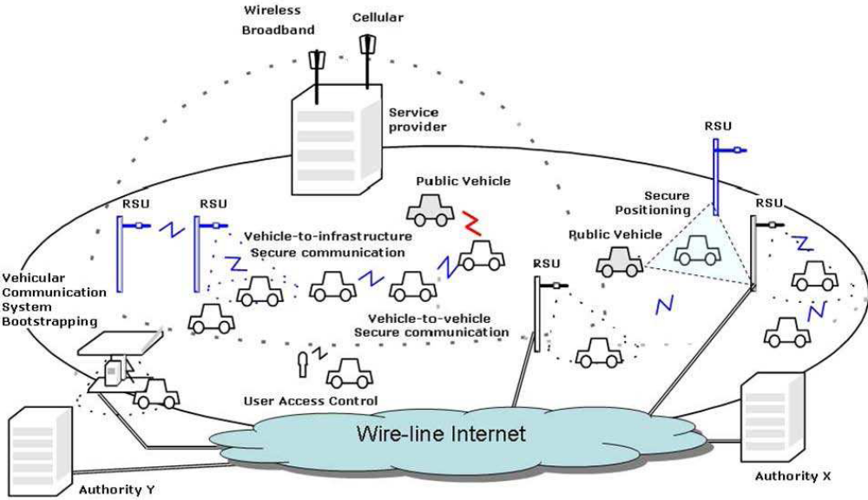
Secure Vehicular Communications System
Source: P. Papadimitratos et al., "Securing Vehicular Communications - Assumptions, Requirements, and
Principles", in ESCAR 2006

Slide 3
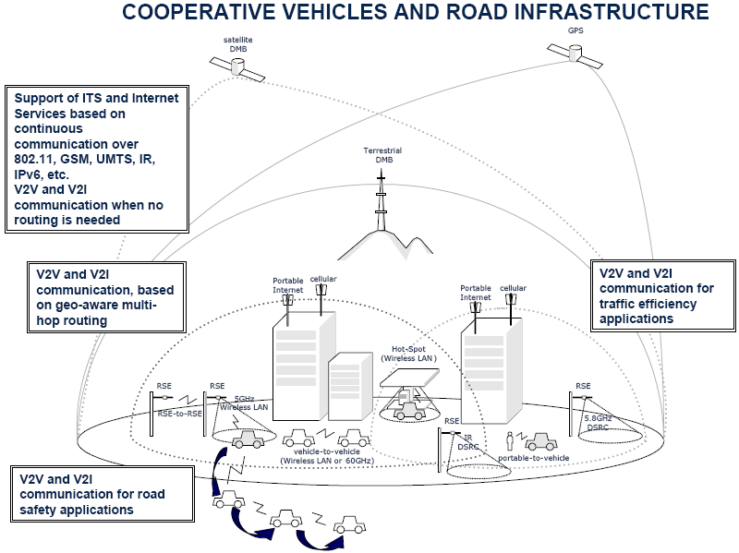
Notes:
DMB: Digital Multimedia Broadcasting.

Slide 4
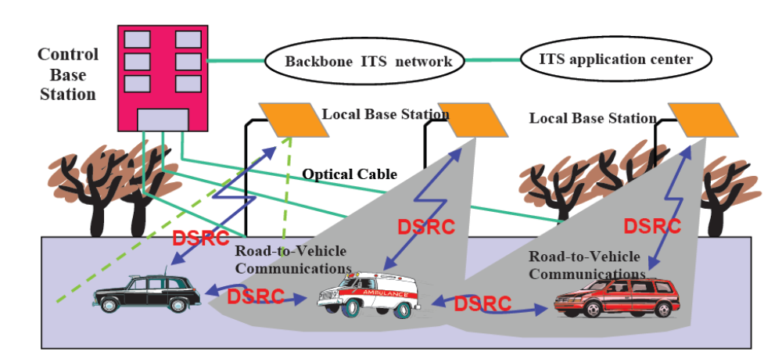
Background
IEEE 802.11p is considered as a layer-2 standard that implements Dedicated Short Range Communication (DSRC)
  Alternatives include RFID, bluetooth …

Slide 5
Background
DSRC
  An important foundation of ITS, for short-range uni- or bi-directional communication
  Used between the Road Side Unit (RSU) and the On-Board Unit (OBU), or inter-OBU communication
  Spectrum @ 5.9 GHz, 7 licensed channels
  Data rate: 6 – 27 Mbps
  To save lives and improve traffic flow, and also to provide value through private applications
Critical Safety of Life
High Power Public Safety
Control Channel
Ch 172
Ch 174
Ch 176
Ch 178
Ch 180
Ch 182
Ch 184
5.850
5.860
5.870
5.880
5.890
5.900
5.910
5.920
Service Channels
Frequency (GHz)
Service Channels

Slide 6
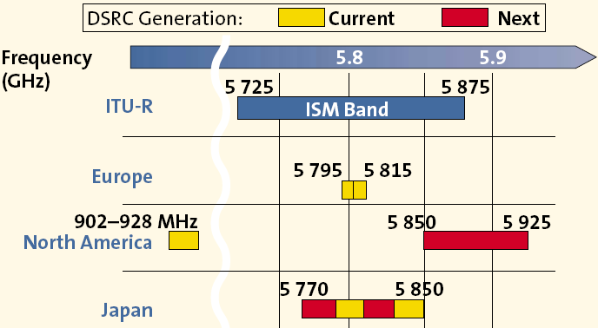
Background
Spectrum (differs from country to country)

Slide 7
DSRC in North America
IEEE 802.11p protocol
Vehicle speeds up to 100 mph (=160.9 km/h)
Low latency: 50 ms
Application priority: 8 levels
Short range radio: 300m (~1000m)
Data rate: 6-27 Mbps
Half duplex
Channel 172: vehicle safety only
Security
  Encrypt using Public Key Infrastructure (PKI)
  Road Side Unit (RSU) Authentication
  On Board Unit (OBU) Privacy

Slide 8
DSRC in North America
How DSRC works?
  Road-Side Unit
    Announces to OBUs 10 times per second
    Applications it supports on which channel
  On-Board Unit
    Listens on Channel 178
    Authenticates RSU digital signature
    Executes safety applications first
    Then switches channels
    Executes non-safety applications
    Returns to Channel 178 and listens

Slide 9
DSRC in North America
IP address
  Long-lived IP address would only happen when stationary
  All devices change IP address when OBU moves from one RSU to another
MAC address
  Generate random MAC address out of local space (?)
  When to change?
    At startup?
      Allows tracking for individual trips
    When the signing key changes?
      Every 5-10 minutes
      Close monitoring can follow transitions

Slide 10
IEEE 802.11p vs. IEEE 1609
IEEE 802.11p (aka. WAVE)
  WAVE = wireless access in vehicular environments
  Extension from IEEE 802.11, used in vehicular networks that meets the application requirements by ITS
  Usable by fast vehicles to communicate with RSUs or other vehicles at spectrum 5.9GHz (5.85-5.925GHz) for data access
  Approved in July 2010
IEEE 1609 is a higher standard based on IEEE 802.11p
  A family of standards dealing with issues like management and security of the network
  Use IPv6 as an overlying protocol for message delivery

Slide 11
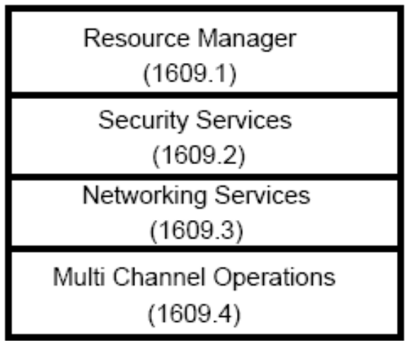
IEEE 1609
IEEE 1609 consist of 4 parts
  IEEE 1609.1: WAVE Resource Manager
    Provides a resource manager for
    WAVE, allowing communication between remote applications and vehicles
    規範多個遠程應用和資源管理間的控制互換流程
  IEEE 1609.2: WAVE Security Services for Applications and Management Messages
    包括WAVE訊息安全、抵制竊聽、電子欺詐和其他襲擊方法
  IEEE 1609.3: WAVE Networking Services
    規範通信協議的網路層與傳輸層
  IEEE 1609.4: WAVE Multi-Channel Operations
    提供IEEE 802.11p MAC對WAVE的支援

Slide 12
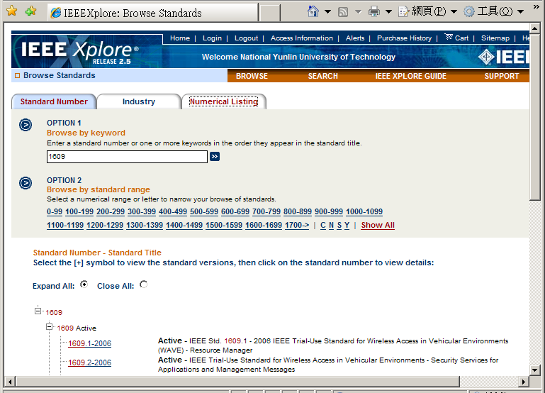
取得IEEE 1609規範文件 (圖書館的西文電子資料庫，進到IEL作查詢即可取得)

Slide 13
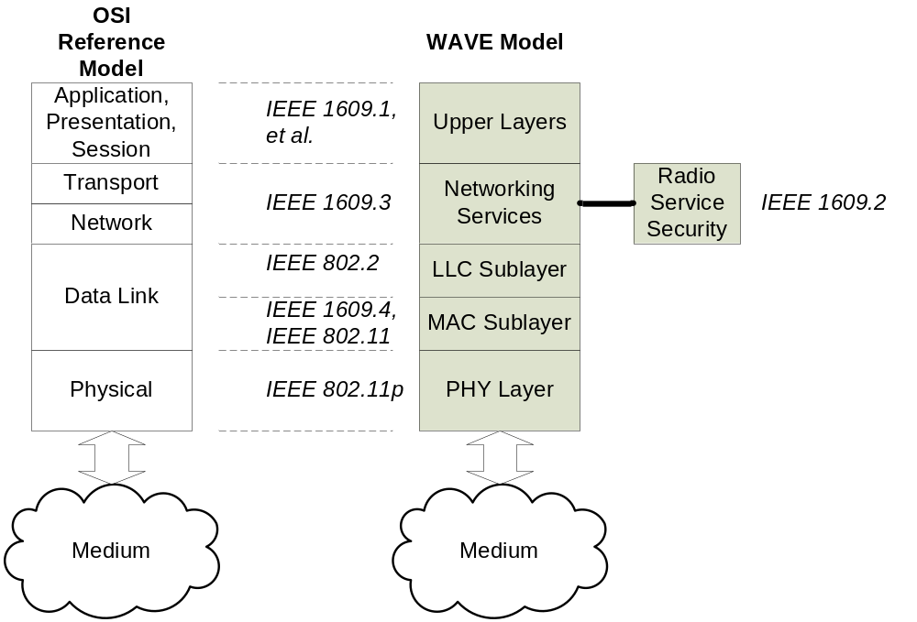
Protocol Stack (Relating to ISO/OSI Ref. Model)

Slide 14
Protocol Stack
OSI Reference Model
Application
Application
Presentation
Session
Security
Services
1609.1
WME
UDP/TCP
WSMP
Transport
IETF
MIB
IPv6
1609.2
Network
1609.3
LLC
Data Link
802.2
MLME
WAVE MAC
802.11
Multi-channel operation
1609.4
802.11p
PLME
WAVE Physical
Physical
1609.3
Management plane
Data plane
A message sent over WSMP (WAVE short message protocol) and routed to a receiving application using an ACID (application class identifier) and an ACM (application context mark) rather than an IP address and port.
Notes:
制定IEEE1609 這一個標準的最主要的目的是提供一個可以將將車輛中的主要系統如引擎、傳動系統、煞車、懸吊系統等行車資訊與道路的基礎架構兩者之間互相溝通。IEEE 1609 使用 5.9 GHz 的波段，並使用IEEE 802.11系列的無線區域網路通訊標準 802.11p 作為底層的通訊技術，同時採用 IPv6 作為上層的通訊協定。
application class identifier (ACID): A code that identifies a class of applications.
application context mark (ACM): A code that identifies a specific instance of an application within a class.

Slide 15

IEEE 802.11p — WAVE
WAVE (wireless access in vehicular environments)
  A mode of operation used by IEEE 802.11 devices in environments where physical channel properties are rapidly changing and short-duration communications exchanges are required
  Interoperability and transactions must be completed in time frames much shorter than the minimum possible with infrastructure or ad hoc 802.11 networks
  Time frames shorter that required for standard authentication and association to join a BSS (Basic Service Set) are accommodated in IEEE 802.11p
    No scanning
    No authentication and association

Slide 16
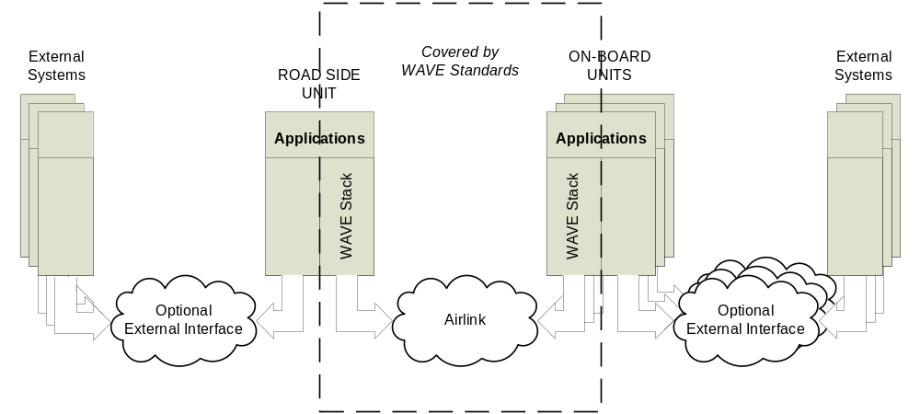
WAVE Components

Slide 17
IEEE 1609.4
Provides frequency band coordination and management within the MAC layer
Supplements 802.11 MAC features
Coordinates operation on the Control Channel (CCH) and Service Channels (SCH)
  CCH for broadcast, high priority, and single-use messages
  SCH for ongoing transactions
提供頻帶的協調及MAC子層的管理功能，它針對 802.11 MAC 層的特色進行增補，協調控制頻道 (CCH)與服務頻道的操作 (SCH)
Notes:
接下來我們簡單的介紹 IEEE 1609 的四個部份：
IEEE 1609.4
IEEE 1609.4 提供頻帶的協調及MAC子層的管理功能，它針對 802.11 MAC 層的特色進行增補，協調控制頻道 (Control Channel，CCH)與服務頻道的操作 (Service Channels，SCH) ：
- 控制頻道用來廣播、高優先權的利用與訊號使用訊息(系統用) 。
- 服務頻道則用來提供線上的傳輸服務。

Slide 18
IEEE 1609.3
Provides WAVE networking services to WAVE devices and systems
Defines WAVE networking services that operate at the network and transport layers
Represents roughly layers 3 and 4 of the OSI model and the IP, UDP, and TCP elements of the Internet model
Notes:
IEEE 1609.3
IEEE 1609.3 提供 WAVE 網路服務給 WAVE 裝置與系統，它定義操作在網路層與傳輸層的 WAVE 網路服務，粗略的重新展現 OSI 網路模型的第三、四層，與網際網路模式中的IP、UDP、TCP等協定。

Slide 19
IEEE 1609.2
Defines secure message formats
Specifies methods for securing WAVE management messages and application messages
Processes secure messages of DSRC/WAVE systems
Exception of vehicle-originating safety messages
Provides administrative functions necessary to support core security functions
Notes:
IEEE 1609.2
IEEE 1609.2 的前身為 IEEE 1556 標準 (之後更名為IEEE 1609.2) ，它的主要目的在發展與定義安全訊息格式、處理 DSRC 與 WAVE 系統內部中的安全訊息、定義WAVE管理訊息與應用程式訊息的加密方法、以及車輛引起的安全訊息例外處理並支援核心安全功能的必要管理功能。

Slide 20
IEEE 1609.1
Resource management
Specifies a DSRC application overlying WAVE
Allows remote site applications to communicate with OBUs or RSUs
Acts like an application layer
  To conduct application-level information interchanges
Notes:
IEEE 1609.1
IEEE 1609.1 為 WAVE 的資源管理。這個標準制定一個用於 DSRC 應用的 WAVE 環境中的無線存取方式，允許遠端應用程式與車上裝置 (OBU) 或路邊裝置 (RSU) 之間的通訊，WAVE的資源管理扮演一個應用層的角色，其通訊的目的是引導資訊交換。
接下來我們將分節來介紹 IEEE 1609 標準的各部份。

Slide 21
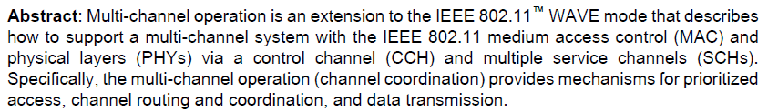
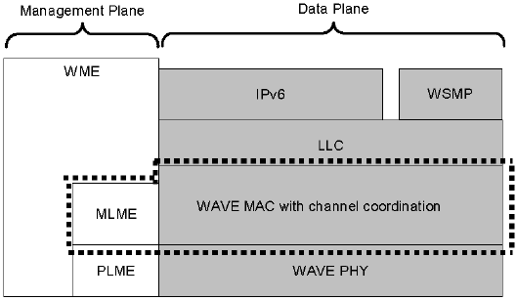
IEEE 1609.4: Multi-Channel Operation
1609.4
Notes:
IEEE 1609.4 提供頻帶的協調及MAC子層的管理功能，它針對 802.11 MAC 層的特色進行增補，協調控制頻道 (Control Channel，CCH)與服務頻道的操作 (Service Channels，SCH) ，本節將討論 IEEE 1609.4 的標準。

Slide 22
Terminology (1/2)
Control channel (CCH)
  A radio channel used for exchange of management frames and WAVE short messages (WSMs)
  Used for broadcast transmission and to establish communications
Service channel (SCH)
  Secondary channels used for application specific information exchanges (用於應用程式的資訊交換)
Transmitter profile
  A data object containing communication parameters to be used by the transmitter, including SCH number, power level, data rate and the adaptable status of power level, and data rate for Internet Protocol (IP)-based applications
Provider
  WBSS initiator or WSM (WAVE short message) sender
Notes:
在開始討論 IEEE 1609.4 標準之前，我們先說明幾個相關的名詞。
- Control channel (CCH) ：使用在管理訊息和 WSM (WAVE short message) 的交換。
- Service channel (SCH)：使用在應用程式的資訊交換。
- Transmitter profile：表示一個資料物件，包含被使用在傳輸上通訊參數，有SCH number、通訊能力等級、資料速率、適合的通訊能力狀態、網際網路通訊協定應用程式的資料速率等。
- Provider：一個WBSS的創建者或是一個WSMs的寄送者。
- User：一個裝置扮演接收WAVE發佈活動的訊框。
- Onboard unit：一個移動的WAVE裝置，能被操作跟RSU或其他OBU之間的資料交換。
- Roadside unit：一個固定不動的WAVE裝置，被操作跟OBU之間的資料交換。
- WAVE short message (WSM)：特別設計用來操作在WAVE頻道的一種訊息，它能直接在WAVE裝置之間被交換，不需要網際網路通訊協定額外的負擔或是被結合管理與一個創建的WBSS。
- WAVE short message protocol (WSMP)：WAVE short messages 所使用的通訊協定。

Slide 23
Terminology (2/2)
User
  A device that acts on the received WAVE announcement action frames
Onboard unit (OBU)
  A WAVE device that can operate in motion and supports the information exchange with RSUs or other OBUs
Roadside unit (RSU)
  A WAVE device operating only when stationary and supports information exchange with OBUs.
  Only RSU can broadcast on the Control Channel
WAVE short message (WSM)
  A message specifically designed to operate in the WAVE band. It can be exchanged directly among WAVE devices without the overhead of IP or management associated with initiating a WBSS
WAVE short message protocol (WSMP)
  WAVE short messages 所使用的通訊協定
Notes:
在開始討論 IEEE 1609.4 標準之前，我們先說明幾個相關的名詞。
- Control channel (CCH) ：使用在管理訊息和 WSM (WAVE short message) 的交換。
- Service channel (SCH)：使用在應用程式的資訊交換。
- Transmitter profile：表示一個資料物件，包含被使用在傳輸上通訊參數，有SCH number、通訊能力等級、資料速率、適合的通訊能力狀態、網際網路通訊協定應用程式的資料速率等。
- Provider：一個WBSS的創建者或是一個WSMs的寄送者。
- User：一個裝置扮演接收WAVE發佈活動的訊框。
- Onboard unit：一個移動的WAVE裝置，能被操作跟RSU或其他OBU之間的資料交換。
- Roadside unit：一個固定不動的WAVE裝置，被操作跟OBU之間的資料交換。
- WAVE short message (WSM)：特別設計用來操作在WAVE頻道的一種訊息，它能直接在WAVE裝置之間被交換，不需要網際網路通訊協定額外的負擔或是被結合管理與一個創建的WBSS。
- WAVE short message protocol (WSMP)：WAVE short messages 所使用的通訊協定。

Slide 24
Main Tasks of IEEE 1609.4
Channel routing
  Routing for WSMP data
  Routing for IP datagram
User priority (UP)
Channel coordination
MAC service data unit (MSDU) data transfer
Notes:
IEEE 1609.4 標準所提供的服務是被用來做頻道協調的管理以及支援 MAC 服務，其中包括：頻道的路由、使用者優先權、頻道協調、MAC服務資料單元（MSDU）的傳輸等。

Slide 25
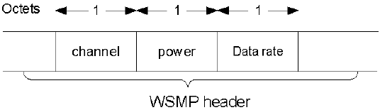
Channel Routing: Routing for WSMP Data (1/2)
Portion of the WSMP header used to control PHY
transmit parameters
WSMP header contains the channel, power level, and data rate associated with the data packet as specified in IEEE 1609.3
Notes:
接下來我們說明WSMP (WAVE short message protocol) data 的頻道路由。
圖中所示為 WSMP header 的一部分, 其中包含了Channel number、Power level 及 Data rate等，這些參數被用來控制實體層的傳輸。相關 Data Packet 的規範請參考 IEEE 1609.3 (下一節中將說明)。
註：1 octet = 8位元組，為網路使用單位。

Slide 26
Channel Routing: Routing for WSMP Data (2/2)
Procedure
  WSMP data is passed from LLC to MAC
  MAC shall route the packet to a proper buffer (queue) corresponding to the channel number contained in the WSMP header
  Data packet shall be discarded when the channel number contained is not a valid channel number
    A channel number is invalid if it does not correspond to the CCH number or the current SCH number (defined by dot4JoinedServiceChannelNumber)
Notes:
WSMP (WAVE short message protocol) data 的頻道路由說明如下：
1.首先 WSMP data 從 LLC 層被傳送到 MAC 層。
2.接下來 MAC 會路由該封包到適當的 buffer 也就是在 WSMP header 中所指的channel number。
3.如果 WSMP header 中所指的 channel number 是無效的，則該封包會被摒棄，而所謂無效的 channel number 是指它並非對應到 CCH number 或目前的 SCH number。

Slide 27
Channel Routing: Routing for IP Datagrams
Procedure
  Before initializing IP data exchanges, the transmitter profile shall be registered to the MAC layer management entity (MLME)
    Transmitter profile contains an SCH number, power level, data rate, and the adaptable status of power level and data rate
    Only one transmitter profile may be active at any given time
  When IP data is passed from LLC to MAC, the MAC shall route the packet to a data buffer that corresponds to the current SCH
  If there is no transmitter profile registered or the transmitting WAVE device is not a member of any WBSS, data is discarded
Notes:
在 IP 封包的路由方面：
首先，在 IP 封包被傳送之前，必須先向 MLME 做一個註冊的動作。註冊的內容包括要告知： SCH number、power level、data rate 及可接受的power level 及 data rate。另外，在任何一個時間點，只有一個註冊動作會被核准。
接下來，IP 封包從 LLC 層被傳送到MAC層，MAC層會轉送該封包到符合目前SCH的緩衝區中。

Slide 28
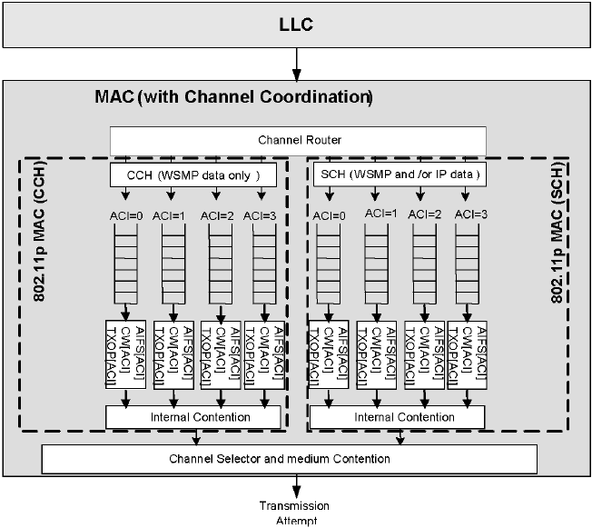
Channel Routing and Coordination
Two 802.11p MAC entities
Transmit Queue
Pre-queue channel access function
Notes:
圖中展示了在一個 Channel 的情況下，資料封包競爭媒體 (PHY) 的概念圖。
當一個 MSDU 被送到 MAC 層，且Channel routing 也完成了之後，MAC 層之後會依照該封包的使用者優先權將該封包對映到某一個存取目錄序列 (ACI) 中，其中每一個存取目錄都有各自獨立的頻道存取函數，用來判斷在目錄序列中的哪一個資料封包可以被挑選出來競爭存取媒體。
再來，各個被選出的封包將會更進一步地根據其轉換時間 (back-off) 去判斷哪一個封包可獲得媒體的存取使用權，其中擁有最小的轉換時間者可獲得媒體的存取使用權。

Slide 29
User Priority
Using IEEE 802.11e Enhanced Distributed Channel Access mechanism (EDCA) to contend for medium access
MAC buffers the data by mapping its user priority to access category index (ACI) as defined in IEEE 802.11
EDCA parameters
  Arbitration inter-frame space (AIFS)
  Contention window (CW)
  Transmit opportunity (TXOP) limit
(附錄一)
Notes:
接下來我們說明 IEEE 1609.4 的使用者優先權 (User priority) 的功能。
IEEE 1609 使用 IEEE 802.11e 的增強分散頻道存取 (Enhanced Distributed Channel Access mechanism ，EDCA) 的機制，來競爭媒體存取。媒體存取控制根據存取分類索引與使用者優先權的配對決定將資料置於何佇列。此部份於 IEEE 802.11 中有定義。
EDCA 相關的參數如下：
- 訊框內部間隔之仲裁 (Arbitration inter-frame space，AIFS)：無線媒體在閒置與開始傳輸一個訊框的最小時間間隔。
- 競爭窗口 (Contention window，CW)：亂數切換機制中，取得的一個間隔。
- 傳輸機會限制 (Transmit opportunity (TXOP) limit) ： 取得TXOP之後可以進行傳輸的最大持續時間，limit =0 時，僅能允許傳輸一個MSDU。

Slide 30
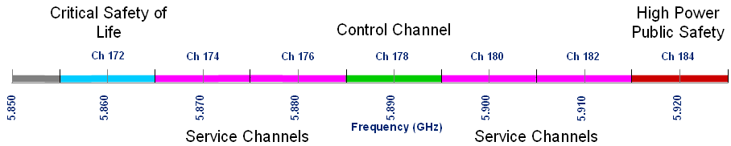
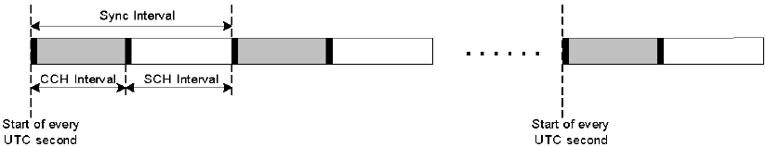
Channel Types
Two types of radio channels: a single control channel (CCH) and multiple service channels (SCH)
  By default, WAVE devices operate on the CCH reserved for short, high-priority application and system control messages
    CCH to transmit WSMs and announce WAVE services
  SCHs for application interactions/transmissions
  Transmit/receive operation on CCH and SCH is coordinated based on sync intervals that are synchronized using a commonly external system time base (e.g. UTC/GPS)
    A sync interval = a CCH interval + a SCH interval
Guard interval
Notes:
UTC: Coordinated Universal Time (http://en.wikipedia.org/wiki/Coordinated_Universal_Time)
During the CCH interval, all devices monitor the CCH. Devices in a WBSS exchange data on the designated SCH (see IEEE 1609.4)

Slide 31
Channel Coordination
Channel coordination (cont’d)
  Channel coordination relies on synchronization (defined in Sec. 8.1)
  All WAVE devices monitor the CCH during a common time interval (e.g., CCH interval) during which high-priority WSMs with the CCH number indicated in the WSMP header and WSAs (WAVE service advertisements) shall be transmitted
    These messages may also be transmitted on the CCH during the SCH interval
    WSA: WME-collected configuration data, identifying WAVE applications and associated network parameters
  For devices remaining on CCH during the SCH interval, low-priority frames may be transmitted at any time

Slide 32
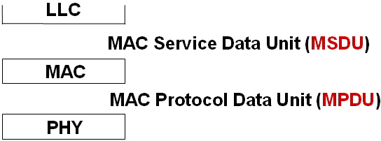
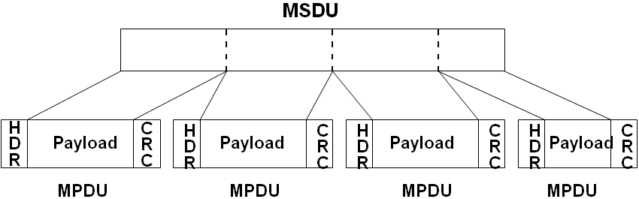
Frame Format
MSDU vs. MPDU
  MAC accepts MSDU (MAC service data unit) from higher layer and adds headers and trailers to create a MAC protocol data unit (MPDU)
  MPDU (i.e. MAC frame) is then passed to PHY and sent over the medium
  MAC may fragment MSDU into several frames to increase the probability of successful delivery

Slide 33

Frame Format (WAVE)
Using EtherType
  MAC shall identify the type of a data packet (WSMP or IP) indicated by its EtherType
  For WSMs, the channel, transmit power, and data rate are specified in the WSMP header and may be modified on a per-message basis (EtherType = 0x88DC)
  For IP datagrams, the channel, transmit power, and data rate to be used are stored in a transmitter profile (EtherType = 0x86DD)
  MSDU format

Slide 34
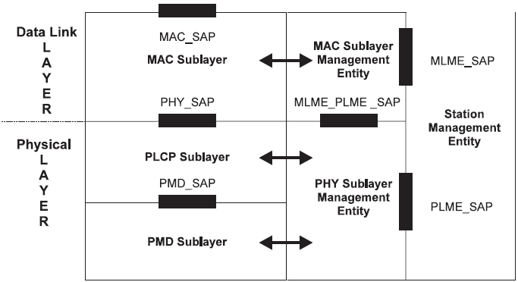
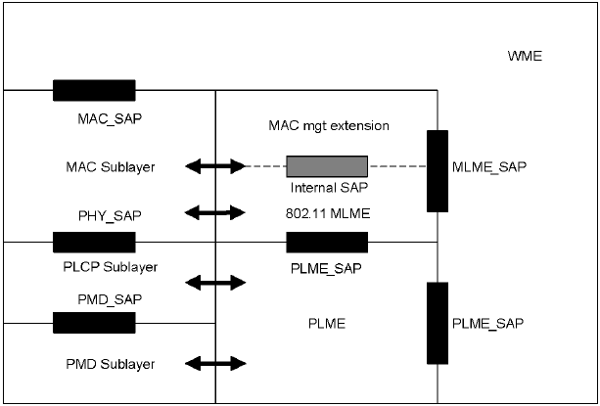
Layer Management
SAP (Service Access Point) interfaces relevant to IEEE 1609.4
(WAVE Management Entity)

Slide 35
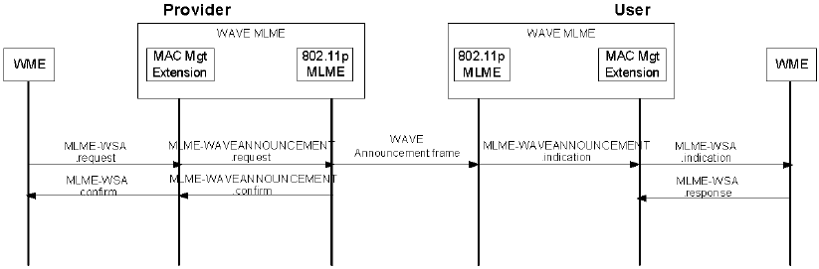
MAC Management Extension
Relationship between MLME-WSA and MLME-WAVEANNOUNCEMENT service primitives
  WBSS provider: a WAVE station advertising the presence of a WBSS
  WBSS user: a WAVE station that elects to join a WBSS advertised by a WBSS provider

Slide 36
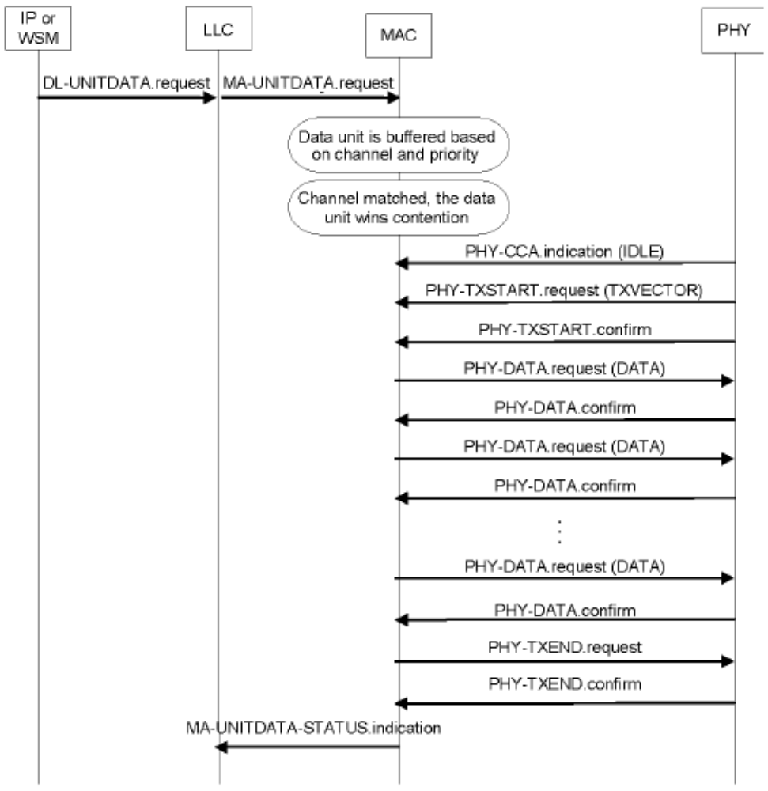
Transmit Operations (1/5)
1
2
3
4
5
6
7
Notes:
在 IEEE 1609.4 的架構下，訊息傳輸的動作如圖：
- IP 或 WSM 提出一個傳輸要求。
- LLC 遞給MAC一個MSDU，MAC 依據 EtherType 判斷封包是 IP or WSMP。
(1) 如果是WSMP時，將根據WSMP header所載明之channel number 來配置MSDU AC分類與UP等參數；
(2) 如果是 IP時，將配置 MSDU SCH、AC 分類與 UP，然後依據其 UP 將 MSDU 放到該channel 的buffer中。
當該channel贏得競爭權時，
(1) 如果是WSMP，從header中取得 transmit power與data rate來進行資料傳輸；
(2) 如果是 IP，則從已登錄的transmitter profile中取得 transmit power與data rate來進行資料傳輸。
- Power level 與 data rate 設定於TXVECTOR中，接下來的動作規範於 IEEE 802.11，
- PHY會報告一個clear channel 到 MAC 經由發行一個 IDLE的命令，MAC發布一個設定TXVECTOR的命令，PHY根據Power level 與 data rate設定完成回覆。經過一連串的資料封包傳輸，完成後通知PHY傳輸完成，PHY回覆。
- 最後 LLC 得到一個 MAC 的狀態指示。

Slide 37
Transmit Operations (2/5)
Procedure
  1. LLC passes an MSDU to MAC.
  2. Channel router examines the EtherType field of the MSDU:
  1) If EtherType indicates WSMP, the channel router looks
  up the channel number in the WSMP header and
  designates the MSDU to the AC based on the channel
  and the user priority. (The MSDU is discarded if the
  channel number is invalid.)
  2) If EtherType indicates IP, the channel router designates
  the MSDU to the AC assigned to the SCH and user
  priority.
  3. Through channel coordination, data buffers allocated to the current channel are served.

Slide 38
Transmit Operations (3/5)
Procedure (cont’d)
  4. MAC selects the MSDU that wins the internal contention on the current channel. The EtherType field of the MSDU is examined again:
  1) If the data unit is a WSM, the transmit power and data rate stored in the WSMP header are used for transmission.
  2) If the data unit is an IP datagram, the transmit power and data rate stored in the registered transmitter profile are used for transmission.
  5. The values of the power level and data rate are set in the TXVECTOR. The procedure between MAC and PHY to transfer an MPDU is summarized below:
  1) PHY reports a clear channel to MAC by issuing a PHY-CCA.indication(IDLE).

Slide 39
Transmit Operations (4/5)
Procedure (cont’d)
  5. The values of the power level and data rate are set in the TXVECTOR. The procedure between MAC/PHY to transfer an MPDU is summarized below:
  1) PHY reports a clear channel to MAC by issuing a PHY-CCA.indication(IDLE).
  2) MAC issues a PHY-TXSTART.request(TXVECTOR) to PHY. A confirmation is issued back to MAC after PHY sets the desired power level and data rate.
  3) The data is then exchanged between MAC/PHY through a series of PHYDATA.request(DATA) primitives issued by MAC, and PHY-DATA.confirm primitives issued by PHY.
  4) After transmitting the final bit of the last MPDU octet, the transmission is terminated by MAC through the primitive PHY-TXEND.request.

Slide 40
Transmit Operations (5/5)
Procedure (cont’d)
  6. If transmission of an MPDU is not completed at the scheduled guard interval, the transmission shall be canceled by MAC through the primitive PHY-TXEND.request.
  7. LLC waits for a status indication from MAC if required.

Slide 41
MSDU Data Transfer
Control channel data transfer
  WSMs conforming to WSMP can be exchanged directly
  Transmission of IP datagrams is not permitted
Service channel data transfer
  Provider
    To initiate communication on an SCH, an RSU or an OBU transmits WAVE announcement action frames on CCH to advertise offered services available on that SCH
  User
    An OBU receives the announcement on CCH and generally establishes communications
Notes:
在 Control channel 資料傳輸面，只有符合WSMP的WSM才能直接地在CCH中傳遞，而IP封包是不能在CCH中傳送的。
在 Service channle 資料傳輸方面，在初始化SCH的溝通時，provider 會先在 CCH 傳送 WAVE announcement action frames 以通知哪一個服務在SCH可被執行了。 而 user 則在 CCH 中接收該announcement之後才開始與provider在SCH建立通訊連結。

Slide 42
IEEE 802.11p: MAC and PHY Operations
Notes:
IEEE 1609.4 提供頻帶的協調及MAC子層的管理功能，它針對 802.11 MAC 層的特色進行增補，協調控制頻道 (Control Channel，CCH)與服務頻道的操作 (Service Channels，SCH) ，本節將討論 IEEE 1609.4 的標準。

Slide 43
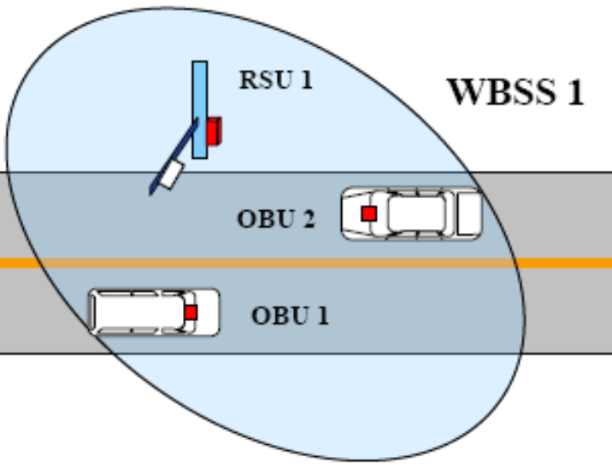
Background
IEEE 802.11p
  Supports data exchange between stations without first establishing a BSS
  Stations transmit data to other stations having any valid MAC address (including group addresses) without being part of a BSS. These data exchanges cannot be transmitted directly to
  a MAC address on a DS (distribution system)
Terminology
  WAVE basic service set (WBSS): A set of cooperating stations operating in WAVE mode consisting of a single WAVE service provider and none or more WAVE service users
  WAVE service information element (WSIE): An information element that contains information specified by the upper
  layers. It may be included as a field in a WAVE Advertisement frame using the on-demand management frame

Slide 44


Recall: Radio Spectrum
Dedicated
Public Safety
Shared Pub.Safety/Private
Medium Range Serv.
Shared Pub.Safety/Private
Medium Range Serv.
Dedicated
Public Safety
Ch 172
Ch 174
Ch 176
Ch 178
Ch 180
Ch 182
Ch 184
Public Safety
V2V
Public Safety /
private
Public Safety /
private
Control
Channel
Public Safety /
private
Public Safety /
private
Public Safety
Intersections
5MHz
10MHz
10MHz
10MHz
10MHz
10MHz
10MHz
10MHz
5.850
5.925 (GHz)
Ch 175
Ch 181
Optionally Combined
Service channel
Optionally Combined
Service channel
Reserved
75 MHz
10MHz for one channel
20MHz
20MHz
Notes:
由此圖我們可得知IEEE 802.11p介於5.85~5.925GHz之間
分成一個5MHz的保留頻寬及七個channel,每個channel都給予10MHz的頻寬大小
Channel 172為Vehicle-to-Vehicle專用
Channel 174及176為中程距離之服務專用
Channel 178為control channel
Channel 180及182為短程距離之服務專用
Channel 184為intersection專用
然而channels的大小可視情況而合併
Channel 174及176合併成一個20MHz的channel
Channel 180及182合併成一個20MHz的channel
每個channel所負責的事項都有定義清楚
Public Safety的內容可包含：
-Intersection collision warning
-Brake notification
-Send picture of accident to authorities
Private Operations的內容可包含：
-Toll collection
-Electronic payment at McDonalds
-Internet access on the road
由於目前IEEE 802.11p的制定內容尚未完全底定
所以就2004年來說，我們所知的架構只定義這些
在IEEE 802.11p標準出來以前，各國的架構可依自己的情況來制定專屬的
使用的頻譜位置
Channel的數目
Channel的功能
Public Safety的內容
Private Operations的內容

Slide 45
IEEE 802.11p MAC Layer
Quality of Service (QoS) — 802.11e
  This amendment defines MAC procedures to support LAN applications with QoS requirements
Reduction of interference — 802.11h
  This amendment is added to the IEEE 802.11 standard for Spectrum and Transmit Power Management Extensions
Service — IEEE 1609 family
  IEEE 1609.1, IEEE 1609.2 , IEEE 1609.3 , IEEE 1609.4
Notes:
關於IEEE 802.11p的服務品質機制是由IEEE 802.11e中參考並修正
以往802.11規定的訪問控制模式（MAC）存在很多“浪費”。這是因為在設計時重視：
（1）提高通信的可靠性
（2）讓無線LAN終端獲得平等的信號發送權
而以上的問題在流量太大時，會造成某些流量被丟棄或者延遲，所以在此情況流量的分配就是必須的。
而低干擾頻道的功能是由IEEE 802.11h中所參考再修正而來的
5G赫茲頻段的標準不止802.11a，如歐盟使用的HyperLAN2
軍事雷達系統、洲衛星通信網路和醫療設備，會和802.11a產生干擾
所以802.11h算是歐洲版的「 802.11a 」。
802.11e和802.11h都已經被納入IEEE 802.11-2007標準中並且明切定義，至於802.11p中的這些特性是否相同則必須等802.11p標準出現。
至於服務的規範則是使用IEEE 1609.1 , IEEE 1609.2 , IEEE 1609.3 , IEEE 1609.4 中的規範

Slide 46
MAC Layer and Frame Format (1/3)
(Annex)
Current MAC Header
  Data frame format as in IEEE 802.11
  Current MAC frame format
    Adds extra 34 (28) bytes to each packet
Data | Size
Frame Control | 2 bytes
Duration | 2 bytes
Address 1 | 6 bytes
Address 2 | 6 bytes
Address 3 | 6 bytes
Sequence Control | 2 bytes
Address 4 | 6 bytes
Data | 0-2321
FCS | 4 bytes
Total | 34 bytes
Vehicle Communication Networks and Protocols
Vehicle Communication Networks and Protocols
Notes:
IEEE 802.11p的MAC frame format遵照IEEE 802.11的標準
目前有兩個版本,一個是現在在使用的版本,另一個是未來將採取的版本
首先先介紹現在正在使用的版本
每個封包增加了34個bytes,但是我們可以發現這部分跟IEEE 802.11e(h)的MAC frame format也幾乎是一模一樣

Slide 47
MAC Layer and Frame Format (2/3)
New MAC header
  Different frame formats (Frame Control field)
    Type: 2 bits
    Subtype: 4 bits
  New MAC frame format
    Adds extra 20 bytes to each packet
(Only 1 of the 4 available subtypes)
(Only 8 of the 16 available subtypes)
Data | Size
Frame Control | 2 bytes
Duration | 2 bytes
Address1 | 6 bytes
Address2 | 6 bytes
Data | 0-2326
FCS | 4 bytes
Total | 20 bytes
Vehicle Communication Networks and Protocols
Notes:
另一種是未來將採取的格式
新增了一個Frame Control field
用2個bits表示frame的型別,可以表示出四種frame,但目前只用到一種
接下來再用4個bits細分封包類型,可以表示出16種類型,但目前只用到8種
由此圖可知
新制的MAC Frame Format版本,每個封包將增加了20個bytes
比原本MAC Frame Format版本的34個bytes還要少了14個bytes

Slide 48
MAC Layer and Frame Format (3/3)
Random MAC addresses
  No one should be able to explicitly identify a particular vehicle by its DSRC transmissions
Short header for vehicle safety messages
  IPv6
Vehicular environment is highly dynamic
  When a vehicles travels from one region to another, handover among access networks becomes necessary
  Adopt IPv6 to achieve fast or seamless handover
Notes:
由於之前所提到的安全性問題
所以MAC Address必須是隨機的,以防止有心人士刻意攻擊

Slide 49
Channel Switching (1/2)
Goal: Make sure safety messages be delivered and maximized service time
  Ensure safety
    Check for ongoing events
    Send routine messages
    Update the context
  Maximize the service usage time
802.11p does not define channel switching mechanisms
  But there are well-known channel switching methods, e.g. global synchronization, distributed synchronization, independent channel switching
  http://www.csie.nctu.edu.tw/~yctseng/WirelessNet05-02/manet-multi-channel.ppt

Slide 50
Channel Switching (2/2)
Assumed channel requirements
  Channel can handle a message every 2 - 4 milliseconds
  An average safety message is around 300 bytes
  Average transmission time of a safety message of about 400 microseconds
Major problems
  Deterministic channel model cannot be assumed in the fast changing topology
  Hidden terminal collisions cannot be avoided efficiently
Notes:
目前在channel switch上最主要的問題有兩種：
其中當網路拓撲變動相當快速時，channel switch model是否可即時回應給station及車子
再者，Hidden Terminal Collisions 仍然需要被解決

Slide 51
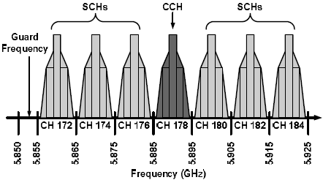
Other Channel Switching Methods (1/2)
Exemplar scheme
  Yunpeng Zang, Lothar Stibor, Bernhard Walke, Hans-Jürgen Reumerman and Andre Barroso, “A Novel MAC Protocol for Throughput Sensitive Applications in Vehicular Environments”, IEEE Vehicular Technology Conference 2007-Spring

Slide 52
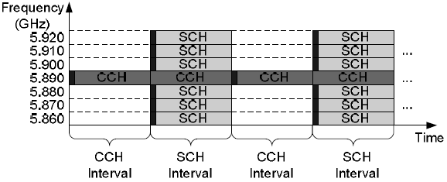
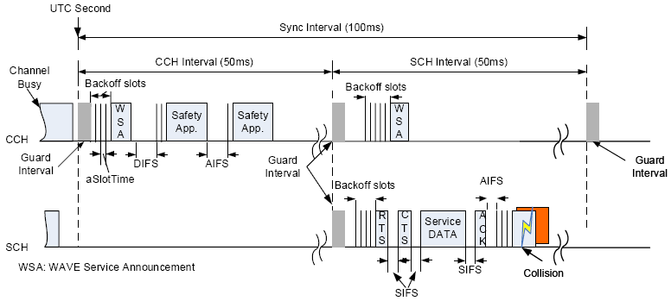
Other Channel Switching Methods (2/2)

Slide 53
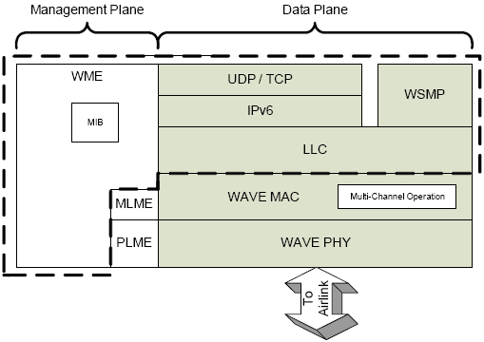
IEEE 1609.3: Networking Services

Slide 54
IEEE 1609.3
Major functions
  Provides addressing and routing services within a WAVE system
  Defines services, operating at the network and transport layers, in support of wireless connectivity among vehicle-based devices, and between fixed roadside devices and vehicle-based devices using the 5.9 GHz DSRC/WAVE mode
Notes:
IEEE 1609.3 的制定目的在於提供WAVE系統的定址及路由的服務。IEEE 1609.3 規範了在 5.9GHz 的 DSRC/WAVE 模式下，無線連接車用裝置和車用裝置與固定的路邊裝置的網路層及傳輸層的服務及操作。

Slide 55
Terminology (1/3)
WAVE basic service set (WBSS)
  A set of cooperating WAVE stations consisting of a single WBSS provider and none or multiple WBSS users
WAVE short message protocol (WSMP)
  A protocol for rapid, reliable exchange of messages in a rapidly-varying RF environment where low-latency is also an important objective
WAVE service advertisement (WSA)
  A data structure containing information that announces the availability of a service. A WSIE is composed of such structures
Secured WSA
  The WAVE service advertisement (WSA) signed by the security services specified in IEEE 1609.2 and 1609.3
Notes:
在開始討論 IEEE 1609.3 標準之前，我們先說明幾個相關的名詞。
WAVE basic service set (WBSS)
一個集合，內含兩個或多個WAVE裝置互相參與在同一個SCH上的通訊。一個WBSS被創建是由一個WAVE裝置使用一個WAVE發佈活動訊框在CCH上。
WAVE short message (WSM)
特別設計用來操作在WAVE頻道的一種訊息，它能直接在WAVE裝置之間被交換，不需要網際網路通訊協定額外的負擔或是被結合管理與一個創建的WBSS。
WAVE service advertisement
WAVE服務公告由 WME配置資料與收集，提供識別WAVE應用程式與用來連結的網路參數。
WAVE routing advertisement (WRA)
RSU 的網路配置資訊廣播。
secured WSA
使用安全服務簽章的WAVE服務公告，分別被定義在 IEEE 1609.2 與 IEEE 1609.3。
WAVE service information element (WSIE)
一個WAVE發佈活動訊框中的欄位，被使用來通知WAVE服務開始被提供，WSIE由secured WSA, timing quality,
and in the case of the RSU, the WAVE routing advertisement 所組成。
WAVE management entity (WME)
一個提供WAVE網路服務管理功能的集合。
Provider service identifier (PSID)
應用程式提供唯一的編號用來識別該服務。
Provider service context (PSC)
一個欄位的組合，包含PSID與一些增補資訊如版本。
Provider service table (PST)
記載登錄在WAVE裝置上應用服務的資訊，如channel number、狀態等。

Slide 56
Terminology (2/3)
WAVE routing advertisement (WRA)
  Network configuration information broadcast by the RSU
WAVE service information element (WSIE)
  A field in a WAVE Announcement action frame used to advertise the WAVE services being offered
  WSIE is comprised of a Secured WSA, Timing Quality, and in the case of the RSU the WAVE Routing Advertisement
WAVE management entity (WME)
  A set of management functions required to provide WAVE networking services
Notes:
在討論 IEEE 1609.3 標準之前，我們先說明幾個相關的名詞。
WAVE basic service set (WBSS)
一個集合，內含兩個或多個WAVE裝置互相參與在同一個SCH上的通訊。一個WBSS被創建是由一個WAVE裝置使用一個WAVE發佈活動訊框在CCH上。
WAVE short message (WSM)
特別設計用來操作在WAVE頻道的一種訊息，它能直接在WAVE裝置之間被交換，不需要網際網路通訊協定額外的負擔或是被結合管理與一個創建的WBSS。
WAVE service advertisement
WAVE服務公告由 WME配置資料與收集，提供識別WAVE應用程式與用來連結的網路參數。
WAVE routing advertisement (WRA)
RSU 的網路配置資訊廣播。
secured WSA
使用安全服務簽章的WAVE服務公告，分別被定義在 IEEE 1609.2 與 IEEE 1609.3。
WAVE service information element (WSIE)
一個WAVE發佈活動訊框中的欄位，被使用來通知WAVE服務開始被提供，WSIE由secured WSA, timing quality,
and in the case of the RSU, the WAVE routing advertisement 所組成。
WAVE management entity (WME)
一個提供WAVE網路服務管理功能的集合。
Provider service identifier (PSID)
應用程式提供唯一的編號用來識別該服務。
Provider service context (PSC)
一個欄位的組合，包含PSID與一些增補資訊如版本。
Provider service table (PST)
記載登錄在WAVE裝置上應用服務的資訊，如channel number、狀態等。

Slide 57
Terminology (3/3)
Provider service identifier (PSID)
  A number identifying a service provided by an application
Provider service context (PSC)
  A field associated with a PSID containing supplementary information related to the service.
  PSC format is PSID dependent.
Provider service table (PST)
  A collection of data describing the applications that are registered with and available through a WAVE device, with supporting channel information
Notes:
在開始討論 IEEE 1609.3 標準之前，我們先說明幾個相關的名詞。
WAVE basic service set (WBSS)
一個集合，內含兩個或多個WAVE裝置互相參與在同一個SCH上的通訊。一個WBSS被創建是由一個WAVE裝置使用一個WAVE發佈活動訊框在CCH上。
WAVE short message (WSM)
特別設計用來操作在WAVE頻道的一種訊息，它能直接在WAVE裝置之間被交換，不需要網際網路通訊協定額外的負擔或是被結合管理與一個創建的WBSS。
WAVE service advertisement
WAVE服務公告由 WME配置資料與收集，提供識別WAVE應用程式與用來連結的網路參數。
WAVE routing advertisement (WRA)
RSU 的網路配置資訊廣播。
secured WSA
使用安全服務簽章的WAVE服務公告，分別被定義在 IEEE 1609.2 與 IEEE 1609.3。
WAVE service information element (WSIE)
一個WAVE發佈活動訊框中的欄位，被使用來通知WAVE服務開始被提供，WSIE由secured WSA, timing quality,
and in the case of the RSU, the WAVE routing advertisement 所組成。
WAVE management entity (WME)
一個提供WAVE網路服務管理功能的集合。
Provider service identifier (PSID)
應用程式提供唯一的編號用來識別該服務。
Provider service context (PSC)
一個欄位的組合，包含PSID與一些增補資訊如版本。
Provider service table (PST)
記載登錄在WAVE裝置上應用服務的資訊，如channel number、狀態等。

Slide 58
Communication Protocols
WAVE Short Message Protocol
  A unique protocol designed for optimized operation in the WAVE environment
  WSMs may be sent on any channel (CCH or SCH)
  Allows application to directly control physical layer in transmitting a message
    Channel number
    Transmitter power
  WAVE short messages
    Provider Service Identifier (PSID)
    Minimal channel capacity
IPv6
  Used on SCH only
  Allows access to generic applications and networks
Notes:
WAVE能支援兩種通訊協定
- WSMP車用無線存取環境短訊息協定：車用無線存取環境短訊息協定 WSMP為獨特的WSMP，被設計來提升在WAVE的傳輸效率，車用無線存取環境短訊息可以使用任意頻道傳送 (CCH or SCH) 。它允許應用程式直接控制實體層PHY例如：頻道號碼、傳輸功率(能量)等利用在傳遞訊息。
WSMs車用無線存取環境短訊息提供一個寄送中的應用程式也能準備目的裝置的MAC address，包含可能的broadcast address。WSMs 基於提供服務識別碼 PSID 能送達目的端正確的應用程式。 WSMs 被設計用來使用最小頻道容量。
- 標準網際網路協定 IPv6：僅能使用在SCH 多重服務頻道，它允許存取一般的應用程式與網路。

Slide 59
WAVE Communications Concepts
Operation without a WBSS
  Limited to WSMs sent on CCH
Operation with a WBSS
  Allows applications to use either WSMs or IPv6 traffic on SCH
Persistent vs. non-persistent WBSS
  Persistent: e.g., Internet access
  Non-persistent: 可限定服務期限
Priorities
  Application (application priority level)
  Lower layers (MAC layer)
Notes:
接下來討論 WAVE 的通訊概念。應用程式可以選擇要不要使用WBSS來傳遞訊息，不使用WBSS時，將被限制WSMs僅能使用CCH。使用WBSS時，則可以選擇WSMs或IPv6在SCH通訊。一個 WAVE device可以發行一個WBSS在SCH上，並且發佈它的存在資訊在CCH上給其他device連結該WBSS使用。
WBSS可分為持久性與非持久性的，持久性的如 Internet access，非持久性的則可以限定服務期限。
WBSS不管是提供者或是使用者皆使用role來控制使用權限，限定哪些使用者能選擇哪些限定的服務要求。應用程式有優先權等級的設計，如當兩個應用程式欲使用同一個通道通訊時，WME可以根據應用程式的優先順序，決定誰先使用通訊服務，下層的優先權則由MAC層來定義與控制。

Slide 60
Operation with a WBSS (1/2)
Two types
  Persistent WBSS
    Announced during CCH interval
    A usage of the persistent WBSS would be to offer an ongoing service to any devices that come into range
  Non-persistent WBSS
    Announced only on initiation
    A usage of the non-persistent WBSS would be to support an on-demand service
Notes:
接下來討論應用程式選擇使用WBSS來傳遞訊息。
WBSS 提供兩種操作型態：Persistent WBSS 及 Non-Persistent WBSS。
Persistent WBSS 發佈在CCH間隔期間，用來提供一個不間斷的服務給任何進入通訊範圍內的設備。
Non-Persistent WBSS 僅發佈在起始階段，用來支援一個被請求的服務。

Slide 61
Operation with a WBSS (2/2)*
WAVE Service Information Element (WSIE)
  Applications offering services to potential user applications are announced on the air interface via a WSIE inside a WAVE announcement frame
WAVE Service Advertisement (WSA)
  The process of creating a WSIE and transmitting it is initiated when an application requests to initiate a WBSS and offer services
  On receipt of the WME-Application.request, the WME builds an MLME-WSA.request to start the WBSS
  (第72頁投影片)
Notes:
WSIE 為 WAVE 服務資訊元素，應用程式提供應用服務給予可能的使用者，是經由WAVE發佈訊框中的WSIE來發佈。
WSA 為 WAVE服務的宣告，它建立一個WSIE與傳遞它的處理方式是起始於當一個應用程式要求起始一個WBSS與提供服務時。WME收到 WME-Application.request 命令之後，WME會建立一個 MLME-WSA.request 命令，然後去開始WBSS的創建。

Slide 62
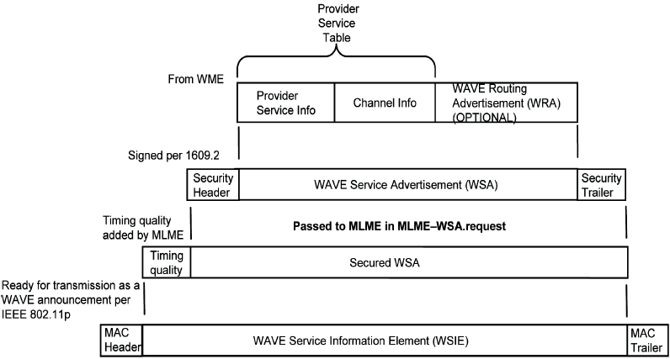
WAVE Service Information Element (WSIE)
Notes:
WSIE WAVE服務資訊元素如圖示，由WME中取得Provider Service Info，Channel Info與WAVE Routing Advertisement WRA(選用)，組成WAVE Service Advertisement WSA，加上 IEEE 1609.2的Security Header與Trailer，成為一個Secured WSA的package，在MLME-WSA.request命令中傳送給MLME，再由MLME加上timing quality header，就形成WSIE，準備好可以加上MAC header 與 trailer 被傳送。

Slide 63
To Build WAVE Service Advertisement
Procedure
  1) Before operation (e.g., at network configuration), system parameters are loaded into the provider device’s WME MIB, including operational channels and their characteristics, and (if applicable) a WAVE Routing Advertisement (WRA) containing IP network configuration info
  2) Applications register their parameters with the WME; the WME enters the parameters into the WME MIB. Provider services include their channel of operation, address information, and application priority; user services include a ConfirmBeforeJoin flag.
  3) A provider application may request a WBSS initiation, including a ProviderServiceContext, and the Repeats (number of announcement repetitions per CCH visit) and Persistence characteristics used by MLME

Slide 64
To Build WAVE Service Advertisement
Procedure (續)
  4) WME generates a WAVE Service Advertisement (WSA), which will be transmitted to potential service users. The WME collects the application information describing the services being offered, previously registered in its MIB, and channel information describing the WBSS characteristics, also from the MIB, and inserts them into the WSA. This combination of data is known as the Provider Service Table. In addition, if a WAVE Routing Advertisement (WRA) exists in the MIB, it is included in the WSA.
  5) The WSA is signed, guaranteeing its validity, with security header and trailer added, per IEEE 1609.2.

Slide 65
To Build WAVE Service Advertisement
Procedure (續)
  6) The secured WSA is provided to MLME in the announcement request. MLME adds a parameter reflecting the quality of its timing information, to be used in the receiving devices’ synchronization function, with the resulting collection known as a WAVE service information element (WSIE). (The timing information itself is within the MAC header.) At this point, over-the-air headers and footers are added and the frame is ready for transmission.

Slide 66
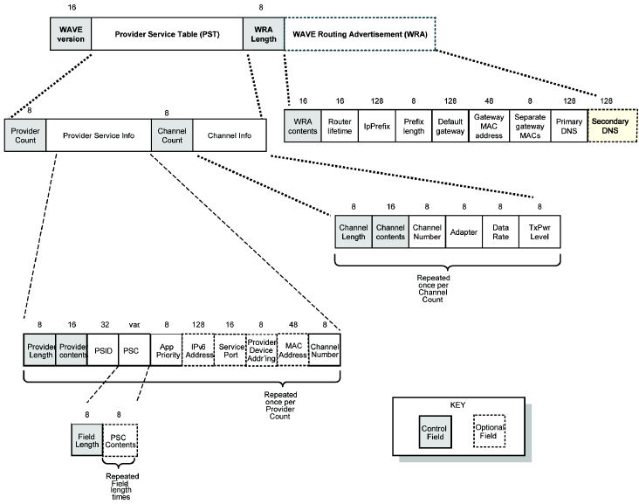
(bits)
Notes:
如圖所示為 Provider Service Info、Channel Info與WAVE Routing 的框架細節。
Peer MAC address. This contains the destination of the WBSS announcement. This parameter is copied
from the WME-Application.request. If Persistence is True, Peer MAC address shall be set to the
broadcast value of all ones (binary).
Service port (UDP or TCP). Defines the end point of offered IP service. Used by a user application in
addressing packets. Applications have advanced knowledge of the network protocol they use. For
remote WSM applications, this provides the WME the ability to deliver the received WSMs.
Provider Device Addressing is 8 bits in length, is coded as in Table 8, and indicates whether the device
transmitting the WSA is also the device hosting the provider application. Present when the provider service
employs IP addressing.

Slide 67
WaveServiceAdvertisement Format*
欄位說明
  Control fields are shown shaded.
  Field ordering shall not be changed.
  “Contents” fields are bit maps indicating which fields are present.
    This allows optional fields to be left out or new fields to be added in future versions.
  “Length” fields are always present and indicate the length in octets of the related data, excluding the “length” field itself.
    Unless otherwise specified, length may equal zero. If the data associated with a “length” does not end on an octet boundary, trailing fill bits shall be added.
  “Count” fields indicate the number of instances of provider or channel information.

Slide 68

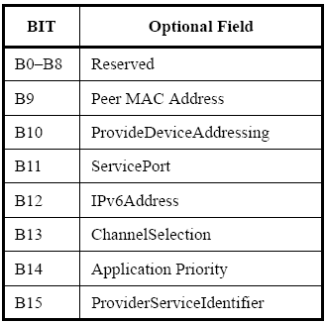
WaveServiceAdvertisement Format*
欄位說明 (續)
  Provider Contents: a bit map indicating the presence/
  absence of a specific optional field
    0: absent; 1: present

Slide 69
WaveServiceAdvertisement Format*
欄位說明 (續)
  Peer MAC address: contains the destination of the WBSS announcement. If Persistence is True, Peer MAC address shall be set to the broadcast address.
  ProviderDeviceAddressing (cf. 第79～82頁投影片)
    Set to “Provider device is same as announcement device” (Scenario 1)
    Set to “Provider device is not the same as announcement device.” (Scenario 2)
    Set to “Provider device is not the same as announcement device.” (Scenario 3)
  ChannelSelection: “Best available channel” or to the ChannelNumber of the existing WBSS

Slide 70
§5.1
  Primitives defined for exchanging information between the data plane components → §7
  Fig. 3 vs. Fig. 4
§5.5
  Review §5.5.1
  §5.5.2 cf. Fig. 4
    WSMP header → §8.3
    LLC DL-UNITDATAX.request → §7.5.2
  §5.5.3 cf. Fig. 4
    Annex E
    Annex F

Slide 71
§6.2.2

Slide 72
WBSS Initiation*
A WBSS is triggered by a provider application via a request to the WME (WME-Application.request)
  provider service context
  persistence
  destination MAC address
    Individual or broadcast (recipient devices)
  number of announcement repetitions per CCH visit
  which SCH to be used
    Optionally, the request directs the WME to choose the “best available” SCH
Notes:
提供者應用程式發出 WME-Application.request 到 WME去起始一個WBSS。
這個請求將會指定：
- provider service context
- persistence
- destination MAC address
- number of announcement repetitions per CCH visit
- which SCH to be used
這個WBSS隨後就以一個WAVE發佈訊框被發佈出去。
在這個WAVE發佈被接受裝置的底層接收之後，接收端的WME會檢查在這個WSA中的PSID是否有 local 本地端的使用者應用程式有興趣，當一個PSID被確認符合所需之後(假定WME檢查credential 、priority等等都沒問題之後) WME將會執行兩個動作中的一個，這將視應用程式登錄的參數而定。
在此例中，WME將產生必要的MAC primitives(原生的MAC位址)去引導local device去join 這個 WBSS，並且設定底層配置合適的參數去支援WBSS的通訊，如果應用程式選擇去做這些事，它會輪流地去確認加入這個WBSS。
這給予使用者應用程式附加的程度控制，例如允許它去決定參予服務，如果最近剛在該WBSS上完成一些目的。
WME會寄通知給事實上發生作用的應用程式，引導其加入該WBSS。

Slide 73
WBSS Communications*
Upon receipt of the notification from the WME informing it of the WBSS initiation, an application (whether provider or user) is free to generate data packets (WSM or IP) for transmission on SCH
  Any received packets destined for the application will be delivered to the application via the (WSMP or IP) stack
WBSS remains active at the local device until it is ended
Notes:
上述的應用程式收到通知之後，可以自由的選擇data packet (WSM or IP) 在SCH上傳遞，隨後這些應用程式將會經由所指明的stack方式(WSMP or IP)被傳遞訊息。
該WBSS的活動將持續到本地端裝置結束動作時。

Slide 74
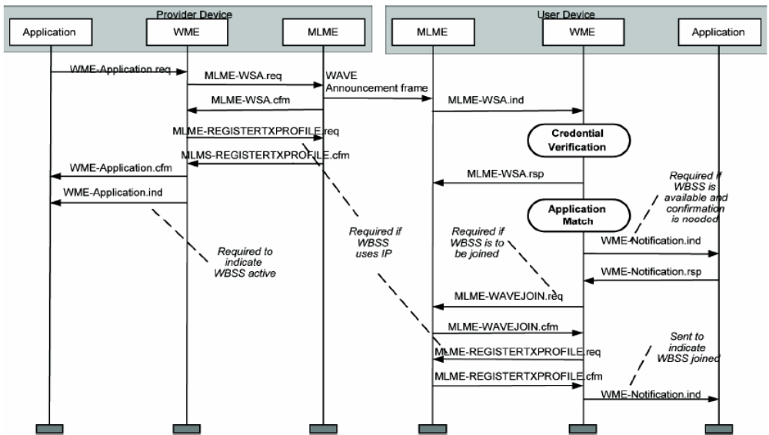
WBSS Initiation Sequence Chart
A WAVE device may establish a WBSS on an SCH, and announce its presence
on CCH for other devices to join that WBSS. WBSSs are initiated based on
application priority and the availability of radio resources.

Slide 75
WBSS Termination*
Once a WBSS is active at a device (initiated by a provider or joined by a user), it remains active at that device until it is locally terminated
Reasons for the WME to terminate participation on a WBSS
  All applications have indicated the completion of their activities on the WBSS, i.e., the WBSS is no longer in use by locally-registered applications
  Participation on a conflicting WBSS (e.g., on another channel) is required to support a higher priority application
  A user device may terminate its participation in the WBSS if the lower layer indicates the SCH has been idle implying an irrecoverable loss of the WBSS
Notes:
WBSS 存活在一個設備有兩種情形，提供者起始或由使用者連結，它將持續在設備中活動到本地端。

Slide 76
Addresses and Identifiers in WAVE (1/2)*
MAC address
  48 bits (e.g., 00-10-79-A3-F5-G8)
  Device with both WAVE and Ethernet interfaces will have a MAC address for each
  Support unicast address, broadcast MAC destination address
  Service provider devices are included MAC address in the service advertisements to facilitate the delivery of packets through WAVE devices
IP address (IPv6)
  Global address type
  Link-local address type
  IP addresses of service provider devices are included in service advertisements (if the application uses IP-based services)
Notes:
在 WAVE 中的媒體存取控制的位址為 48bits 長度，每一個WAVE與乙太網路介面的設備都有MAC Address 支援單一定址與廣播，多重定址是被允許的但是不需要，MAC Address 可以依據外部的請求結果而改變。服務提供裝置的MAC位址包含在 service advertisements ，使的經由WAVE裝置容易傳遞封包，
Link Local Scope：所有在同一個Layer2網路下的Host所使用的位址空間，其位址稱為Link-Local Addresses。
Unique-Local Scope (類似IPv4的Private Address)：所有在一個網路管理機制下之私用網路位址空間, 其位址稱為 Unique-Local Addresses。
Global Scope：可在Internet上互連之位址空間，其位址為Global Unicast addresses。
在一個WAVE環境中，大部分的應用程式使用 Internet Protocol 上，都預期去使用UDP在他們的傳輸層協定上(而不是TCP) ，因為它相當符合WAVE通訊的無連接傳輸模式的天性。為了傳送應用程式 的 IP packet 經由UDP或TCP，就必須知道它的 port number。Port number可由應用程式在其設備上選擇任何可用的。

Slide 77
Addresses and Identifiers in WAVE (2/2)*
Protocol/port
  Use UDP rather then TCP
Application identification
  Provider Service Identifier (PSID)
  Provider Service Context (PSC)
Application registration
  Service providers (applications that can initiate a WBSS)
  Service users (applications that can join a WBSS)
Notes:
應用程式再WAVE通訊堆疊中位處上層實體，從此觀點的網路服務來看，每一個應用程式都有一個唯一的識別，稱PSID。
服務提供者應用程式的PSID與PSC都是包含在WAVE Service Advertisement中，提供前述的那些登錄在接收端的使用者設備，用來判定是否對此WBSS有興趣。PSC的內容與PSID有關聯，包含一些增補的資訊，例如指明該服務的版本號碼。
應用程式登錄器服務服務提供者 (應用程式可以起始一個WBSS) 與服務使用者 (應用程式可以連結 join 一個WBSS)

Slide 78
Application Status Table
WME基於支援WBSS的狀態與應用程式的可用性，使用Application Status Table來記載 (維護登錄的每一個應用程式的狀態)
Application Status Table 記載：
  Application identification
  Application status (default inactive)
  Application priority
  Notification IP address and port
Notes:
WME維護登錄的每一個應用程式的狀態，基於支援WBSS的狀態與應用程式的可用性，使用Application Status Table來記載。
裡面記載：
應用程式識別碼 PSID
應用程式狀態 預設為Inactive
應用程式優先權
與應用程式的IP與port

Slide 79
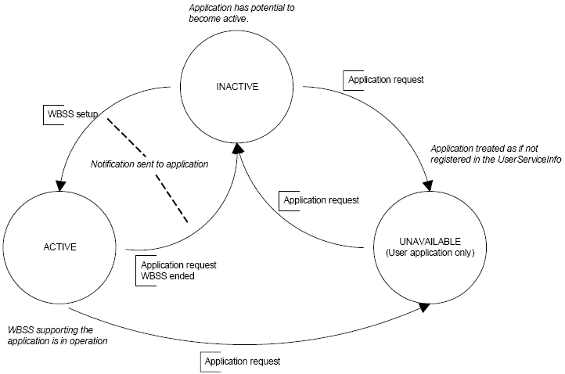
Application Status*
Unavailable status indicates a user application does not require the WME
to join a WBSS on its behalf
Notes:
圖示應用程式狀態的週期變化。WBSS被建立時，狀態為Active，這時候是可用狀態。當應用程式被使用中則狀態變成不可用。另外應用請求WBSS結束服務，狀態會變成Inactive狀態。

Slide 80
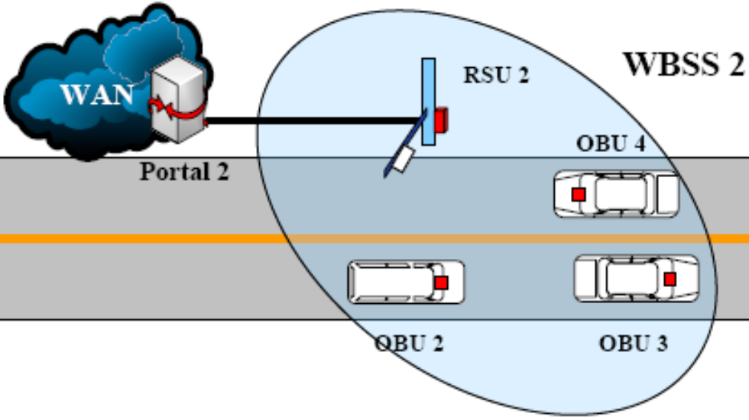
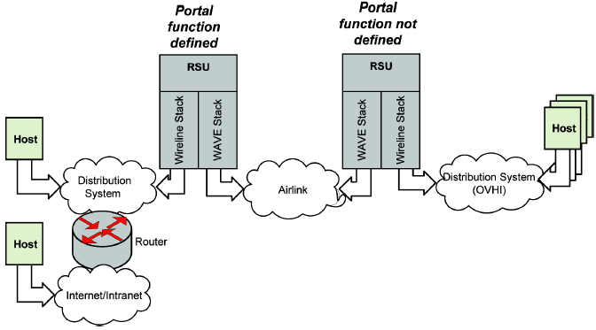
RSU Portal Function
Supports a system configured with portal function at the RSU, between the WAVE network and a wired network
OBU to vehicle host interface (OVHI):
An interface on the OBU offering access
to WAVE capabilities by other vehicle-
based devices.
Notes:
OVHI-OBU to vehicle host interface
IEEE 802.11描述一個(portal function)入口功能介於無線網路與分散式系統之間(有線區網) 。所有定址被 MAC addresses 小節所提及，針對RSU與OBU的所有定址被 WAVE MAC addresses 小節所提及。
這個標準支援一個系統配置在RSU的入口網站功能上，連接WAVE網路與有線網路。它並沒有明確的支援或阻止一個入口網站功能在OBU上(連接WAVE網路到OBU vehicle host interface)
這個portal操作位於data link layer的protocol stack，因此利用MAC address for packet delivery。
有三種packet delivery與addressing的情境，說明了四種device的角色，分別為傳送端與接收端(在無線網路連結上)，封包來源與目的。
傳送端與來源端可以再同一個設備上被執行，憑藉著寄送端是否利用portal。同樣的，接收端與目的端可以再同一個設備上被執行，憑藉著接收端是否利用portal。
在封包header的 FromDS 與 ToDS flags上指明何種腳色。

Slide 81
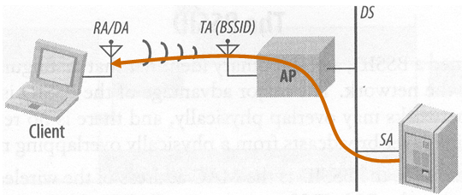
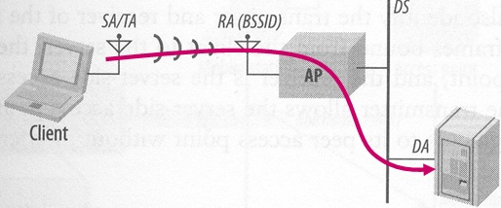
IEEE 802.11 MAC Header Fields
 |  | ToDS | FromDS | Provider Device Addressing | Address1 | Address2 | Address3
 |  |  |  |  | MAC of receiver | MAC of transmitter (for ack)
NoDS | OBU-OBU RSU-OBU OBU-RSU | 0 | 0 | 0 | DA | SA | BSSID
DS on receiving side | OBU-RSU-Host via DS | 1 | 0 |  | BSSID (RSU) | SA(OBU) | DA (Host or Router)
DS on sending side | Host via DS-RSU-OBU | 0 | 1 | 1 | DA(OBU) | BSSID (RSU) | SA (Host or Router)
Notes:
說明如何利用802.11的MAC header 參數，在WAVE通訊的應用。
RSU的BSSID在此例中假定是相同的。
RSU-RSU通訊不需具體的位址，在標準中也未禁止。
每個 Basic Service Station BSS 都有一個具唯一性的辨識碼 (BSSID, 長度為 48 位元), 對於有基礎架構的BSS, 此辨識碼為擷取點 (AP) 中的工作站的位址。
例一，NoDS是指在WAVE網路中互傳，因此ToDS與FromDS是0, Destination Address (DA), Source Address (SA)
例二，DS on receiving side，指OBU產生封包傳送訊息到RSU連接的DS中的一個host(經由Ethernet) ，所以ToDS為1，OBU將自己的MAC address置於 address2，Address 1中即記載RSU的address (BSSID) ，address 3則是該host address，也可以設成router的位址，如果該host須經由router送達。
例三則相反過來。

Slide 82
Service Advertised by RSU or OBU, No DS
RSU
OBU
WSA (on CCH)
App Data (on SCH)
App Data (on SCH)
ToDS | FromDS | Provider Device Addressing | Address1 | Address2 | Address3
0 | 0 | 0 | Broadcast | RSU | RSU
0 | 0 | 0 | RSU | OBU | RSU
0 | 0 | 0 | OBU | RSU | RSU
Notes:
WAVE device (RSU)提供一個服務寄出advertisement到廣播的位址，ProviderDeviceAddressing 這個參數在WAVE Service Advertisement中，將表明提供者設備與訊息發佈者設備相同，任何接收端回應此發佈訊息時，皆會攜帶此位址，經過交換資訊後，便能在兩者之間使用一對一通訊直接溝通。

Slide 83
Service Advertised by RSU, Provider Host on DS
Host
RSU
OBU
WSA
App Data
App Data
App Data
App Data
ToDS | FromDS | Provider Device Addressing | Address1 | Address2 | Address3
0 | 1 | 1 | Broadcast | RSU | Host
1 | 0 | 1 | RSU | OBU | Host
0 | 1 | 1 | OBU | RSU | Host
Notes:
WAVE device (RSU)產生一個WSA包含提供者應用程式的host的IP與MAC address和port number，寄出advertisement到廣播的位址，ProviderDeviceAddressing 這個參數在WAVE Service Advertisement中，將表明提供者設備與訊息發佈者設備不相同，任何接收端回應此發佈訊息時，皆將提供者應用程式的host位址放到address3，RSU位址放到address1，接收者OBU的位址放於address2，ToDS設為1，經過交換資訊後，便能在兩者之間使用一對一通訊直接溝通。

Slide 84
Service Advertised by RSU, Provider Host Beyond DS
Host
Router
RSU
OBU
WSA
App Data
App Data
App Data
App Data
App Data
App Data
ToDS | FromDS | Provider Device Addressing | Address1 | Address2 | Address3
0 | 1 | 1 | Broadcast | RSU | Router
1 | 0 | 1 | RSU | OBU | Router
0 | 1 | 1 | OBU | RSU | Router
Notes:
WAVE device (RSU)產生一個WSA包含提供者應用程式的host的IP與MAC address和port number，寄出advertisement到廣播的位址，ProviderDeviceAddressing 這個參數在WAVE Service Advertisement中，將表明提供者設備與訊息發佈者設備不相同，任何接收端回應此發佈訊息時，皆將提供者應用程式的router位址放到address3，RSU位址放到address1，接收者OBU的位址放於address2，ToDS設為1，經過交換資訊後，便能在兩者之間使用一對一通訊直接溝通。

Slide 85
Review Questions

