Slide 1
25CS1302E · DATABASE SYSTEMS ENGINEERING & DISTRIBUTED BACKEND DEVELOPMENT
Event & Room Occupancy
Management System
Project Review 2 — Design, Progress & Demonstration
TEAM
TRIMESTER
MEMBERS
Sec 10 · Team 1
2026–2027, Tri-4
J. Geya Reddy · Kamtam Priyanka
01 / 15

Slide 2
THE CHALLENGE
Problem Statement
Students and administrators lack a single, reliable way to see which campus rooms are free and to manage events without last-minute chaos.
!
Room availability is invisible
↯
Spot registrations disrupt planning
Students struggle to find free rooms during college hours — there is no shared, real-time view.
Hackathons, workshops and seminars often see sudden participant surges beyond initial estimates.
⌁
Conflicts go undetected
⚠
Space is used inefficiently
Manual coordination leads to double-booked rooms and scheduling clashes.
Without occupancy tracking, capacity mismatches and overcrowding are common.
EVENT & ROOM OCCUPANCY MANAGEMENT SYSTEM
02 / 15

Slide 3
WHAT WE AIM TO ACHIEVE
Objectives
1
Provide a centralized platform for room and event management across campus
2
Give students real-time visibility into room availability and schedules
3
Streamline event creation, room allocation and participant registration
4
Detect and prevent room-booking conflicts before they occur
5
Track expected vs. actual occupancy to support data-driven decisions
6
Improve overall utilization of campus spaces and reduce manual effort
EVENT & ROOM OCCUPANCY MANAGEMENT SYSTEM
03 / 15

Slide 4
OUR SOLUTION
Proposed System
A centralized, web-based platform where students discover rooms and events, and administrators allocate space, monitor registrations, and track real occupancy — all from one dashboard.
◷
✎
✓
Live Room Availability
Event Scheduling
Participant Registration
View real-time room status, capacity and schedules before booking.
Admins create and manage events, allocate rooms and set expected turnout.
Students register for events; the system tracks registrations against capacity.
△
▤
◎
Conflict Detection
Admin Dashboard
Occupancy Tracking
Automatically flags overlapping bookings and capacity mismatches.
A single console to monitor bookings, rooms and occupancy trends.
Compares expected vs. actual attendance to guide future planning.
EVENT & ROOM OCCUPANCY MANAGEMENT SYSTEM
04 / 15

Slide 5
SYSTEM DESIGN
System Architecture
Client Layer
Application Layer
Data Layer
React.js
→
Node.js + Express.js
→
MySQL Database
• Room availability views
• REST API endpoints
• Users, Rooms, Events
• Event & registration UI
• Business logic & validation
• Bookings & Schedules
• Admin dashboard
• Conflict detection engine
• Occupancy Records
Client requests flow through the Express REST API, which applies business rules (e.g. conflict checks) before reading or writing to MySQL — keeping presentation, logic and data cleanly separated.
EVENT & ROOM OCCUPANCY MANAGEMENT SYSTEM
05 / 15

Slide 6
BUILDING BLOCKS
Modules / Functionalities
◈
▦
✎
✓
User Management
Room Management
Event Management
Registration Module
Registration, login and role-based access for students & admins.
Add/edit rooms with capacity, building, type and equipment.
Create, edit and allocate rooms to events with expected turnout.
Students register for events; seats tracked against capacity.
▤
◎
△
▥
Booking & Scheduling
Occupancy Tracking
Conflict Alerts
Admin Dashboard
Reserve rooms for time slots; detect overlapping bookings.
Log expected vs. actual attendance per event and room.
Flags double-bookings and capacity mismatches automatically.
Central view of rooms, events, registrations and analytics.
EVENT & ROOM OCCUPANCY MANAGEMENT SYSTEM
06 / 15

Slide 7
UI BLUEPRINT
Frontend Design
Home
Login / Register
Home Page
Landing view surfacing quick room search and featured events.
Find a room. Join an event.
Login / Registration
Role-aware auth screen for students and administrators.
Forms
Event Registration Form
Admin Dashboard
Guided event registration capturing attendee details.
Name
Dashboard
Email
Admin control center for rooms, events and occupancy.
Select Event
EVENT & ROOM OCCUPANCY MANAGEMENT SYSTEM
07 / 15

Slide 8
BUILD IN PROGRESS
Frontend Implementation
Working screens are being implemented in React and connected to the REST API. Frames below mark each page's current build status.
▢
▢
▢
▢
Screenshot placeholder
Screenshot placeholder
Screenshot placeholder
Screenshot placeholder
Home Page
Login / Registration
Event Forms
Admin Dashboard
In progress
In progress
Planned
Planned
EVENT & ROOM OCCUPANCY MANAGEMENT SYSTEM
08 / 15

Slide 9
DATA MODEL OVERVIEW
Database Design
Seven related tables model the domain — normalized to 3NF so every non-key attribute depends only on its table's primary key.
Users
Rooms
Events
KEY RELATIONSHIPS
→
One User → Many Registrations
Registrations
Bookings
Room Schedules
→
One Event → Many Registrations
→
One Event → One or More Bookings
Occupancy Records
→
One Room → Many Room_Schedules
→
One Event → One Room (via Bookings)
NORMALIZATION — 3NF
1NF
2NF
3NF
All attributes hold atomic, indivisible values.
Every non-key attribute fully depends on the primary key.
No transitive dependencies between non-key attributes.
EVENT & ROOM OCCUPANCY MANAGEMENT SYSTEM
09 / 15

Slide 10
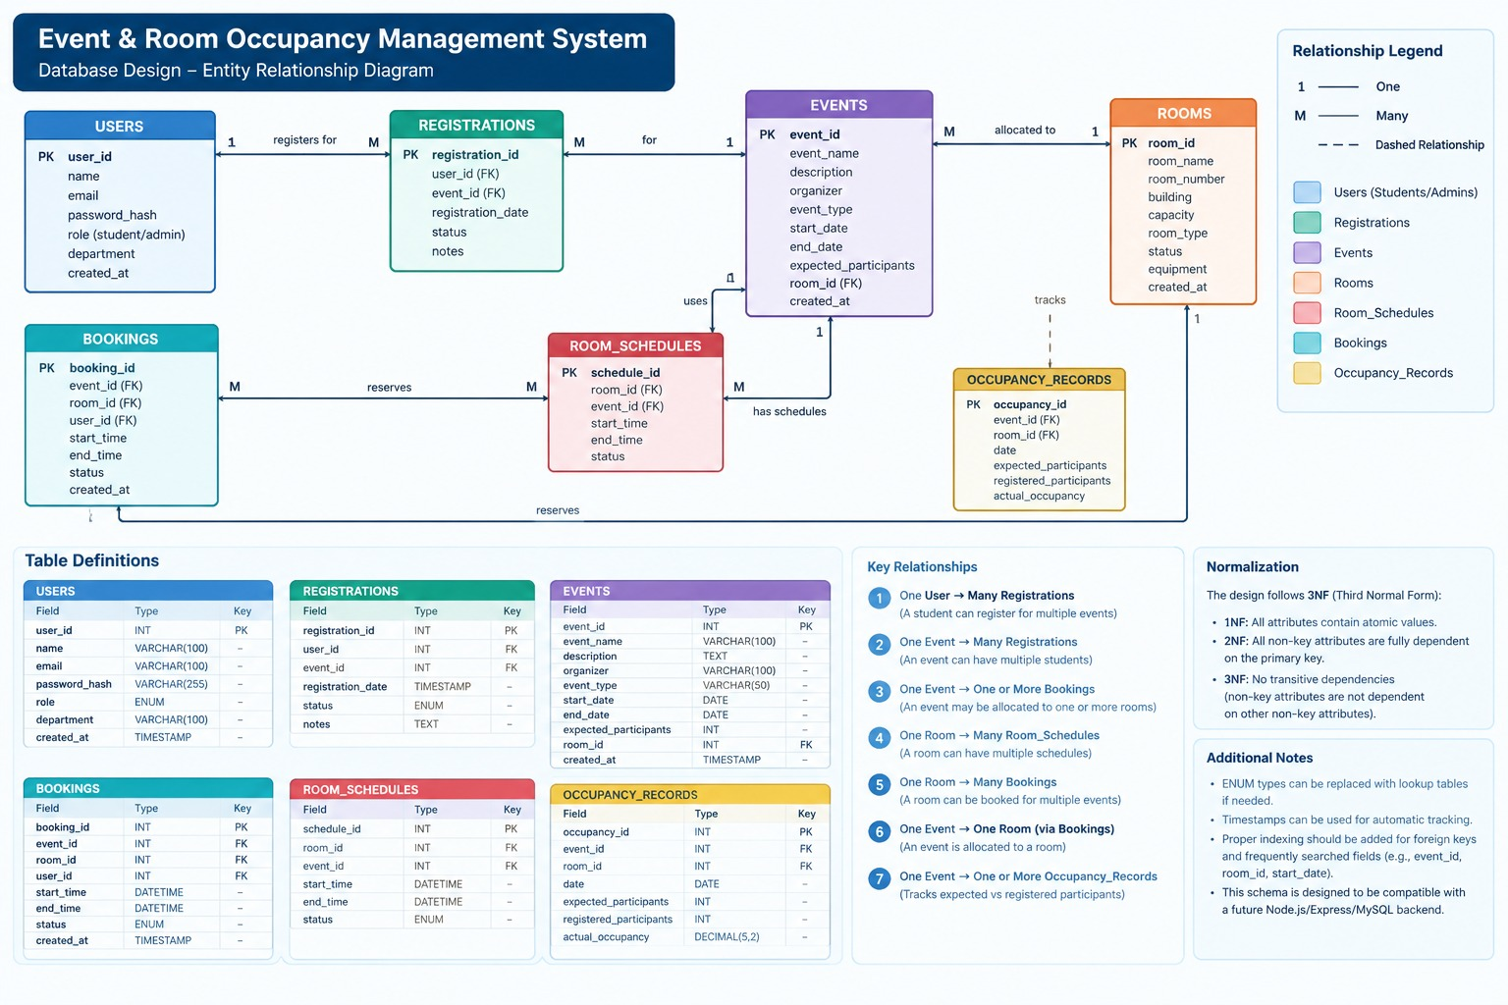
ENTITY RELATIONSHIP DIAGRAM
ER Diagram
EVENT & ROOM OCCUPANCY MANAGEMENT SYSTEM
10 / 15

Slide 11
STRUCTURE DETAIL
Database Tables / Schema
USERS
EVENTS
REGISTRATIONS
user_id
INT
PK
event_id
INT
PK
registration_id
INT
PK
name
VARCHAR(100)
event_name
VARCHAR(100)
user_id
INT
FK
email
VARCHAR(100)
description
TEXT
event_id
INT
FK
password_hash
VARCHAR(255)
organizer
VARCHAR(100)
registration_date
TIMESTAMP
role
ENUM
event_type
VARCHAR(50)
status
ENUM
department
VARCHAR(100)
start_date / end_date
DATE
notes
TEXT
created_at
TIMESTAMP
expected_participants
INT
room_id
INT
FK
BOOKINGS
ROOM_SCHEDULES
OCCUPANCY_RECORDS
booking_id
INT
PK
schedule_id
INT
PK
occupancy_id
INT
PK
event_id / room_id
INT
FK
room_id / event_id
INT
FK
event_id / room_id
INT
FK
user_id
INT
FK
start_time / end_time
DATETIME
date
DATE
start_time / end_time
DATETIME
status
ENUM
expected_participants
INT
status
ENUM
registered_participants
INT
actual_occupancy
DECIMAL(5,2)
EVENT & ROOM OCCUPANCY MANAGEMENT SYSTEM
11 / 15

Slide 12
ILLUSTRATIVE DATA
Sample Database Records
Representative rows showing how EVENTS and ROOMS data will be stored (sample values for demonstration).
EVENTS
event_id
event_name
event_type
start_date
expected_participants
room_id
101
Code Sprint Hackathon
Hackathon
2026-09-20
120
4
102
AI & ML Workshop
Workshop
2026-09-25
60
2
103
Cultural Fest Meet
Seminar
2026-10-02
200
6
ROOMS
room_id
room_name
building
capacity
room_type
status
2
Seminar Hall B
Block B
80
Seminar Hall
Available
4
Innovation Lab
Block C
150
Lab
Reserved
6
Main Auditorium
Block A
250
Auditorium
Available
EVENT & ROOM OCCUPANCY MANAGEMENT SYSTEM
12 / 15

Slide 13
WHERE WE ARE
Current Progress
COMPLETED
IN PROGRESS
✓
Problem statement, objectives & scope finalized
◐
React frontend build-out (home, login, forms, dashboard)
✓
Proposed system & architecture designed
◐
Express REST API endpoints for rooms & events
✓
ER diagram & normalized (3NF) schema completed
◐
Booking conflict-detection logic
✓
Database tables created in MySQL Workbench
◐
Connecting frontend forms to backend APIs
✓
Frontend wireframes for key pages designed
◐
Seeding sample data for demo walkthroughs
✓
Tech stack finalized: React, Node, Express, MySQL
◐
Postman test collections for API validation
EVENT & ROOM OCCUPANCY MANAGEMENT SYSTEM
13 / 15

Slide 14
LOOKING AHEAD
Challenges & Future Work
CHALLENGES FACED
FUTURE WORK
Concurrent bookings
Notifications
Preventing race conditions when two users book the same room at once.
Email/SMS alerts for registration confirmation & schedule changes.
Conflict-detection logic
Analytics dashboard
Designing reliable overlap checks across rooms, dates and time ranges.
Trend reports on room utilization and event turnout over time.
Occupancy estimation
Mobile-friendly PWA
Capturing accurate real-time headcounts versus registered numbers.
Extend the responsive web app for on-the-go access.
EVENT & ROOM OCCUPANCY MANAGEMENT SYSTEM
14 / 15

Slide 15
REVIEW 2 SUMMARY
Conclusion
The Event & Room Occupancy Management System now has a finalized database design, a normalized 7-table schema, and wireframed React screens. With the REST API and conflict-detection logic underway, the project is on track to deliver a centralized platform that gives students real-time room visibility and equips administrators with the tools to plan, allocate and monitor campus spaces confidently.
7
8
3NF
React+Node
Database Tables
Core Modules
Normalized
Stack
Thank you — questions welcome.
15 / 15

