Slide 1

Mall-Connected Shopping & Errand Planner
Final Project Presentation — Full-Stack JavaScript & Mobile Development
React Native • Expo SDK 57 • Supabase PostgreSQL • AsyncStorage
Notes:
Good day! Today I am presenting Plan_.ed, an offline-first mobile application designed to streamline shopping trips and errand planning by directly connecting shopping lists to local mall store directories, automatic cost estimates, and native device reminder alarms.

Slide 2
THE PROBLEM
The Problem with Traditional Errand Planning
[!] Disconnected Shopping Notes
Generic note apps lack location and store context, leaving shoppers without store-level item organization.
[!] Budget Surprises at Checkout
Without automatic item price tallies, shoppers lose track of estimated costs until reaching the cashier counter.
[!] Inefficient Mall Travel
Walking back and forth between supermarkets and department stores due to unorganized shopping checklists.
[!] Missed Errand Deadlines
Lack of calendar scheduling and native alarm alerts leads to forgotten shopping trips and errand delays.
Notes:
When shoppers prepare checklists, they typically rely on generic notepad apps. But these notes are completely detached from mall directories, don't calculate real-time running budgets, and lack calendar alarm integration. Shoppers end up walking back and forth and overspending.

Slide 3
THE SOLUTION
The Solution: A Mall-Connected Errand Hub
Mall & Store Directory
Links shopping items directly to Pampanga malls (SM City Clark, Marquee Mall, Nepo Mall, Newpoint Mall) and specific retail stores for targeted trips.
Live Cost Estimation in PHP
Calculates automatic running totals formatted in standard Philippine Peso currency (₱0,000.00) so you always know your budget before checkout.
Calendar Trip Planning
Integrated monthly calendar view to schedule shopping trips by date, view upcoming errands, and set exact native device alarms.
Offline-First Resilience
Loads checklists instantly from local device storage using AsyncStorage with background Supabase PostgreSQL synchronization.
Notes:
Plan_.ed solves this by bridging the gap between checklists and shopping destinations. It groups items by mall and store, tallies your budget in Philippine Peso, and schedules native device alarms so you never miss a trip.

Slide 4
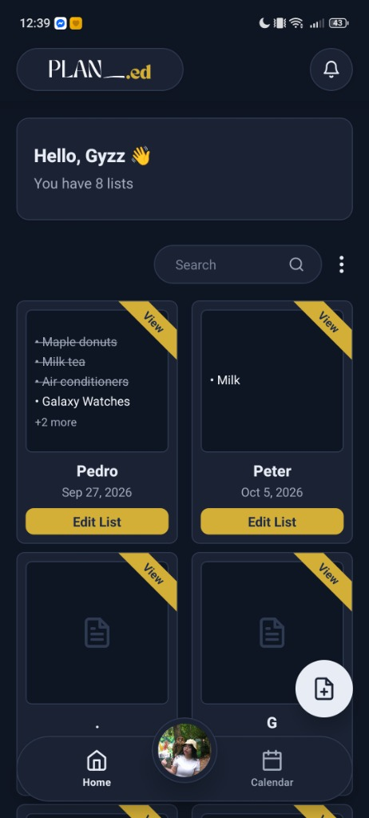
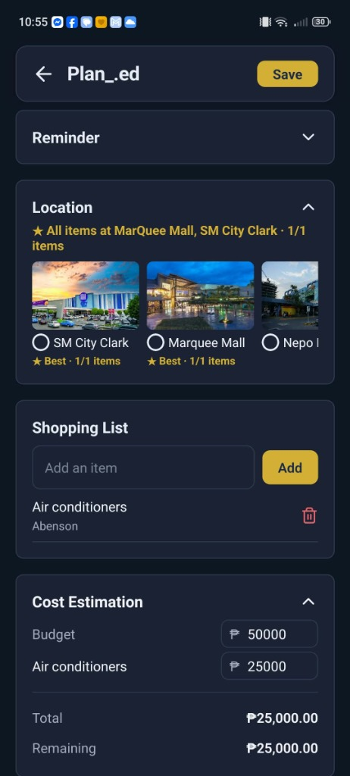
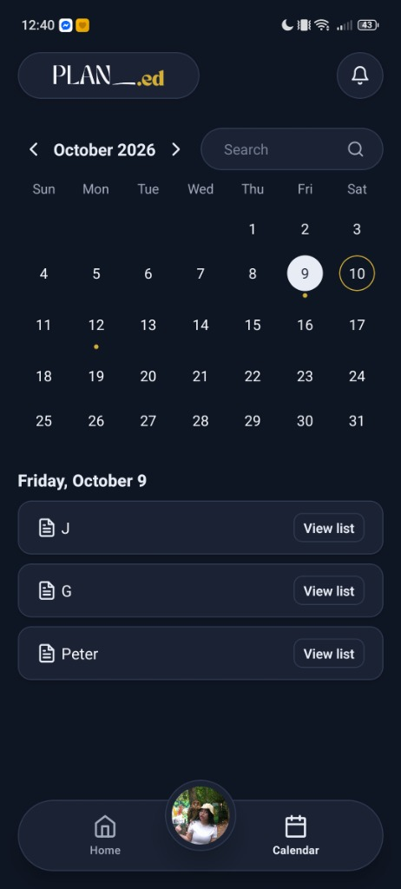
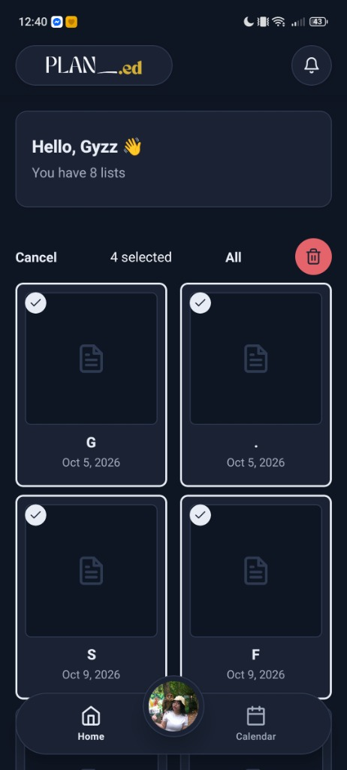
FEATURES & DEMO
Live Application Demo: Core Features
1. Home & Lists
2. 4 Malls & ₱ Budget
3. Errand Calendar
4. Smart Batch Tools
Adaptive two-column grid with search, custom list tags & 60 FPS scroll.
SM Clark, MarQuee, Nepo, Newpoint with running cost estimates in PHP.
Interactive monthly trip scheduling with native device reminder alarms.
Multi-select list management, batch trash, and quick sorting options.
Notes:
Here is the live app walkthrough:
1. Home Dashboard: Displays our adaptive list grid with collapsing header and instant search.
2. Mall Directory & Budgeting: Lets shoppers select between SM City Clark, MarQuee Mall, Nepo Mall, and Newpoint Mall, with live cost estimations in Philippine Pesos.
3. Errand Calendar: Shows scheduled shopping dates and native reminder alarms.
4. Batch Tools: Supports multi-select list deletion and sorting by date or last opened.

Slide 5
TECHNICAL ARCHITECTURE
Full-Stack Architecture & Technology Stack
FRONTEND MOBILE
React Native 0.86 & Expo SDK 57
File-based navigation with Expo Router, atomic design system (atoms, molecules, organisms), Safe Area Context, and custom ThemeContext (Light & Dark modes).
BACKEND & AUTH
Supabase & PostgreSQL
Relational database modeling malls, stores, lists, and items with Row-Level Security (RLS) policies guaranteeing multi-tenant data privacy.
STORAGE ENGINE
AsyncStorage Cache
Stale-While-Revalidate caching pattern delivering instant offline launch times with seamless background PostgreSQL synchronization.
DEVICE APIS & BUILD
Expo Notifications & EAS
Native exact alarm triggers (SCHEDULE_EXACT_ALARM), Expo Image Picker for avatars, and EAS Build generating standalone Android APKs.
Notes:
For our architecture, we chose Expo SDK 57 and React Native for performance and cross-platform consistency. Data is secured via Supabase PostgreSQL using Row-Level Security, backed by client-side AsyncStorage for offline support.

Slide 6
THE 80/20 RULE
AI Pair-Programming & Developer Ownership
How Claude Was Utilized
- Interactive pair-programming assistant for code reviews and architectural advice.
- Refactoring tricky algorithmic state transitions and notification channel setups.
- Generating initial seed templates and EAS build profiles.
- All code was reviewed, debugged, and verified under real-device testing.
What I Wrote Myself (>20%)
- Atomic UI component system (atoms, molecules, organisms) in Navy (#1B2A4A) & Gold (#D4AF37).
- PostgreSQL relational schema and curated directories for all 4 Pampanga malls (SM City Clark, Marquee Mall, Nepo Mall, and Newpoint Mall).
- Expo Router file-based navigation, modal sheets, and safe-area responsive layouts.
- Detailed in AI-USAGE.md with exact GitHub commit hashes.
Notes:
Following the 80/20 rubric, Claude served as an interactive pair programmer. However, all core frontend component architecture, local mall data modeling, and theme styling were authored and directed by me, as detailed in our AI-USAGE documentation.

Slide 7
CHALLENGES & DEBUGGING
Technical Challenges & AI Bugs Caught
[!] Scroll Jitter in Animated Header (Commit f176920)
Bug: AI attempted to animate layout height (48 -> 0) and vertical margin inside FlatList, forcing Yoga engine re-measure feedback loops.
Fix: Refactored to non-layout opacity (1 -> 0) and scale transforms, keeping layout dimensions fixed for solid 60 FPS scrolling.
[!] EAS Asset Schema Validation in app.json (Commit c4af20e)
Bug: AI configured icon and adaptiveIcon pointing to a .jpg file, failing Expo schema validation during cloud Gradle build.
Fix: Audited project assets with expo-doctor and updated app.json to 1024x1024 .png format, restoring 21/21 passing checks.
[!] Brevo SMTP Integration & Terms Agreement (Commit 24845d4)
Bug: Sandbox limitations blocked verification delivery; nested Pressable caused double-toggle checkbox glitch.
Fix: Integrated Brevo relay credentials and built a dedicated Terms & Policies modal with atomic toggle state.
Notes:
We didn't take AI suggestions blindly. For example, when the AI's header animation caused violent list jitter, I analyzed the Yoga engine behavior and refactored the interpolation to use non-layout opacity and scale properties instead.

Slide 8
WHAT IS NEXT
Future Roadmap: What is Next for Plan_.ed
In-Mall Floor Navigation
Step-by-step indoor mapping to locate stores inside SM City Clark, Marquee Mall, Nepo Mall, and Newpoint Mall directly on the screen.
Barcode & Receipt Scanning
Camera integration using Expo Camera to scan product barcodes for instant price lookup and automatic checklist checking.
Real-Time Shared Lists
Collaborative shopping lists enabling family members or errand partners to edit lists simultaneously via Supabase Realtime.
Smart Errand Route Optimizer
Automated sorting algorithm that arranges checklist items based on physical store proximity to minimize walking distance.
Notes:
Looking ahead, our next steps include integrating indoor mall maps for navigation, barcode scanning for instant price logging, and real-time shared family checklists. Thank you for listening, and feel free to try our APK build!

