Slide 1



Following the Fusion Network in the Crust of Accreting Neutron Stars
Amber Lauer, Louisiana State University Dept. of Physics & Astronomy, Baton Rouge, LA, 70802
Fei Yuan, Michigan State University Dept. of Physics & Astronomy, East Lansing, MI, 48824
Tsunghan Yeh, University of Illinois, Dept. of Physics, Urbana-Champaign, IL, 61801

Slide 2
Abstract
Xnet uses various methods to solve the nuclear network differential equation. We applied this method to the X-ray burst using the formulation devised by Fisker in 2007[1]. The major component of this formulation was the temperature profile, which is created using various observables and basic physics arguments. Using this profile, we varied the initial abundances to observe the nucleosynthesis over time as well as gauge burst efficiency in the form of the ratio of initial and final H abundance. In addition, previously created python scripts for reading the special binary output file were modified and refined to a useful and valuable tool to complement XNet. In addition the files necessary to run the specific XRB example were modified and repackaged to be a standalone version of Xnet suitable for reuse.
Notes:
*Pikachu was critically hit by wall of text*
*Pikachu has fainted!*

Slide 3
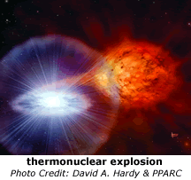
X-ray Burst Scenario
H and ⁴He-rich material falling from companion star
Burning through steady fusion process while sinking
Heating up the NS surface to ignite ¹⁵O(α;γ)¹⁹Ne
Gateway between hot CNO cycle and rp-process
Powering a bright X-ray flash

Slide 4
Temperature Profile Theory
Radiative flux: F ~ σ T⁴
Upper & lower limit: flux & heavy burning
>3α heavy Coulomb-suppressed
basic shape from assumptions & observables
H & He hot CNO
ramp up
hot CNO→ burst
radiative cooling/H burning

Slide 5
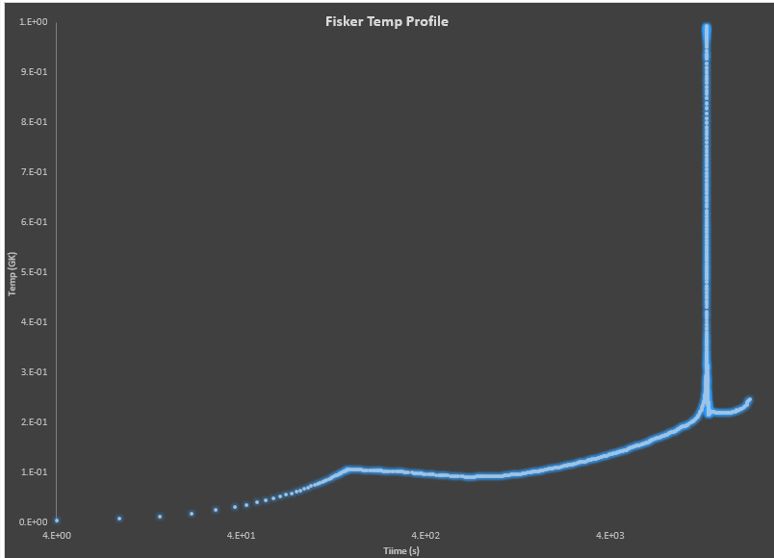
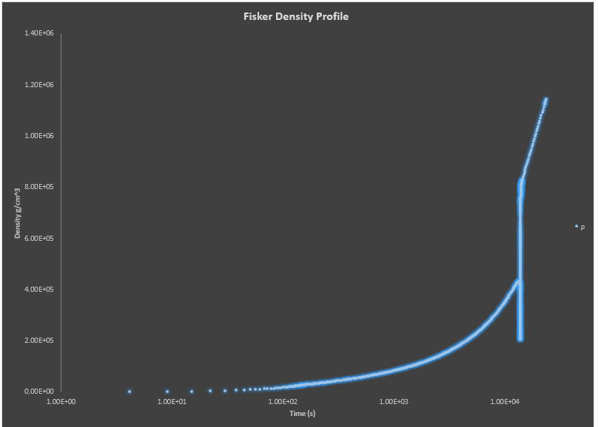
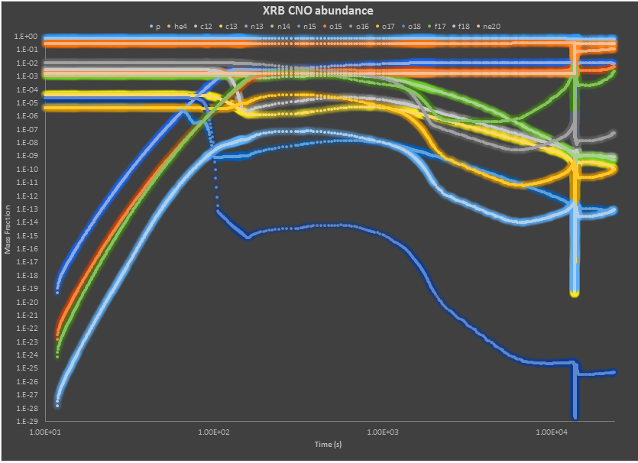
Temperature & Density Profiles
[1]

Slide 6
Experimental Design: Code
XNet: differential equation (DE) solver implemented using matrix operations
Choice of DE solver:
Backward Euler method
Bader–Deufelhard
Choice of matrix solver:
Lapack
Pardiso
MA28
MA48
GPU
Parallelization:
MPI
OpenMP
GPU

Slide 7
Experimental Design: Code
Took existing Python scripts for rendering graphs and nuclide chart animation[3,4] streamlined compiling and rendering
Reorganized and modified code and control files for a standalone X-ray burst (XRB) implementation of XNet
Wrote makefile for both Xnet and Reactionlib to unify installation

Slide 8
Experimental design: Inputs
Networks:
sunet
sunet.xrb
sunet provided by W. R. Hix
Thermal profile:
Fisker et al. (2007): "xnet folder"/test/Test_Problem/
Reaction rate library:
https://groups.nscl.msu.edu/jina/reaclib/db
Multiple abundance files
solar abundance data by Lodders et al. (2009)
half solar metallicity (various ratios H/He)
no metallicity (various ratios H/He)
full abundance file provided by W. R. Hix

Slide 9
Goal
How do the initial abundances affect the reactions in an X-ray burst?
Can we model a full reaction network burst?
Notes:
F

Slide 10
Output files
ev*: ASCII, max 14 nuclides
tso*: binary, all nuclides
decoded with Python (tip-o-hat → Kevin)https://github.com/xrf/talent-astro-proj2/blob/master/tso_reader.py
plot with Matplotlib
generate animation (tip-o-hat → Kaitlin)https://github.com/xrf/talent-astro-proj2/blob/master/plot-chart
uses (A, Z) data (tip-o-hat → Alison)
Notes:
F

Slide 11
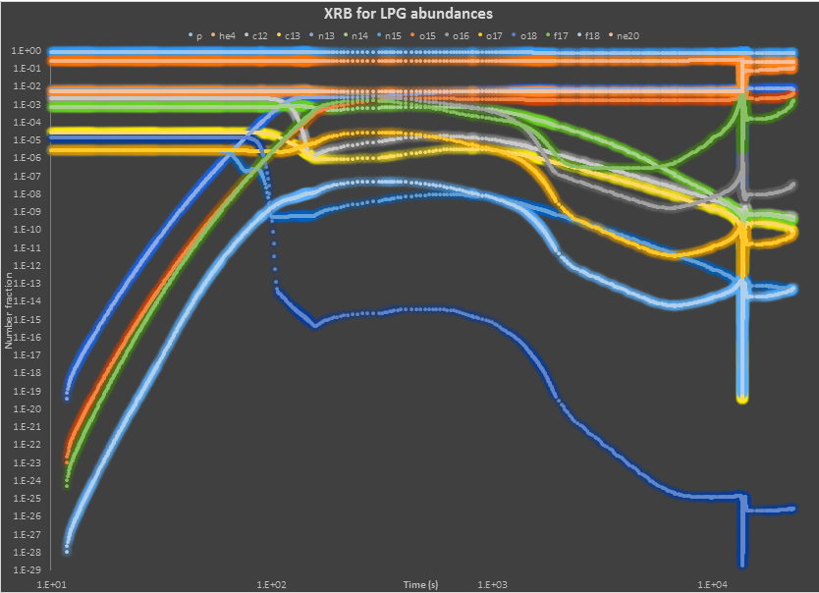
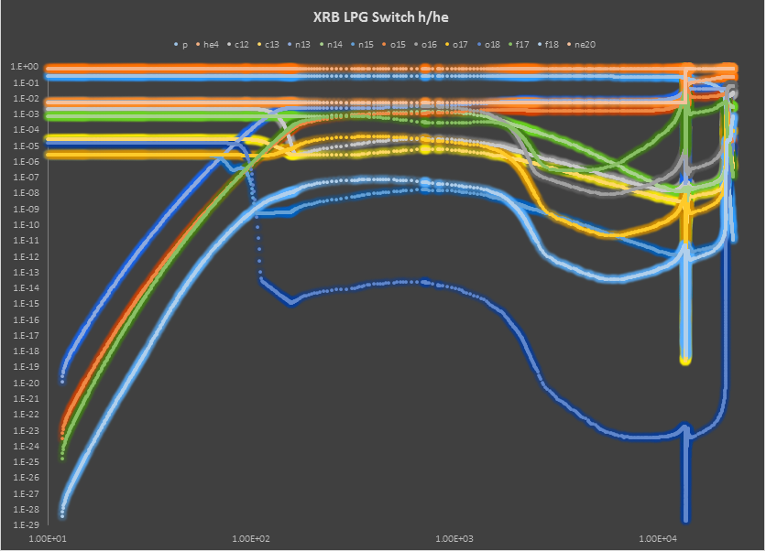
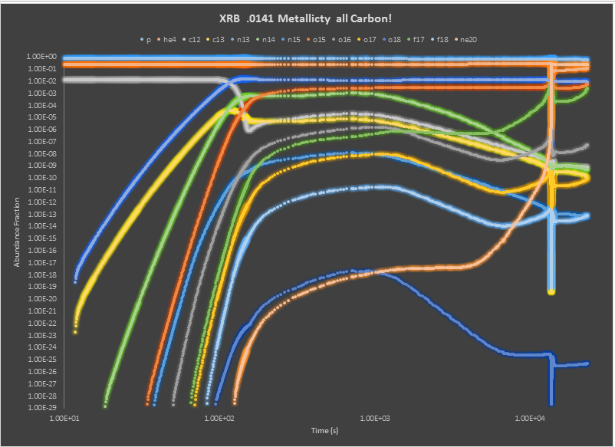
Toy Models
← Small CNO
network
Updated Solar Abundances →
← Updated solar abundances
switch H/He
Solar metallicity all carbon →

Slide 12
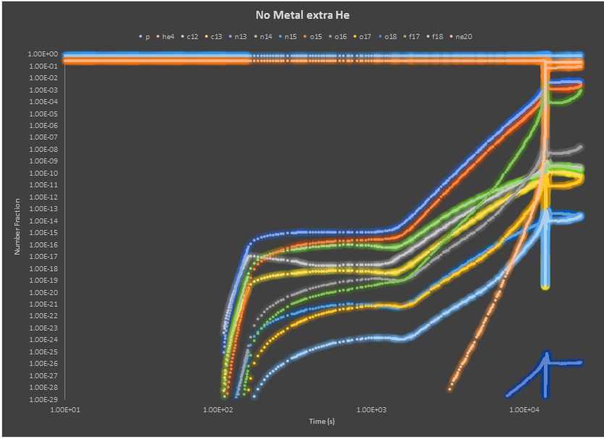

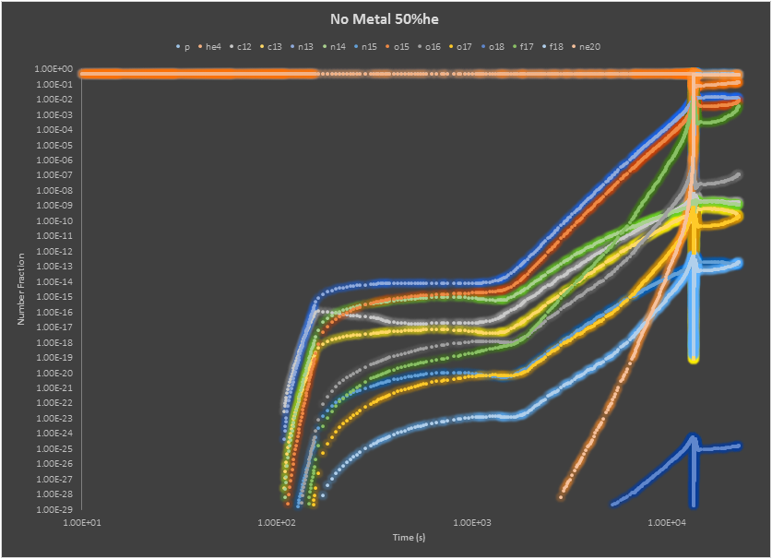
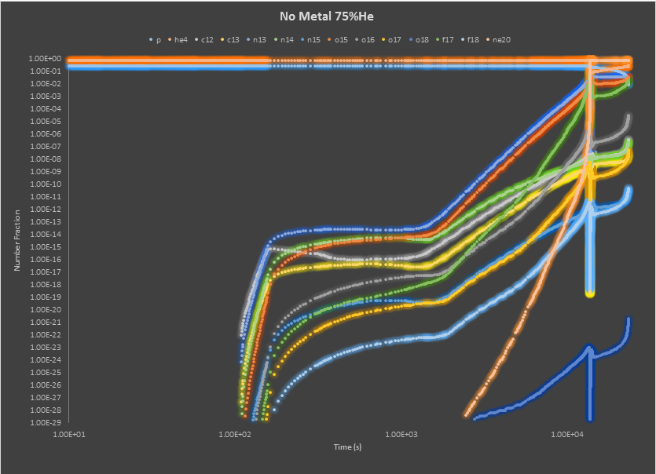
No Metal
Toy Model
<=Extra number fraction in He
25% He=>
<=50% He
75% He=>

Slide 13
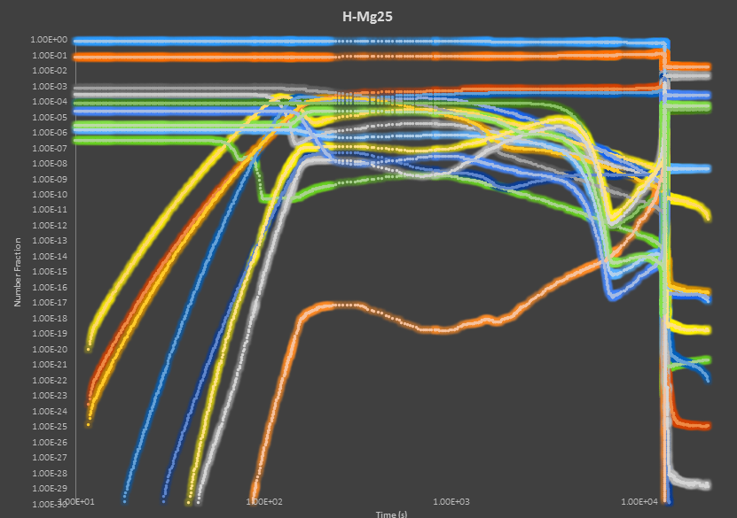

Slide 14
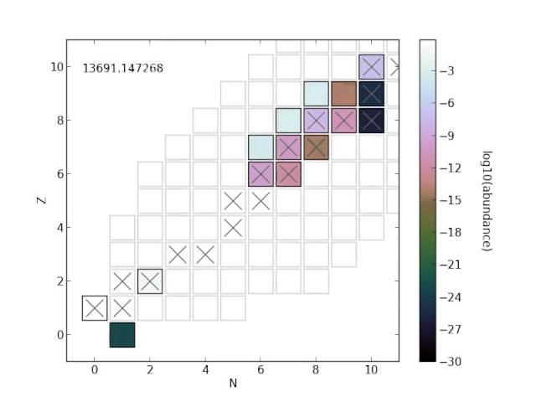
Notes:
F

Slide 15
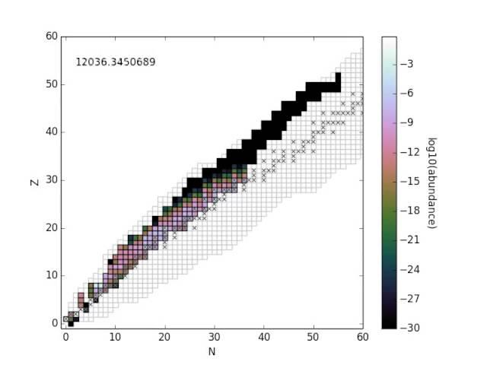

Slide 16
Conclusions
Since the initial X-ray burst is dependent on so few nuclei, almost no configuration can stop the burst behavior in a toy model.

Slide 17
References
[1] J. L. Fisker, W. Tan, J. Görres, M. Wiescher, and R. L. Cooper, The Astrophysical Journal 665, 637 (2007). http://dx.doi.org/10.1086/519517
[2] Kaitlyn Cook, https://github.com/KJCook/sedov-solution
[3] Kevin Siegl, http://goo.gl/ghtj51
[4] K. Lodders, H. Palme, and H.-P. Gail, (2009).
[5] Alison Dreyfuss, http://goo.gl/JF78Yu

