Slide 1



BAO la Kiswahili – the East African Board Game
Setup:
Each player owns one half of the board consisting of 2 rows with 8 bowls each. Each bowl takes 2 stones. The first row is the one next to the opponent’s bowls.
Move selection:
A player selects one of his bowls containing at least 2 stones for starting his move.
Then he selects one of the neighbor fields to determine the direction of the move.
The move can be canceled by selecting the same field again.
Move execution:
All stones from the selected bowls are taken and then starting with the selected neighbor field, they move around the player’s 2 rows in a circle, leaving 1 stone in each bowl. When the last stone is put into its bowl, the move either stops if it was empty before, or continues in the same way, by emptying the respective bowl and move further in the same direction, leaving stones in each bowl. If the latter happens with a bowl in the player’s first row and the opponent has stones in the directly adjacent bowl, they are taken as well for the move.
End of game:
A player has lost if his first row is empty, or he has no bowls left with more than 1 stone.
v1.0, 01/2021 Alexander Rühl,
alex@geziefer.de
BGA: Alex_tgiu

Slide 2
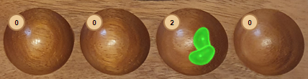
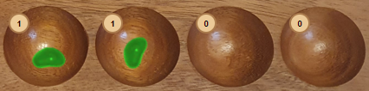
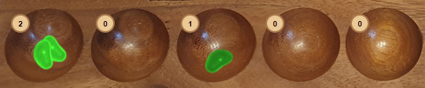
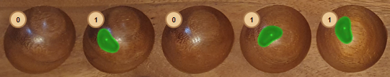
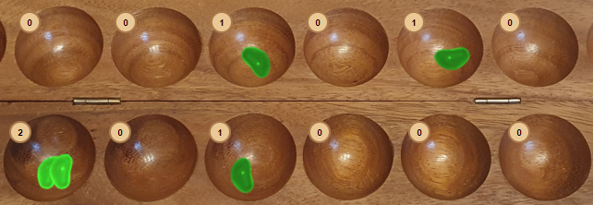
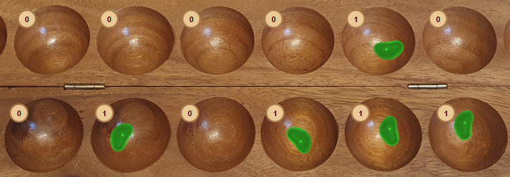
BAO la Kiswahili – the East African Board Game
Example moves:
(1) Bowl A is selected with 2 stones and direction left. Now bowl A is emptied and stones move to the left, filling bowls B and C with 1 stone each.
(2) Bowl A is selected with 2 stones and direction right. Now bowl A is emptied and stones move to the right, filling bowls B and C with 1 stone each. Since the move stops in bowl C which was not empty before, the move continues in the same way filling D and E.
(3) Same start situation as in (2), but now bowl C is opposite to opponent’s bowl X which is not empty. So not only the move continues, but also the stones from X will be emptied and take part in the move filling D, E and F.
C
B
A
A
B
C
D
E
X
v1.0, 0/2021 Alexander Rühl,
alex@geziefer.de
BGA: Alex_tgiu
A
B
C
D
E
F

