Slide 1
Principles of Database Design
CSGY6083
Final Project
Gerard Forster – gf2206@nyu.edu

Slide 2
Database use Case – The Fancy Hotel
For my Final Project I’ve built a Hotel Management System for the staff of the fictitious Fancy Hotel. It is used to register guests, check them into rooms, and prepare their final bill. It is full of time-saving features like a function that finds a vacant room matching the room type a guest wants at check-in, a stored procedure that calls this function, and also assigns it to the guest and sets the status of the room to occupied so the room doesn’t get double-booked. There are also many triggers working behind the scene that do things like automatically enrolling guests in the rewards program when they are registered, and rewarding points to the guest on check in. Join me as I walk you through my small, but Fancy, hotel.

Slide 3
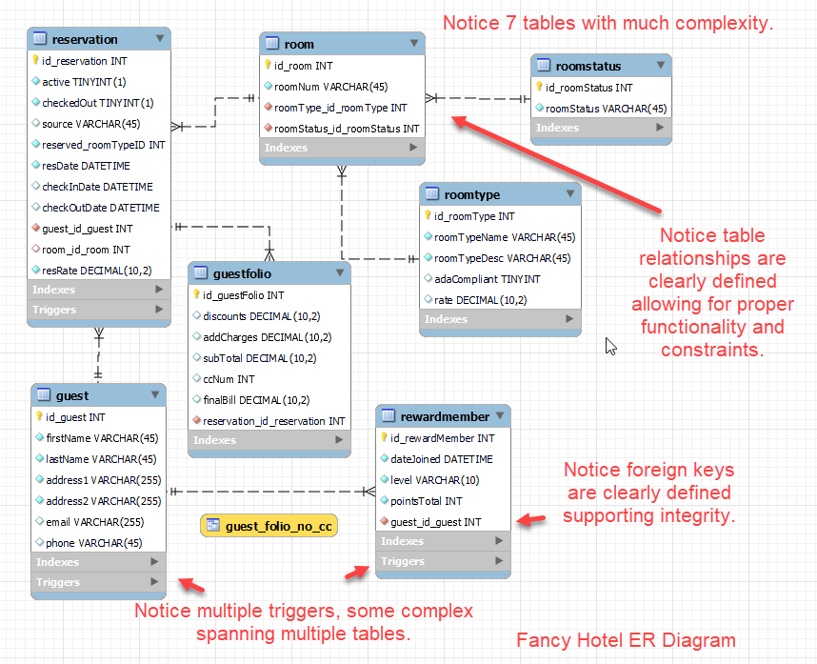
ER Diagram
7 Complex Tables
Multiple Complex Triggers
Clearly defined relationships between tables.
Foreign keys clearly defined to support integrity.

Slide 4
Demonstrate the Fancy Hotel Management System
Show CRUD operations on tables.
Show the Complex VIEW I’ve created that allows staff to view guest bills data that combines information from multiple tables yet does not show credit card information.
Show the PROCEDURE I’ve created that executes multiple complex tasks when a guest checks in like assigning a room and marking it occupied.
Explain the complex FUNCTION I’ve created that searches through a list of vacant rooms matching a guest’s desired room type and selects the lowest number room so it can be assigned to the guest.
Show several complex TRIGGERS I’ve created that automatically update multiple tables after a guest checks in, or checks out, etc.
Given these demonstrations I believe I’ve satisfied all the requirements to receive a exceptional score of 6 in each part of the Rubric.

Slide 5
Normalization – 4NF
According to the website guru99.com, Normalization is a database design technique that reduces data redundancy and eliminates undesirable characteristics like Insertion, Update and Deletion Anomalies. Normalization rules divides larger tables into smaller tables and links them using relationships. The purpose of Normalization in SQL is to eliminate redundant (repetitive) data and ensure data is stored logically.
For my project, I have designed it to be in Fourth Normal Form (4NF). How do I know? Well, to be 4NF, it must satisfy the requirements of all the forms below it.
1NF requires that each column contains atomic (indivisible) values, and each record is unique. My database does this.
2NF further requires that we remove redundant data from a table that is being applied to multiple rows and placing them in separate tables. It requires all non-key attributes to be fully functional on the primary key. Check.
3NF Extends 2NF by ensuring that all non-key attributes are not only fully functional on the primary key but also independent of each other. I have NO non-key columns in my database that if I change them would change another non-key column data.
If no database table instance contains two or more, independent and multivalued data describing the relevant entity, then it is in 4th Normal Form. You’ll notice that in my database, I had to spilt up the room, roomtype and roomstatus tables to keep with this level of Normalization.

Slide 6
Integrity Enforcement
There are several places throughout my database and application design where I enforce data integrity.
For example, the foreign key CONSTRAINTS in most of my tables are set to ON DELETE NO ACTION AND ON UPDATE NO ACTION. This prevents things like deleting a guest that has a reservation.
I’ve also added my own additional level of CONTRAINTS directly in the database. In fact, since for reporting reasons it might be important to have phone numbers entered in a particular format, say 444-444-4444 or 4444444444 but NOT (444)-444-4444, I’ve created a constraint on the phone column in the guest table that uses a regex expression to create a mask that they data entry must meet.
I’ve also used my php code to enforce the format of how an email is entered by setting the data type to email rather than text.
See demo.

Slide 7
ISOLATION Level
I used the phpMyAdmin tools available in the hostinger.com platform. According to their documentation, the database is MariaDB and the default Isolation Level is REPEATABLE READ.
According to postgresql.org,The Repeatable Read isolation level only sees data committed before the transaction began; it never sees either uncommitted data or changes committed by concurrent transactions during the transaction's execution. This is good for most of my application, but there is one instance where I changed the ISOLATION LEVEL
When a guest checks into the hotel, it is important that 2 guests are assigned to the same room. So, in the stored procedure I created called p_checkin, I’ve set the Transaction Level Isolation Level to SERIALIZABLE.
See demo of code.

Slide 8
Remaining items on rubric
Table Inserts – These were clearly demonstrated in my demo of the system and the reviewer can test themselves using the links on the next page.
Table Updates – Also clearly demonstrated in my walk-through of the system.
Table Deletes - Also clearly demonstrated in my walk-through of the system.
Selects – Many of the web pages are include complex Select statements of all the tables, so I feel I’ve demonstrated this quite well. My PHP and database code also supports this.
Reports – I have a couple of reports that I deliver by calling on them in my php code - view.php and report.php. You’ll notice they feature aggregation and cross multiple tables.

Slide 9
Links
Link to NYU Stream where I uploaded my video.
https://stream.nyu.edu/media/GForster-PrinciplesOfDatabaseDesign/1_m09m6sa0
Link to Hostinger Platform where you can play with the Fancy Hotel Management System
https://magenta-mallard-276939.hostingersite.com/test/main.htm
Link to github repository containing all supporting files for this project:
https://github.com/gf2206/CS-GY6083/tree/main

