Slide 1
The SPARQL query language for RDF
Gilles Falquet

Slide 2
Main idea: Querying by pattern matching
rdf:type
:Volcano
?x
rdf:type
:Mount_Etna
rdf:type
:Volcano
:Naples
:Vesuvius
:near
Pattern
:in
:population
Results
?x
:Vesuvius
:Mount_Etna
:Italy
967068
Graph

Slide 3
Main idea: Querying by pattern matching
rdf:type
:Volcano
:Naples
?x
:near
:Mount_Etna
rdf:type
rdf:type
?y
:Naples
:Vesuvius
:near
Pattern
:in
:population
Results
?x | ?y
:Vesuvius | :Volcano
:Italy
967068
Graph

Slide 4
Main idea: Querying by pattern matching
rdf:type
:Volcano
:Naples
?p
:Mount_Etna
rdf:type
?v
:Naples
:Vesuvius
:near
Pattern
:in
:population
Results
?p | ?v
:in | :Italy
:population | 967068
:Italy
967068
Graph

Slide 5
SPARQL – based on graph patterns
Triple pattern a triple from
(RDF-Term ∪ Var) × (IRI ∪ Var) x (RDF-Term ∪ Var)
RDF-Term : IRI or literal or blank
Var : variable
Graph pattern
a set of triple patterns
Same syntax as Turtle + Variables
{?x rdf:type :Volcano}
{?x :near :Naples. ?x rdf:tye ?y}
{ :Naples ?p ?v}
{ ?x ex:address _:adr . _:adr ex:city ex:Madrid }

Slide 6
SPARQL Basic Graph Pattern Query
prefix definitions
select output variables
[ from graph ]
where { basic graph pattern }
PREFIX rdf: <http://www.w3.org/1999/02/22-rdf-syntax-ns#>
PREFIX : <http://cui.unige.ch/geo/>
SELECT ?x ?y
WHERE {?x :near :Naples. ?x rdf:tye ?y}

Slide 7
Definition: Basic Graph Pattern Matching
Let BGP be a basic graph pattern and let G be an RDF graph.
μ is a solution for BGP from G when
there is a pattern instance mapping P such that P(BGP) is a subgraph of G
P maps variables and blank nodes to RDF-terms
and μ is the restriction of P to the query variables in BGP.

Slide 8
Example
:p
:a
:b
On the graph
:a :p :b. :a :p _:w. :b :q _:w. _:w :q :b
solutions for { ?x ?y :b }
solutions for { ?x :p ?y . ?y :q ?z }
solutions for { ?x :p _:h . _:h :q ?z }
:q
:q
:p
_:w
?x | ?y
:a | :p
_:w | :q
?x | ?y | ?z
:a | :b | _:w
:a | _:w | :b
?x | ?z
:a | _:w
:a | :b

Slide 9
Simple Graph Patterns are not Enough
Need to express
disjunctions (match this or that)
optional parts in patterns (match if possible)
negations (match this but not that)
conditions on variable values ( <, >, =, ...)
multiple paths (path expressions) in patterns
Need to process the results
combine the solution variables (+, -, ...)
aggregation functions (sum, average, ...)
ordering
grouping

Slide 10
Optional parts
{pattern₁ OPTIONAL { pattern₂ }}
Find solutions for { pattern₁ pattern₂ } and for { pattern₁ }
In the solutions for pattern₁ only, the variables that appear in pattern₂ only are unbound.

Slide 11
Example
:p
On the graph
:a :p :b. :aa :p :bb. :b :q :c.
The solutions of
{ ?x :p ?y OPTIONAL {?y :q ?z} }
are
:a
:b
:q
:q
:aa
:c
:p
:bb
?x | ?y | ?z
:a | :b | :c
:aa | :bb | UNBOUND

Slide 12
Union
To represent disjunctions
a solution to
pattern1 UNION pattern2
is a solution to pattern1 or to pattern2 (or both)

Slide 13
Example
"Find people who own a cat or a dog"
{?p a :Person. ?p :owns ?a. ?a a :Cat }
UNION
{?p a :Person. ?p :owns ?a. ?a a :Dog }
can be simplified by using group graph patterns
{?p a :Person. ?p :owns ?a. {{?a a :Cat} UNION {?a a :Dog}}}

Slide 14
Filtering with a boolean exprression
{pattern FILTER( expression ) }
retain only the solutions to pattern for which expression evaluates to true
Example
{ ?x a :Car. ?x :price ?p. ?x :category ?c
FILTER(?p < 10000 && ?c != :sport) }

Slide 15
Testing For the Absence of a Pattern
Data:
:alice rdf:type foaf:Person . :alice foaf:name "Alice" .
:bob rdf:type foaf:Person .
Query:
SELECT ?person
WHERE { ?person rdf:type foaf:Person .
FILTER NOT EXISTS { ?person foaf:name ?name } }
Query Result:
:bob

Slide 16
Testing For the Presence of a Pattern
Query:
PREFIX rdf: <http://www.w3.org/1999/02/22-rdf-syntax-ns#>
PREFIX foaf: <http://xmlns.com/foaf/0.1/>
SELECT ?person
WHERE { ?person rdf:type foaf:Person .
FILTER EXISTS { ?person foaf:name ?name } }
Query Result:
<http://example/alice>

Slide 17
Removing Possible Solutions
MINUS evaluates both its arguments, then calculates solutions in the left-hand side that are not compatible with the solutions on the right-hand side.
:alice foaf:givenName "Alice" ; foaf:familyName "Smith" .
:bob foaf:givenName "Bob" ; foaf:familyName "Jones" .
:carol foaf:givenName "Carol" ; foaf:familyName "Smith" .
SELECT DISTINCT ?s
WHERE { ?s ?p ?o . MINUS { ?s foaf:givenName "Bob" . } }
Results:
:carol
:alice

Slide 18
Relationship and differences between NOT EXISTS and MINUS
NOT EXISTS and MINUS represent two ways of thinking about negation
one based on testing whether a pattern exists in the data, given the bindings already determined by the query pattern,
one based on removing matches based on the evaluation of two patterns. In some cases they can produce different answers.

Slide 19
@prefix : <http://example/> .
:a :b :c .
SELECT * { ?s ?p ?o FILTER NOT EXISTS { ?x ?y ?z } }
No solutions because { ?x ?y ?z } matches given any ?s ?p ?o
SELECT * { ?s ?p ?o MINUS { ?x ?y ?z } }
There is no shared variable between the first part (?s ?p ?o) and the second (?x ?y ?z) so no bindings are eliminated.
Results:
:a :b :c

Slide 20
Property path
iri
^elt | inverse path
elt / elt | sequence
elt | elt | alternative
elt* | repetition (0...n)
elt+ | repetition (1...n)
elt? | option
!iri or !(iri₁| ...|iri_{n}) | negation
!^iri or !(^iri₁| ...|^iri_{n}) | negation of the inverse
!(iri₁| ...|iri_{j}|^iri_{j+1}| ...|^iri_{n})

Slide 21
Using property path to access lists
Recall that a list structure, written as
:france :flagColors (:blue :white :red) .
is an abbreviation for:
:france :flagColors [
rdf:type rdf:List ;
rdf:first :blue ;
rdf:rest [
rdf:type rdf:List ;
rdf:first :white ;
rdf:rest [
rdf:type rdf:List ;
rdf:first :red ;
rdf:rest rdf:nil ]]]

Slide 22
Some queries over such structures can only be solved by using property path expressions.¹
Find all the colors in the french flag
select ?c
where {:france :flagColors/rdf:rest*/rdf:first ?c }
Find the last color of the french flag
select ?c
where {:france :flagColors/rest* ?last.
?last rdf:rest rdf:nil. ?last rdf:first ?c }
1. Or with entailment regimes that take into account transitive properties

Slide 23
Accessing Trees
Example: a part is decomposed into subparts, sub-subparts, etc. linked through a :partOf property.
Display all the parts that belong to :b
select ?p where {?p :partOf* :b. }
If part :a belongs to part :b, display its part number
select ?pn where {:a :partOf* :b. :a :partNo ?pn }
What are the subparts of :b that have more than 10 subparts (at any level)
select ?p where {?p :partOf* :b.
filter count(select ?q where {?q partOf* ?p}) > 10 }
:b
:f
:c
:d
:a
:g
:e

Slide 24
RDF Datasets
Many RDF data stores hold multiple RDF graphs
A SPARQL query is executed against an RDF Dataset
An RDF Dataset comprises
the default graph, which does not have a name
zero or more named graphs identified by IRIs.
A SPARQL query can match different parts of the query pattern against different graphs
The graph that is used for matching a basic graph pattern is the active graph.
The GRAPH keyword is used to make the active graph one of all of the named graphs in the dataset for part of the query.

Slide 25
In SPARQL
PREFIX ...
SELECT ...
FROM <...> # add this graph to the default graph of the query dataset
FROM NAMED <...> # add this graph as a named graph of the query dataset
WHERE { ... }

Slide 26
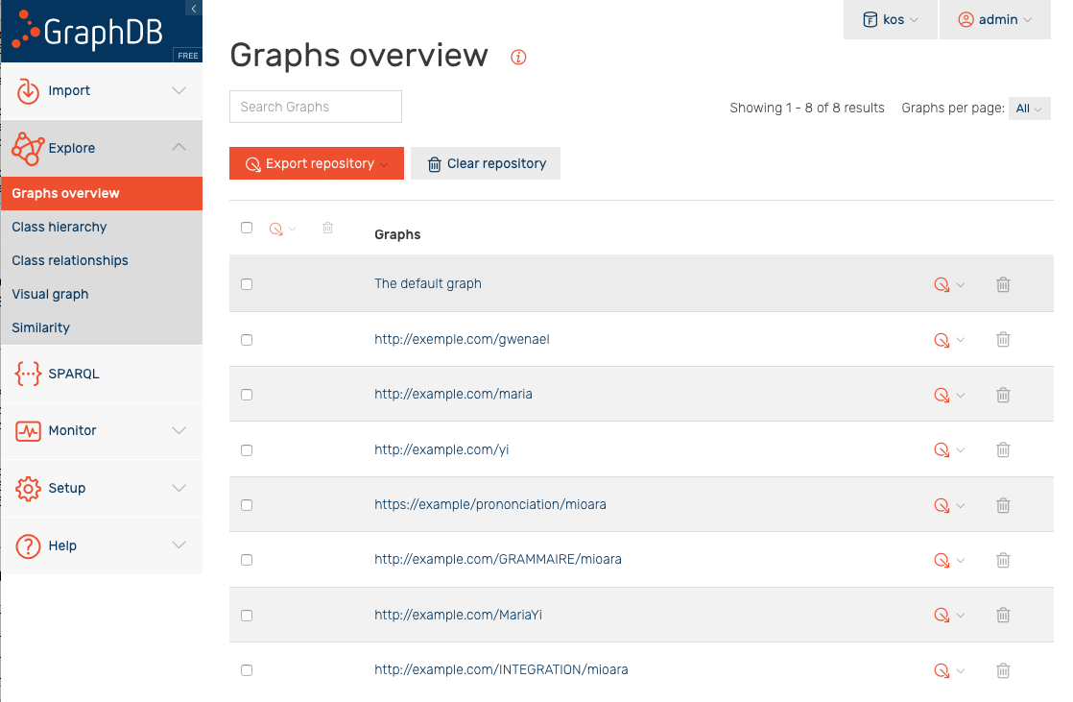

Slide 27
select (count(*) as ?nbTriples)
from <http://exemple.com/gwenael>
where { # query the default graph
{?s ?p ?o .}
}
Results
nbTriples
4562

Slide 28
select (count(*) as ?nbTriples)
from <http://exemple.com/gwenael>
from <http://example.com/maria>
where { # query the default graph
{?s ?p ?o .}
}
Results
nbTriples
7066

Slide 29
select (count(*) as ?nbTriples)
from named <http://exemple.com/gwenael>
where { # query over the default graph
{?s ?p ?o .}
}
Results
nbTriples
0

Slide 30
select (count(*) as ?nbTriples)
from named <http://exemple.com/gwenael>
where {
graph <http://exemple.com/gwenael> {?s ?p ?o .}
}
Results
nbTriples
4562

Slide 31
select (count(*) as ?nbTriples)
from named <http://exemple.com/gwenael>
from <http://example.com/maria>
where {
graph <http://exemple.com/gwenael> {?s ?p ?o .}
}
Results
nbTriples
4562

Slide 32
The default default graph is the merge of the graphs
select (count(*) as ?nbTriples)
where {
?s ?p ?o .
}
Results
nbTriples
18595

Slide 33
Blank nodes in graphs and results
Blank nodes are local
They have no URI
They cannot be "exported" to the answer
The answer mapping must "invent" blank nodes
ex:MITPress
ex:published ex:bk1 ;
ex:published _:2 .
select ?pub where {ex:MITPress ex:published ?pub}
Infinitely many possible answers ?
?pub
ex:every
_:u123
?pub
ex:every
_:cx323322
?pub
ex:every
_:abc

Slide 34
Scoping Graph – to avoid infinite answers
Since SPARQL treats blank node identifiers in a results format document as scoped to the document, they cannot be understood as identifying nodes in the active graph of the dataset.
If DS is the dataset of a query, pattern solutions are therefore understood to be not from the active graph of DS itself, but from an RDF graph, called the scoping graph, which is graph-equivalent to the active graph of DS but shares no blank nodes with DS or with BGP.
The same scoping graph is used for all solutions to a single query.

