Slide 1
Inference rules in DL and SWRL
G. Falquet C. Métral

Slide 2
Expressivity of DL
Vocabulary:
classes: Department, Employee, Building
properties: director, cto, office-location
How to define a class CompactDept to represent
departments that have their director and chief technology officer offices located in the same building
CompactDept ≡ ???

Slide 3
director
office-location
P-1
B-1
Dpt-1
office-location
rdf:type
cto
P-2
CompactDept
P-3
office-location
director
Dpt-2
P-4
B-2
not in CompactDept
cto
office-location

Slide 4
In DL (OWL 2)
Impossible to define CompactDept in OWL-2
Many other examples cannot be defined in OWL-2
Theoretical reason: most DLs enjoy the Tree Model Property.
if a Tbox has a model
then it has a model that doesn't contain cycles
A fact is a consequence of a Tbox if it is true in every model of the Tbox
⇒ no "cyclic fact" is a consequence of a TBox.
⇒ Need for a another language to express these facts

Slide 5

Inference rules
Rules to produce
New type assertions
$x$ is a member of class $C$
New property assertions
$x$ is connected to $y$ through property $p$

Slide 6
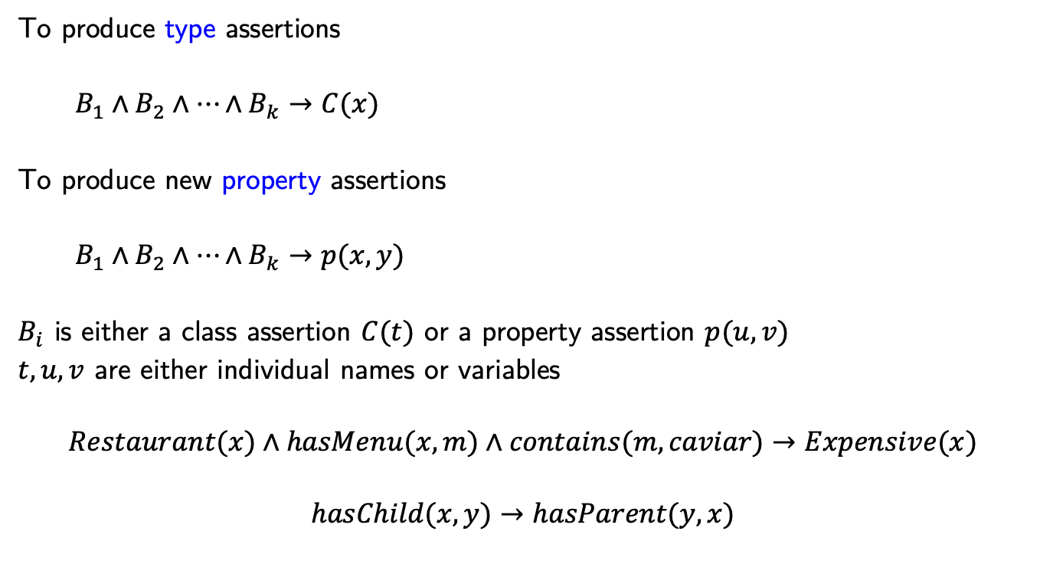
Inference rules
To produce type assertions
$B_{1}∧B_{2}∧…∧B_{k}→C(x)$
To produce new property assertions
$B_{1}∧B_{2}∧…∧B_{k}→p(x,y)$
$B_{i}$ is either a class assertion $C(t)$ or a property assertion $p(u,v)$
$t,u,v$ are either individual names or variables
$$Restaurant(x)∧hasMenu(x,m)∧contains(m, caviar)→Expensive(x)$$
$$hasChild(x,y)→hasParent(y,x)$$

Slide 7
SWRL Rules - syntax
rule ::= antecedant -> consequent
antecedant ::= atom, atom, ...
consequent ::= atom, atom, ...
atom ::= description '(' i-object ')'
| dataRange '(' d-object ')'
| individualvaluedPropertyID '(' i-object i-object ')'
| datavaluedPropertyID '(' i-object d-object ')'
| sameAs '(' i-object i-object ')'
| differentFrom '(' i-object i-object ')'
| builtIn '(' builtinID { d-object } ')'
Person(?x), Person(?y), Person(?z), hasChild(?x, ?y), hasChild(?y, ?z) -> hasGrandChild(?x, ?z)

Slide 8
Interpretation
Find all the variable bindings that satisfy the antecedent
For each such binding the consequent must be satisfied
hasChild(?x, ?y), hasChild(?y, ?z)
-> hasGrandChild(?x, ?z)
a
b
c
d
e
f
hasChild

Slide 9
Interpretation
hasChild(?x, ?y), hasChild(?y, ?z)
-> hasGrandChild(?x, ?z)
x=a, y=b, z=d -> hasGrandChild(a,d)
a
b
c
d
e
f

Slide 10
Interpretation
hasChild(?x, ?y), hasChild(?y, ?z)
-> hasGrandChild(?x, ?z)
x=a, y=b, z=d -> hasGrandChild(a,d)
x=a, y=c, z=e -> hasGrandChild(a,e)
a
b
c
d
e
f

Slide 11
Interpretation
hasChild(?x, ?y), hasChild(?y, ?z)
-> hasGrandChild(?x, ?z)
x=a, y=b, z=d -> hasGrandChild(a,d)
x=a, y=c, z=e -> hasGrandChild(a,e)
x=a, y=c, z=f -> hasGrandChild(a,f)
a
b
c
d
e
f

Slide 12
Interpretation
hasChild(?x, ?y), hasChild(?y, ?z)
-> hasGrandChild(?x, ?z)
x=a, y=b, z=d -> hasGrandChild(a,d)
x=a, y=c, z=e -> hasGrandChild(a,e)
x=a, y=c, z=f -> hasGrandChild(a,f)
a
b
c
d
e
f
an interpretation that
satisfies the rule

Slide 13
DifferentFrom
Variables with different names may represent the same individual !
hasChild(?x, ?y), hasChild(?x, ?z)
-> hasSibling(?y, ?z)
a
b
c
d
e
f

Slide 14
DifferentFrom
Variables with different names may represent the same individual !
hasChild(?x, ?y), hasChild(?x, ?z)
-> hasSibling(?y, ?z)
a
b
c
d
e
f

Slide 15
DifferentFrom
hasChild(?x, ?y), hasChild(?x, ?z), DifferentFrom (?y, ?z)
-> hasSibling(?y, ?z)
a
b
c
d
e
f

Slide 16
DifferentFrom
hasChild(?x, ?y), hasChild(?x, ?z), DifferentFrom (?y, ?z)
-> hasSibling(?y, ?z)
⚠ works only if
DifferentIndividual(b,c)
DifferentIndividual(e,f)
a
b
c
d
e
f

Slide 17
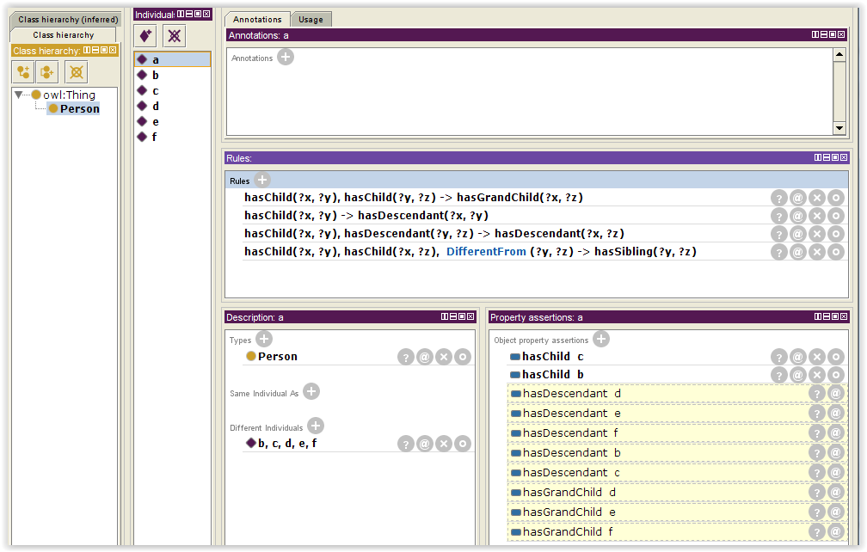
Example
hasChild(?x, ?y) -> hasDescendant(?x, ?y)
hasChild(?x, ?y), hasDescendant(?y, ?z) -> hasDescendant(?x, ?z)

Slide 18
DL-safe rules
Query answering for DL-axioms + rules is undecidable
It is decidable if rules are DL-safe
A rule r is called DL-safe if each variable in r occurs in a non-DL-atom in the rule body.
Practically: the variables in rules can only be bound to known individuals

Slide 19
Axioms:
TBox: Parent ≣ hasChild some Person
ABox: Parent(a), Parent(b), Parent(c), Person(d), hasChild(a,d)
Rule:
hasChild(?x, ?y) -> PersonWithChild(?x)
consequence:
PersonWithChild(a)
without the DL-safe restriction:
PersonWithChild(a), PersonWithChild(b), PersonWithChild(c)

Slide 20
Builtin predicates
To deal with numbers, strings, etc.
Rectangle(?x), hasWidthInMetres(?x, ?w), greaterThan(?w, 10)
-> WideRectangle(?x)
Rectangle(?x), hasHeightInMetres(?x, ?h), hasWidthInMetres(?x, ?w), greaterThan(?a, 100), multiply(?a, ?w, ?h)
-> LargeRectangle(?x)

Slide 21
swrlb:equal swrlb:notEqual swrlb:lessThan swrlb:lessThanOrEqual swrlb:greaterThan swrlb:greaterThanOrEqual

Slide 22
swrlb:add swrlb:subtract swrlb:multiply swrlb:divide swrlb:integerDivide swrlb:mod swrlb:pow swrlb:unaryPlus swrlb:unaryMinus swrlb:abs swrlb:ceiling swrlb:floor swrlb:round swrlb:roundHalfToEven
swrlb:sin swrlb:cos swrlb:tan

Slide 23
swrlb:stringEqualIgnoreCase
swrlb:stringConcat
swrlb:substring
swrlb:stringLength
swrlb:normalizeSpace
swrlb:upperCase
swrlb:lowerCase
swrlb:translate
swrlb:contains
swrlb:containsIgnoreCase
swrlb:startsWith
swrlb:endsWith
swrlb:substringBefore
swrlb:substringAfter
swrlb:matches
swrlb:replace
swrlb:tokenize

Slide 24
When you don't need SWRL: DL rules
Some SWRL rules can be encoded in OWL expressions
Example
Man(?x) ∧ hasBrother(?x,?y) ∧ hasChild(?y,?z) → Uncle(?x)
becomes
Man ⊓ ∃hasBrother.∃hasChild.⟙ ⊑ Uncle

Slide 25
it's sometimes tricky ...
NutAllergic(x) ∧ NutProduct(y) → dislikes(x,y)
NutAllergic ≡ ∃nutAllergic.Self
NutProduct ≡ ∃nutProduct.Self
nutAllergic o U o nutProduct ⊑ dislikes
U = universal property (x U y is always true)
U
nutAllergic
x
y
nutProduct

Slide 26
... more
dislikes(x,z) ∧ Dish(y) ∧ contains(y,z) → dislikes(x,y)
becomes
Dish ≡ ∃dish.Self
dislikes o contains– o dish ⊑ dislikes
dislikes
z
contains
x
dish
y
dislikes

Slide 27
Rules vs. SPARQL queries
Rules are “executed” globally
all rules must be satisfied simultaneously
Rules may have interactions
the outcome of a rule may trigger another one
SPARQL queries are executed independently

Slide 28
Simulating rules with queries
define a 'construct' query for each rule
repeat
execute each query
add the results to the RDF graph
until nothing new is created
parent(?x, ?y)∧ ancestor(?y, ?z) → ancestor(?x, ?z)
construct {?x ancestor ?z.}
where {?x parent ?y. ?y ancestor ?z.}

Slide 29
Simulating rules with queries
parent(?x, ?y)∧ ancestor(?y, ?z) → ancestor(?x, ?z)
repeat
construct {?x ancestor ?z.}
where {?x parent ?y. ?y ancestor ?z.}
until nothing new
Can be extremely inefficient

