Slide 1
Hybrid Power Failure Recovery
for Intermittent Computing
Gan Fang¹, Jongouk Choi², Changhee Jung¹
1. Purdue University, USA
2. University of Central Florida, USA
Notes:
Hi, this is Gan Fang from Purdue University. Today I’gona share our research work about energy harvesting systems.

Slide 2


Energy Harvesting Systems (EHS)
WiFi
RF
Solar
Notes:
Energy harvesting system is quite popular since it does not require any batteries. Instead, they collect energy from ambient sources, such as WIFI, radio frequency, and solar.

Slide 3






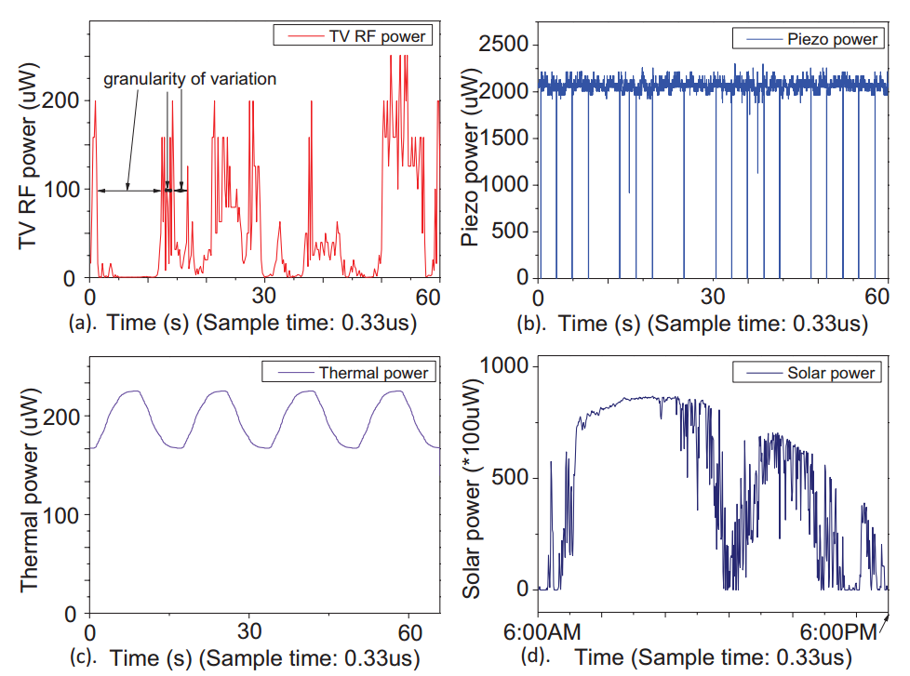
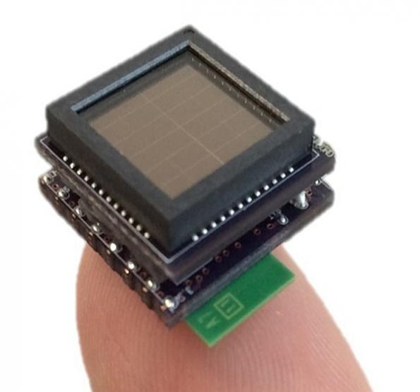
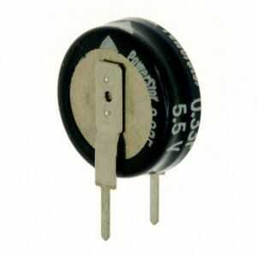
Overview of EHS
Collect energy
(device off)
Run program
(device on)
Ambient energy
Capacitor
(as energy buffer)
Energy harvesting system
[Ma,HPCA’2015]
Notes:
These energy are collected inside a [click] capacitor.
Once it is fully charged, [click] the system starts to run the program by consuming the energy in the capacitor.
When energy is fully depleted, it stops the execution to charge the capacitor again. And this cycle repeats forever.
The bad thing for ehs is that its energy sources may be [click] unreliable. [click] sometimes the input supply can be poor and much worse some other times.
As a result, these ambient energy sources can lead to frequent power outages.

Slide 4


Problem of Frequently Power Outages
Stagnation
∞
Timeline of program execution
: Power failure on which all volatile data is lost
Notes:
The problem is that
[click]
If a power failure happens in the middle of program execution, [click] all the volatile program status is gone. The only way the program can recover is to restart from the program beginning.
[click]
If the power failure happens again and again before reaching the end of program [click], program never finishes, causing a so-called stagnation problem. [click]

Slide 5



NVM & Crash Consistency Mechanism
Non-Volatile
Memory (NVM)
Crash Consistency
Mechanism
Notes:
To address this issue, ehs use [click] nvm as main memory to save data and [click] crash consistency mechanism for correct recovery across power failure.
In the literature, there are two types of crash consistency mechanisms
let’s take a look at the first one.

Slide 6
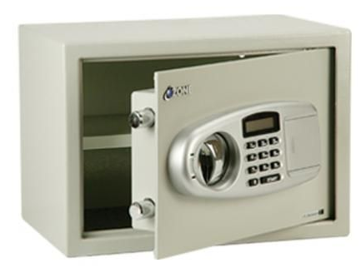



Roll-Forward Recovery
Registers
Checkpoint
NVM
Registers
Timeline of program execution
Notes:
[click] Rollforward persists registers [click] to the NVM right before a power failure—this is do-called just-in-time checkpointing
[click] When power comes back, [click] it restores these registers and resumes from the interrupted program point.
Let’s take a look at a typical example of rollforward recovery scheme

Slide 7
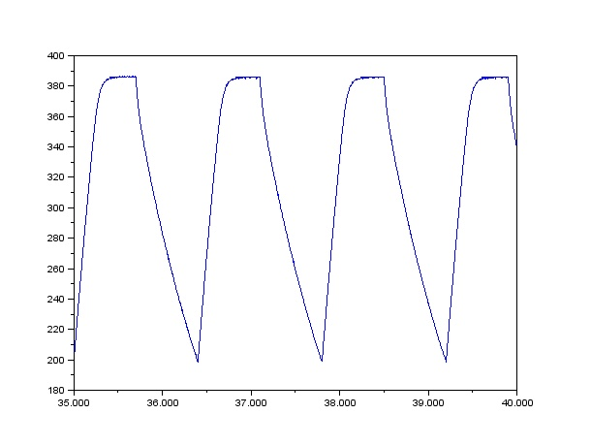
Non-Volatile Processor (NVP)
Vdd
NVP
Harvested
energy
Capacitor charge
Vbk
Voltage monitor
Vdd
Backup/recovery controller
Voff
Pipeline
NVM
Volatile register
NVFF
Time
[Ma,HPCA’2015]
Notes:
In this figure, we show the design of nonvolatile processor (NVP).
NVP equips a special backup storage for the register file [click], which is called a nonvolatile flip-flop (NVFF).
Each register bits has its neighouring NVFF, so that NVP can enable parallel checkpoint (restoration).
Now, Let’s ses the workflow details of NVP.
[click] when input voltage drops below backup threshold, [click] the voltage monitor will send a signal to stop the pipeline and inform the backup controller to checkpoint the entire RF.
[click] When the votlage rise above the restoration threshold, the voltage monitor will send another signal to restores the register from NVFF and then resumes the program from the interrupted point.

Slide 8
Roll-Forward: Advantage
Advantage:
No checkpointing overhead when the quality of energy harvesting is good and steady.
Capacitor charge
Vbk
Voff
Time
Notes:
Roll-forward recovery is very beneficial when the quality of energy harvesting is good and steady.
For example, as shown in the left figure, if the voltage is always above the backup thresholds, there is no need to stall the pipeline for any checkpoints.

Slide 9


Roll-Forward: Disadvantage
Disadvantage:
Secure a sufficient energy for JIT checkpointing all the time.
Capacitor charge
Vbk
Usable
Voff
Unusable
Capacitor
Time
Notes:
However, Rollforward has its limitations.
As power failure can happen at any moment,
rollforward must [click] secure sufficient energy in the capacitor all the time to ensure the successful checkpoints.
As a result, this limitation can make roll-forward recovery not fully use energy for forward progress in scenarios of poor energy harvesting.
So, people explore many rollback recovery schemes as a replacement. Let’s take a look at how rollback recovery works.

Slide 10


Rollback Recovery
Checkpoint
Potential memory inconsistency
NVM
Registers
Timeline of program execution
Notes:
Rollback recovery makes checkpoints of program state [click] along the way of execution.
Any time a power failure happens [click], it can restored to the most recent checkpoint and restart execution from there.
In particular, rollback recovery has to deal with idempotence violations resulting from write-after-read(WAR) dependence.
[click] The reason is that the re-execution of WAR can lead to memory inconsistency.
Let’s see an example of this inconsistency issue.

Slide 11
Memory Inconsistency
r: register
m: memory
Initial: m1 = 0
Reboot: m1 = 1
Checkpoint
r1 = m1
m1 = r1 + 1
Recover
r1 = m1
m1 = r1 + 1
Register → Persists upon JIT checkpoint
Memory → Persists when store commits
Expected: m1 = 1
Wrong: m1 = 2
Memory Inconsistency!!!
Notes:
Initially, m1 is 0 and after the second instruction, its value is updated to 1 in the NVM.
[click] At this moment, a power failure happens, the program is restarted from the checkpoint with m1 = 1. The resulting m1 after the re-execution becomes 2 [click] which is inconsistent with the expected value.
The reason for this inconsistent issue is that [click] registers and memory are persisted at different time. Let’s see another example to better understand this difference.

Slide 12
Memory Inconsistency
r1 = 0, m1 = 0
Init: r1 = 0, m1 = 0
Checkpoint1
1. r1 = r1 + 1
2. m1 = m1 + 1
……
……
Checkpoint2
Inconsistent:
r1 = 0, m1 = 1
m1 persists to 1
r1 persists to 1
r1 = 1, m1 = 1
Notes:
In this simple program, we increment both r1 and m1 by the same amount so that we can easily see the difference.
Initially, we assume that m1 and r1 [click] has persisted to 0 in the NVM.
After the second inst, [click] m1 persists to nvm again with value 1.
Finally, r1 [click] persists to 1 at the second checkpoint. At both checkpoints, r1 and m1 are consistent as our expectation.
We can see that r1 and m1 persist at different time.
If a power failure happens before checkpoint2, only m1 persist to 1 and r1 loses its value upon this failure, leading to an inconsistent state after restoration.
To adderss this memory inconsistent issue, existing rollback recovery, TCCP, use GSB to delay the memory persistence time until the next checkpoint.
Let’s see how this works.

Slide 13

TCCP
Checkpoint0
Memory consistent
Load [A]
Load [B]
…
Store [A]
Store [B]
…
Load [A]
…
Store [A]
…
Vdd
TCCP
A’
Harvested
energy
Voltage monitor
B’
Checkpoint1
Vdd
Backup/recovery controller
Pipeline
A’’
NVM
Reg
NVFF
A
SB
NVSB
B’
A’
B’
A’
B’
A’
13
Notes:
This figure shows the design of TCCP which almost shares the same architecture as NVP except that it has a SB and its NV backup.
Let’s see how it TCCP works.
[click] TCCP treats stores A and B as speculative and quarantines them in a SB, assuming no failure will happen. [click] When the SB becomes full, [click] TCCP will back up RF and SB to their nonvolatile counterpart. After that, [click] it resumes execution.
When power failure happens [click], TCCP will discard all quarantined stores in the SB. This design can avoid the issue of potential WAR dependencies.
In this example, we have WAR dependence in the re-execution, but TCCP already discards the modified value A’’ upon power failure, so the load instruction can get the correct value from NVM [click].

Slide 14
Rollback: Advantage
Advantage:
No need to secure high amount of energy always.
Capacitor charge
Voff
Capacitor
Time
Notes:
The advantage of rollback recovery is that it does not require securing the energy all the time.
Instead, it only needs to [click] secure energy right before each checkpoint.
So in poor and unstable energy environment, rollback recovery can leverage more hard-won energy for program execution.

Slide 15
Rollback: Disadvantage
Redundant!
Useful!
Disadvantage:
Redundant checkpoints when energy harvesting is good and steady.
Capacitor charge
Vbk
Voff
Time
Notes:
However, rollback also has its drawbacks.
since rollback recovery schemes make checkpoints without considering energy condition,
they can introduce high run-time overhead by making [click] redundant checkpoints when energy condition is good.
In this case, power failure rarely occurs, all these checkpoints become useless, except [click] for the last one to be used for the recovery of some future failure if it occurs.

Slide 16

Summary
Roll-Forward
Rollback
Roll-Forward
Rollback
Notes:
In summary, rollback and roll-forward recovery schemes only work well in their own world.
Due to the variation [click] of the energy harvesting quality, they will encounter unfriendly cases and suffer performance degradation.
So, we need a practical solution to adapt to different energy conditions.

Slide 17

Proposed Solution: RollSwitch
Switches between rollback (TCCP) and roll-forward (NVP).
Rollback mode
Roll-forward mode
Rollback mode
Roll-forward mode
At the end of each time quantum, selects suitable recovery modes, based on underlying energy harvesting condition.
Notes:
With NVP and TCCP, RollSwitch can easily make switches between rollback and roll-forward recovery modes, based on the underlying energy harvesting condition.
[click] When energy condition is poor, it will use rollback mode.
Otherwise, it will switch to rollforward mode.
To achieve this [click], we divide the program execution into a series of time quantums. At the end of each time quantum, it decides which recovery modes to use in the next time quantum.
To allow the seamless switching, it is important to select suitable recovery mode candicates.

Slide 18
Implementation
Checkpoint both registers and SB
RollSwitch = NVP (Roll-Forward) + TCCP (Rollback)
Rollback mode
Roll-Forward mode
Rollback mode
Roll-Forward mode
NVFF
NVSB
Notes:
In the implementation, we pick [click] NVP and TCCP for roll-forward and rollback recovery modes, respectively.
For seamless mode transition in between, we allow the SB to be used by NVP, i.e., [click] its JIT checkpoint persists both the REG and SB,
And [click] lets the two recovery modes share the same checkpoint storage, i.e., NVFFs and NVSB.
Thus, no matter which recovery mode encounters power failure [click], RollSwitch takes the same recovery process, which is the restoration of both REG and SB from the most recent checkpoint.
After deciding the recovery mode candidates, it looks like rollswtich can easily handle different energy conditions and switch between different recovery modes.
But unfortunately, there are two challenges that need to be considered before making it practical.

Slide 19



Challenges for RollSwitch
C1: How can a system know energy conditions?
C2: Crash consistency issues after switch?
Roll-forward
Rollback
Roll-forward
Notes:
The first challenge [click] is how can we know the energy conditions?
And the second one [click] is how to ensure crash consistency during the recovery mode switching.
For the first challenge, it is very hard to predict energy conditions directly since they are fluctuating all the time.
So we need some help to make this prediction easier.

Slide 20
C1: Energy Prediction
Counter++
(2-bit)
Predict
If MSB == 1:
Use roll-forward
else:
Use rollback
Yes
V>Vthres
No
Counter--(2-bit)
Easy to predict energy conditions.
Hard to
know energy conditions.
Vthres
Capacitor
Notes:
Recall that the system uses its capacitor to buffer harvested energy and power the execution, this implies that the capacitor voltage provides a real-time feedback on the current state of the energy condition.
[click] So we can use the capacitor voltage level as a proxy for energy condition and then make suitable recovery mode selection. This way, it becomes easier to predict energy conditions.
[click] To achieve this, we introduce a new voltage threshold and a 2-bit saturation counter as shown in the figure.
Let me show how this predictor works.
Then capacitor votlage is higher than threshold [click], we predict the energy condition is good and increment counter by one; Otherwise [click], we predict poor energy condition and decrease counter by one. Then we can use the counter value to determine the recovery mode.
[click], If MSB is 1, we use roll-forward. If it is 0, we use rollback.
Now, we solve the first challenge

Slide 21
Challenges for RollSwitch
C1: How can a system know energy conditions?
C2: Crash consistency issues after switch?
Roll-forward
Rollback
Roll-forward
Notes:
The second challenge is whether there is crash consisntency issue during recovery mode switch.
What happens if a power failure occurs right after switch?
To make the discussion clear, we categorize this challenge into two cases.

Slide 22
C2: Crash Consistency Issue
From rollback to roll-forward:
JIT handles failure as usual
→ No problem!
NVM
Consistent
Rollback mode
Roll-forward mode
Notes:
First case is switching from rollback to roll-forward mode.
Initially, we have a checkpoint in the rollback mode [click], and sometime later switch to rollforward mode [click].
In the roll-forward mode, JIT checkpointing [click] can handle power failure as usual.
So in the wake of power failures, it can always [click] guarantee crash consistency!

Slide 23
C2: Crash Consistency Issue
From roll-forward to rollback:
May have memory inconsistent issue
→ Crash inconsistency!
Potential memory inconsistency
NVM
Roll-forward mode
Rollback mode
Notes:
The second case is switching from roll-forward to rollback mode.
Initially, we have a JIT checkpoint [click] made in the rollforward mode, then we switch to rollback mode [click].
Before we make any checkpoints in the rollback mode, a power failure occurs [click]. In the wake of this failure, [click] it will be restored to previous JIT checkpoint and then restarted from there [click].
This might have some potential issues that are caused by WAR dependence.
Let’s take a look at an example.

Slide 24
C2: Crash Inconsistency Example
Roll-Forward
Rollback
Checkpoint0
Load [A]
Load [B]
…
Store [A]
Store [B]
…
Load [A]
…
Store [A]
…
Wrong! Should read but get A’.
A
A’
Vdd
RollSwitch
A’
Harvested
energy
Voltage monitor
B’
Vdd
Backup/recovery controller
Pipeline
24
A’’
NVM
Reg
NVFF
A
SB
NVSB
Notes:
Initially, program is running in the roll-forward mode, [click] writing stores to SB and achronously persisting them to NVM. After store [B] instruction, it switches to execute in the rollback mode [click] and then encounters a [click] power failure.
In this example, we only have one checkpoint as recovery point.
So when power come back [click], program will re-execute from checkpoint0.
The problem is that during the re-execution, this load instruction read the modified value A [click] from NVM. This value has been changed by the subsequent store before power failure, so it will make re-execution to be wrong.

Slide 25
C2: Crash Inconsistency Example
Roll-Forward
Rollback
Checkpoint0
Load [A]
Load [B]
…
Store [A]
Store [B]
…
Load [A]
…
Store [A]
…
Correct! A’’ is held in SB and never pollutes NVM.
A’’
Vdd
RollSwitch
Harvested
energy
Voltage monitor
Vdd
Checkpoint1
Backup/recovery controller
Pipeline
25
A’’
NVM
Reg
NVFF
A’
SB
NVSB
B’
B’
B’
Notes:
Our solution for this issue is quite simple.
We just need to make a checkpoint [click] right after switching to rollback mode and then [click] resume execution in rollback mode.
By doing that, [click] when the same power failure happens again, the system can be restored to checkpoint1 and restart from there.
This re-execution is protected by the crash consistency mechanism provided by rollback recovery;.
The reason is that the modified value A’’ completely disappears from the system upon power failure since it was quarantined in the SB and never been persisted to NVM
[click] During this re-execution, the load instruction can read the correct value from NVM and avoid crash inconsistency issue
Now, we have addressed all issues in RollSwitch. Let’s see its performance in the evaluation.

Slide 26
Experimental Setup
Gem5 (NVPSim)
Mibench + Mediabench
Competitors: Roll-forward recovery (NVP) + Rollback recovery (TCCP)
Energy traces: RFOffice, RFHome, solar and thermal
Notes:
In our evaluation, we implement our design on top of gem5 simulator, running with mibench and mediabench.
We compare Rollswtich against NVP and TCCP with four power traces from real energy harvesting systems.
Among these traces, RFHome and RFOffice have a higher portion of poor energy harvesting, while solar and thermal have more sufficient and steady portion of energy harvesting.
[prediction ratio]

Slide 27
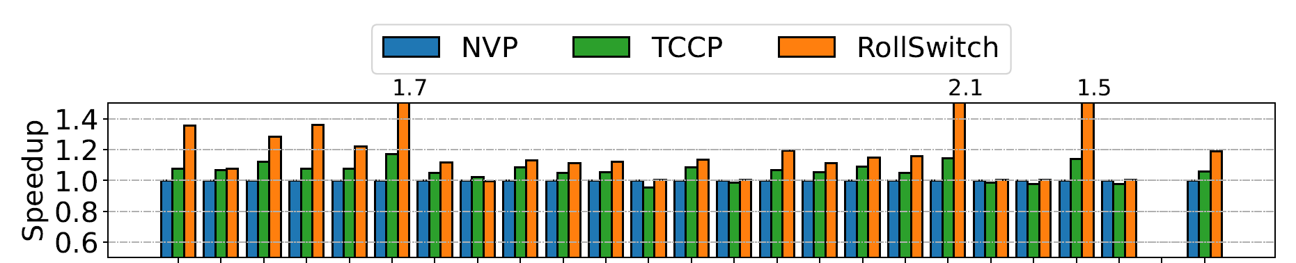
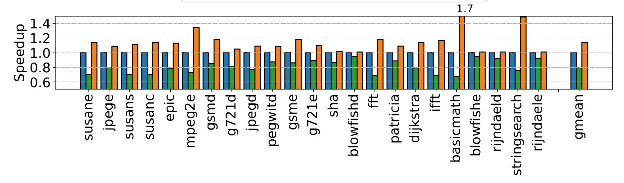
Performance
RFHome
thermal
Notes:
Here is the speedup of RollSwitch.
Overall, Rolswitch is always better than the other two schemes across all different energy conditions.
//On some traces like solar and thermal, NVP outperforms TCCP while on some other traces, TCCP is much better.

Slide 28
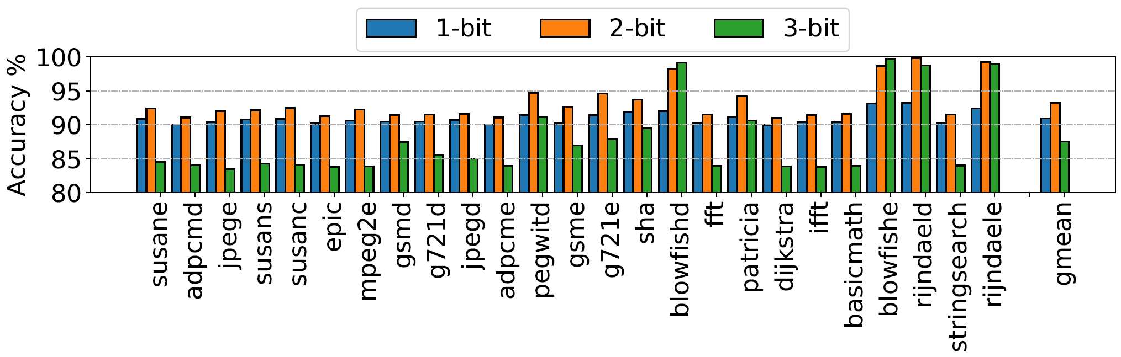
Accuracy
Notes:
Here is the prediction accuracy of RollSwitch.
Overall, Rolswitch achieves 93% prediction accuracy.

Slide 29
Conclusion
A hybrid power recovery approach for energy harvesting systems.
Integrates both rollback and roll-forward recoveries and dynamically switches between them.
Achieve a significant speedup over both recovery schemes.
Thank You Q&A
Notes:
This is the end of my talk, thanks for your listening.

Slide 30


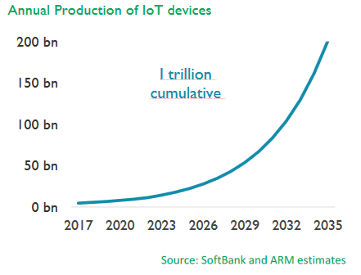
Battery is Not the Way to Go!
Batteries are bulky
Environmental-unfriendly
Cause significant maintenance cost
2
Notes:
We all know battery’s not environmental friendly. [click] And the large size of battery has always been a challenge for IoT device. Also these device is bottlenecked by battery; according to market projection here [point to the figure], the number of thses devices will reach 50 billion in the next 10 years. If they are all battery operated, there is a high matennance cost for just replacing the batteries.
So, energy harvesting systems emerged in response to these problems.

Slide 31
2. Rollback Recovery: TCCP
r1 = Load [m1]
r2 = Load [m3]
r1 = r1 + 1
Store r1, [m1]
r1 = r1 + 1
r2= r2 + 1
r2 = Load [m2]
Store r2, [m3]
r3 = Load [m4]
Vdd
NVP
Harvested
energy
Voltage monitor
Vdd
Backup/recovery controller
Pipeline
NVM
Reg
NVFF
SB
NVSB
Notes:
We show TCCP is an example of rollback recovery [click]
TCCP treats all stores as speculative and holds them in a SB. [click] Once it progresses to
the point where the SB becomes full, [click] TCCP will back up RF and SB to their nonvolatile counterpart respectively, and then flush stores in the SB to memory. After that, [click] it resumes execution and does the same thing at[click] the next checkpoint.
[click] [click]
[click] In the wake of power failure, the register and SB can be restored so that TCCP can restart from the most recent checkpoint.
Of course, rollback recovery also has it advantages and disadvantages.

Slide 32
Implementation
RollSwitch = NVP + TCCP
Vdd
Harvested
energy
Voltage monitor
Vdd
Backup/recovery controller
Pipeline
32
NVM
Reg
NVFF
SB
NVSB
Notes:
[click] To select suitable recovery modes, we picks NVP as roll-forward recovery and TCCP as rollback recovery because of their simple design and good performance. And integrate them properly to ensure seamless transition.
And for seamless mode transition in between, RollSwitch allows the SB to be used by NVP. So in the rollforward mode, the data can be written to SB and then asynchronously written back to main memory. At each checkpoint, it will back up both the RF and SB, and lets the two recovery modes share the same checkpoint storage of NVFFs and NVSB. So, no matter which recovery mode encounters power failure, it takes the same recovery process by restoring both RF and SB to the most recent checkpoint.
It sounds easy that rollswtich can freely switch between different recovery modes and handle different energy conditions by picking the suitable recovery schemes.
But unfortunately, there are two challenges that need to be considered before making it practical.

Slide 33
Crash Consistency Issue
How does it ensure crash consistency
across recovery mode switching?
Roll-forward mode:
JIT checkpointing
Restart from interrupted program point
Rollback mode:
Periodic checkpointing
Restart from latest checkpoint
What happens if a power outage happens
after switching?
Roll-forward mode
Rollback mode
Notes:
Both recovery schemes have their own strategy to guarantee crash consistency.
[click] Thus, the correctness of Rollswitch relies on how it can ensure crash consistency in recovery mode switching.
[click] To be specific, this question is what happens if a post-switching power failure occurs?
To answer this question, we categorize the recovery switching into two cases and consider them respectively.
[remove this page]
[anomation for switching in both dire tion]

Slide 34

Crash Inconsistency Example
1. R1 = 0
2. M1 = 1
3. R1 = M2
4. M2 = R1 + 1
Roll-
forward
PC
5
5
SB
M2:2
rst
PC
5
5
ckpt
5. R1 = M1
6. M1 = R1 + 1
NVSB
M2:2
SB
M2:2
M1:2
M2:2
NVSB
M2:2
NVM
NVM
M1:1
M2:2
rst
M1:2 (wrong);
Should be M1:1 (correct)
5. R1 = M1
6. M1 = R1 + 1
Roll-
forward
PC
7
5
SB
M1:2
NVSB
M2:2
7. R2 = M1
Rollback
M1:2
M2:2
NVM
Roll-forward mode
Rollback mode
Notes:
[click] Initially, Rollswitch is running in the roll-forward mode. [click] when a power failure is upcoming, it will make a JIT checkpoint of register and SB. [click] When power comes back, it continues to execute instruction 5 and 6. In instruction 6[click], the value of M1 in both SB and memory will be updated to 2. After that, [click] rollswitch changes to rollback mode and [click] encounter a power failure.
[simplify tis exampke]
[connect with tccp example]
Unfortunately, after recovery, [click]program will be restored to previous JIT checkpoint and restart from Instruction 5. In the re-execution, [click] the correct value of M1 of instruction 5 should be 1. But instruction 5 will read wrong M1 from NVM, leading to the crash inconcsitency issue.
To address this issue [click], we only need to make a new checkpoint right after switching to rollback mode.
By doing this, even if a post-switching power failure happens [click], the program can be restarted [click] with crash consistency guarantee provided by TCCP.
Let’s go back to this example.

Slide 35
Crash Inconsistency Example
1. R1 = 0
2. M1 = 1
3. R1 = M2
4. M2 = R1 + 1
Roll-
forward
PC
7
7
SB
M1:2
rst
PC
5
5
ckpt
7. R2 = M1
NVSB
M1:2
SB
M2:2
M1:2
M2:2
NVSB
M2:2
NVM
NVM
M1:1
M2:2
rst
M1:2 (correct)
5. R1 = M1
6. M1 = R1 + 1
Roll-
forward
PC
7
7
ckpt
SB
M1:2
7. R2 = M1
Rollback
NVSB
M1:2
M1:2
M2:2
NVM
Notes:
After switch to rollback mode[point to instruction 6], [click] it makes a checkpoint immediately. So when the same power failure happens [click] later, program can restart [click] from instruction 7 with correct value of M1 read [click].
Now, we have addressed these two challenges in Rollswitch. Let’s take a look how it performs in the evaluation.

Slide 36
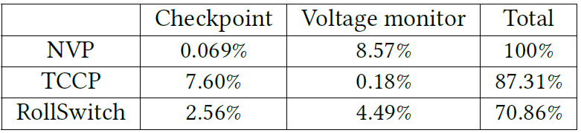
Energy efficiency
RollSwitch reduces total energy consumption by 29.1% compared to NVP and 18.7% compared to TCCP.
Notes:
For energy efficiency, RollSwitch reduce total energy consumption by 29.1% compared to NVP and 18.7% compared to TCCP.

Slide 37

Need Optimizations
Q1: Continuous voltage monitoring leads to substantial energy expenditure.
Q2: How to make energy predictor adapt to real-time fluctuations in energy conditions.
Notes:
In the current design, there are two aspects that can be further optimized.
[click] First, Rollswitch enables voltage monitor all the time for the timely recovery mode switching. However, such constantly activation of voltage monitor is not required by rollback recovery, which can this makes it not energy-efficient.
[click] Second, the current energy predictor only relies on a simple voltage threshold. Due to real-time fluctuations in energy conditions, the prediction may not be accurate.
For instance, once RollSwitch detects that the capacitor voltage (𝑉𝑐 ) has dropped below the threshold (𝑉𝑡ℎ𝑟𝑒𝑠 ) and thus switches to the rollback recovery mode, the voltage might happen to go above 𝑉𝑡ℎ𝑟𝑒𝑠 and quickly get back since the energy condition varies suddenly in both directions.
Let’s consider the fitst optimizations.

Slide 38



Time Quantum
Roll-forward mode
Rollback mode
Roll-forward mode
Enable voltage monitor always!!!
Notes:
To avoid using the voltage monitor all the time [click], when the system switches to the rollback mode,
[click] we apply a periodic approach [click] that activates the voltage monitor only at the end of each time quantum for predictions.
As long as a suitable time quantum length is used, we can ensure timely energy predictions.
By doing this, Rollswitch does not need to maintain voltage monitor active all the time during the rollback mode.
The next point that can be optimized is to make the energy predictor more adaptable to the real-time fluctuations of energy conditions.

