Slide 1
Deanonymizing Anonymous Social Networks
Giulia Fanti and Wenting Zheng

Slide 2


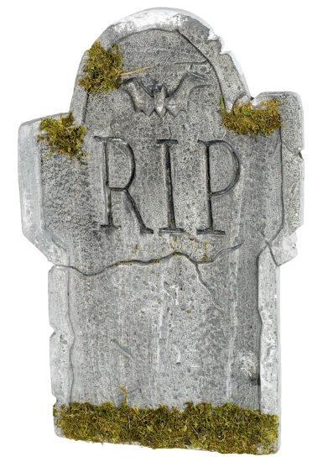

Anonymous messaging is on the rise.

Slide 3
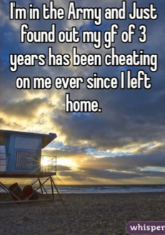
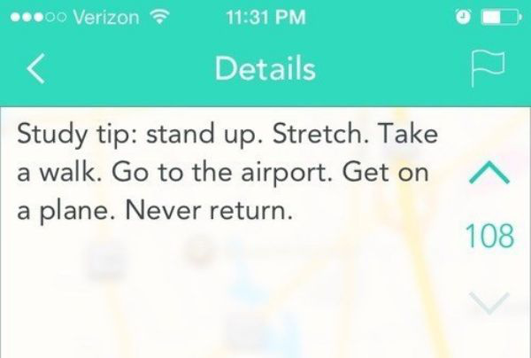


Slide 4
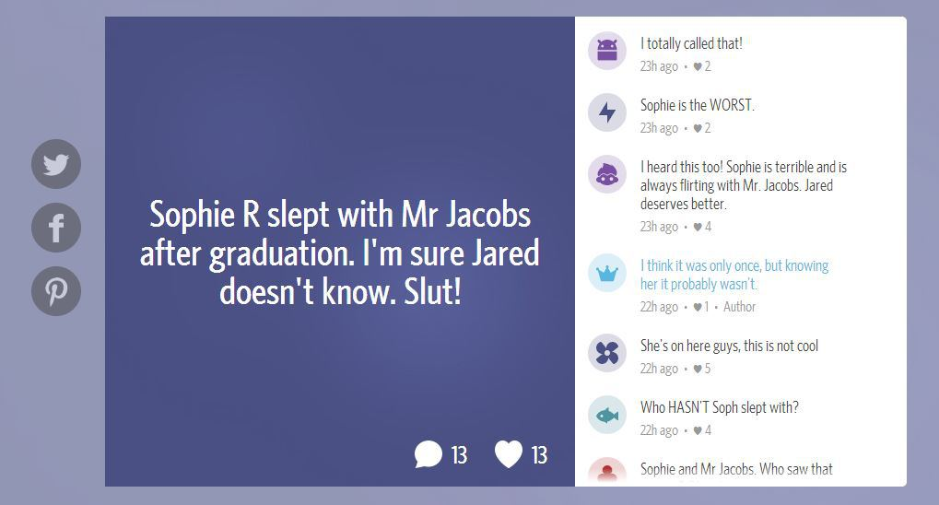
These networks attract a lot of abuse.

Slide 5
Could a moderately powerful adversary deanonymize these networks?

Slide 6





Bob
Mary
Server
Alice

Slide 7
High likelihood
Low likelihood

Slide 8
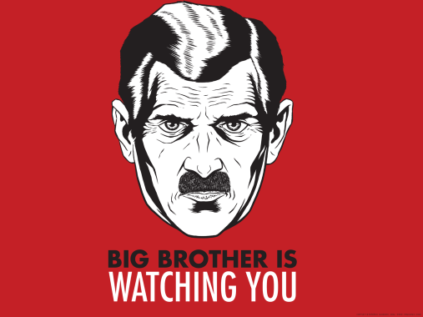
What if an adversary could recruit spies?
T=2
Spies collect:
- Timing information
- Direction of transmission
T=4
T=1
T=4
T=1
T=4
Notes:
Police=> citizens
Principal=> brown-nosers

Slide 9
Our hypothesis: This should be easy!
(…as long as you have enough spies)

Slide 10
The reality: ☹

Slide 11
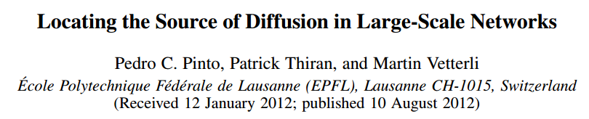
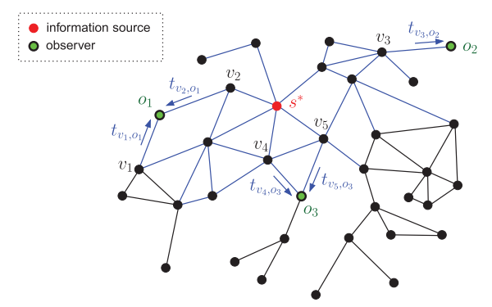
What estimator do we want?

Slide 12
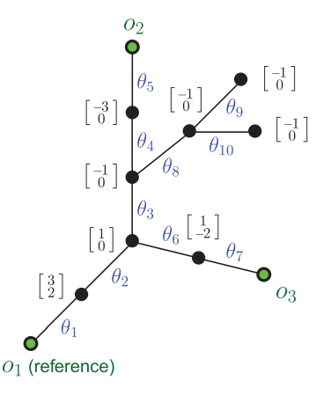
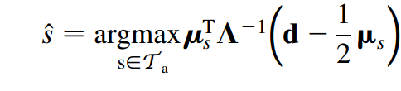
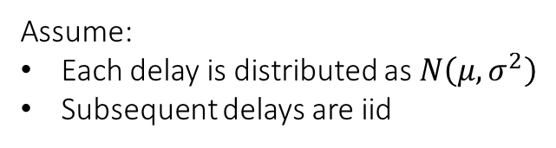
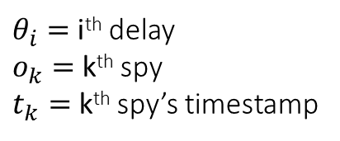
Assume:
Each delay is distributed as $N\left(μ, σ^{2}\right)$
Subsequent delays are iid
$θ_{i}=$ i^{th} delay
$o_{k}=$ k^{th} spy
$t_{k}=$ k^{th} spy’s timestamp
Covariance of delay
random variables
Expected
delay
Deviation from
expected delay

Slide 13
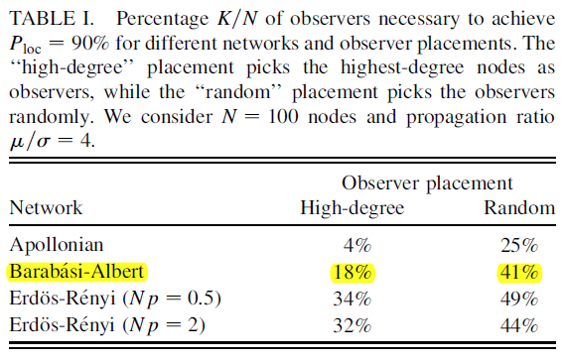
Notes:
We weren’t even able to reach 90% accuracy with 41% spies!

