Slide 1
Deanonymizing Anonymous Social Networks
Giulia Fanti and Wenting Zheng

Slide 2


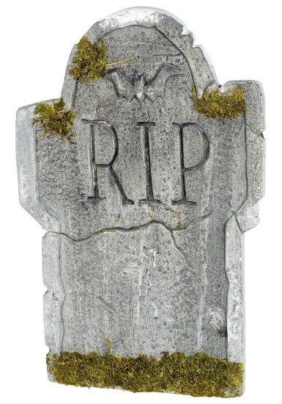

Anonymous messaging is on the rise.

Slide 3
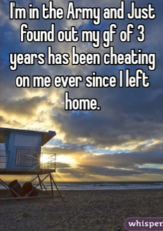
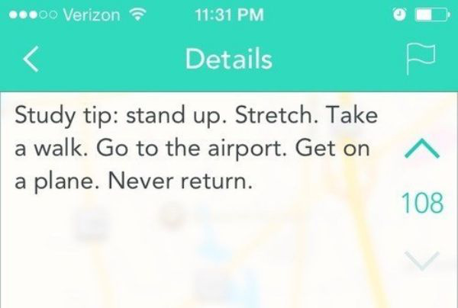


Slide 4
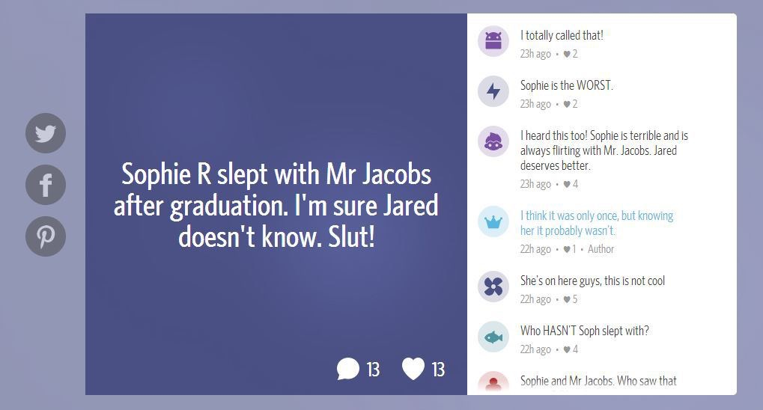
These networks attract a lot of abuse.

Slide 5
Could a moderately powerful adversary deanonymize these networks?

Slide 6





Bob
Mary
Server
Alice

Slide 7
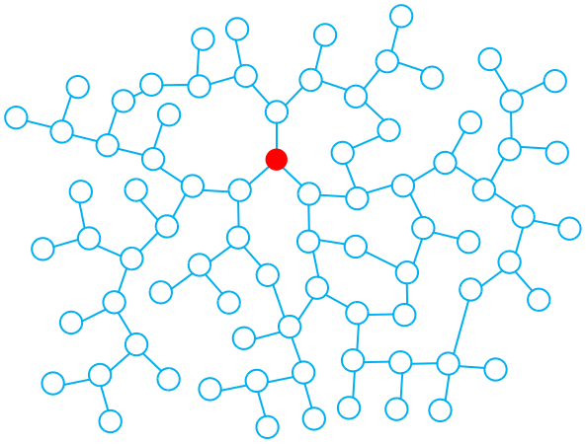
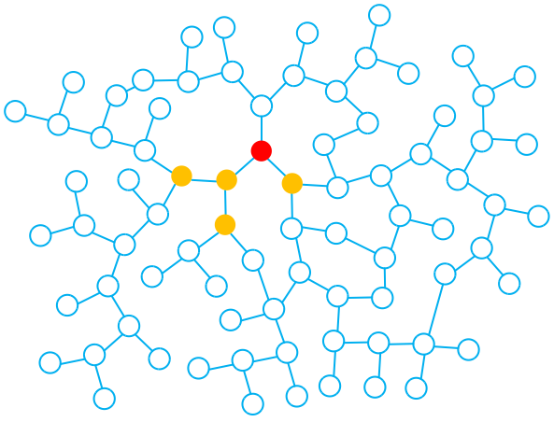
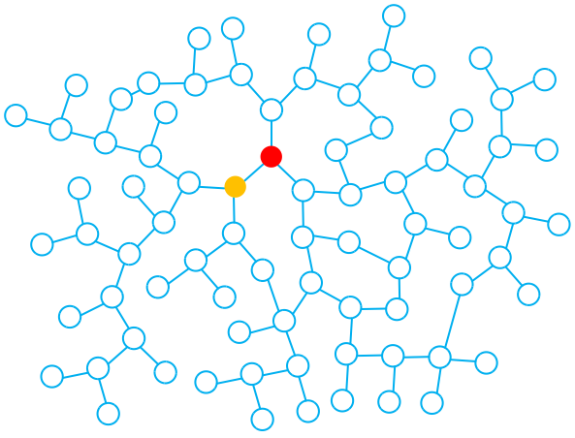
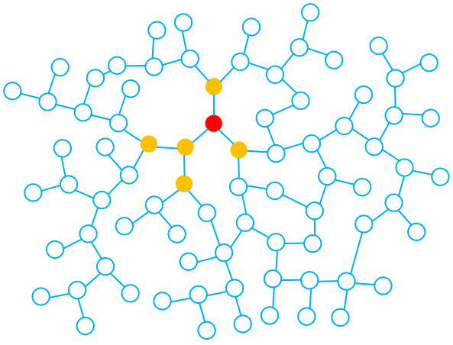
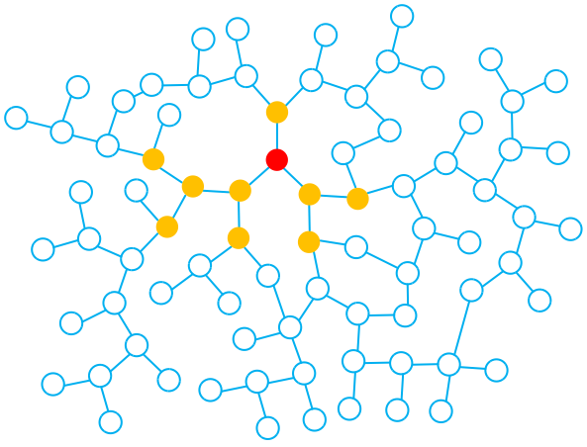
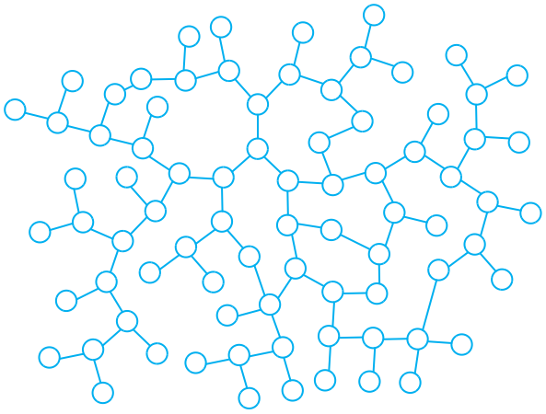
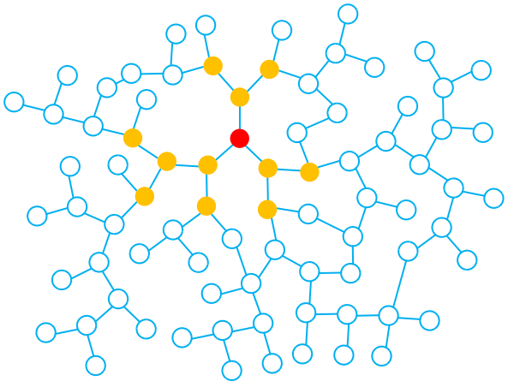
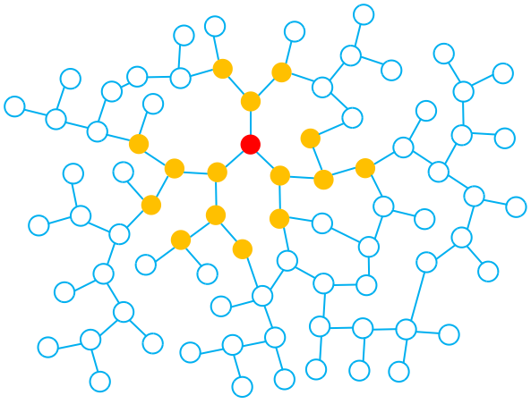
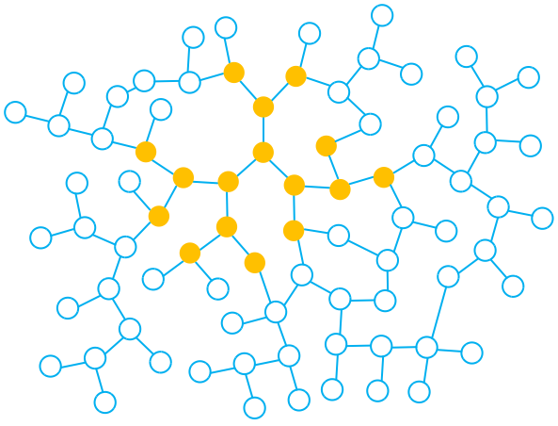
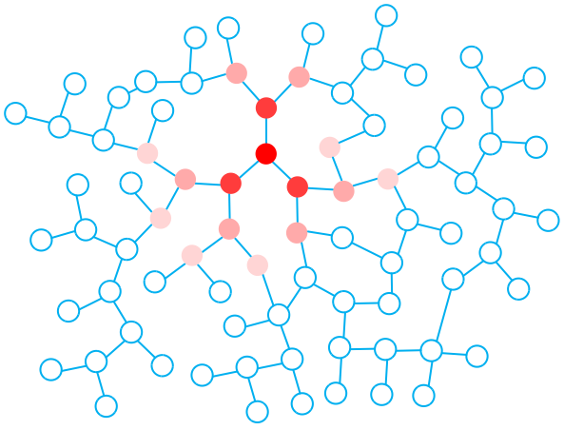
High likelihood
Low likelihood

Slide 8
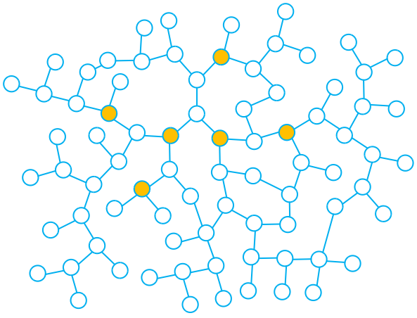
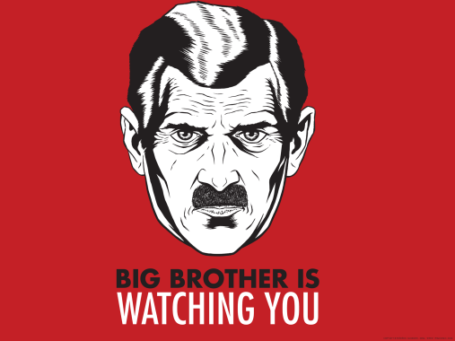
What if an adversary could recruit spies?
T=2
Spies collect:
- Timing information
- Direction of transmission
T=4
T=1
T=4
T=1
T=4
Notes:
Police=> citizens
Principal=> brown-nosers

Slide 9
Our hypothesis: This should be easy!
(…as long as you have enough spies)

Slide 10
The reality: ☹

Slide 11
Model
Network modeled as graph
Erdos-Renyi
Barabasi-Albert
Latency modeled as Gaussian distribution
Discrete-event simulation

Slide 12
Jordan Estimator

Slide 13
Nearest Spy Estimator

Slide 14
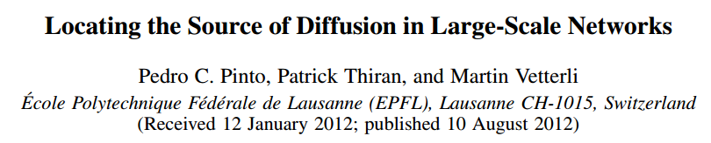
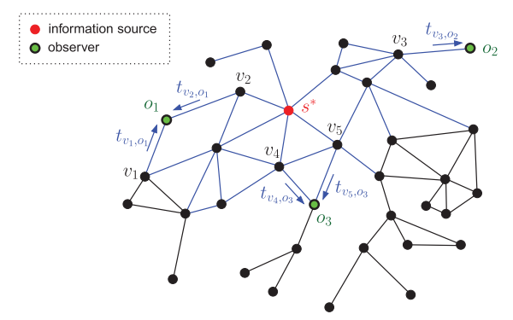
Optimal Estimator

Slide 15

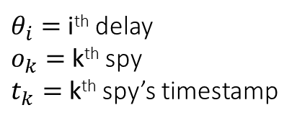
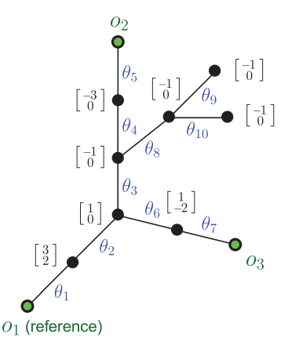
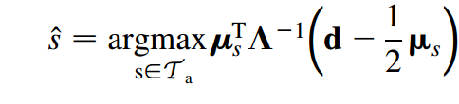
Covariance of delay
random variables
Expected
delay
Deviation from
expected delay
This estimator is optimal for
tree-structured graphs

Slide 16
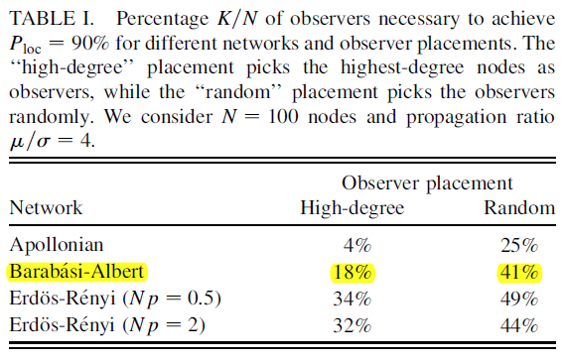
Notes:
We weren’t even able to reach 90% accuracy with 41% spies!

Slide 17
What about simpler graphs?

Slide 18
Heuristics — Multiple Messages

