Slide 1
Deanonymizing Anonymous Social Networks
Giulia Fanti and Wenting Zheng

Slide 2


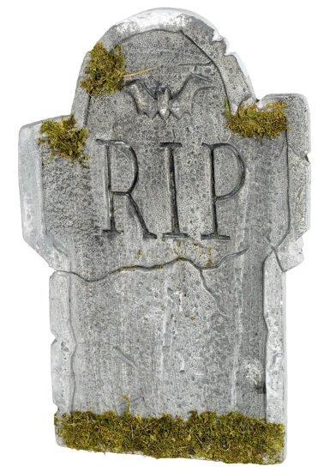

Anonymous messaging is on the rise.

Slide 3

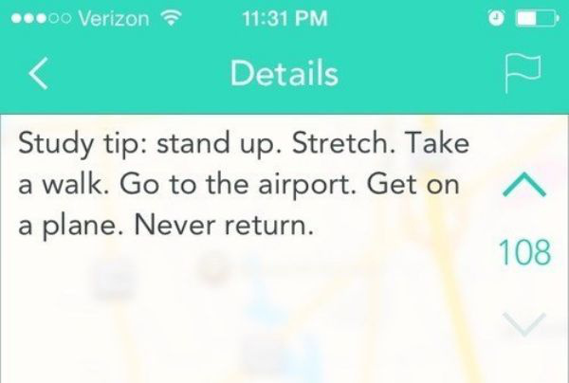


Slide 4
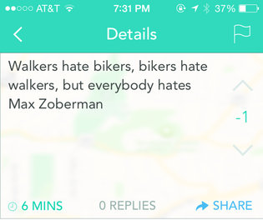
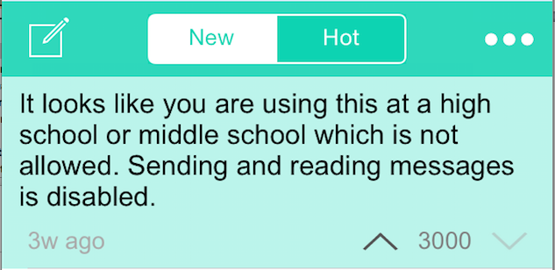
These networks attract a lot of abuse.

Slide 5
Could a moderately powerful adversary deanonymize these networks?

Slide 6





Bob
Mary
Server
Alice

Slide 7
High likelihood
Low likelihood

Slide 8

What if an adversary could recruit spies?
T=2
Spies collect:
- Timing information
- Direction of transmission
T=4
T=1
T=4
T=1
T=4
Notes:
Police=> citizens
Principal=> brown-nosers

Slide 9
Our hypothesis: This should be easy!
(…as long as you have enough spies)

Slide 10
The reality: ☹

Slide 11
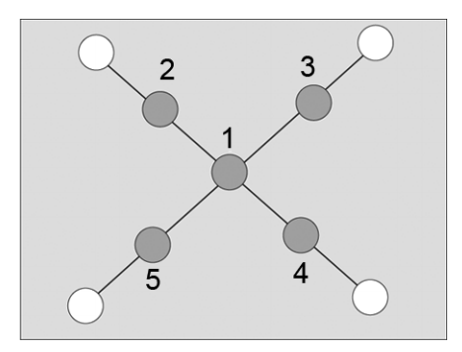
What estimator do we want?
Snapshot adversarial model
Shah and Zaman, 2011
Karamchandani and Franceschetti, 2013
Dong et al., 2014
Lokhov et al., 2014
Altarelli et al., 2014

Slide 12
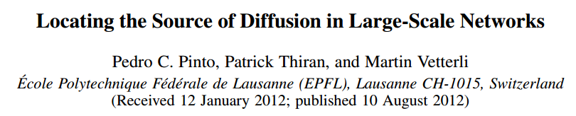
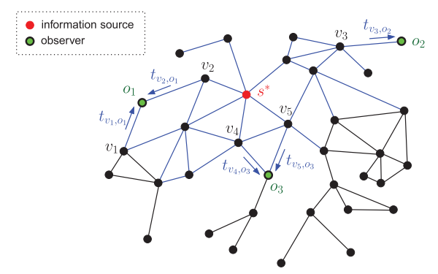

Slide 13
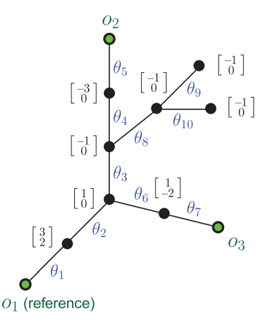
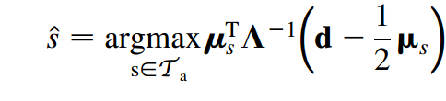

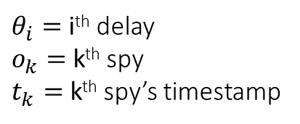
$θ_{i}=$ i^{th} delay
$o_{k}=$ k^{th} spy
$t_{k}=$ k^{th} spy’s timestamp
$$Gaussian delays: N\left(μ, σ^{2}\right)$$
Covariance of delay
random variables
Expected
delay
Deviation from
expected delay
This estimator is optimal for
tree-structured graphs

Slide 14
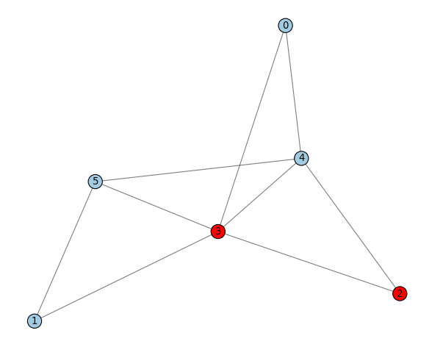






$$l_{0}=−2.33$$
True source
$$l_{5}=−2.33$$
$$l_{4}=0$$
$$t_{2}=2.33$$
$$l_{1}=−2.33$$
$$t_{2}=2.17$$

Slide 15
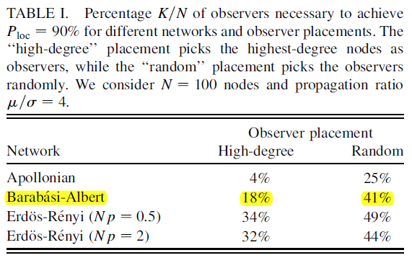
Notes:
We weren’t even able to reach 90% accuracy with 41% spies!

Slide 16

What about simpler graphs?
Regular trees
(Assume this is an infinite tree)
Restrict candidates to $T_{a}$

Slide 17
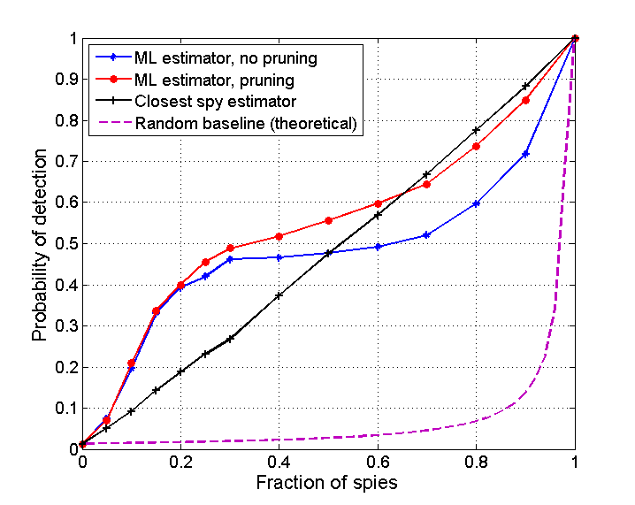

Slide 18
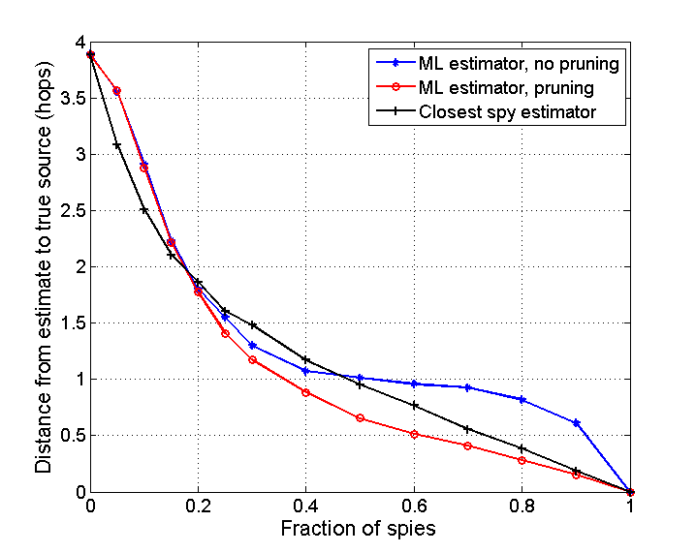

Slide 19

Other challenges
Why is
this 1.0?
How do you compute $T_{a}$for non-tree-like graphs?
What parameters do we use to replicate results?
Now that Secret is dead, does any of this even matter?

Slide 20
Moving forward
Understand why the “ML” estimator is performing worse than “first spy” estimator
Replicate the results in Pinto et al. paper?
Study the parameter space in more detail

