Slide 1
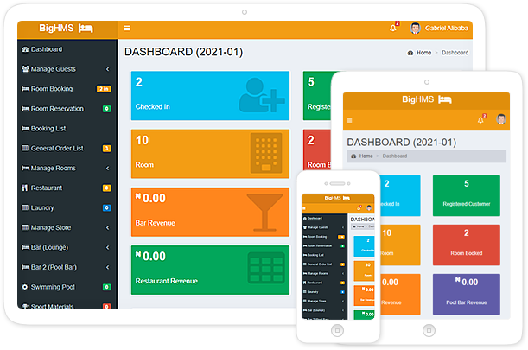
BIGHMS
Hotel Management System
(with Hotel Door-Lock System)

Slide 2
Table of Contents
Introduction on BigHMS
Types of App. Architecture
Modules
Functionalities
Hotel Door-Lock & encoder (RFID) Installation

Slide 3
Introduction
BigHMS is a hotel management system that comes with hotel door-lock software. This software enables you to manage every aspect of your hotel starting from;
Installation and configuration of hotel door-locks
Generating door-lock card for each hotel doors
Check-in and check-out of guest from hotel
Writing/Erasing customer door-lock card
Reservation
Manage bar(s)
Restaurant(s)
Spa
Laundry
Swimming Pool(s)
Cab
Generate daily, monthly as well as yearly reports
Open/Close Shift System
Store Management System
Multiple-order Bar Cart System
Multiple-order Restaurant System
Printing of Invoice/Receipt For Customer
Multiple-order Laundry System
Bar tablet app. for Waiter/Waitress
Trend Analysis System
Theft monitoring system through log history
Database Backup system
Staff Management
Guest room-package viewing system

Slide 4
Type of App. Architecture
Single-Client Application
Client-Server Application
Single-Client Application
This setup runs BIGHMS application on a single (PC) system. This system doesn’t need internet or server to run the hotel management system. No remote/local server, or internet is needed to use the app.

Slide 5
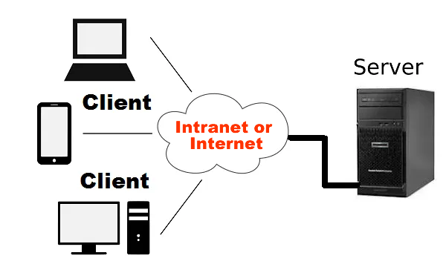
Client-Server Application
Remote/local server is need to setup Client-Server Application. BigHMS runs on the Server while all PCs (Client Systems) connect to it through intranet or internet network to run the hotel management system.
You can connect the client systems to the server either through wireless or cable. No need of internet except you want to set it up remotely.

Slide 6
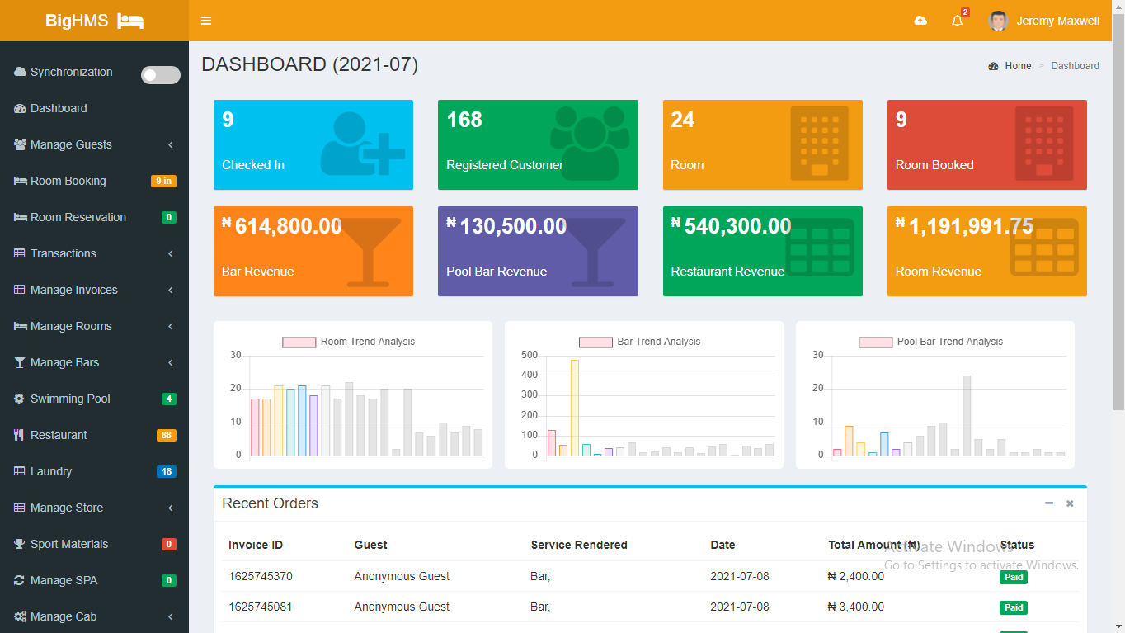
Modules & Their Functionalities
BigHMS comprises of so many modules to manage your hotel.

Slide 7
(1) Reception Modules:
Manage Guest: Registration of Guest, Companies, and open/close shift
Guest Wallet: For deposit and payment of customer bills.
Room Booking: Checking in and out of Guest
Room Reservation: Reserving room for Guest(s)
Expenditure: To manage expenses
Module to printing guest invoice and receipt.

Slide 8
(2) Bar Modules:
Bar POS System: POS system to sell drinks, manage transactions, and print receipts for customers.
Waiter/Waitress Tablet: Tablet app for waiters/waitresses to place customers’ orders.
Swimming Pool:
Generate Daily Report

Slide 9
(3.) Restaurant Modules:
Restaurant POS System: POS system to sell food, manage transactions, and print receipts for customers.
Generate Daily Report

Slide 10
(4.) Other Modules:
Laundry Module: To render laundry service.
SPA Module: To render SPA service.
Sport Module: To sell sport materials.
Manage Cab: To register cab for clients, and manage their cab history
Manage Gym: To register members for gym and manage their subscription
Bar Request: To manage requests from bar
Trend Analysis: To show trend of sales in a graphical form. This lets you know which services/products clients order frequently.
Manage Staff: To create and manage staff accounts.
Service category: To configure/compute the category of room, food, and drink.
Settings: To configure general app setting, Restaurant/Bar Table Numbering, Backing Up Database.
Comprehensive Reports: This module lets you generate general (bar, restaurant, room, etc.) reports, Stock Report, Hotel-door Master Card Log History, SSS Report, etc.

Slide 11
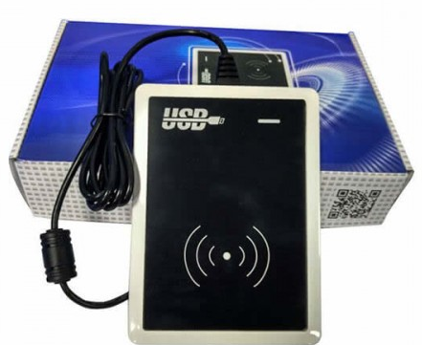
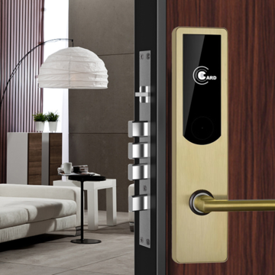
Hotel Door-Lock & Software Installation
We specialize in the installation of Hotel Door-Locks and setting up the USB encoder and its software to manage your hotel doors. This software is customized to work with BigHMS to write/read/erase Smartcard. The card can be Guest card, master card, and building card. With this software coupled with BigHMS, you can effectively monitor transactions and generation of cards. See diagram below;

Slide 12
THANK YOU

