Slide 1
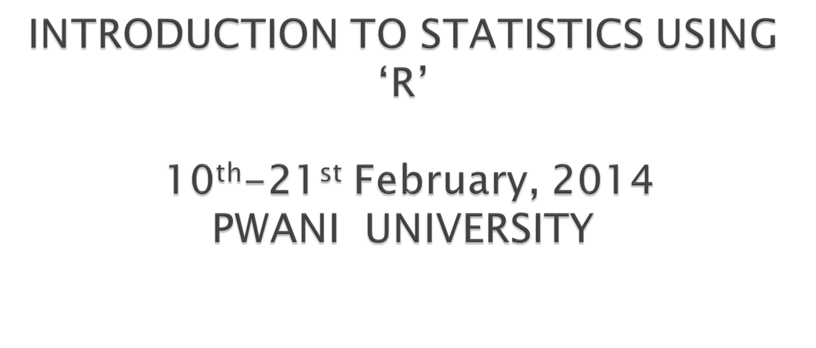
Dr Tabitha Mwangi

Slide 2

Definition of statistics and its components
Populations and samples
Exposures and outcomes
Variables
Statistics

Slide 3
Statistics is the science of Collecting, Summarising, Presenting and Interpreting data

Slide 4

There is anecdotal evidence of a phenomena...

Slide 5
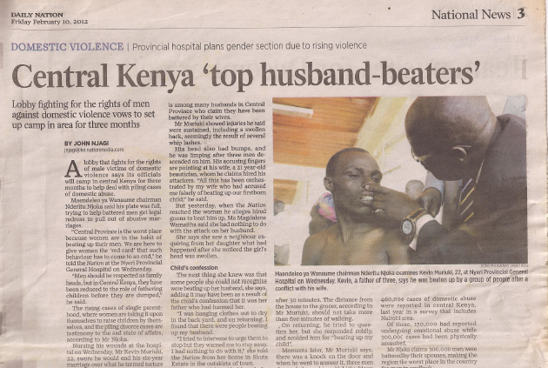

Slide 6
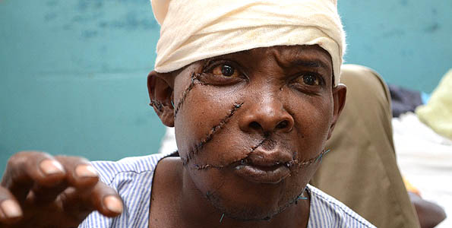
All stitched up: Simon Mwangi at the Nyeri Provincial General Hospital in February 2012.

Slide 7
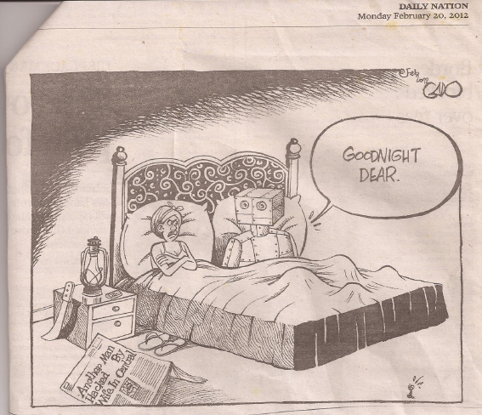

Slide 8

Are women from Central Province battering their husbands/partner more than women from other provinces in Kenya?

Slide 9

The exposures and outcomes of interest are specific to study hypotheses
Should always be clearly defined before the study starts. Why??

Slide 10
The exposures and outcomes of interest are specific to study hypotheses
Should always be clearly defined before the study starts. Why??
Type of outcome determines the analysis that will be used.

Slide 11

The outcome of a study is a broad term for any defined disease, state of health, health-related event or death.

Slide 12
An outcome is the result of an experiment or other situation involving uncertainty.
Its the focus of your attention – seeking to understand its occurrence and variation
In some studies, there may be multiple outcomes.

Slide 13



Slide 14
Husband bashing

Slide 15

The exposure of interest may be associated with either an increased or a decreased occurrence of disease or other specified health outcome,
May relate to the environment, or inborn or inherited characteristics

Slide 16


Slide 17

Residence = Central province ??
Ethnicity = Kikuyu??

Slide 18
Spousal battering in Central Kenya
POPULATION
Population of interest?
SAMPLE
Choosing sample?

Slide 19

Population of interest?
  Partnered/married women in Kenya

Slide 20
Population of interest?
  Partnered/married women in Kenya
Choosing sample
  Partnered/married women from central + other provinces
  Why would you not choose married/partnered men?

Slide 21
POPULATION
How to best obtain the required data
Comparison groups
Sample size
Study design
SAMPLE

Slide 22

Descriptive
  Cross sectional
Analytical
  Case-control
  Cohort
Experimental

Slide 23
POPULATION
Study design
SAMPLE
Describe

Slide 24
Characteristic measured for each subject.
The name refers to the fact that values of the characteristic vary among subjects in a sample or a Population.
These can be categorical or quantitative

Slide 25

Unordered categorical variables
Ordinal categorical variables

Slide 26
Set of unordered categories:
Marital status: never married, married or living together, divorced/separated/ widowed
Residence: Rural, Urban
the categories are unordered, there aren’t higher or lower values.

Slide 27
Ordinal categorical variables: the categories have a natural order:
Wealth quintile: lowest, Second, Middle, Fourth, Highest
Employment : Not employed, Employed but not for cash, employed for cash

Slide 28
Takes numerical values, which differ in magnitude. Each value is greater than or lower than any other possible value:

Slide 29
Takes numerical values, which differ in magnitude. Each value is greater than or lower than any other possible value:
Age: 0, 1, 2, 3, …
Number of years of education completed: 5, 10, 15
Number of children: 0, 1, 2, 3, 4, …

Slide 30
POPULATION
Statistic
Study design
SAMPLE
Describe

Slide 31

Allow us to use the sample to make inferences about the population from which it was derived……

Slide 32
POPULATION
Parameter
Inference
Statistic
Study design
SAMPLE
Describe

Slide 33
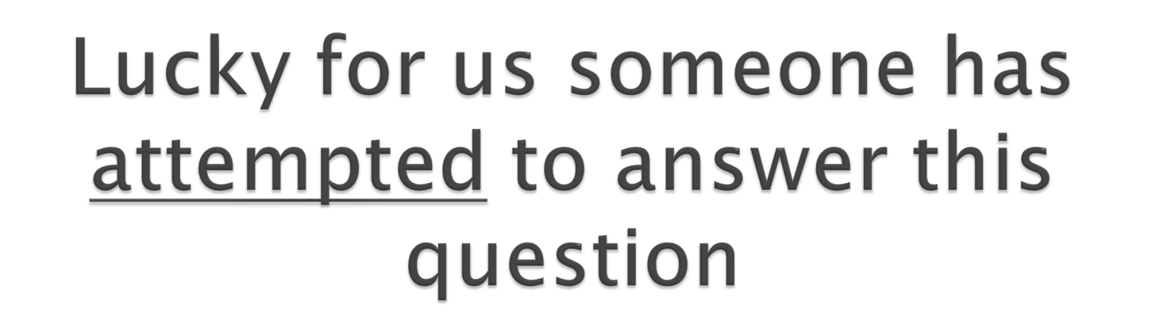

Slide 34


Slide 35

Are women from Central Province battering their husbands/partner more than women from other provinces in Kenya
The purpose of a statistical analysis is to quantify the magnitude of the association between one of more exposure variables and the outcome variable

Slide 36

13th Nov 2008 to Feb 2009
All 8 provinces
8,444 women 15-49 years old
One-off quesstionnaire

Slide 37

Have you ever hit, slapped, kicked or done anything else to physically hurt your (last)husband/partner at times when he was not already beating or physically hurting you?
6,318 Kenyan women 15-49 years old participated

Slide 38
Do you trust KDHS?
OK
Wait for this……

Slide 39
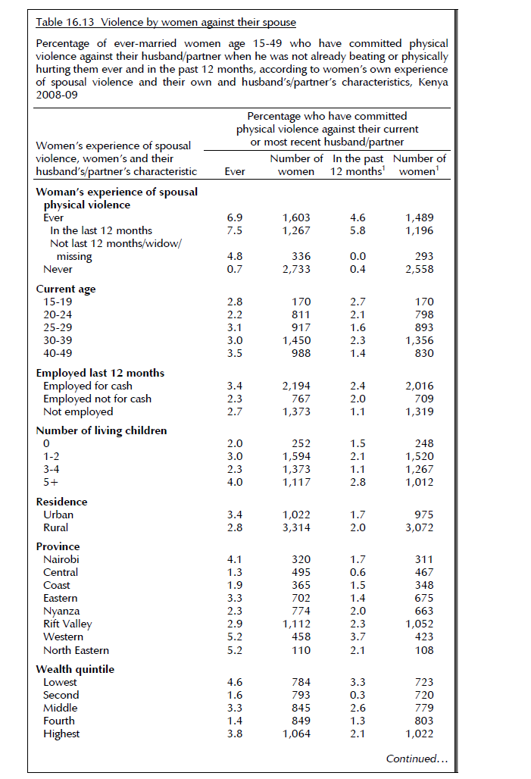
Page 261
I’ll make it clear in a mo..

Slide 40
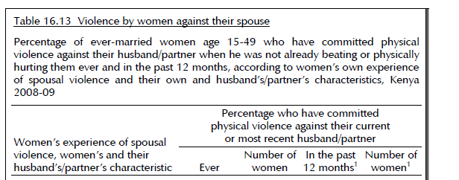
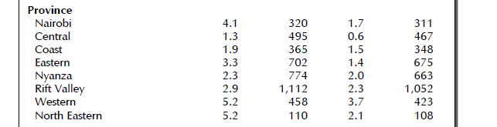

Slide 41

Central province women are the least likely to batter their husbands than women from any other province.

Slide 42
Central province women are the least likely women to batter their husbands than women from any other province.
What is missing?

Slide 43


Slide 44

Have you ever hit, slapped, kicked or done anything else to physically hurt your (last)husband/partner at times when he was not already beating or physically hurting you?

Slide 45
If you have collected the wrong data – the best analysis will not help you....

Slide 46
In conclusion= MARRY A WOMAN FROM CENTRAL PROVINCE
BUT
DO NOT PROVOKE HER
Thank you!

