Slide 1
Poisson regression

Slide 2
Poisson regression
Y [outcome] = count
X [Independent vars] = continuous or categorical factors

Slide 3
Poisson distribution
Discrete counts – number of occurrences of an event over a period of time
Session data set
vimp = number of occurrences of optic nerve disease in a community in the 1980s-1990s

Slide 4
Example of Poisson regression
Session dataset
A study of optic nerve disease carried out in Nigeria
  mortality_ptime.dta
  Nigerian cohort study in the 1980-90’s
  conducted in a area of high prevalence of microfilarial infestation
  objective: to investigate relationship between visual impairment and mortality

Slide 5
Generalized Linear Models
In R:
Generalized linear models are fit using the glm( ) function.
The form of the glm function is
glm(formula, family=familytype(link=linkfunction), data=)

Slide 6
Generalized Linear Models
Family | Default Link Function
binomial | (link = "logit")
gaussian | (link = "identity")
Gamma | (link = "inverse")
inverse.gaussian | (link = "1/mu^2")
poisson | (link = "log")
quasi | (link = "identity", variance = "constant")
quasibinomial | (link = "logit")
quasipoisson | (link = "log")
See help(glm) for other modeling options
See help(family) for other allowable link functions

Slide 7
Poisson regression in R
# Poisson Regression
# where count is a count and
# x1-x3 are continuous/ categorical predictors
fit <- glm(count ~ x1+x2+x3, data=mydata, family=poisson())
summary(fit) display results

Slide 8
Poisson regression for rates
In epidemiology we are more interested in rate of occurrence of an event rather than count of events
The mean rate, λ, of the occurrence of an event is given by:
λ = r / t

Slide 9
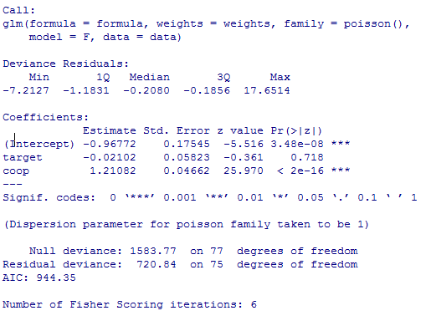

Slide 10
Interpreting coeficients
The regression coefficients, βs represents the expected change in the log of the mean per unit change in X.
Or
Increasing X by one unit is associated with an increase of β in the log of the mean
It is good to exponentiate the βs:
  exp(β) is the effect of the independent variable on the mean.

Slide 11
Overdispersion in Poisson model
Poisson distribution is described by single parameter, λ
Mean (λ) = variance
If conditional variance > conditional mean, then there is overdispersion in data

Slide 12
R Practical
# Attach the data frame
hospital.data<-read.csv(“hospital_data.csv”)
# Fit the statistical model
poisson.model<- glm(num ~ target + coop, family = "poisson", data = hospital.data)
# Summary of the statistical model
summary(poisson.model)

