Slide 1
Final Project Presentation
Gabe Feliciano-Munoz

Slide 2

Question of Interest and General Information
What factors are associated with increased quality of life for patients with brain, pancreatic, and colon cancer?
2021 NHIS dataset being used in this study with a variety of variables of interest
Quality of life on a scale from 1 - 14
Income Ratio
Number of Kids
Impact of Pain on Family
Relationship Status
Education
Potential Confounders
Age, Sex, Past History of Depression
Source: National Center for Health Statistics

Slide 3
DAG
Age, Sex, History of Depression
Individuals with Brain/Pancreatic/Colon Cancer
Quality of Life

Slide 4
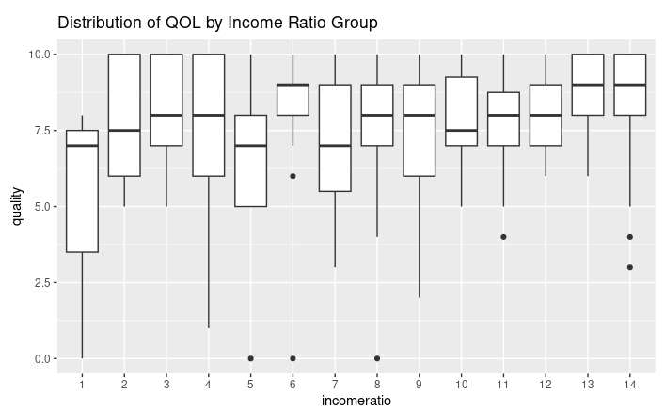
Data Display

Slide 5
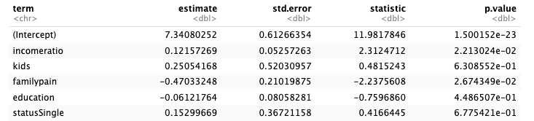
Linear Regression Results
Considering making collective groups for certain variables (income and education) to help with significance of results

