Slide 1
Bisulfite Sequence MAPping

Slide 2
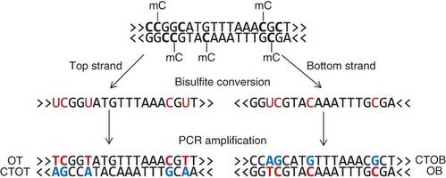
Bisulfite Sequencing
-Denaturation (separation)
-Bisulfite Treatment (un-methylated cytosine to uracil)
-PCR Amplification (converting the sulfites into base pairs for 4 distinct strands)

Slide 3
Problems with the Sequencing
-Bisulfite sequencing conversion only occurs on C’s so the strands are not complementary.
-4 different strands result from the PCR amplification

Slide 4
Problems with the Sequencing
-Most, but not all, of C’s will change to T’s in the BSW and BSC strands.
-However, all G’s will be changed to C’s in the BSWR and BSCR strands.
-Results in large reduction of the number of C’s.

Slide 5
Problems with the Sequencing
-T’s cannot be mapped back to C’s, so the mapping is only one-way.
-T’s can be mapped to C or T, but C’s can only be mapped to C.
-This causes some problems in the efficiency of algorithms since it greatly increases the search space.

Slide 6
Approaches
-Convert and map all C’s to T’s
-Counts all C/T alignments as mismatches
-However, this is ineffective for G-poor strands, since the C’s will actually come from G’s from PCR amplification
-Therefore, many problems arise for bigger strands since the C/T asymmetry is ignored

Slide 7
Approaches
-Aligning bisulfite reads to 3 reference sequences
-The original genome and 2 bisulfite converted genomes
-Captures C/T alignments and allows them to be mismatches
-However this compromised mapping sensitivity since mapping software has a maximum number of mismatches

Slide 8
Approaches
-CokusAlignment uses a tree-searching algorithm
-It is very slow even when optimized for a specific genome
-Does not support gapped or pair-end alignment

Slide 9
BSMAP
-HASH table includes seeds of all possible variants of C/T in the bisulfite read
-Masks T’s as C’s at the positions that were originally C. The masked read is generated by using 2 bits to represent each nucleotide, then using the table for the original reference and the bisulfite read.
Read\Ref | A(00) | C(01) | G(10) | T(11)
Mask | 11 | 01 | 11 | 11
A(00) | 00 | 01 | 10 | 11
C(01) | 10 | 00 | 11 | 10
G(10) | 10 | 01 | 00 | 01
T(11) | 11 | 00 | 01 | 00

Slide 10
BSMAP
-After mapping the bitwise masked read to the reference, the masks are also stored in a HASH table
-Using this, mismatches can be counted efficiently using the XOR operation. Matches result in 00, and mismatches result in non-zero.
-BSMAP aligns the read and the complementary sequence to the Watson and the Crick strands
-BSMAP also supports pair-end and gapped alignment
-BSMAP is much faster and also less erroneous than other mapping algorithms

