Slide 1
Background and Motivation
Scott Simmons

Slide 2
Why OGC APIs?
OGC web service standards should be more flexible with respect to current and emerging IT trends
OGC standards should be far more easy to use by developers
OGC has long provided guidance to make standards more modular
OGC Web Services (OWS) Common was an attempt to retroactively build a common core for W*S standards… now we have a chance to do this proactively!

Slide 3
OGC Board of Directors guidance – why Hackathons are working
Get to 90% of a standard really fast…
Then take time to finish the last 10%
Make the 90% product available to stakeholders and implementers to test
Develop a repository of example implementations
Be more public for the 90%
Control the 10% in the OGC process to ensure the final product is truly an “international consensus standard”

Slide 4
Old news
Used since 2012 in GeoPackage
Mostly used to manage text for OGC
New news
More repos are public
Let the users contribute
Relax the rules during compilation
Now in use
Document from the developer’s perspective
Used in OGC API efforts
Retrofit of older standards by numerous parties

Slide 5
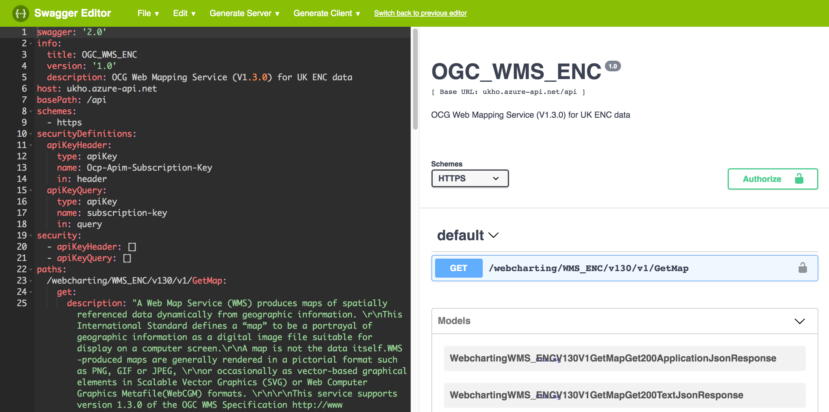
Members were already doing this – RESTful WMS
https://ukho.portal.azure-api.net/docs/services/58f944d83e1431114cccd1f1/export?DocumentFormat=Swagger
Try it: https://ukho.portal.azure-api.net/docs/services/58f944d83e1431114cccd1f1/operations/58f944da3e14310718fe00e1

Slide 6
OGC API family of standards
Modernization of web service standards (W*S) started with Web Feature Service v. 3
Additional standards in the hackathon investigating the same pattern:
Processing
Map Tiles
Coverages
Standards will be named “OGC API - [resource]”
OGC API - Features, OGC API - Processing, etc.
Old W*S standards don’t go away, but will have less focus for future revision

Slide 7
OWS Evolution
WFS3
Public comment period complete
Coordination with ISO
WPS3
API in public GitHub with implementations
Public comment coming soon
WMS/WMTS
Vector Tiles Pilot results
Draft OpenAPI definition
WMTS direct link to OWS Common work
Catalogue
STAC using WFS3, coordinating with OGC
CSW4 (draft, unofficial)
Coverages
2018: Testbed 14 & Met/Ocean Hack
2019: Hackathon supported by several members
OWS Common
API Common Guidelines
API Common Spec with requirements

Slide 8
This is not completely new…
CTO discussions with OpenAPI Initiative (2016)
CTO Open APIs White Paper [16-019r4]
OAB discussions on OpenAPI (2017)
Call-out to members experimenting with OpenAPI (2017)
See earlier example from UKHO
OGC staff OpenAPI definitions for WMTS (2017)
Spatial Data on the Web Working Group (2017)
Best Practices document detailing more “webby” web services use cases and requirements
OGC WFS3 Hackathon (2018)
Testbed 14 – NextGen Thread (2018)
Two Engineering Reports [18-045] and [18-021]
MetOcean Hackathon for WCS (2018)

Slide 9
Expectations
Scott Simmons

Slide 10
Can we converge on a common core?
All OGC Web API efforts are equal stakeholders
Some borrowing or convergence is already happening
Hack away and find those “building blocks” that are universal to all candidate standards
Improve guidance on use of Web APIs

Slide 11
Output from participants
Running services/clients
Suggestions for a common core
Rules/guidance that can be documented
Validation of work completed to date
Contribute to the GitHub repo

