Slide 1
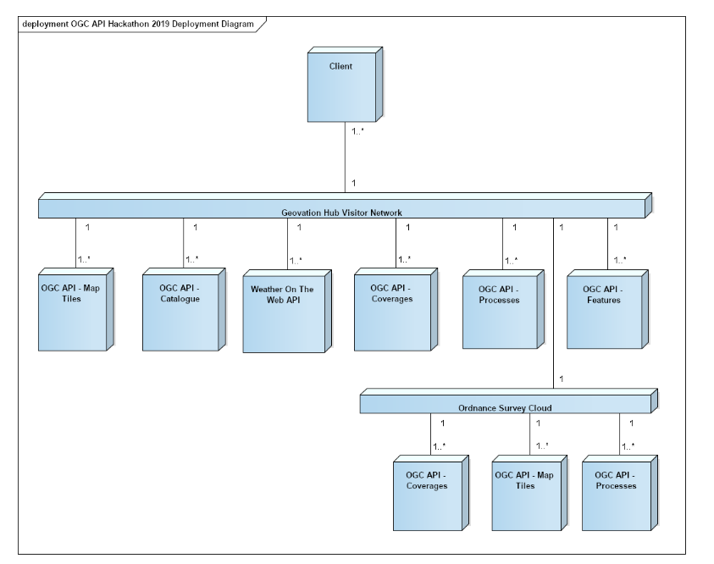

OGC API Hackaton 20-21/06/2019

Slide 2
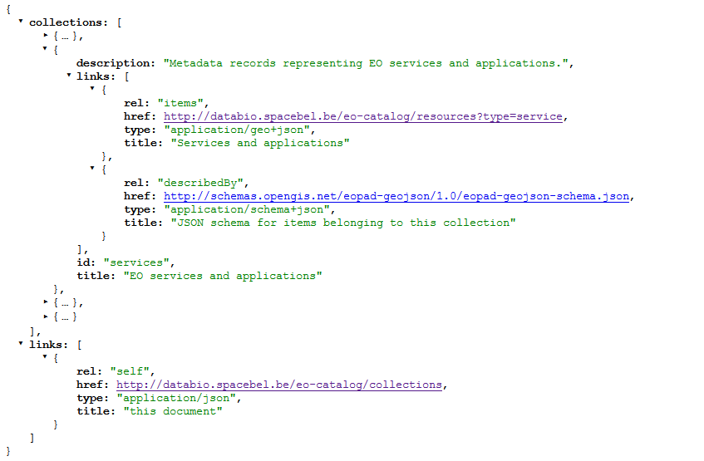
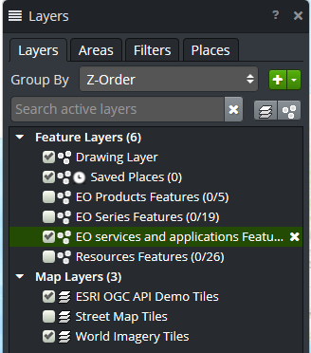
OGC API Hackaton
/collections response

Slide 3
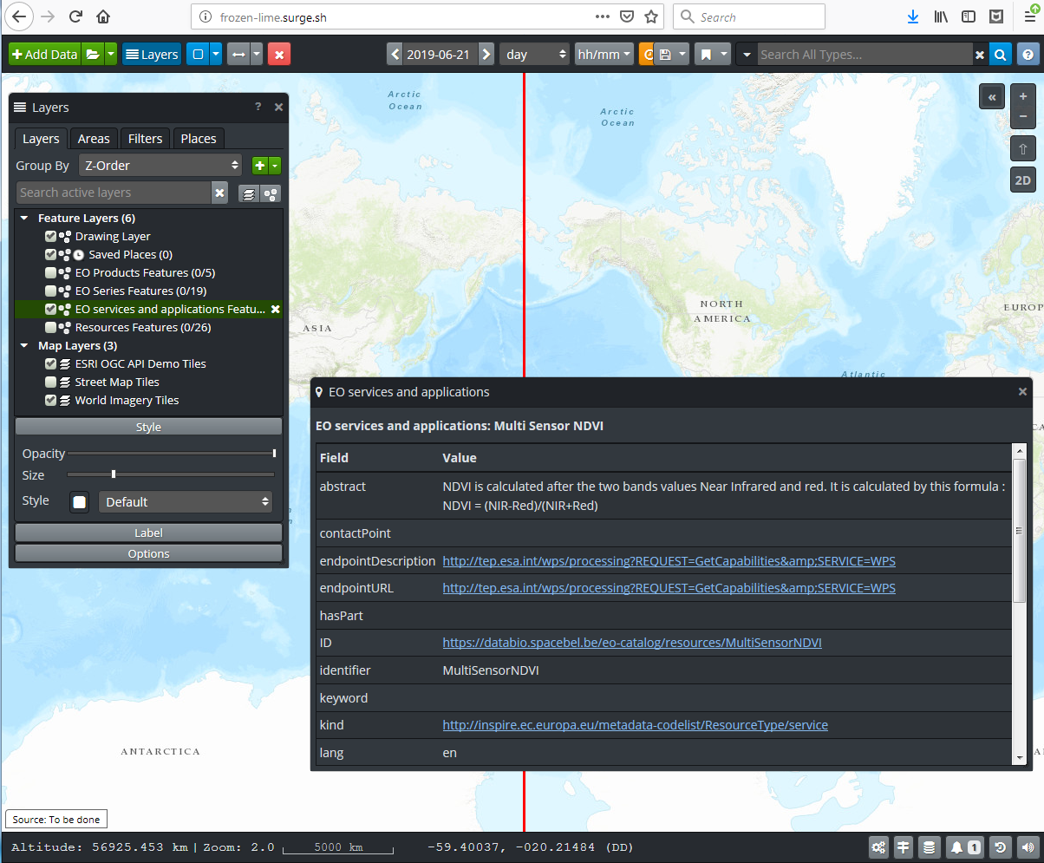
OpenSphere OGC API Plugin TIE

Slide 4
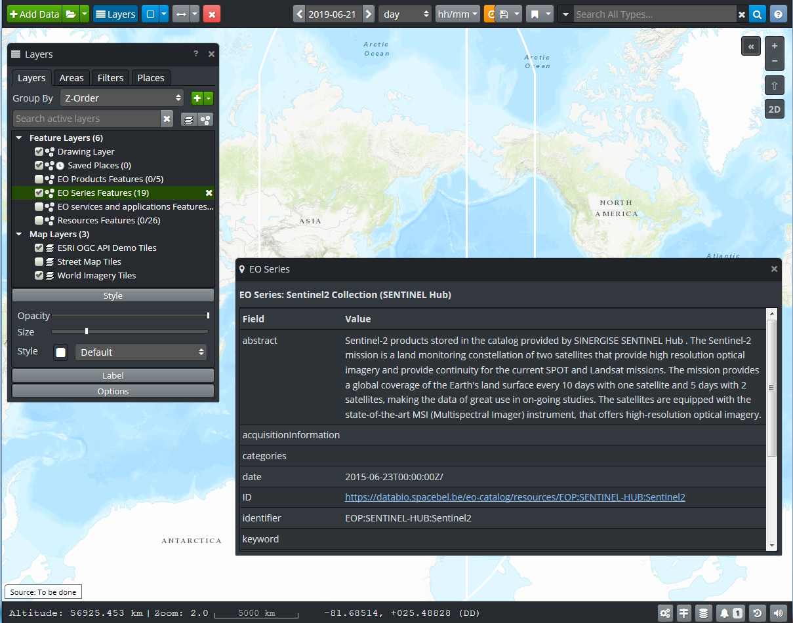
EO Series – demo scenario

Slide 5
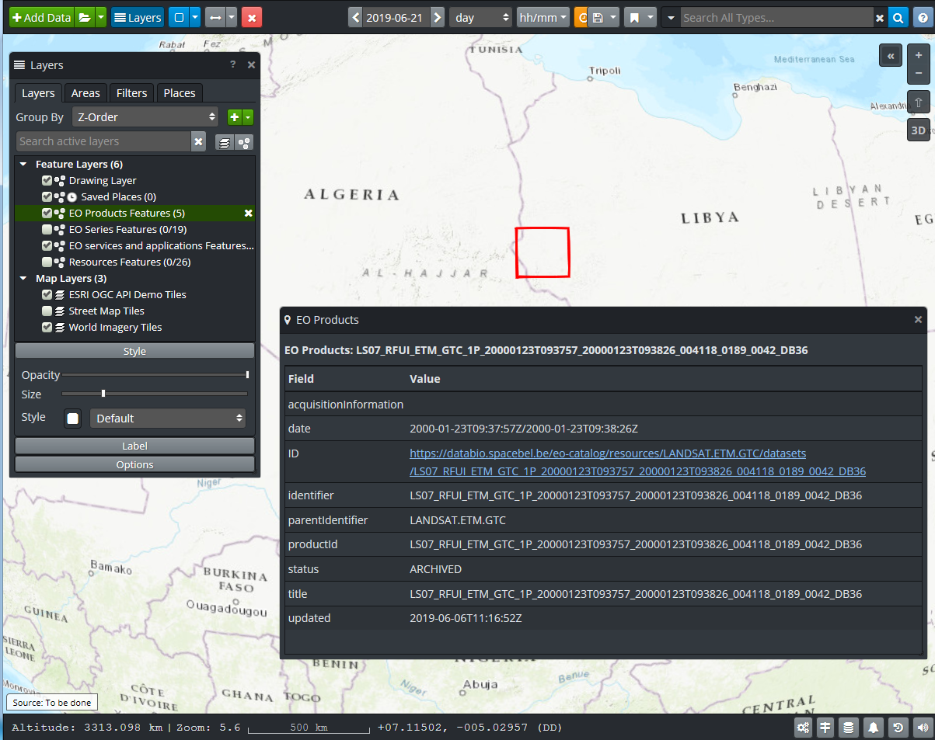
EO Products

Slide 6
