Slide 1

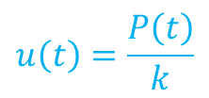






Input
“Excitación”
Sistema
Output
“Respuesta”
$$f\left(t\right)$$
$$m$$
$$u\left(t\right)$$
$$m\ddot{u}\left(t\right)+ku\left(t\right)=f(t)$$
$$k$$
$$k$$
Fuerza inercial
Fuerza elástica
Fuerza externa
$$P(t)$$
$$u\left(t\right)=\frac{P\left(t\right)}{k}$$

Slide 2






$$u(t)$$
Sistema
$$y(t)$$
$$k$$
$$f_{s}=ku^{2}$$
$$p$$
$$u$$

Slide 3








$$m$$
$$k$$
$$u(t)$$
$$y(t)$$
$$u(t)$$
Sist.
$$y(t)$$
$$t$$
$$t$$

Slide 4







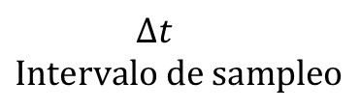
$$d(t)$$
$$d[k]$$
ADC
Analog-to-Digital Converter
$$t$$
$$k$$
$$∆t$$
$$d(t)$$
$$d[k]$$
$$∆t$$
$$Intervalo de sampleo$$

Slide 5
















Sist.
$$u_{1}$$
Sist.
$$u$$
$$y$$
$u_{2}$
$$y$$
$$u_{n}$$
Sist.
$$y_{1}$$
$$u_{1}$$
$$y_{1}$$
$$u$$
$$y_{2}$$
Sist.
$u_{2}$
$$y_{2}$$
$$y_{m}$$
$$u_{n}$$
$$y_{m}$$

Slide 6

















$$δ(t)$$
$$δ(t−T)$$
$$f(T)$$
$$f(t)$$
$$t$$
$$t$$
$$t$$
$$−2$$
$$−1$$
$$0$$
$$1$$
$$T$$
$$T$$
$$f(t)$$
$$f(t)$$
$$t$$
$$t$$

Slide 7




















Subamortiguado
Parte del reposo
$$δ(t)$$
Sist.
$$h(t)$$
$$I=1$$
$$δ(t)$$
$h(t)$ es FRI
$$t$$
$$t$$
$$0$$
$$0$$
$$u(t)$$
C.I.=0
$$y(t)$$
$$u(t)$$
Sist.
$$y(t)$$
$$t$$
$$t$$
$$τ$$
$$τ$$
$$0$$
$$0$$
FRI para impuslo en $τ$

Slide 8

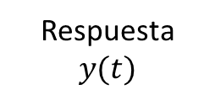




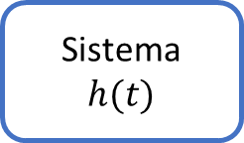





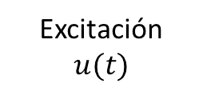







$$u(t)$$
$$h\left(t−τ\right)u(τ)$$
$$δ(t−τ)$$
$$t$$
$$t$$
$$0$$
$$τ$$
$$τ$$
$$0$$
Excitación
$$u(t)$$
Sistema
$$h(t)$$
Respuesta
$$y(t)$$
Dominio tiempo
$$u(t)$$
$$h\left(t\right)∗u(t)$$
$$y(t)$$
convolución
$$ℒ$$
$$ℒ^{−1}$$
Dominio complejo
$$U(s)$$
$$H\left(s\right)U(s)$$
$$Y(s)$$
multiplicación

Slide 9















$$h(t)$$
Dominio tiempo
$$u(t)$$
Sistema
$$y\left(t\right)=h\left(t\right)∗u\left(t\right)$$
$$|H\left(s\right)|$$
Resonancia “portantes”
$$ℒ$$
Magnitud |H(s)|
“superficie carpa”
Dominio complejo
$$U(s)$$
Sistema
$$Y(s)=H\left(s\right)U(s)$$
$$Im(s)$$
$$H(s)$$
$$Im(s)$$
$$Re(s)$$
$$s$$
$$Re(s)$$
Anti-resonancia “estacas”
$$Im(s)$$
: polos
: ceros
$$Re(s)$$

Slide 10























$$h(t)$$
$$h(t)$$
“Estable”
$$h(t)$$
$$1$$
$$+1$$
|a| aumenta
“Estable”
$$+1$$
$$t$$
$$t$$
$$−1$$
$$−1$$
$$t$$
$$h(t)$$
$$T=\frac{2π}{β}$$
$β=ω_{n}$: Frecuencia natural del sistema
(?)
$$1$$
$$t$$
$$h(t)$$
“Inestable”
$$h(t)$$
$$+1$$
“Inestable”
$$t$$
$$−1$$
$$1$$
|a| aumenta
$$t$$

Slide 11
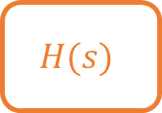


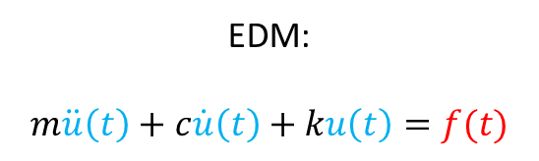

$$f\left(t\right)$$
$$m$$
$$u\left(t\right)$$
$$Im(s)$$
EDM:
$$m\ddot{u}\left(t\right)+c\dot{u}\left(t\right)+ku\left(t\right)=f(t)$$
$$k, c$$
$$Re(s)$$
Estable
Inestable
$$F(s)$$
$$H(s)$$
$$U(s)=H\left(s\right)F(s)$$
Sistema

Slide 12














$$Im(s)$$
$$h(t)$$
$$a_{1}=+βj$$
$$a_{1}=−α+βj$$
$$a_{1}=+α+βj$$
$$h(t)$$
Oscilación decreciente
Asintóticamente estable
Oscilación creciente
“Inestable”
$$h(t)$$
$$Re(s)$$
$$h(t)$$
$$1$$
Asintóticamente estable
Decrecimiento exponencial
Crecimiento exponencial
Inestable
$$a_{2}=−α−βj$$
$$a_{2}=−βj$$
$$a_{2}=+α−βj$$
$$h(t)$$
Oscilación amplitud constante “Estable”

Slide 13



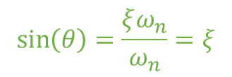





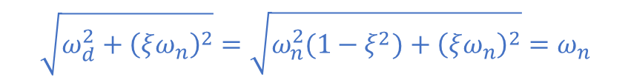
$$Im(s)$$
$$s_{1}$$
$$+ω_{d}$$
$$\sqrt{ω_{d}^{2}+{\left(ξω_{n}\right)}^{2}}=\sqrt{ω_{n}^{2}(1−ξ^{2})+{\left(ξω_{n}\right)}^{2}}=ω_{n}$$
$$ω_{n}$$
$$θ$$
$$Re(s)$$
$$−ξω_{n}$$
$$\sin\left(θ\right)=\frac{ξω_{n}}{ω_{n}}=ξ$$
$$s_{2}$$
$$−ω_{d}$$

Slide 14



$$u(t)$$
$$y\left(t\right)$$
Dominio tiempo
$$\left[\begin{matrix}A & B \\ C & D\end{matrix}\right]$$

Slide 15
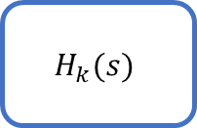


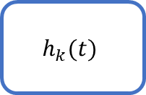
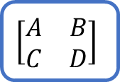
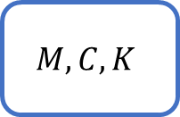
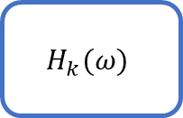


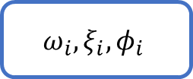

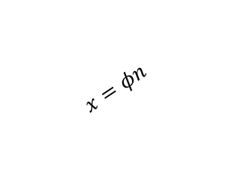

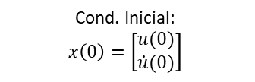
$$ω_{i},ξ_{i}, φ_{i}$$
$$x=φn$$
Dominio Físico
EOM coordenadas modales
(dom. Tiempo)
Cond. Inicial:
$$u\left(0\right), \dot{u}(0)$$
$$M, C, K$$
Cond. Inicial:
$$x\left(0\right)=\left[\begin{matrix}u(0) \\ \dot{u}(0)\end{matrix}\right]$$
Modelamiento numérico
State-space
$$\left[\begin{matrix}A & B \\ C & D\end{matrix}\right]$$
EOM
Coord. Físicas
(dom. Tiempo)
$$ℱ\{∙\}$$
$$ℒ\{∙\}$$
State-space
Dom. Tiempo
Integración
$$ℒ\{∙\}$$
$$ℱ\{∙\}$$
$$ℒ\{∙\}$$
$$H_{k}(ω)$$
$$h_{k}(t)$$
$$H_{k}(s)$$
Función de Resp. en Frecuencia (FRF)
(dom. Frecuencia)
Función respuesta impulso
(dom. Tiempo)
Función transferencia
(dom. Complejo)

Slide 16






















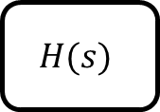




$$u\left(t\right)=ℋ(t)$$
$$H(s)$$
$$y\left(t\right)=𝒰(t)$$
Sistema
$$y(t)$$
$$M_{p}$$
$$ℋ(t)$$
$$101\%$$
$$1$$
“step”
$$99\%$$
$$1$$
$$90\%$$
$$Im(s)$$
$$𝒰(t)$$
$$t$$
$$10\%$$
$$t$$
$$s_{1}$$
$$0$$
$$+ω_{d}$$
$$t_{r}$$
$$t_{s}$$
$$ω_{n}$$
Respuesta transiente
Respuesta estacionaria
“steady state”
$$θ$$
$$−ξω_{n}$$
$$Re(s)$$
$$s_{2}$$
$$−ω_{d}$$

Slide 17


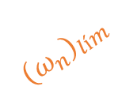




$$Im(s)$$
$${\left(ω_{n}\right)}_{lím}$$
$$θ_{lím}$$
$$Re(s)$$
$${\left(ξω_{d}\right)}_{lím}$$
$$θ_{lím}$$
$${\left(ω_{n}\right)}_{lím}$$
: zona donde se cumplen todas las especificaciones

Slide 18







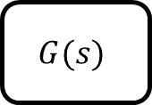


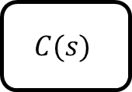

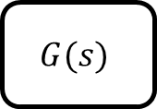
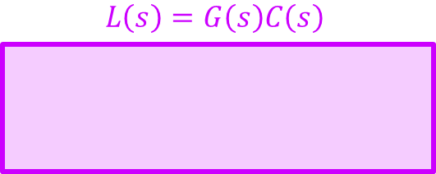

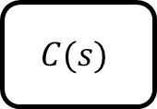




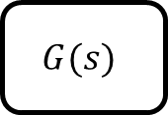
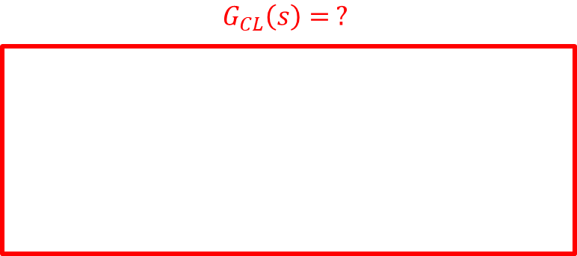



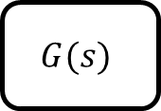





$d$: perturbación
$$r$$
referencia
$$C(s)$$
$$u$$
señal control
$$u+d$$
$$G(s)$$
$$y$$
respuesta
$$+$$
$$+$$
$$u(t)$$
$$G(s)$$
$$y(t)$$
Controlador
Planta
$d$: perturbación
$$+$$
-
$$e$$
error
$$C(s)$$
$$u$$
señal control
$$u+d$$
$$G(s)$$
$$y$$
respuesta
$$E(s)$$
$$C(s)$$
$$U(s)$$
$$r$$
referencia
$$+$$
$$+$$
Controlador
Planta
$y$: respuesta
$$G_{CL}\left(s\right)= ?$$
$$L\left(s\right)=G\left(s\right)C\left(s\right)$$
$$r$$
$$e$$
$$C(s)$$
$$u$$
$$G(s)$$
$$y$$
$$+$$
-

Slide 19

















$u(t)$= $\sin{(Ωt)}$
$$G(s)$$
$$y\left(t\right)=A\sin{(Ωt+φ)}$$
= $A\sin\left(Ω\left(t+τ\right)\right)$
$$y\left(t\right)=A\sin{(Ωt+φ)}$$
$$φ=Ωτ$$
$$A$$
$u(t)$= $\sin{(Ωt)}$
$$t$$
$$1$$
$$φ(°)$$
$τ$: retraso
$$ω_{n_{1}}$$
$$ω_{n_{2}}$$
$$0$$
$$Ω$$
$$−90$$
$$−180$$

Slide 20











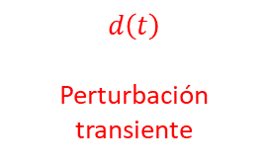
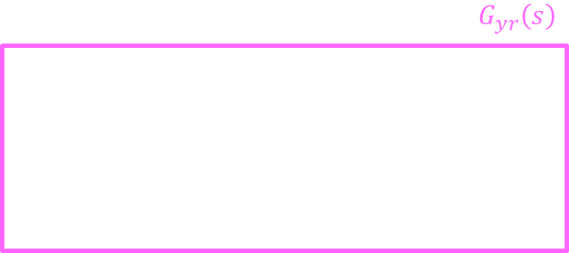





Actuador (motor)
$$f_{a}$$
Fuerza activa del AMD
$$m_{a}$$
$$z\left(t\right)$$
$$z\left(t\right)$$
$$d\left(t\right)$$
Perturbación transiente
$$d\left(t\right)$$
$$m$$
$$kz$$
$$c\dot{z}$$
$$k, c$$
$$G_{yr}\left(s\right)$$
$$r$$
$$e$$
$$C(s)$$
$$u$$
$$G(s)$$
$$y$$
$$+$$
-
$$U(s)$$
$$G(s)$$
$$Y(s)$$
$$y(t)$$
$$y_{∞}≠1$$
$$1$$
$$r(t)$$
$$t$$

Slide 21






$$u$$
Actuador lineal
$$z$$
$$m$$
Control
$$k, c$$
$$y$$
$${\ddot{z}}_{g}$$

Slide 22








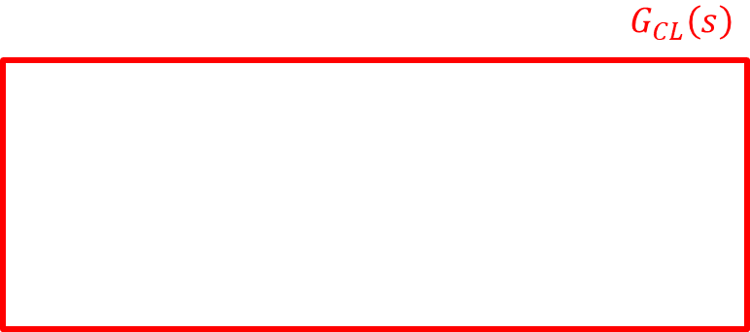











$$G_{CL}\left(s\right)$$
$$e$$
$$C(s)$$
$$u$$
$$G_{yu}(s)$$
$$y$$
Sys
Obs
-
$$u$$
$$y$$
$$\hat{x}$$
Constate que varía de 1 hasta $∞$
$$Im(s)$$
$$Im(s)$$
$$Im(s)$$
$K_{p}$ aumenta
$T_{I}$ fijo
$K_{p}$ aumenta
$T_{D}$ fijo
$K_{p}$ aumenta
$$Re(s)$$
$$Re(s)$$
$$Re(s)$$
Control P
Control PI
Control PD

Slide 23







Sistema cerrado
$$r$$
$$e$$
$$K$$
$$u$$
$$\begin{matrix}A & B \\ C & D\end{matrix}$$
$$y=x$$
$$+$$
-

Slide 24







$$y, \dot{y}$$
$$x_{2}=\dot{y}$$
$$\left(x_{1}\left(t\right),x_{2}\left(t\right)\right)$$
$$x\left(t\right)=φ\left(t\right)x_{0}$$
$${\dot{y}}_{0}$$
$$x_{1}=y$$
$$y_{0}$$
Curva que representa dinámica del sistema para una condición inicial específica

Slide 25






$$x_{2}$$
$$x_{2}$$
$$x_{2}$$
$$x_{1}$$
$$x_{1}$$
$$x_{1}$$
“Condicionalmente” Estable
Asintóticamente
Estable
Inestable

Slide 26























$$δ$$
$$δ$$
$$V\left(x\right)=x^{T}x$$
$$x_{e}$$
$$x_{e}$$
$$x_{0}$$
$$x_{0}$$
$V\left(x\right)=$constante
$$ε$$
$$ε$$
$$V\left(x_{0}\right)=V_{0}$$
$$x(t)$$
$$x(t)$$
$$V\left(x_{1}\right)=V_{1}<V_{0}$$
$$x_{2}$$
$$x_{1}$$
$$x_{e}=0$$
$$x_{0}$$
$$x_{1}$$
$$V\left(x\right)=l_{0}$$
$$f\left(x\right)=\dot{x}$$
$$x_{e}$$
$$∇V$$

Slide 27


T: temperatura barra
$u\left(t\right)$: Posición barras de combustible nuclear
$y\left(t\right)$: potencia eléctrica
Reactor nuclear

Slide 28
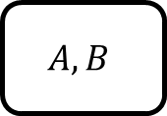






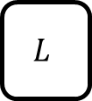






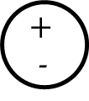

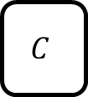








Sist. Físico
Caja negra
$$u(t)$$
$$A,B$$
$$x(t)$$
$$C$$
$$y(t)$$
$$u(t)$$
Planta
$$y(t)$$
Estimador
$$\hat{x}(t)$$
$$x\left(0\right)=x_{0}$$
$$\tilde{y}=y−\hat{y}$$
$$+$$
-
Dinámica Estimador
$$A,B$$
$$C$$
$$\hat{x}(t)$$
$$\hat{y}(t)$$
$$\hat{x}(t)$$
$$L$$
Sistema Cerrado
$$\tilde{y}$$
Gain Observador
$$u$$
Planta
$$y$$
Estimador
$$\hat{x}$$
Estimador
$$y$$
$$K$$
$$−\hat{x}$$
$$+$$
-

Slide 29












$$u$$
Planta
$$y=x$$
$$x(t_{1})$$
$$u_{\left[t,t_{m}\right]}^{o}$$
$$u_{\left[t_{m},t_{1}\right]}^{o}$$
$$K(t)$$
$$−x$$
$$+$$
-
$$x\left(t_{m}\right)=x_{m}$$
$$x(t)$$
Trayectoria óptima partiendo en $x$ y $t$
Trayectoria óptima partiendo en $x_{m}$ y $t_{m}$

Slide 30




























$$x_{1}(t)$$
$$x_{1}(t_{1})$$
$$Y$$
$$Y$$
$$x_{1}(t_{3})$$
$$t_{2}$$
$$t_{m}$$
$$0$$
$$t$$
$$t_{1}$$
$$t_{3}$$
…
$$X$$
$$X$$
$$x_{1}(t_{2})$$
$$x_{1}(t_{m})$$
$$x_{2}(t)$$
$$ρ_{XY}≈1$$
$ρ_{XY}≈$0
$$x_{2}(t_{2})$$
$$x_{2}(t_{1})$$
$$x_{2}(t_{m})$$
$$t_{3}$$
$$0$$
$$t$$
$$t_{1}$$
…
$$t_{2}$$
$$t_{m}$$
$$x_{2}(t_{3})$$

Slide 31







$$a_{g}(t)$$
$$0$$
$$t$$
$$x(t)$$
$$x_{1}\left(t\right)$$
$$x_{2}\left(t\right)$$
$$x_{3}\left(t\right)$$
$$0$$
$$t$$
$$t$$
$$t+τ$$

Slide 32
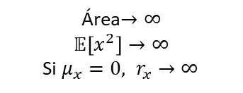





















$$S_{X}(ω)$$
$$S_{X}(ω)$$
$$R_{X}(τ)$$
$$\int_{−∞}^{∞}{S_{X}\left(ω\right)dω=R_{X}\left(0\right)=σ_{x}^{2}+μ_{x}^{2}}$$
$$S_{0}$$
$$ω$$
$$ω$$
$$τ$$
$$τ=0$$
Área$→∞$
$$𝔼\left[x^{2}\right]→∞$$
Si $μ_{x}=0, r_{x}→∞$
Ruido blanco es completamente incoherente consigo mismo
$$S_{X}(ω)$$
$$R_{X}(τ)$$
$$R_{X}\left(0\right)=2S_{0}ω_{c}$$
$$S_{0}$$
$$ω$$
$$τ$$
$$−ω_{c}$$
$$+ω_{c}$$
$$0$$
$$\frac{2π}{ωc}$$
$$\frac{π}{ωc}$$
Área$=2S_{0}ω_{c}<∞$

Slide 33





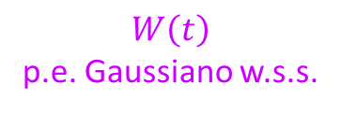




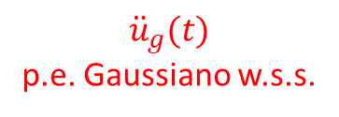


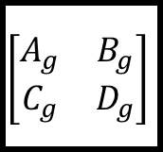

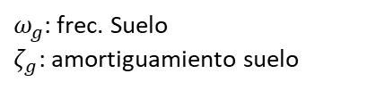


$${\ddot{u}}_{g}$$
$ω_{g}$: frec. Suelo
$ζ_{g}$: amortiguamiento suelo
$$\left[\begin{matrix}A_{g} & B_{g} \\ C_{g} & D_{g}\end{matrix}\right]$$
$$W\left(t\right)$$
p.e. Gaussiano w.s.s.
$${\ddot{u}}_{g}(t)$$
p.e. Gaussiano w.s.s.
Roca base
Filtro K-T
$$S_{W}$$
$$S_{{\ddot{u}}_{g}}$$
$$ζ_{g}$$
${\ddot{u}}_{roca}=W\left(t\right)−$ p.e. Gaussiano estacionario $⇒$ ruido blanco
$$S_{0}$$
$$S_{0}$$
$$ω$$
$$ω$$
$$ω_{g}$$
$$|H_{KT}(Ω)|$$
$$ζ_{g}$$
Ruido blanco
Ruido coloreado
$$1$$
$$ω_{g}$$
$$Ω$$

Slide 34












Sistema aumentado
$$x_{g}$$
$$x_{s}$$
$$W(t)$$
Filtro K-T
$${\ddot{u}}_{g}(t)$$
Modelo estructural
$y$(t)
$$t$$
$$t$$
$$t$$
Sistema aumentado
$$x_{g}$$
$$x_{s}$$
$$W(t)$$
Filtro K-T
$$u_{KT}$$
$$×$$
$${\ddot{u}}_{g}(t)$$
Modelo estructural
$y$(t)
Función de modulación
Reloj

Slide 35



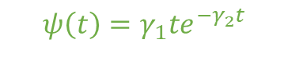

$$ψ\left(t\right)=γ_{1}te^{−γ_{2}t}$$
$$u_{KT}$$
$$0$$
$$t$$
p.e. no-estacionario ${\ddot{u}}_{g}$
$$0$$
$$t$$

Slide 36
















$$ω(t)$$
$$v(t)$$
Planta
$$x(t)$$
$$y(t)$$
$$u(t)$$
$$C$$
+
+
Filtro de Kalman
$$ω(t)$$
$$v(t)$$
$$u(t)$$
Planta
$$y(t)$$
$$\tilde{y}(t)$$
$$L_{KAL}$$
$$\tilde{x}(t)$$
+
-
Planta
$$y(t)$$
+
+
+
$$\hat{y}(t)$$
$$\tilde{y}(t)$$
$$C$$
-
Filtro de Kalman
$$\hat{y}(t)$$

Slide 37





$$ω(t)$$
$$v(t)$$
Sistema aumentado
$$u(t)$$
Planta
$$y(t)$$
Planta controlada
$$ω(t)$$
$$y(t)$$
$$v(t)$$
LQG
LQR
$$\tilde{x}(t)$$
Kalman

Slide 38
Rehabilitación,
Reparación
Diseño
Síntesis de datos empíricos
Indicadores
Comparación con procedimientos de diseño
Verificación
Construcción
Instrumentación
Recolectar datos relevantes del desempeño estructural

Slide 39
Sistema
Input
Output
Conocido
Predecir respuesta
Conocido
Sistema
Input
Output
Predecir “fuerza”
Conocido
Conocido
Sistema
Input
Output
Conocido
Conocido
Determinar modelo del sistema

Slide 40

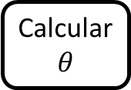

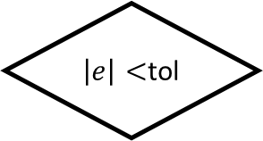


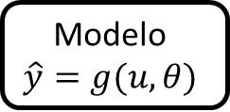

$$G_{yu}(ω)$$
Caja negra
$$U(ω)$$
$$Y(ω)$$
$$x(t)$$
$$z(t)$$
$$u(t)$$
Sistema
$$y(t)$$
$\left|e\right|<$tol
$$e(t)$$
+
-
$$\hat{y}(t)$$
Modelo
$$\hat{y}=g(u,θ)$$
Calcular $θ$

Slide 41









$$G_{zx}\left(ω\right)$$
$$U(ω)$$
$$G_{yu}(ω)$$
$$Y(ω)$$
$$M(ω)$$
+
+
$$N(ω)$$
+
+
$$X\left(ω\right)$$
Señal entrada medida
$$Z\left(ω\right)$$
Señal salida medida

Slide 42








Mag
$$H_{2}$$
$$H_{1}$$
$G_{yu}$ real
$$ω$$
$$ω_{N_{1}}$$
$$ω_{N_{2}}$$
$$ω_{N_{3}}$$
Coherencia
$$1$$
$$0.5$$
$$ω$$

Slide 43





























$$x_{1}(t)$$
Sistema
sensor
Señal análoga
$$t$$
$$x[n]$$
“Digitalizar”
$$x_{1}$$
$$x_{1}(t)$$
$$x_{2}$$
$$x_{3}$$
$$x_{4}$$
$$x_{0}$$
Señal discreta
$$n$$
$$t$$
$$0$$
$$1$$
$$2$$
$$3$$
$$4$$
A/D
T
$$x_{a}\left(t\right)$$
$$x[n]$$
$$1$$
A/D
$$x[n]$$
Computer
$$y[n]$$
D/A
$$n$$
$$x_{a}\left(t\right)$$
Sensor análogo
$$y_{a}(t)$$
Actuador
Voltaje
Corriente
$$−2$$
$$−1$$
$$0$$
$$1$$
Análogo/Digital
Filtering
Denoising
Predicciones lineales
compresión
Digital/Análogo
$⇒$Interpolación

Slide 44







Tiempo
Frecuencia
$$x_{a}(t)$$
FT
Fourier Transform
$$X(Ω)$$
Sampling en el tiempo
$$x[n]$$
DTFT
Discrete-Time
Fourier Transform
$$X_{d}(Ω)$$
Sampling en frecuencia
DFT
Discrete
Fourier Transform
$$X[m]$$
$$x[n]$$
$⇒$Objetivo!!

Slide 45















$f_{1}=6$ Hz
$sin⁡(2πf_{1}t)$- Análoga
Reconstrucción de señal análoga
$$sin⁡(2πf_{2}t)$$
Aliasing
Digital $f_{2}<{2f}_{1}$
$f_{2}=1$ Hz$<2(6$Hz$)$
$$X(f)$$
$$A$$
$${−F}_{s}$$
$$−F_{s}/2$$
$$F_{s}/2$$
$$F_{s}$$
$${−f}_{máx}$$
$$f_{máx}$$
$$f$$
$$X_{d}(f)$$
$$F_{s}A$$
$$f$$

Slide 46













$$X(f)$$
$$f_{máx}>F_{N}=\frac{F_{S}}{2}$$
$$A$$
$${−f}_{máx}$$
$$f_{máx}$$
$$f$$
$$X_{d}(f)$$
$$F_{s}A$$
$$f$$
$${−F}_{s}$$
$$−F_{s}/2$$
$$F_{s}/2$$
$$F_{s}$$

