Slide 1


Mining Toronto Fire Services Incident Data
CKME 136: Data Analytics Capstone
by Geoffrey Clark
2018

Slide 2
Research Question
What additional information, if any, can be provided to first responders at the time of incident call?
Geoffrey Clark

Slide 3
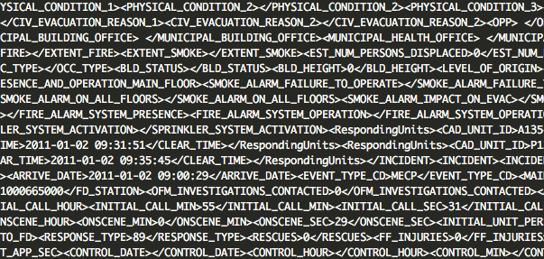
Dataset
Open Source: Toronto Open Data Catalogue
XML
720,340 Observations, 100 Features
2011 - 2016
Geoffrey Clark

Slide 4
Features
Temporal: Date & Time of Incident call, dispatch, arrival (on-scene) & control
Types of Incidents: Fire, Alarm, Vehicle, Rescue, Medical, …
Location: Property Type, FSA, Main & Cross Street
Call Source: Agency, Ambulance, 911...
Geoffrey Clark

Slide 5
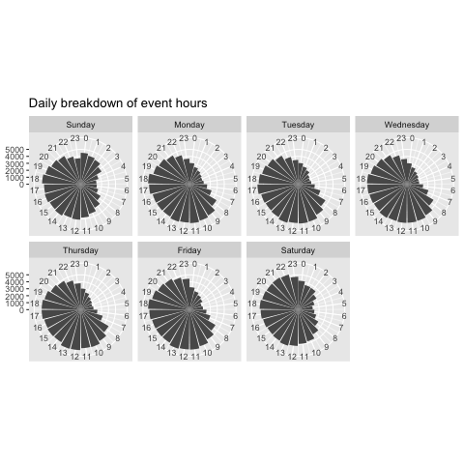
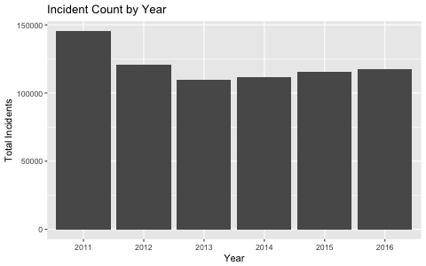
Some Patterns
Geoffrey Clark

Slide 6
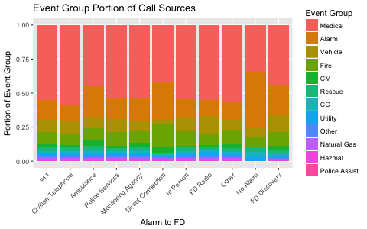
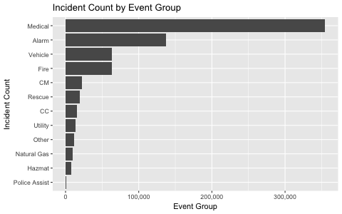
Some Patterns
{Event group = Alarm} => {Response Group = False Fire Calls}
81% Confidence! 112,659 Incidents
Geoffrey Clark

Slide 7
Modeling
Logistic Regression, Naive Bayes, Random Forest
Train & Predict “Critical Incidents”
Randomly selected training set (60%), test set (40%)
“Before” and “After” features
Accuracy, Precision, Recall & F₁-Score
Geoffrey Clark

Slide 8
Supervised Learning
Critical Incidents:
  Class Label: Damage, Responding Units, OFM Investigations, Injuries, Fatalities, Rescues
  Predict: Event type, call source, estimated km, month, day, hour..
Only Fire Incidents Used
 | Non-Critical | Critical
Whole Dataset | 690,588 (96%) | 29,782 (4%)
Fire Incidents | 49,722 (79%) | 13,512 (21%)
Geoffrey Clark

Slide 9
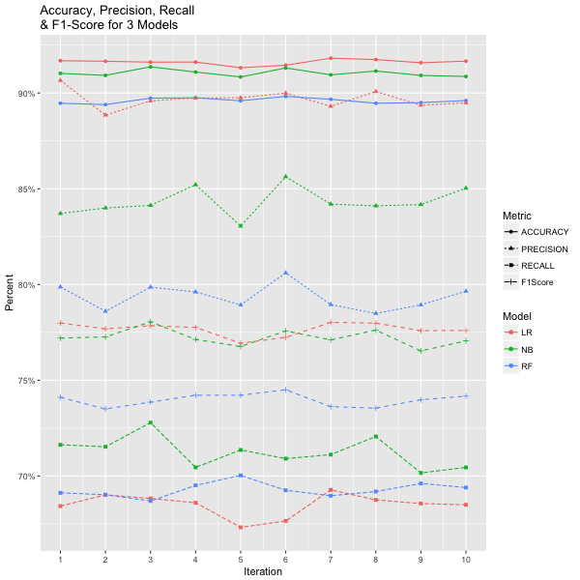
Modeling Results
Predicted
 | Non-Critical | Critical
Non-Critical | 19423 | 1175
Critical | 383 | 3717
Actual
Accuracy | 91.6
False-Negative Rate | 31.5
Precision | 90.6
Recall | 68.4
F₁-Score | 77.9
Geoffrey Clark

Slide 10
Conclusion
What additional information, if any, can be provided to first responders at the time of incident call?
Logistic Regression: Accuracy, Precision
Naive Bayes: Recall
Generalizability
  Entire Dataset
Limitations
  Time, Domain knowledge, Computation Power, Dataset
Geoffrey Clark

Slide 11
Questions & Thanks

