Slide 1

Cascading Style Sheet
FROM ZERO TO HERO

Slide 2
CSS Introduction
Cascading style Sheet
Used to override the default styles of HTML
CSS Describes how the html elements will be displayed
Separates the document from presentation
Inline / Block / File Modes

Slide 3
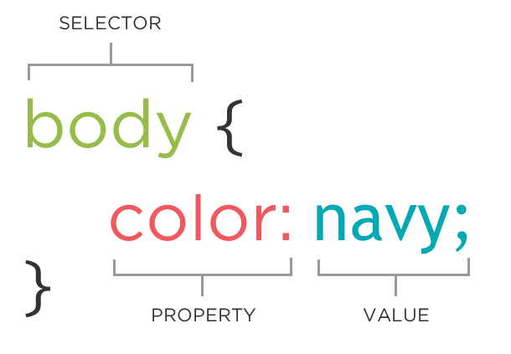
CSS Syntax

Slide 4
CSS Comments
Single Line Comments
/* …………..*/
Multi Line Comments
/* …………….*/

Slide 5
CSS Usage
Inline usage
Style attribute
Internal usage
<style>…………</style>
External usage
<link rel="stylesheet" href=“styles.css">

Slide 6
CSS Selectors
Element Selector h1{…}
Id selector #yourId{..}
Class selector .yourClass{…}
Attribute Selector input[type=“text”]
Pseudo Classes button:hover

Slide 7
CSS COLORS
Background-color
Text Color
Border colors
Border : 2px solid red
Color values
RGB
rgb(88,24,68)
HEX
#581845 (rrggbb)
HSL (hue,saturation,lightness)
318, 73%, 22%

Slide 8
CSS Colors
RGB
rgb(100,100,100)
red green blue
0 to 255 values
HEX Value
#rrggbb
00 to ff
HSL
hsl(hue,saturation,lightness)
Hue -> Degree on the color wheel ( 0:red , 120:green: , 240: blue)
Saturation is a percentage value, 0% means a shade of gray, and 100% is the full color.
Lightness is also a percentage, 0% is black, 50% is neither light or dark, 100% is white

Slide 9
CSS Backgrounds
background-color
background-image
background-repeat
background-attachment (fixed scroll)
background-position (right top)
background : color url repeat attachment position

Slide 10
CSS Borders
border-width 2px
border-style solid
border-color green
Border-radius 2px
border: 2px solid green

Slide 11
CSS Margins
margin-top
margin-right
margin-bottom
margin-left
Margin (all sides)

Slide 12
CSS Padding
padding-top
padding-right
padding-bottom
padding-left
Padding: (all sides)

Slide 13
CSS Outline
Outline-width
Outline-style
Outline-color
outline: 2px solid red

Slide 14
CSS Text Styles
Color
Text-align
Text-decoration
Text-transform
Text-indent
Letter-spacing
Line-height
Direction
Word-spacing
Text-shadow (horizontal , vertical , color)
text-shadow: 3px 2px red;

Slide 15
CSS Fonts
Font-family
Serif (Times New Roman,)
Sans-serif (Arial , Verdana, Georgia)
Monospace (Courier New , Lucida Console)
Font-style (normal , italic)
Font-size (px , cm , em)
Font-weight (normal , bold,bolder)

Slide 16
CSS Links
a:link - a normal, unvisited link
a:hover - a link when the user mouse over it
a:active - a link the moment it is clicked
a:visited - a link the user has visited

Slide 17
CSS Tables
Border
Padding
Text-align
Hover
Nth-child

Slide 18
CSS Position
Static (default and not effected by top , bottom , right , left)
Relative (position is relative to its normal position)
Fixed (always placed in a fixed even after scroll)
Absolute ( This is positioned relative to nearest ancestor)
Sticky (positioned based on users scroll position)

Slide 19
CSS Rounded Corners
Border-radius

Slide 20
CSS Box Modal layout
Margin
Border
Padding
Content

Slide 21
CSS Display Classes
Inline
Block
Inline Block
none

Slide 22
CSS Float
Float left
Float right
clear

Slide 23
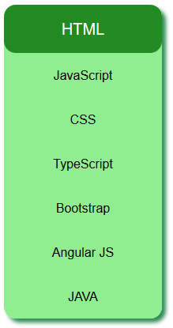
CSS Vertical Navigation

Slide 24
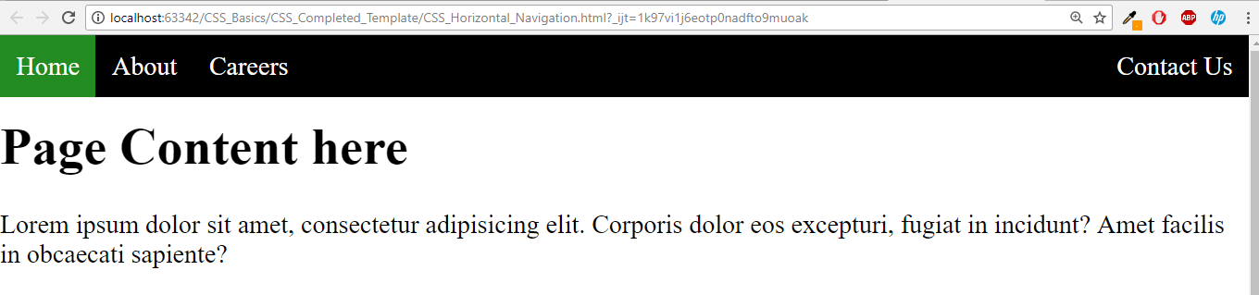
CSS Horizontal Navigation

Slide 25
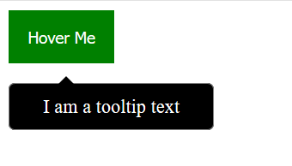
CSS Tooltips

Slide 26
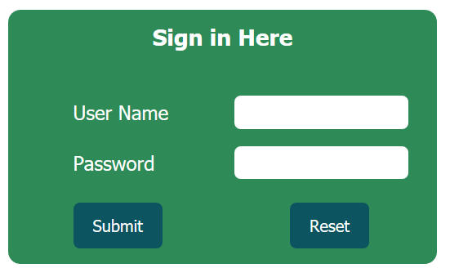
CSS Forms

Slide 27
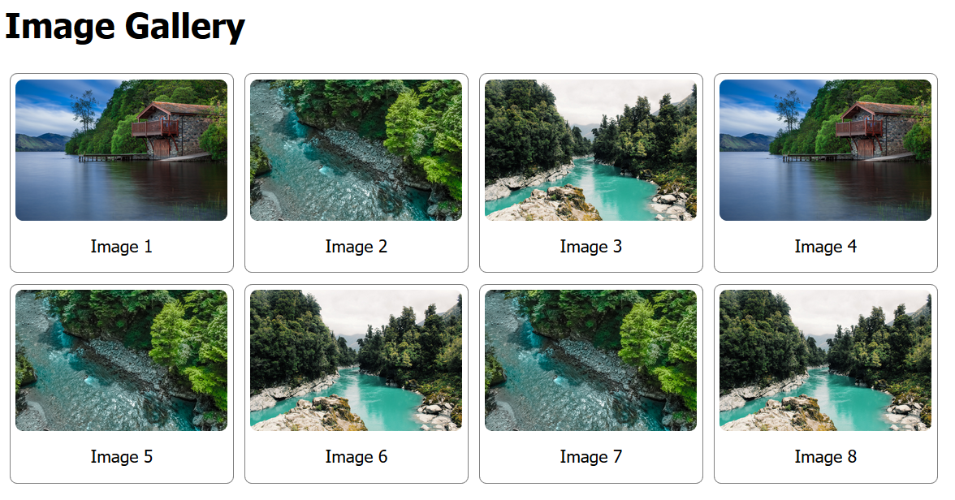
CSS Image Gallery

Slide 28
CSS3 Transformation
Transformation
A Transformation is an effect that lets an element to change its shape , size and position
CSS Transform
The transform property allows you to visually manipulate an element by skewing, rotating, Translating or Scaling.
CSS3 Supports 2D and 3D Transforms.

Slide 29
2D Transform
CSS allows to transform its elements by using the following
translate()
The translate() method moves an element from its current position (according to the parameters given for the X-axis and the Y-axis).
Ex: transform: translate(10px, 20px);
rotate()
The rotate() method rotates an element clockwise or counter-clockwise according to a given degree.
Ex: transform: rotate(20deg);

Slide 30
2D Transform cont.….
scale()
The scale() method increases or decreases the size of an element (according to the parameters given for the width and height).
Ex: transform: scale(0.5, 0.5);
skewX()
The skewX() method skews an element along the X-axis by the given angle.
Ex: transform: skewX(20deg);

Slide 31
2D Transform cont.…
skewY()
The skewY() method skews an element along the Y-axis by the given angle.
Ex: transform: skewY(20deg);
skew()
The skew() method skews an element along the X and Y-axis by the given angles.
transform: skew(20deg, 10deg);

Slide 32
2D Transform cont.…
matrix()
The matrix() method combines all the 2D transform methods into one.
The matrix() method take six parameters, containing mathematic functions, which allows you to rotate, scale, move (translate), and skew elements.
The parameters are as follow: matrix(scaleX(),skewY(),skewX(),scaleY(),translateX(),translateY())

Slide 33
3D Transform
3D Transform allows the elements to transform in 3D way.
rotateX()
The rotateX() method rotates an element around its X-axis at a given degree
rotateY()
The rotateY() method rotates an element around its Y-axis at a given degree
rotateZ()
The rotateZ() method rotates an element around its Z-axis at a given degree

Slide 34
CSS3 Transitions
CSS3 transitions allows you to change property values smoothly (from one value to another), over a given duration.
To create a transition effect, you must specify two things
The CSS property you want to add an effect to
The duration of the effect

Slide 35
CSS3 Transitions Cont..
transition: width 2s;
transition: height 2s;
transition: height 2s , width 2s;
transition: height 2s , width 2s , transform 2s;
transition-timing-function: linear;
transition-timing-function: ease-in;
transition-timing-function: ease-out;

Slide 36
CSS 3 Animations
An animation lets an element gradually change from one style to another.
CSS3 animations allows animation of most HTML elements without using JavaScript or Flash!
You can change as many CSS properties you want, as many times you want.
To use CSS3 animation, you must first specify some keyframes for the animation.
Keyframes hold what styles the element will have at certain times.

Slide 37
@keyframes Rule
First we needs to define rule for animation
Bind that rules with HTML Elements
animation-name: simple;
animation-duration: 4s;
animation-iteration-count: infinite;
animation-direction: alternate;
animation-timing-function: linear
animation-delay:2s

Slide 38
Animation cont…
animation-name: the name of an animation
animation-duration: duration of an animation effect
animation-iteration-count: the number of times an animation should be repeated.
animation-direction: the direction of an animation
animation-timing-function: same as the timing function of transition effect.
animation-delay: the delay time of an animation

Slide 39
Mini Project
Technology Portal Website

