Slide 1
JQuery
FROM ZERO TO HERO

Slide 2
JQuery
JQuery is a lightweight JavaScript library.
JQuery’s biggest feature is write less and do more
For most of the common tasks of JavaScript may required more number of lines code, which are wrapped in to methods in JQuery they can be called by using a single line of code.
JQuery simplifies the complicated things by JavaScript like AJAX calls and DOM Manipulation.

Slide 3
Features of JQuery
HTML / DOM Manipulation.
CSS Manipulation
JavaScript Event Handling methods.
Effects and Animations
JQuery is also having lot of plugins for most of the complicated tasks in JavaScript.
JQuery code works perfectly in all the modern browsers.

Slide 4
Link JQuery to any website
JQuery comes along with two versions
Production version (minified version)
Development version (non minified version)
We can install JQuery using the following ways
CDN link
Google CDN link
Microsoft CDN Link
Offline version

Slide 5
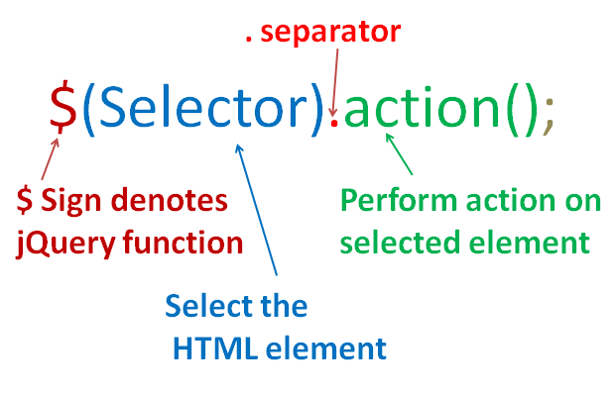
JQuery Syntax

Slide 6
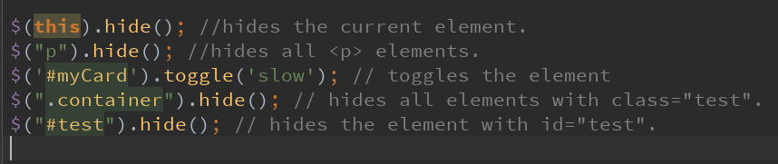
JQuery Examples

Slide 7
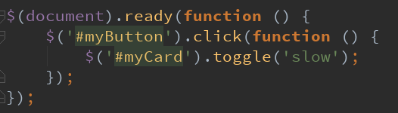
The document.ready event
This statement is to prevent any JQuery code running before the document finished loading.
It is good practice to wait for the document to be fully loaded and ready before working with it.

Slide 8
JQuery selectors
Element Selector $(‘p’)
ID selector $(‘#main-nav’)
Class selector $(‘.container’)
Attribute Selector $(“input[type=‘text’]”)
Pseudo classes selector $(‘tr:even’)

Slide 9
JQuery Usage
Internal Way
Using <Script> tag
External Way
Using separate .js File.

Slide 10
JQuery Events
All kinds of actions that a user can perform on a webpage is called an event.
An Event is the moment when a user performing an action
Example:
Selecting a Radio Button
Focus on an input field
Hover on a button

Slide 11
Common DOM Event
Mouse Events | Keyboard Events | Form Events | Document Events
Click | Keypress | Submit | Load
Dbclick | Keydown | Change | Resize
Mouseenter | Keyup | Focus | Scroll
Mouseleave |  |  | unload

Slide 12
Demo

Slide 13
AJAX Introduction
Traditionally webpages required reloading to update their content.
For web based emails if users have to reload the page each time to check the new mails is the biggest drawback, as it is slow and requires user input.
For each reload server has to send the completed HTML , CSS , JavaScript code and also the data to the browser.
This approach is highly inefficient and ideally the server should only send the new messages only to the browser instead of the complete page.
By 2003 all the major browsers solved this issue by adopting a new concept called XMLHttpRequest Object.
XMLHttpRequest is a part of a Technology called AJAX.

Slide 14
AJAX
Using AJAX the data could be passed between the browser and server using XMLHttpRequest API without complete reload of the entire webpage.
Example :
Google Maps uses AJAX to get new map tiles without reload of a webpage.
Gmail gets the new mails without reload the entire web page.
CricInfo website displays the data without reloading the actual page.
Unfortunately each browser implements the AJAX API differently. But JQuery supports AJAX which works in all the browsers uniformly.

Slide 15
AJAX
AJAX Stands for Asynchronous JavaScript and Xml
AJAX is just a client side programming technique to updates the different parts of the webpage without reloading whole page.
For This it uses the browsers built-in object called XMLHttpRequest Object.
This object is responsible to request the data from the webserver for some specific intervals.
Once we fetch the data from the webserver, we can display the data on the HTML using JavaScript DOM Manipulation or JQuery.
Using AJAX we can asynchronously get the data from the server. We may get the data in ‘xml’ format.
Usually the same AJAX technique is used to transfer the data along with the ‘xml’ , we can even transfer the data in JSON and ‘plain Text’ format.

Slide 16
How AJAX Works
An event occurs in the client or the page loads
We create an XMLHttpRequest and send to server
Server process the Request and prepares the response and send back to the browser
Client process the returned data from the server using JavaScript and updates the page contents using HTML DOM Manipulation.
Client
server
client

Slide 17

XMLHttpRequest Object
In the whole process of AJAX, this Object places the key role.
This object is responsible to exchange data with a webserver behind the scenes. It means that we can updates the parts of the webpage without reloading the entire webpage.
All the modern browsers have a built in XMLHttpRequest Object.
To create this object we use the below syntax,

Slide 18
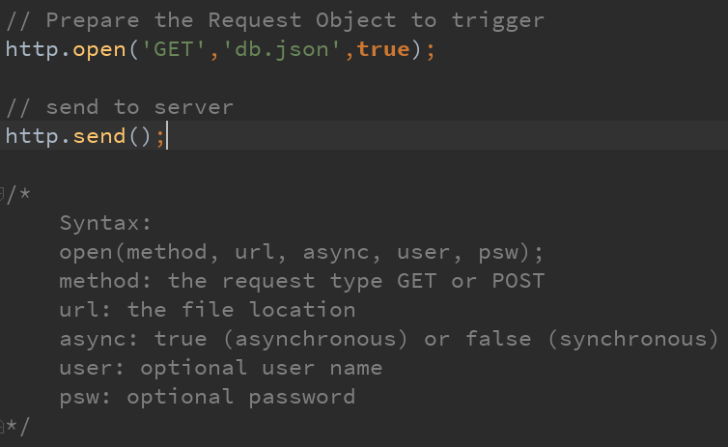

Slide 19
The onreadystatechange Property
The readyState property holds the status of the XMLHttpRequest.
The onreadystatechange property defines a function to be executed when the readyState changes.
The status property and the statusText property holds the status of the XMLHttpRequest object.

Slide 20
Property | Description
Onreadystatechange | Defines a function to be called when the readyState property changes
readyState | Holds the status of the XMLHttpRequest. 0: request not initialized 1: server connection established 2: request received 3: processing request 4: request finished and response is ready
Status | 200: "OK" 403: "Forbidden" 404: "Page not found"
statusText | Returns the status-text (e.g. "OK" or "Not Found")
Note: The onreadystatechange function is called every time the readyState changes.
When readyState is 4 and status is 200, the response is ready:

Slide 21
Demo

Slide 22


