Slide 2
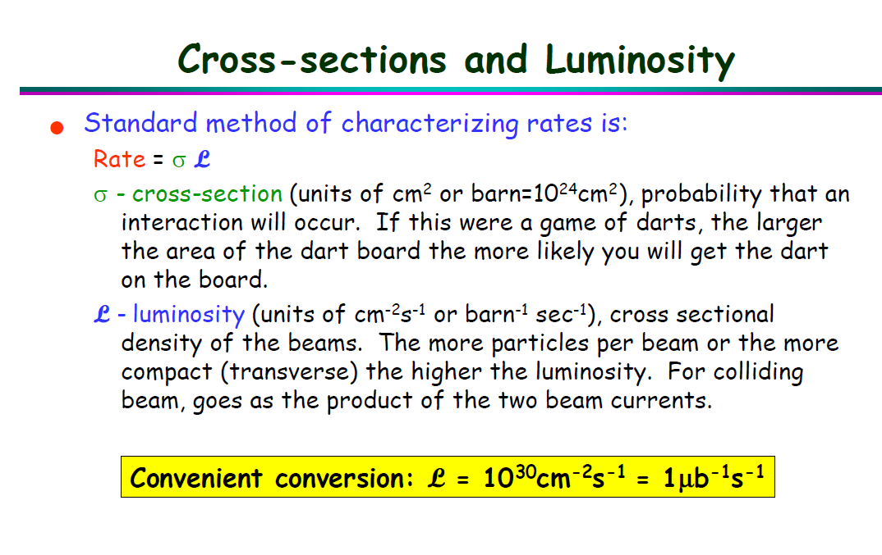
Date: 2018-10-15
Source: google <Triggering in Particle Physics Experiments>

Slide 3
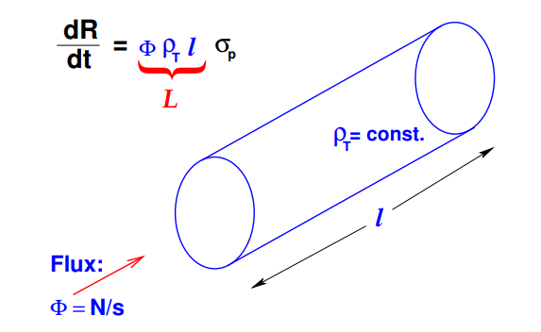
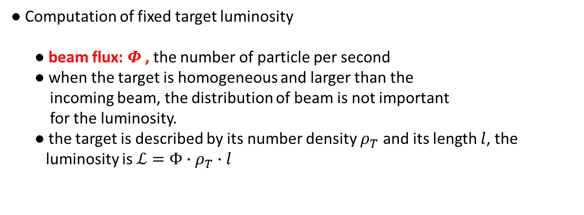
Date: 2018-11-01
Source: https://cds.cern.ch/record/941318/files/p361.pdf
Luminosity
● count rate $\frac{dR}{dt}=ℒ∙σ_{P}$
● Computation of fixed target luminosity
● beam flux: $Φ$, the number of particle per second
● when the target is homogeneous and larger than the
incoming beam, the distribution of beam is not important
for the luminosity.
● the target is described by its number density $ρ_{T}$ and its length $l$, the
luminosity is $ℒ=Φ∙ρ_{T}∙l$
Number of interaction
per beam particle

Slide 4
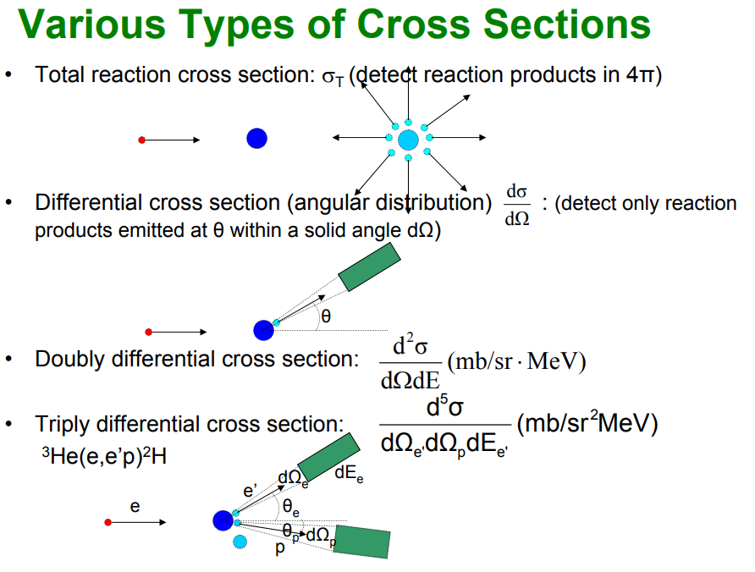
Date: 2018-11-01
Source:https://facultystaff.richmond.edu/~ggilfoyl/research/nuclearCrossSections.pdf
How to measure cross section?
● Types of cross sections

Slide 5
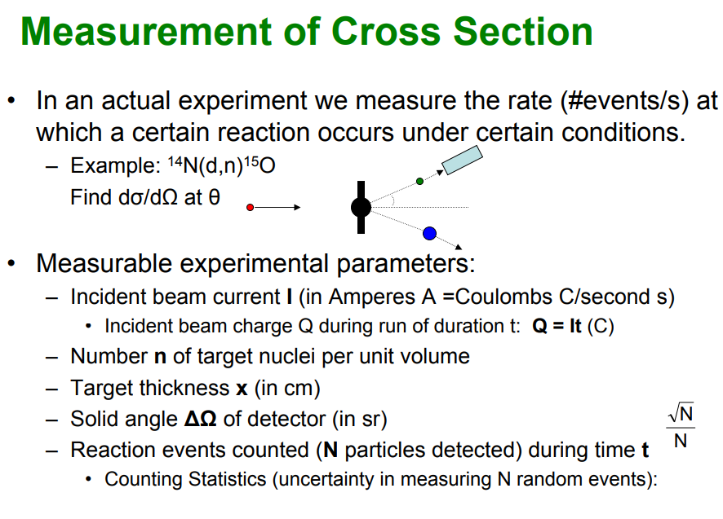
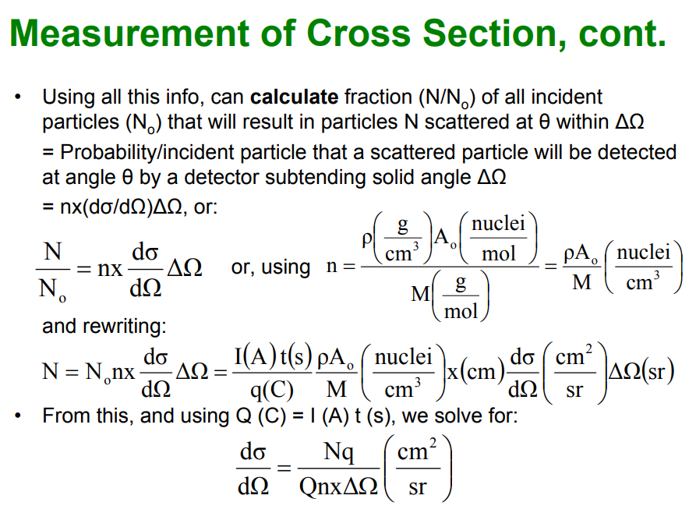
● Measurement of Cross section

Slide 6
Date: 2018-11-06
Source: Talk to Daniele
Some basic concepts
● What is an event ? What is an entry? What is multiplicity?
● event: the results after a fundamental interaction took place between subatomic particles
● an entry: the same as an entry, including particles detected in one trigger period
● multiplicity: the number of particles detected in an entry (within one trigger period)

Slide 7
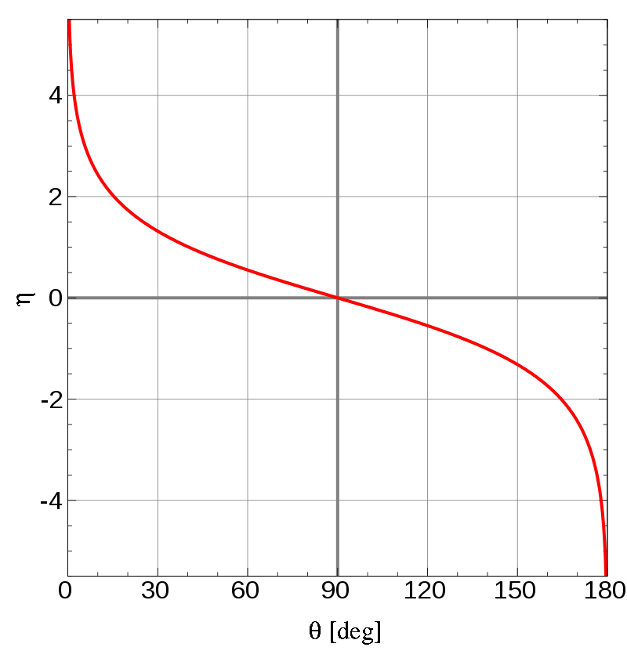
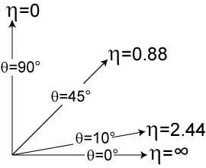
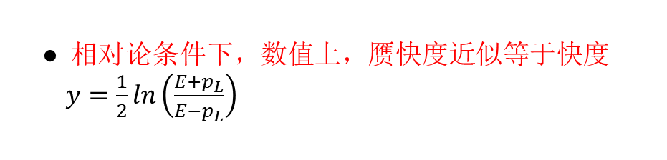

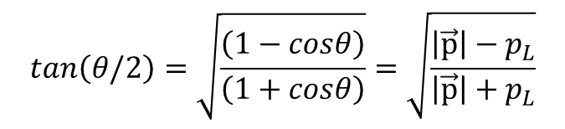
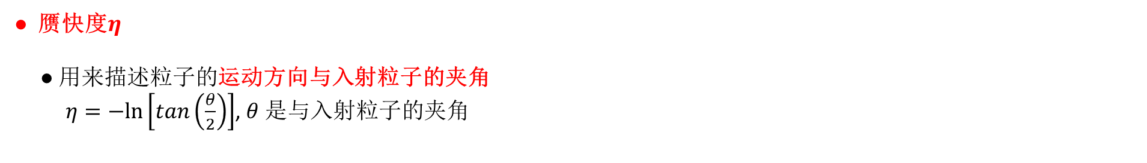
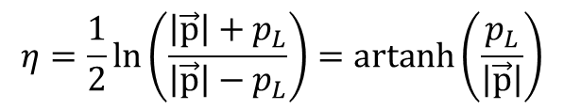



Date: 2018-11-07
Source:
快度(Rapidity) 赝快度(PseudoRapidity)
● Rapidity is a type of “velocity” while pseudorapidity is a type of “angle” that tells us where we are in the detector.
● 赝快度$η$
● 用来描述粒子的运动方向与入射粒子的夹角
$η=−ln⁡\left[tan\left(\frac{θ}{2}\right)\right]$, $θ$是与入射粒子的夹角
● 赝快度也可以表示为动量$\vec{p}$的函数：
$$η=\frac{1}{2}\ln\left(\frac{\left|\vec{p}\right|+p_{L}}{\left|\vec{p}\right|−p_{L}}\right)=artanh\left(\frac{p_{L}}{\left|\vec{p}\right|}\right)$$
$p_{L}$是纵向动量, 即动量沿着束流方向的分量
$$cosθ=1−2\sin^{2}\left(θ/2\right)=2\cos^{2}\left(θ/2\right)−1$$
● 相对论条件下，数值上，赝快度近似等于快度
$y=\frac{1}{2}ln\left(\frac{E+p_{L}}{E−p_{L}}\right)$
$$sin\left(θ/2\right)=\sqrt{\left(1−cosθ\right)/2}$$
$$cos\left(θ/2\right)=\sqrt{\left(1+cosθ\right)/2}$$
$$tan\left(θ/2\right)=\sqrt{\frac{\left(1−cosθ\right)}{\left(1+cosθ\right)}}=\sqrt{\frac{\left|\vec{p}\right|−p_{L}}{\left|\vec{p}\right|+p_{L}}}$$

Slide 8




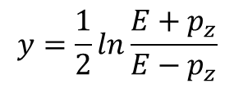
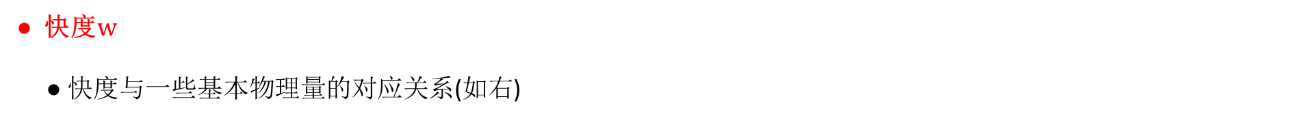

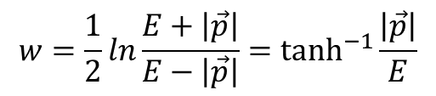

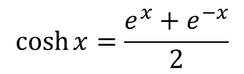

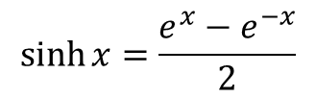

● 快度$w$
● 快度与一些基本物理量的对应关系(如右)
$$w=\tanh^{−1}{β}$$
$γ =\cosh{w}$
● 快度可以通过测量的动量和能量测量
$βγ=\sinh{w}$
$$w=\frac{1}{2}ln\frac{E+\left|\vec{p}\right|}{E−\left|\vec{p}\right|}=\tanh^{−1}{\frac{\left|\vec{p}\right|}{E}}$$
$$β=\tanh{w}$$
$$w=\tanh^{−1}{β}$$
● 在粒子物理实验中，经常使用下面的定义：
$$e^{w}=γ\left(1+β\right)$$
$$y=\frac{1}{2}ln\frac{E+p_{z}}{E−p_{z}}$$
$$e^{−w}=γ\left(1−β\right)$$
$$\sinh{x}=\frac{e^{x}−e^{−x}}{2}$$
$p_{z}$是纵向动量, 即动量沿着束流方向的分量
$$\cosh{x}=\frac{e^{x}+e^{−x}}{2}$$

Slide 11
Date:
Source:

Slide 12
Date:
Source:

Slide 13
Date:
Source:

