Slide 1
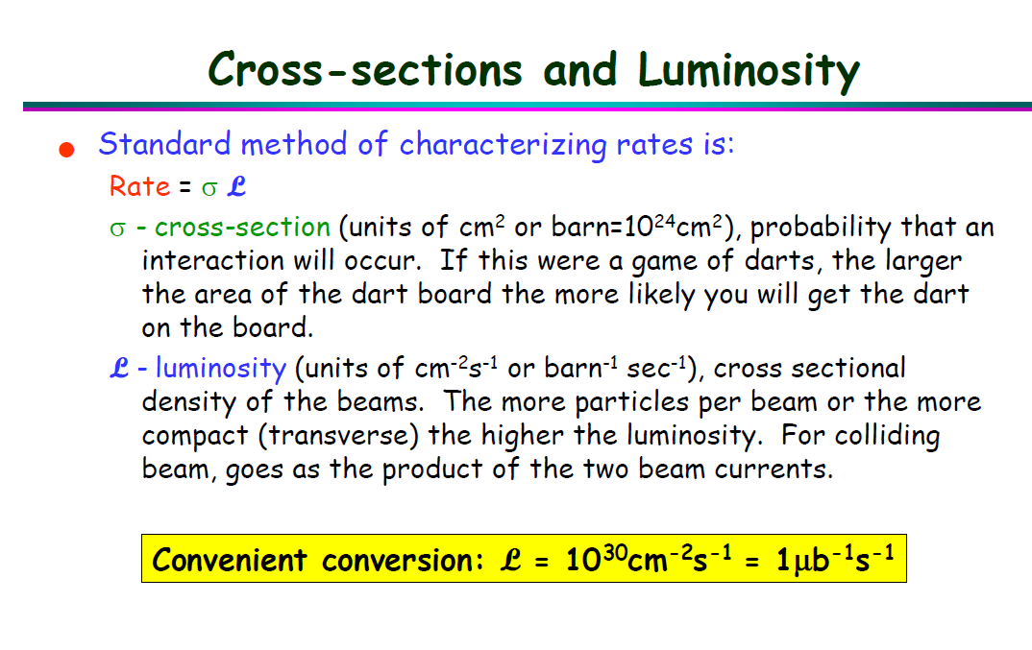
Date: 2018-10-15
Source: google <Triggering in Particle Physics Experiments>

Slide 2
Date: 2018-10-15
Source: CAEN <Digital Pulse Processing in Nuclear Physics>

Slide 3
Date:
Source:

