Slide 1
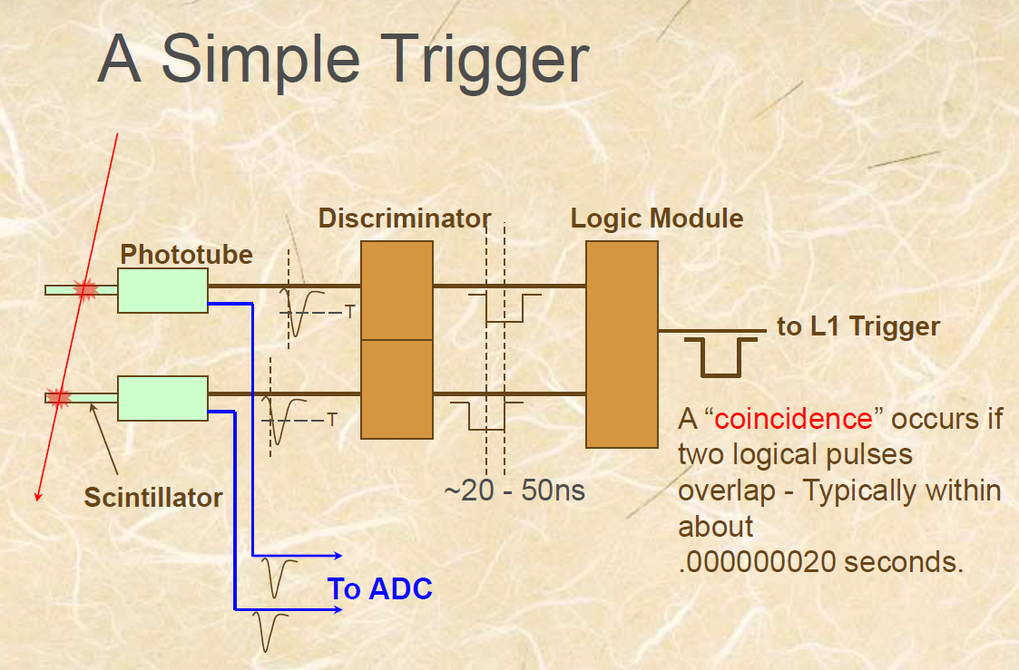
Date: 2018-10-15
Source: google <Data Acquisition Systems for Experimental Nuclear Physics>

Slide 2
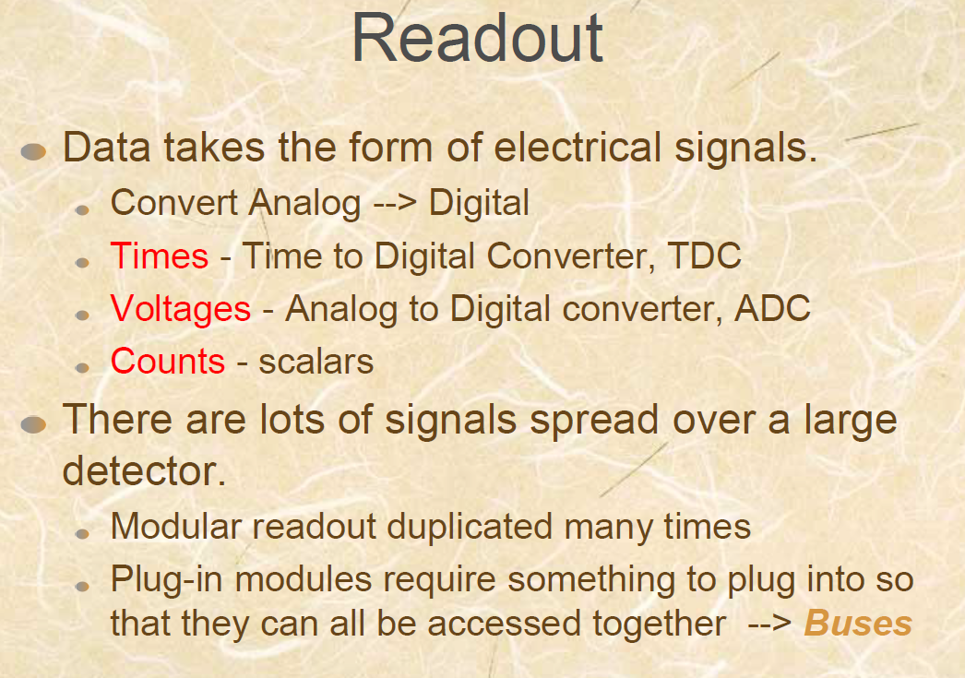
Date: 2018-10-15
Source: google <Data Acquisition Systems for Experimental Nuclear Physics>

Slide 3
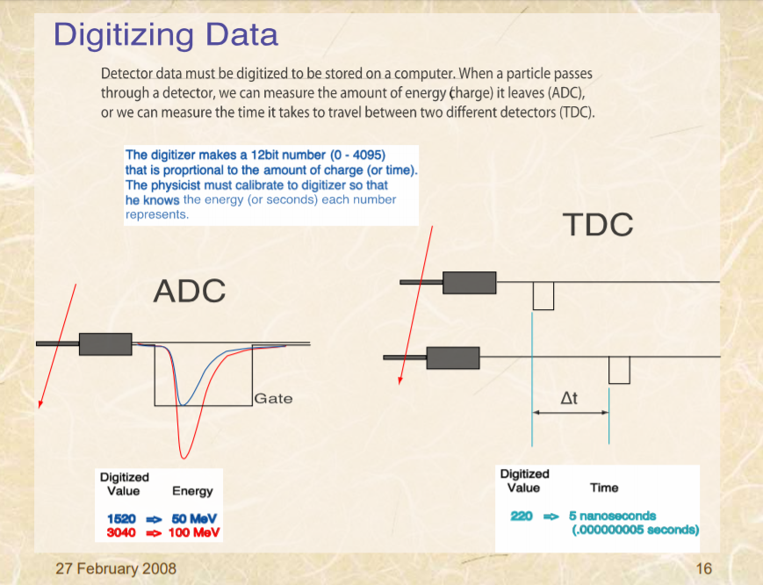
Date: 2018-10-15
Source: google <Data Acquisition Systems for Experimental Nuclear Physics>

Slide 4
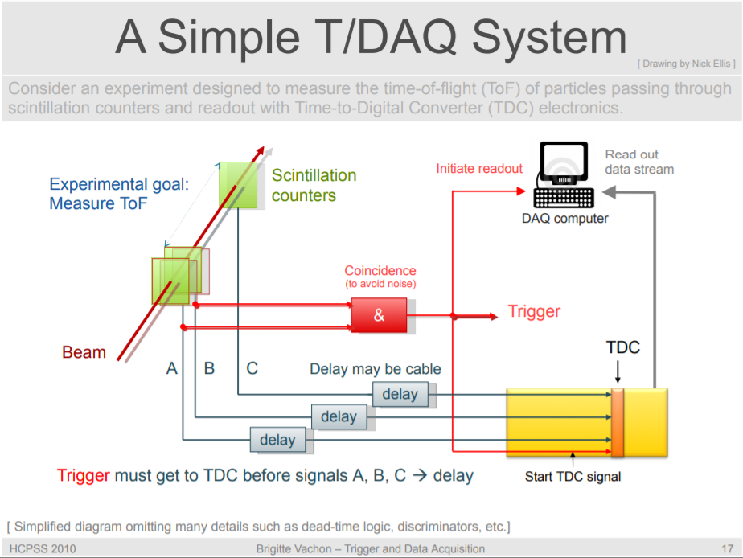
Date: 2018-10-15
Source: google <Trigger and Data Acquisition(I)>

Slide 5
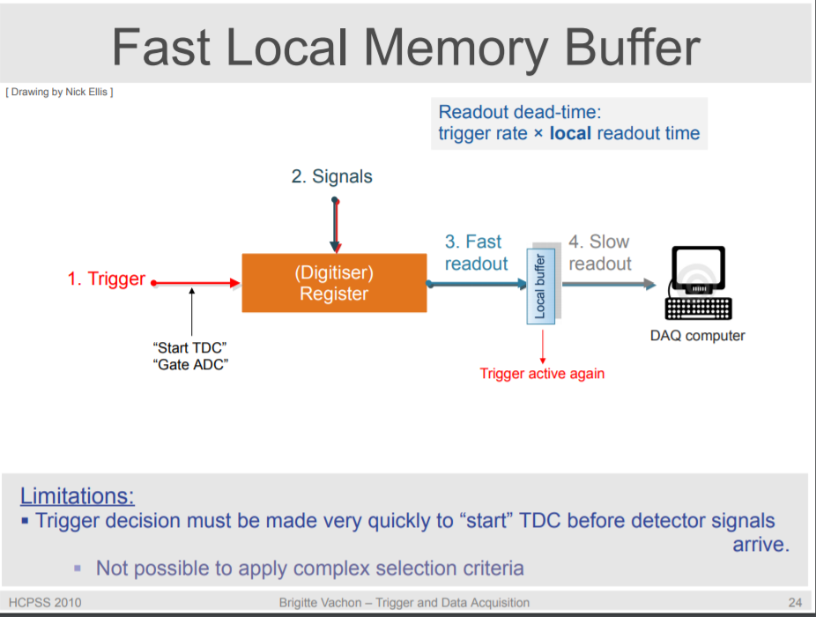
Date: 2018-10-15
Source: google <Trigger and Data Acquisition(I)> “Trigger and data acquisition” CERN, N .Ellis

Slide 6
Date: 2018-10-15
Source: CAEN <Digital Pulse Processing in Nuclear Physics>

Slide 7
Date:
Source:

