Slide 1
Tutorials for HiRA CsICalibrations

Slide 2
What we need to do CsI Calibrations?
Fragmentation Data
WMU Data
CsI Calibrations
DE – E points
Kinematics points
Punch Through points
affect
affect
Step 4
Step 1
Step 5
Si Calibration
Beam Geometry
Cuts, Projection
CsILength
DE-E Data
Step 3
Kinematics Line
Step 2
Ca+CH2 Data

Slide 3
I. How to get different kinds of datasets?
1. How to get ∆E-E points?
2. How to get kinematic points?
3. How to get punch-through points?

Slide 4
1. How to get ∆E-E points?
Notes: ∆E-E points depend on the calibrations of silicon strip!
Two methods:
1. Projection method
2. DEEFIT method

Slide 5
1. Projection method
Notes: For those particles travel through silicon strips and stop in the CsI, from the ∆E-E spectra, we know the energy loss[∆E(MeV), calibrated] in silicon strips, and the energy deposited in CsI [ECsI(ch)].
Step 1: (macro to be used: 00DEEProfilingPoints/ macro_PunchThroughCuts.cxx)
● Do a cut for each particle in the ∆E-E spectra
Step 2: (macro to be used: 00DEEProfilingPoints/ macro_CsIDEEProfiling.cpp)
● Within the cut region, take samples points of a constant bin step in X-axis, make projection to Y-axis, do Gaussian fit.
=> ∆E(MeV), err ∆E(MeV) && ECsI(ch), errECsI=0.5(ch) (set by hand)
● Use pulser calibration data to convert energy deposited in CsI from channels [ ECsI(ch)] to voltages [CsIV(V)]
[Notes: pulser calibration data can be attained by using precision pulse generator]
=> ∆E(MeV), err∆E(MeV) && ECsI(ch), errECsI=0.5(ch) && CsIV, errCsIV
Step 3: (macro to be used: 00DEEProfilingPoints/ macro_CsIPIDCalibrationPointsFromProfiling.cpp)
● Use LISE module to calculate the energy deposited in CsI in MeV [CsIE(MeV)]
=> CsIV, errCsIV && CsIE, errCsIE

Slide 6
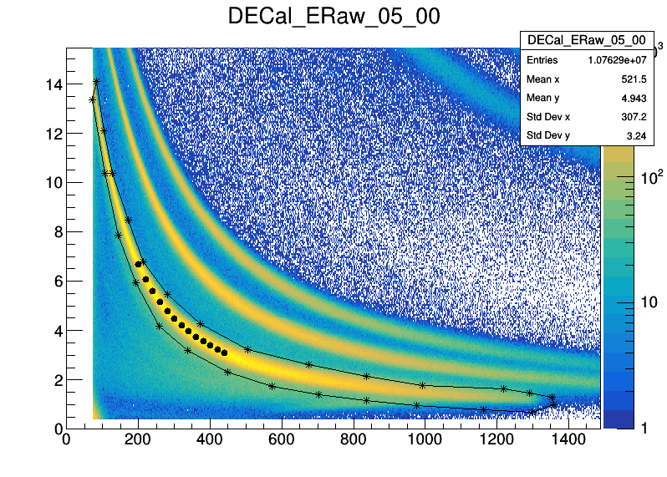
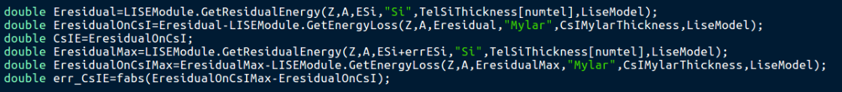
Step 4: To estimate the the errors of ∆E-E points
(macro to be used: 00DEEProfilingPoints/ macro_CsIDEEProfiling.cpp)
(macro to be used: 00DEEProfilingPoints/ macro_CsIPIDCalibrationPointsFromProfiling.cpp)
● For a certain channel number of CsIch, the error err_CsIch=0.5, set by hand
● For errors of voltage:
CsIV = CsICalibrationModule.GetVoltageValue(CsIch, telnum, csinum);
err_CsIV = CsICalibrationModule.GetVoltageValue(CsIch+err_CsIch, telnum, csinum) - CsIV ;
● For Gaussian fit
ESi = fit_result->GetParameter(1);
// the center of the Gaussian peak
err_ESi = fit_result->GetParError(1);
// the error of the center of Gaussian fit
● For errors of CsIE
∆E(MeV)
ESi(∆E)
CsIch
ECsI(Ch)

Slide 7
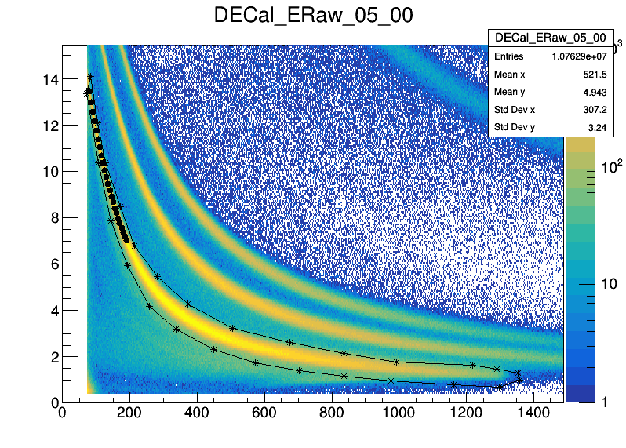
Notice 1:
1. Since low energy points (smaller ECsI) are more reliable, I would like to take a little bit more points at low energy regoin
∆E(MeV)
LowEnergy
more points
MidEnergy
fewer points
Esi(∆E)
CsIch
ECsI(Ch)

Slide 8
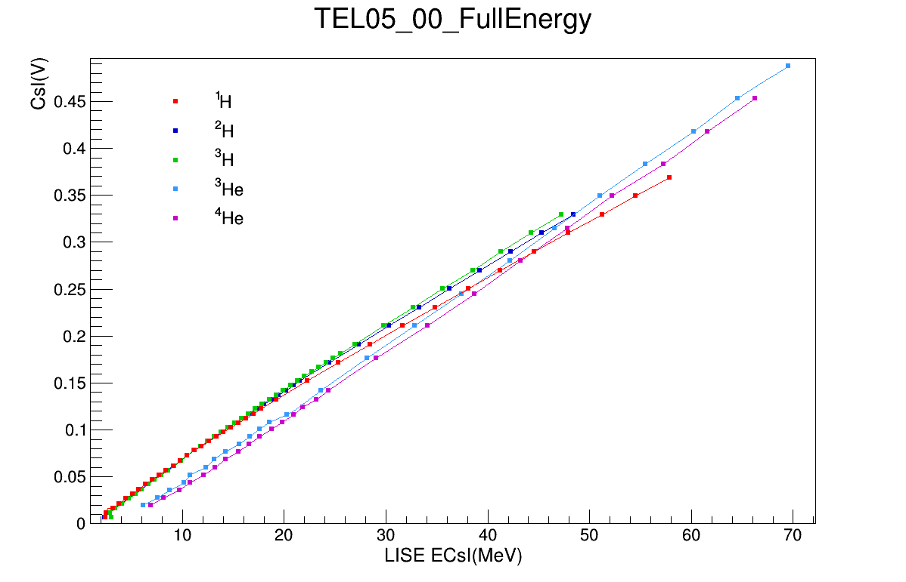
Notice 2:
1. The way to calculate the energy deposited in CsI by using the energy loss in silicon (∆E)
2. An example of the calibration of CsI

Slide 9
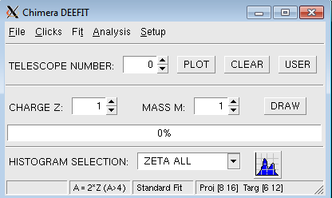
2. DEEFIT method
DEEFIT: A tool for charge and mass identification in Si-CsI matrices od the CHIMERA detector
See the readme “docdeefit.1.1.pdf” inside the DEEFIT folder
The procedures are based on the followings:
(1) Obtain a set of raw data for a set of telescopes with a well defined ∆E-E spectra
(2) Draw a set of sampling clicks for selected Z and M in the Si-CsI matrix
(3) Fit the data(click points) with a multi-dimensional function
(4) Get charge and mass identification by an iterative procedure based on the previous fit result.
(5) Check the goodness of the results on charge and mass spectra.
How to run DEEFIT:
For Standalone version (I use this version):
simply sun “deefit_S”: ./deefit_S

Slide 10
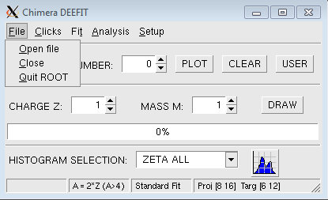
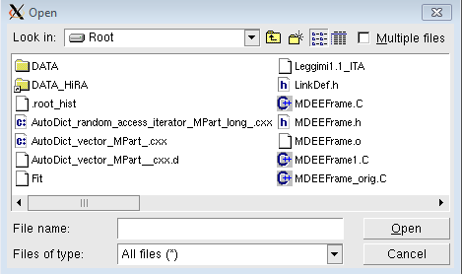
Step 1: Open file
Step 1: Chose the correct data to be fitted
Click 1
Click 3
Click 2
Step 2: Plot
Step2: Chose a certain telescope to plot
Click 1

Slide 11
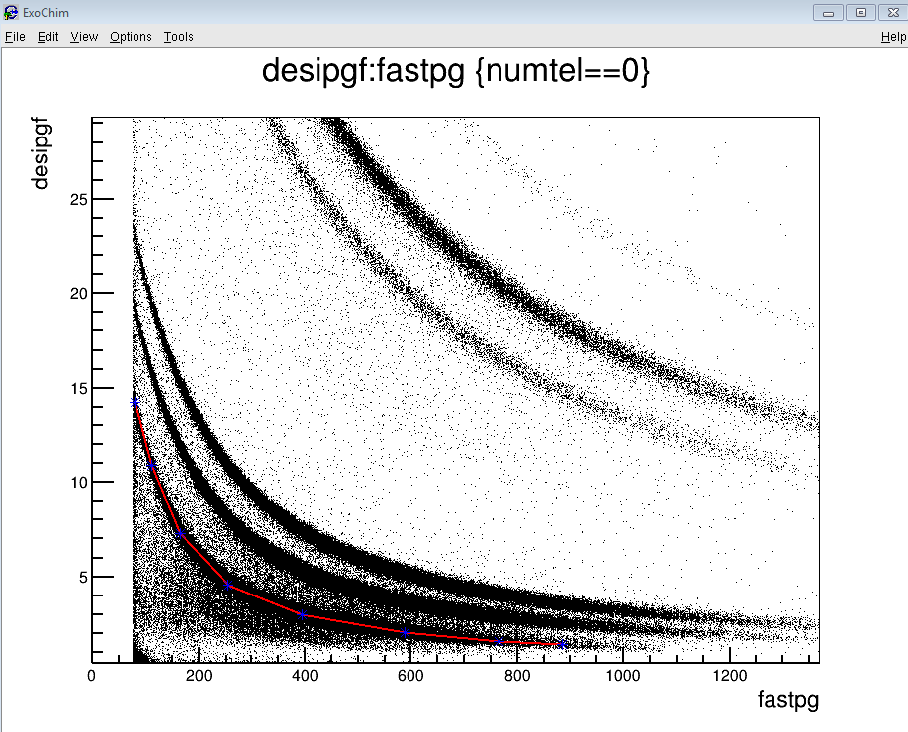
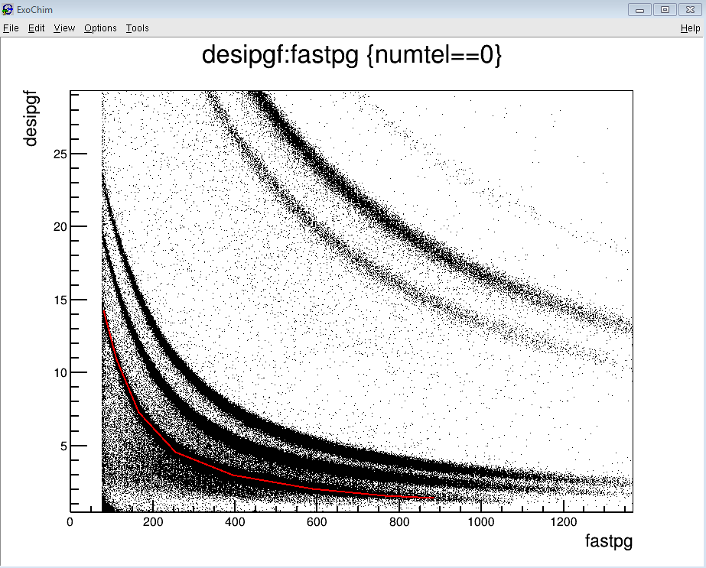
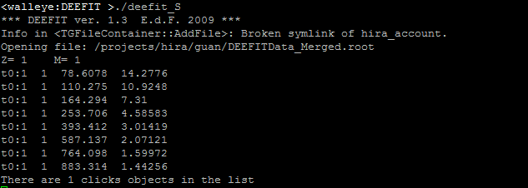
Step 3: Set charge Z and mass A, draw the clicks for each particle
Step3: chose a certain particle to draw
Click 1
Then, the clicks will be saved in the list.
Click the center of the line
Click 2

Slide 12
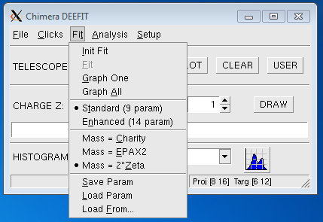
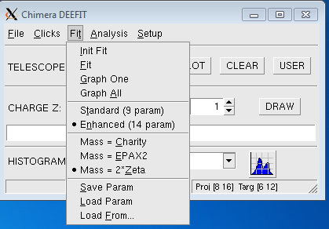
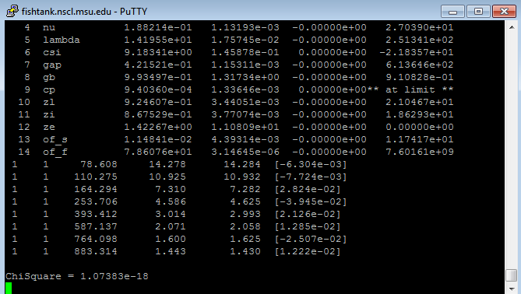
Step 4: After drawing the clicks for all particles, then fit
Click 1
Click 3 Init Fit
Click 4
Two fit function, the one with14 parameters is recommended
Click 2
Click Fit, until the ChiSquare is minimum!

Slide 13
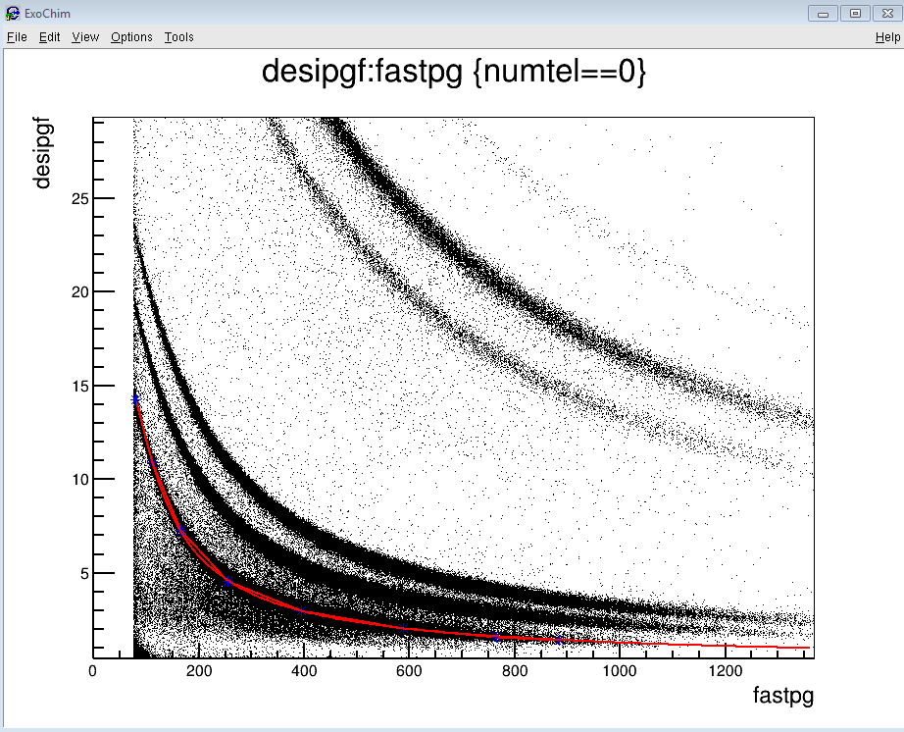
Step 5: Check the fit result
Click 1
Chose a certain particle
We can see if the fit and the clicks match or not

Slide 14
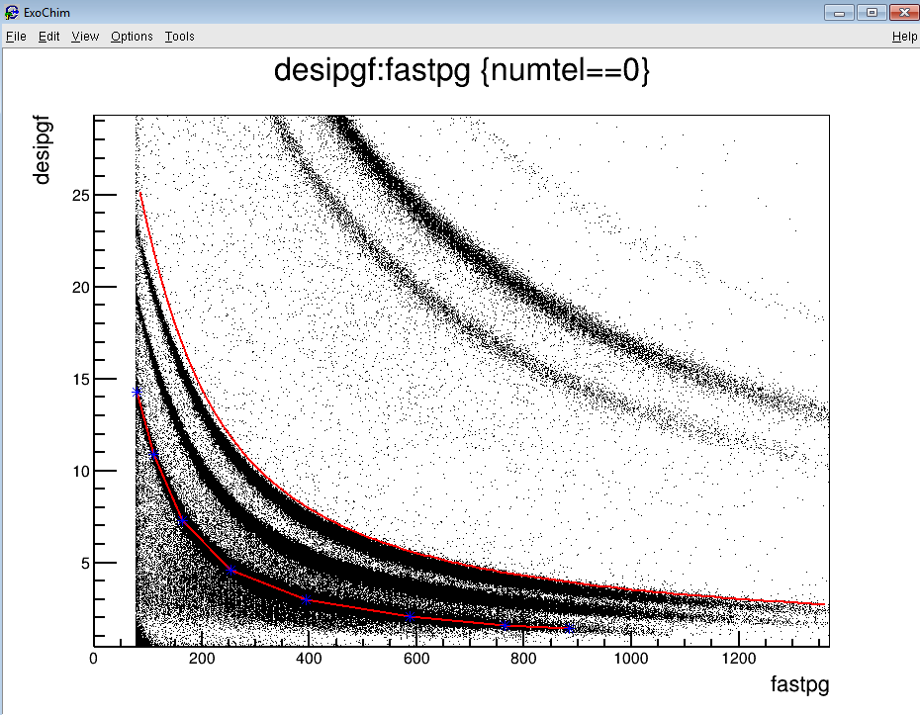
Step 6: One of the most powerful function of DEEFIT-------- “particle prediction ”
According to the fit result, triton should be here!
In this tutorial, we just draw the clicks for proton, according to the fit result, we can predict where are the other particles. Of cause, with more particles to do the fit, we will get more accurate predictions!

Slide 15
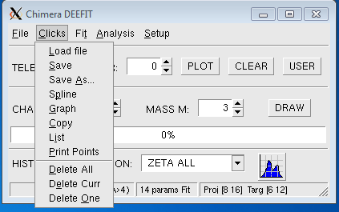
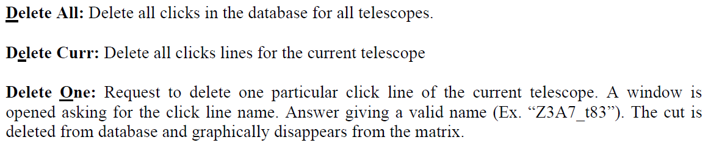
Step 7: Delete one click and redo the fit
If we don’t satisfied with the fit result, then delete some clicks, and redo the clicks

Slide 16
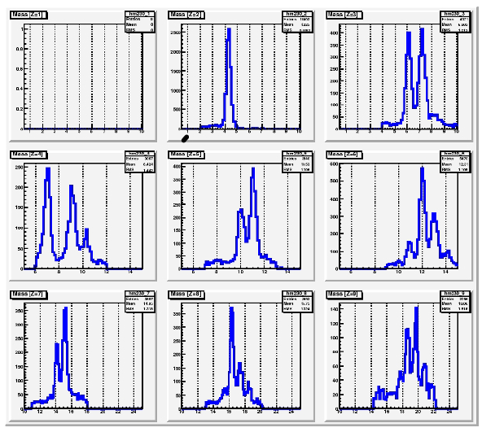
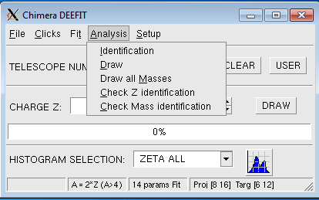
Step 8: Analysis
Sea “docdeefit1.1.pdf” for detials
Mass distributions

Slide 17
Step 9: If the fit result is good enough(the ChiSqurae is small enough ), then save fit parameters
We can also load the parameters next time when we want to improve the fit!
Click 1
Step 10: Save the clicks
Click 1
We can also load the click file next time when we want to improve the fit!

Slide 18
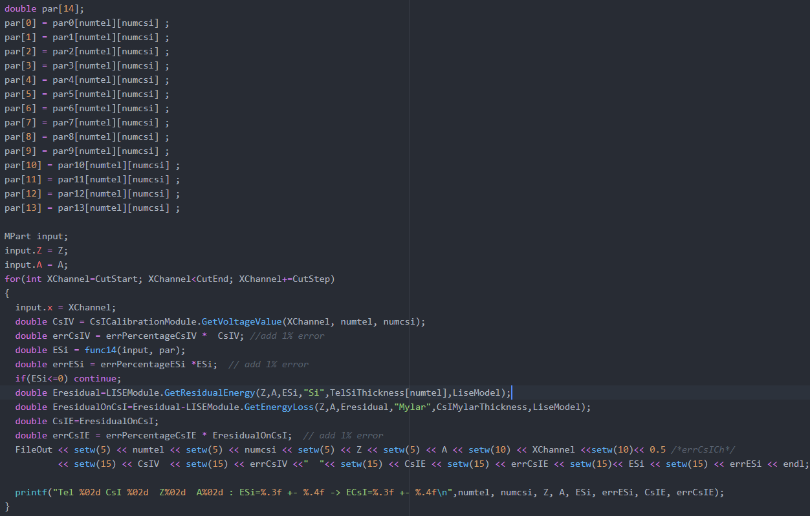
Use the DEEFIT parameters to get ∆E-E points:
(macro to be used: DEEFITReadCutFile.cpp)
(macro to be used: DEEFITExtractPoints.cpp)
● To find the range of ∆E-E line of each particle for all the
telescopes. Save as /calibrations/DEEFITCut.dat
● Read the cut file and the fit parameter, calculate
CsIV, errCsIV, Esi, errESi, CsIE, errCsIE with
certain channel step.
(It takes a long time to calculate all the particles for
all the telescopes, so it would be better to take more
points at one time, and then extract as many points
as we want from this file when we do some analysis.)
● Extract a few points(about 20 points for each particle)

Slide 19
To estimate the errors of ∆E-E points:
(macro to be used: DEEFITReadCutFile.cpp)
(1) For errors of voltage:
CsIV = CsICalibrationModule.GetVoltageValue(XChannel, numtel, numcsi);
err_CsIV = errPercentageCsIV * CsIV; // add 1% errors by hand
(2) For energy loss in Si:
ESi = func14(input, par);
err_ESi = errPercentageESi *ESi; // add 1% errors by hand
(3) For errors of CsIE

Slide 21
2. How to get kinematics points?

Slide 22
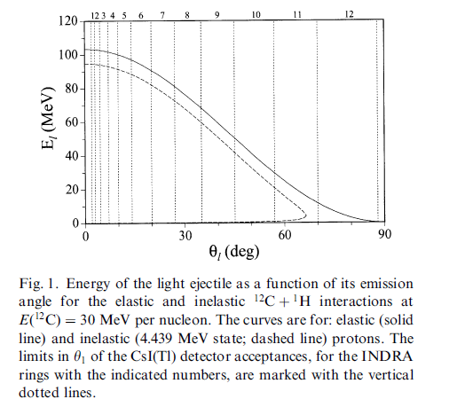
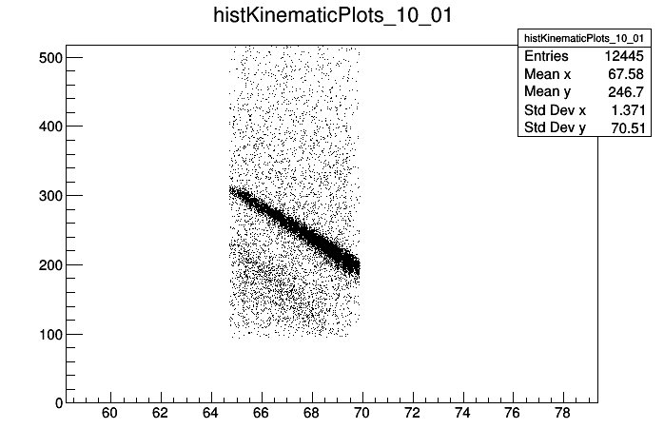
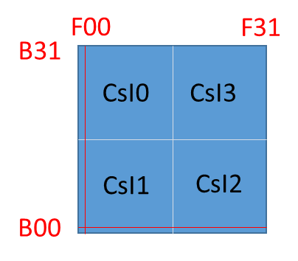
Extension: what is kinematics line?
● For two-body reaction kinematics, the final states can be completely determined by the initial conditions:
for a certain scattering angle, the energy of emitting particles are fixed. The correlation looks like:
NIM A 501(2003) 367
HiRA.fEnergycsi (ch)
HiRA.fTheta(Degree)
● The kinematics line should be a continuous line, the range of angle is determined
by the size of the CsI crystal.
● The energy width of the kinematics line comes from the energy resolution of CsI.

Slide 23
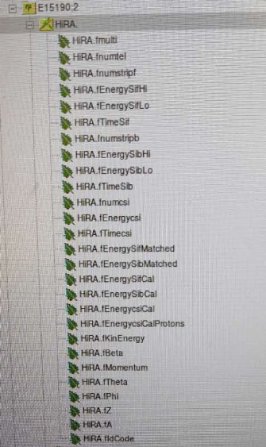
Step 1: Build Histograms for Kinematics Lines
(macro to be used: CsIKinematicLineBuildHistogram.cpp)
The raw kinematics data can be saved as a tree with different branches, e.g. HiRA.fmulti, HiRA.fnumtel, HiRA.fnumcsi, HiRA.fEnergycsi, HiRA.fTheta …
We need HiRA.fEnergycsi && HiRA.fTheta to build the histograms of kinematics lines
HiRA.fEnergycsi (ch)
kinematics lines
HiRA.fTheta(Degree)

Slide 24
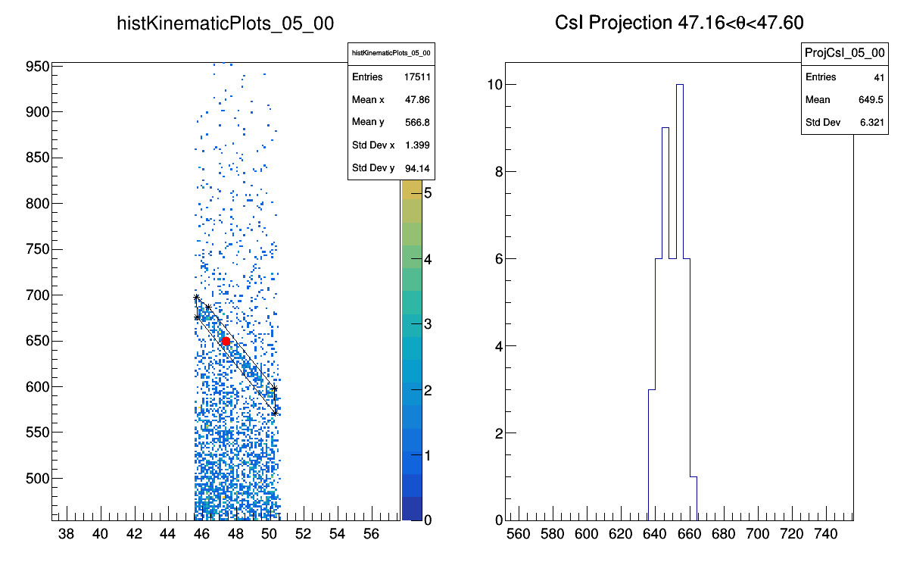
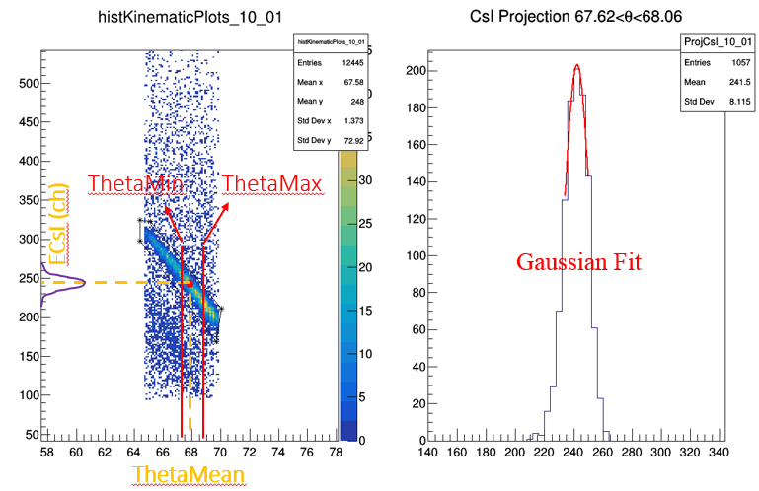
Step 2: Make cuts for the kinematics lines
(macro to be used: CsIKinematicHistogramCutForProtons.cpp)
(1) Make cuts for all the kinematics lines (maybe no kinematics lines for some telescopes )
Step 3: Make projection to get the data points
(macro to be used: CsIKinematicLineProjection.cpp)
Get Mean Value
(1) Within the cut region, take samples points of a constant bin step in X-axis,
make projection to Y-axis:
For high statistics, do Gaussian Fit
For low statistics, get mean values
ThetaMean, ThetaMin, ThetaMax && ECsI_Ch, err_ECsI_Ch
(2) Use ECsI_Ch , ThetaMean to calculate CsI_V and EnergyValue
EnergyValue, err_EnergyValue && CsI_V, err_CsI_V
(3) Just take a few points (4 points, for example) in the cut region.
(4) Draw the points. If it is in the cut region and in the center of the
kinematics line. I think it is a good data point. Otherwise, redo the
cut, and repeat this step.

Slide 25
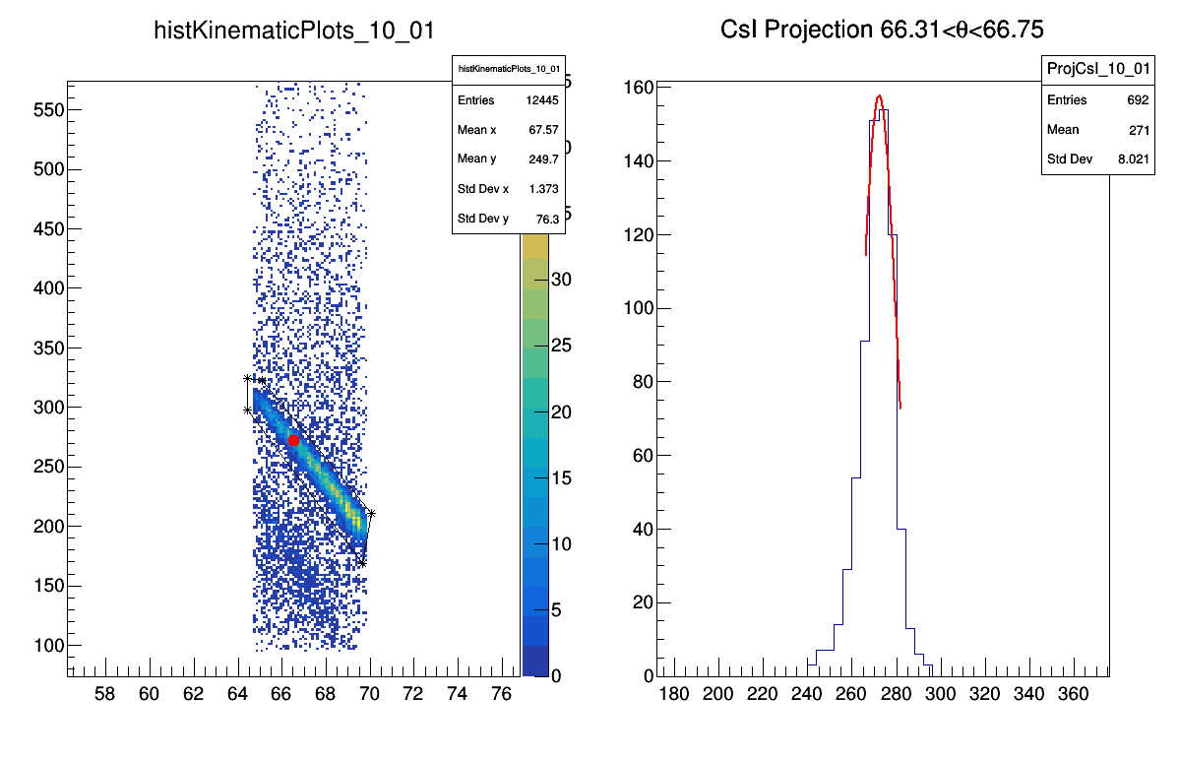
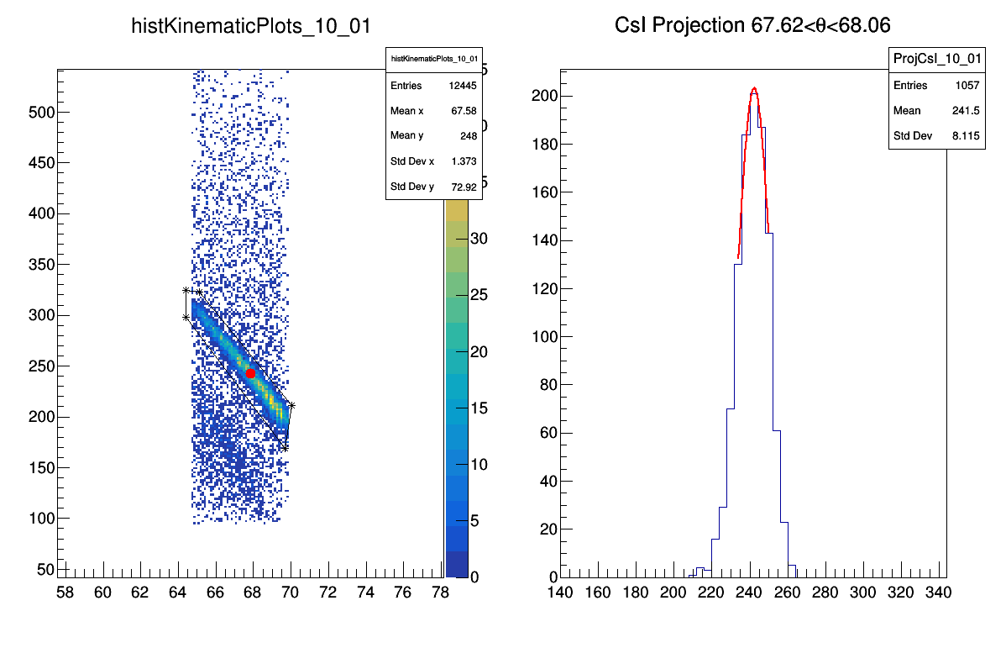
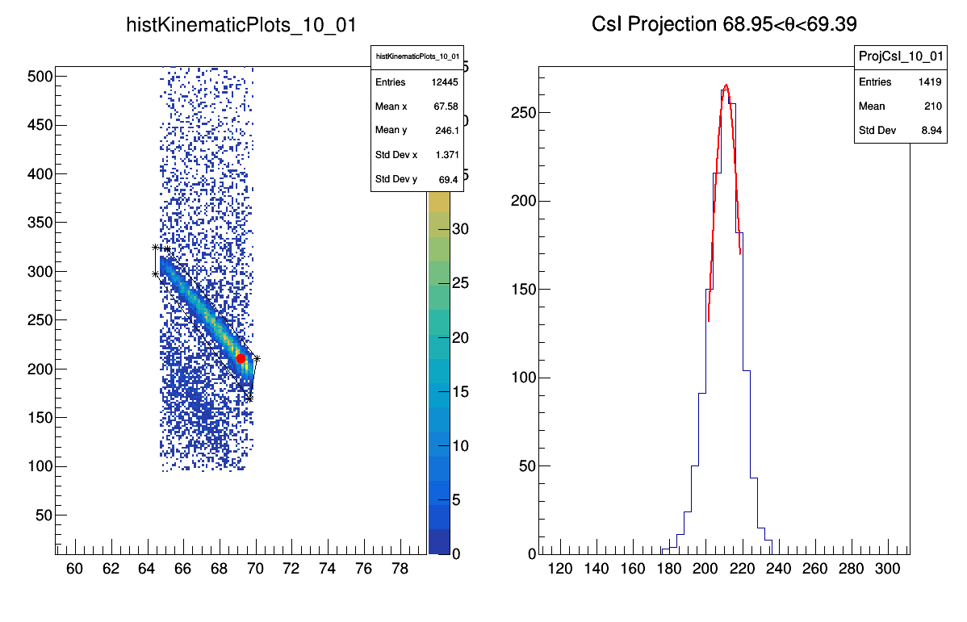
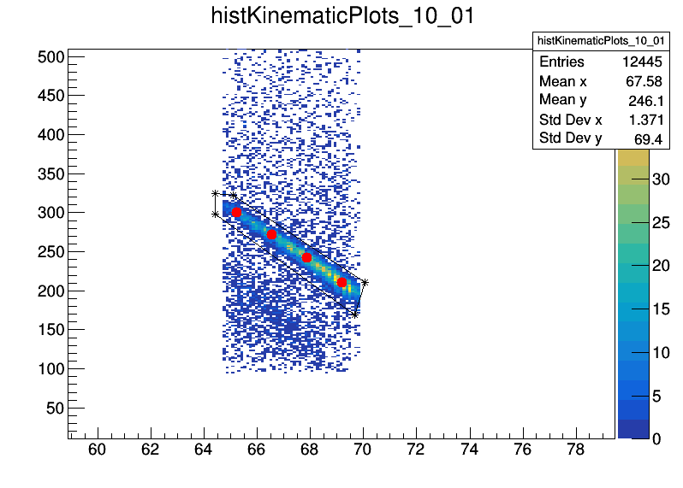
Gaussian Fit
Gaussian Fit
Here is a good cut as an example!
Gaussian Fit

Slide 26

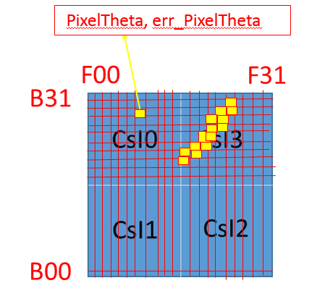
Step 4: Estimate the errors of points
(1) Errors from calculation
(macro to be used: CsIKinematicLineProjection.cpp)
Get mean value
Gaussian fit
(2) Errors from geometry and beam energy
(macro to be used: CsIKinematicPointsCorrection.cpp)
● For each pixel, we calculate the PixelTheta and Err_PixelTheta
If ThetaMin < PixelTheta < ThetaMax : calculate the AverageErr_PixelTheta
● Use AverageErr_PixelTheta to calculate the errors of ECsI (MeV)

Slide 27
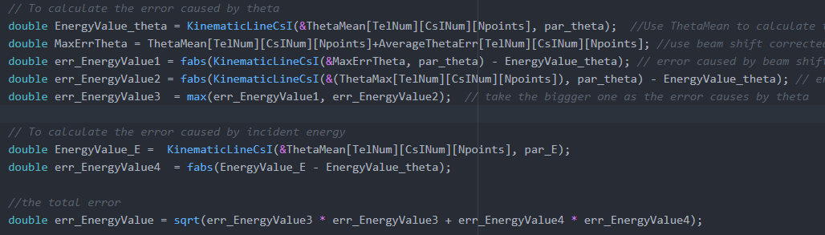
● The method to estimate the errors of kinematics points in the program

Slide 29
3. How to get punch-through points?

Slide 30
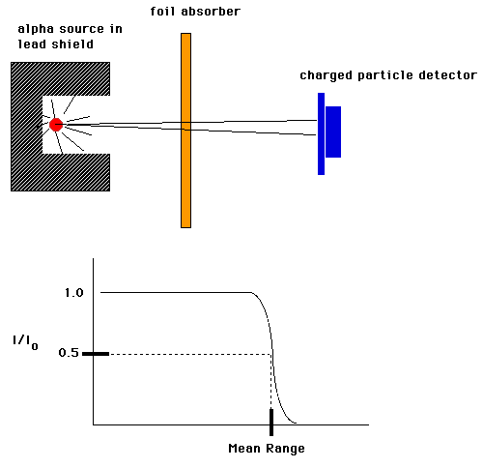
Extension: what is punch through point?
● Punch through means that a particle stops at the end of the material. The energy of this kind of
particle is called punch-through energy. With a little more energy, this particle would fly away.
● It is a similar concept as the range of a charge particle, because the stopping power is known for a
given energy.

Slide 31
Step 1: To get the punch through points(in channel) for raw data
(macro to be used: 20PunchThroughPoints/TogetPunchThroughPoints.C)
● With the ∆E-E spectra, make projection to X axis
ProjectionX

Slide 32

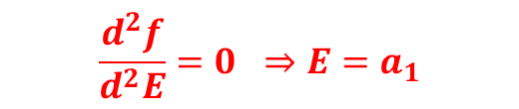
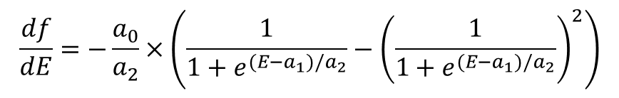
● Fit with Fermi Function + linear function.
$$f\left(E\right)=a_{3}+\frac{a_{0}}{1+e^{(E−a_{1})/a_{2}}}$$
$$\frac{df}{dE}=−\frac{a_{0}}{a_{2}}×\left(\frac{1}{1+e^{(E−a_{1})/a_{2}}}−{\left(\frac{1}{1+e^{(E−a_{1})/a_{2}}}\right)}^{2}\right)$$
$$\frac{d^{2}f}{d^{2}E}=0 ⇒E=a_{1}$$
Current punch through point
● parameter $a_{1}$ is the current punch through points.
Prediction via exrapolation

Slide 33
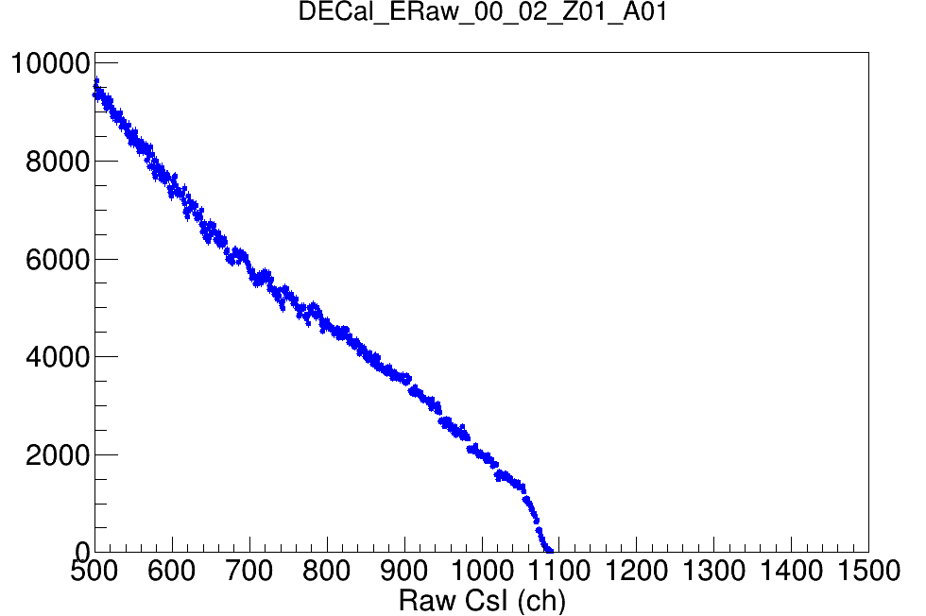
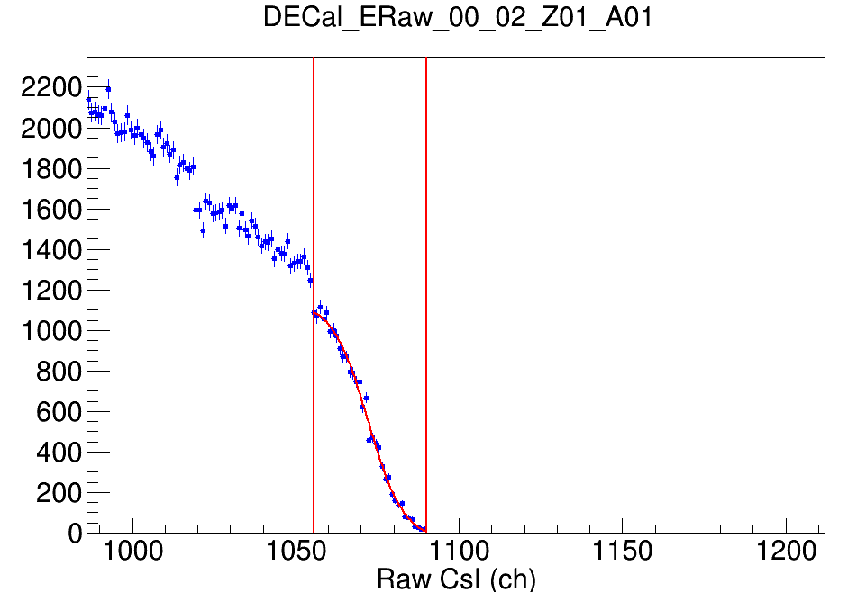
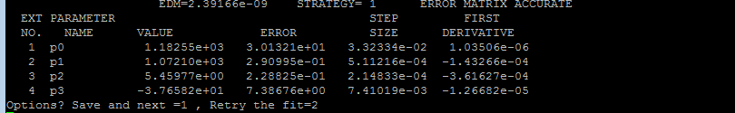
● The details how to get this punch through points
● Run this program: TogetPunchThroughPoints.C
● Zoom and press the central button of the mouse to
set the range, and then fit automatically.
● If the fit looks good, input “1” in the terminal, and then fit the
next telescope. Or input “2” to redo the fit.

Slide 34
Step 2: Use LISE++ to calculate the punch through points in MeV
Notes:
● Punch through energy depends on the particle species and the length of the material
● For a certain particle in the a given material, the length is the only factor which determines the punch through energy
● Directly, use LISE++ to calculate the punch through energy.
● More conveniently, use the program “EnergyLossModule.cpp(by Daniele)”
● Run EnergyLossModule.cpp: root –l EnergyLossModule.cpp
● root[1] EnergyLossModule Fenhai (here can be any name you want)
● root[2] Fenhai.GetEnergyFromRange(int Z, int A, double range($μm$), const char* material, int model=1);
● The errors of punch through points can be calculated by using the error of the length (by the manufacturer)

Slide 36
II. How to do simultaneous fit?

Slide 37
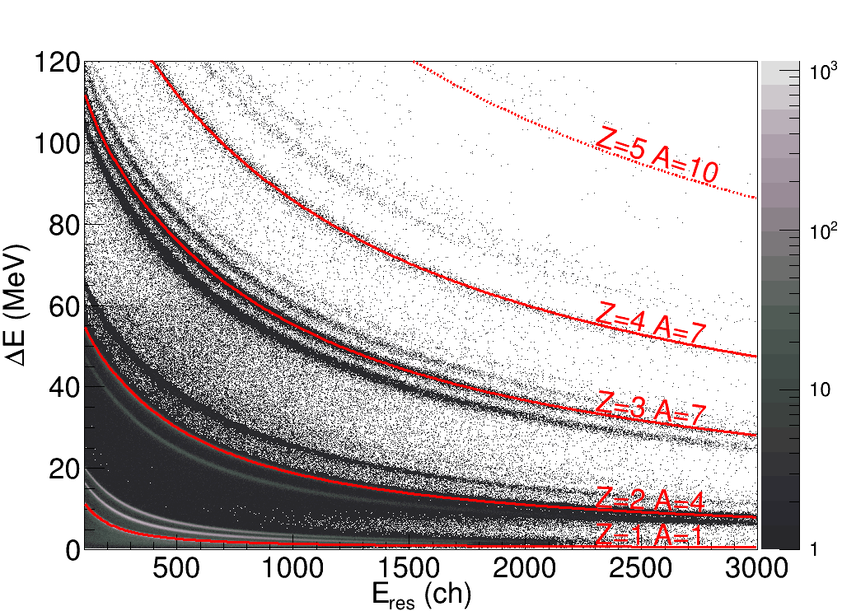
∆E-E Fit with DEEFIT program
● The DEEFIT program is developed for the Si-CsI identification in the Chimera detector.
Fit with a 14-parameters function
● The procedures are based on the followings:
(1) Obtain a set of raw data for a set of telescopes with a well defined ∆E-E spectra
(2) Draw a set of sampling clicks for selected Z and M in the Si-CsI matrix
(3) Fit the data(click points) with a multi-dimensional function
(4) Get charge and mass identification by an iterative procedure based on the previous fit result.
(5) Check the goodness of the results on charge and mass spectra.
● Get the ∆E-E points in this way

Slide 38
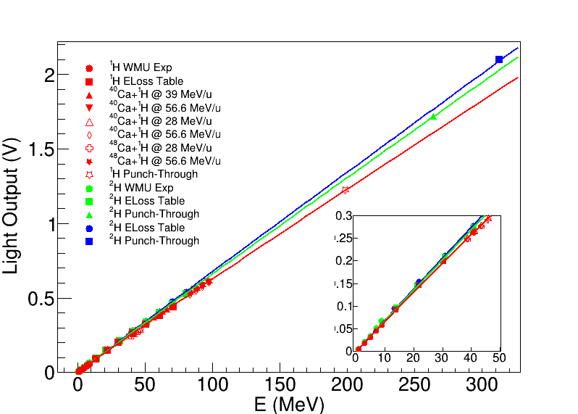
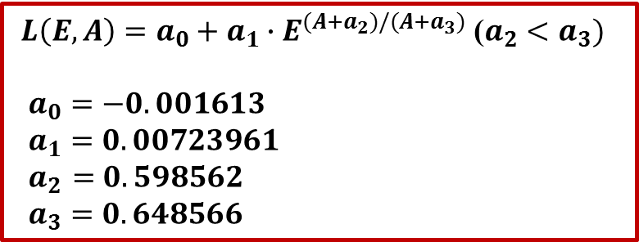
Simultaneous Fit to get the light response curves
● Since proton, deuterons, tritons have different light response behavior from heavy ions. We use different
formulas to fit: one for protons, deuterons, tritons, and
another one for heavy ions ( Z≥2 )
● We figure out a new formula to fit the data of protons, deuterons and tritons (Z=1)
$L\left(E,A\right)=a_{0}+a_{1}∙E^{(A+a_{2})/(A+a_{3})}$ ($a_{2}<a_{3})$
$a_{0}=−0.001613$
$a_{1}=0.00723961$
${ a}_{2 }=0.598562$
$a_{3}=0.648566$
● Obvious saturation effect can be seen for Z=1.

Slide 39
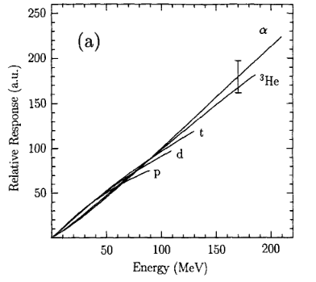
Compared with the results in the previous literature
● Saturation effects observed for Z≤3, more important for Z=1.
● For Z=1, saturation effect occurs at around 30 MeV
~30MeV
C.J.W. Twenhofel et al., NIM B 51(1990) 58
~30MeV

Slide 40
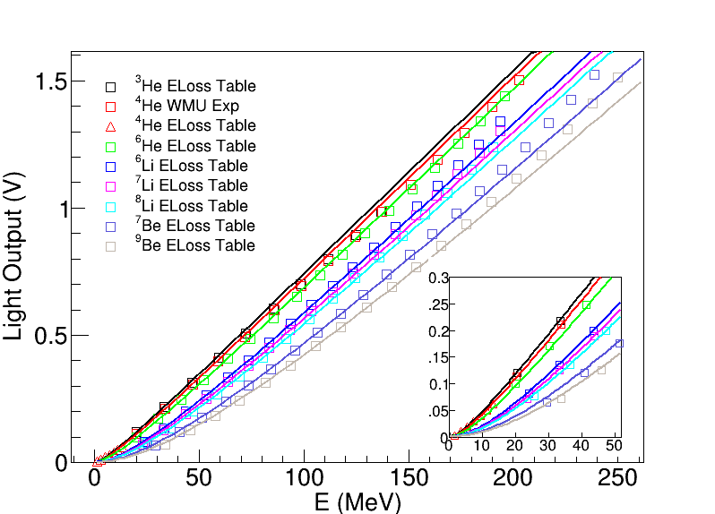
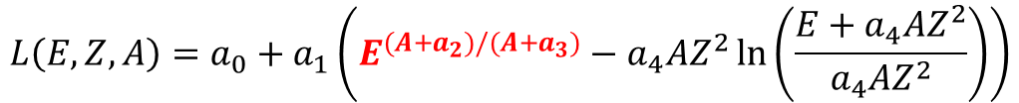
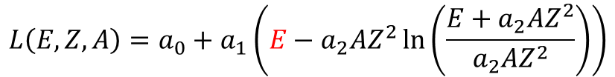
Simultaneous Fit for heavy ions (Z≥2)
● Horn Formula:
D. Horn et al., Nucl. Instr. Meth A 320 (1992) 273
$$L\left(E,Z,A\right)=a_{0}+a_{1}\left(E−a_{2}AZ^{2}\ln\left(\frac{E+a_{2}AZ^{2}}{a_{2}AZ^{2}}\right)\right)$$
Quenching effect
● Fit with a modified Horn Formula:
$$L\left(E,Z,A\right)=a_{0}+a_{1}\left(E^{(A+a_{2})/(A+a_{3})}−a_{4}AZ^{2}\ln\left(\frac{E+a_{4}AZ^{2}}{a_{4}AZ^{2}}\right)\right)$$
Saturation effect
Quenching effect

Slide 41
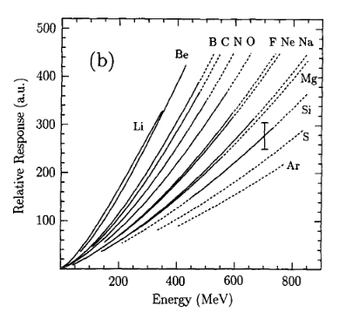
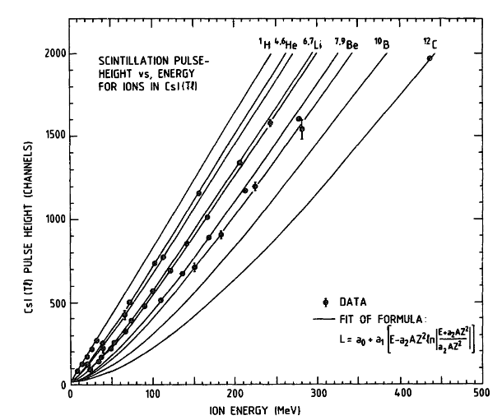
Compared with the results in the previous literature
● Obvious quenching effects
C.J.W. Twenhofel et al.,
NIM B 51(1990) 58
D. Horn et al.,
NIM A 320 (1992) 273

Slide 42

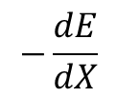
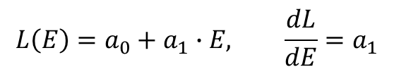


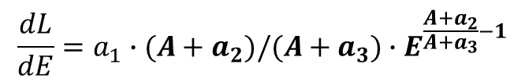
Light efficiency curves
● Linear light response
$$L\left(E\right)=a_{0}+a_{1}∙E, \frac{dL}{dE}=a_{1}$$
$$\frac{dL}{dE}$$
● Saturation effect
$$L\left(E,A\right)=a_{0}+a_{1}∙E^{(A+a_{2})/(A+a_{3})}$$
$$\frac{dL}{dE}=a_{1}∙(A+a_{2})/(A+a_{3})∙E^{\frac{A+a_{2}}{A+a_{3}}−1}$$
more or less linear
more or less linear
$\frac{A+a_{2}}{A+a_{3}}$-1<0
quenching
saturation
● Quenching effect
high energy
low energy
$$−\frac{dE}{dX}$$
E

Slide 43


Light efficiency curves
● Obvious saturation effect for Z=1 in the whole
energy region
● Saturation effect as well as quenching effect for Z=2
● Obvious quenching effect and a little bit saturation
effect at high energy for Z=3
● Completely quenching effect for Z>3
C.J.W. Twenhofel et al., NIM B 51(1990) 58

Slide 44
● Useful references
D. Horn et al., Nucl. Instr. Meth A 320 (1992) 273
N. Colonna et al., Nucl. Instr. Meth. A 321 (1992) 529
Y. Larochelle et al., Nucl. Instr. Meth. A 348 (1994) 167
S. Aiello et al., Nucl. Instr. Meth. A 369 (1996) 50-54
G. Viesti et al., Nucl. Instr. Meth A 252 (1986) 75
C.J.W. Twenhofel et al., Nucl. Instr. Meth B 51 (1990) 58

Slide 46
Some basic questions?

Slide 47
Q1: How to build the ∆E-E spectra?

Slide 48
Q2: How to build kinematics data ?

