Slide 1
Q1: What is an event? What is an entry? What is multiplicity?

Slide 3
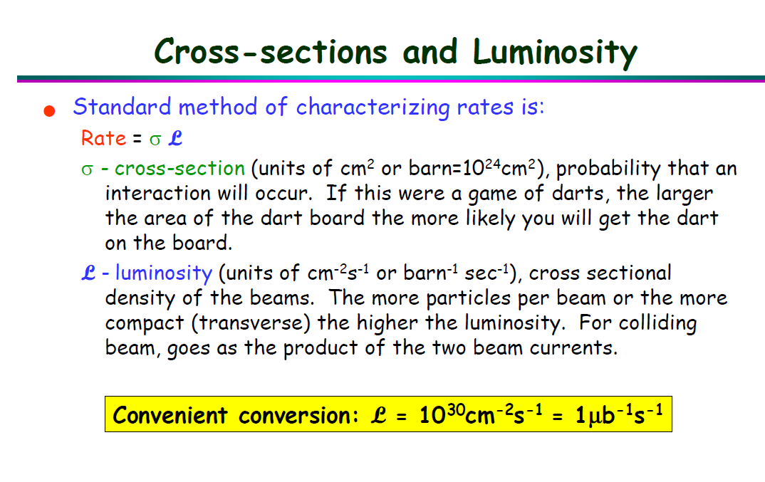
Date: 2018-10-15
Source: google <Triggering in Particle Physics Experiments>

Slide 4
Date: 2018-10-15
Source:

Slide 5
Date:
Source:

