Slide 1
Q1: How to calibrate the double side SSD in our experiment?
Q2: 电荷重心法
Q3: 光在晶体中的自吸收？

Slide 3
Basic Knowledges of ∆E1- ∆E2-E Detector

Slide 4
Date: 2018-10-23
Source: https://groups.nscl.msu.edu/hira/05049/LASSA_Calibrations.pdf
Calibration on Silicon Detectors
● Th228, characterized by eight well-known alpha energies, and alpha peak are separated by at least 0.1MeV
● If a dE silicon detector is placed in front of the double sided E silicon detector, the dE detector can be calibrated by 228Th source as discussed above; while pin source is used to calibrate E detector

Slide 5
Date: 2018-10-27
Source: Talk with Daniele
Si-Si-CsI detector data analysis procedures：
1. Energy calibrations of Si detector with alpha source
2. Charge sharing method to determine the position of the hits: if the hit happens between two strips
3. Calibrations of CsI
4. Pixelization
5. Multiplicity analysis
6. Double hit or multi-hit
7. Particle Identification

Slide 6
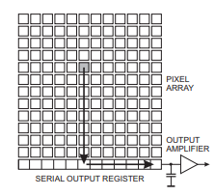
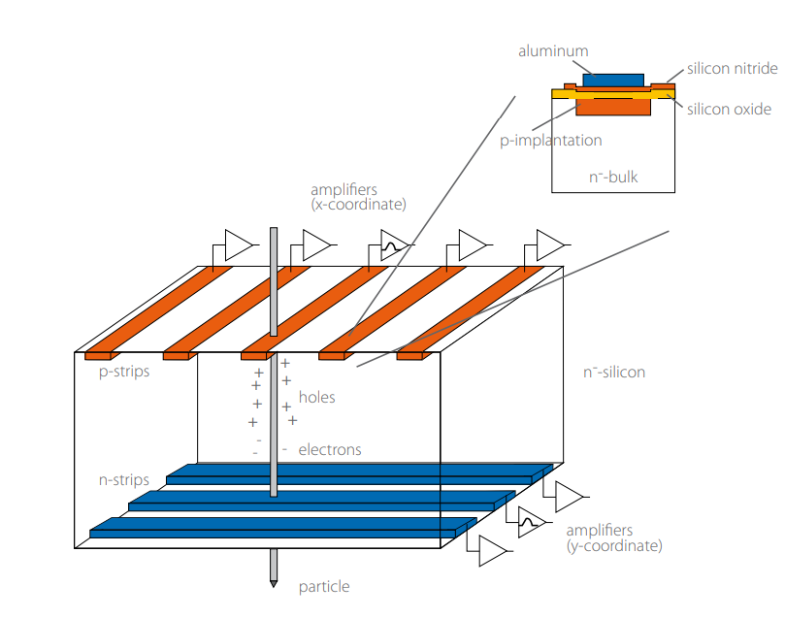
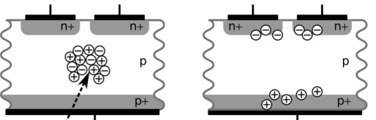
Date: 2018-10-30
Source: Talk with Daniele
Double-sided Silicon Strip Detector
1. What is a “pixel” ?
● Double-sided silicon strip detector can read out signal on both the
sides. The back strips are perpendicular to the front strips. A “pixel”
means the overlap of a font strip and a back strip.
● Double-sided SSD also called “matrix detector”
2. What does a pixel works as a position sensitive detector?
● The position of SSD is determined by the pixel. When charge particle pass
through a SSD, ideally, there will be a same a energy signal on both a front strip
and a back strip, which determines the position of the particle hits the detector.
● Charge sharing effect: means the charge generated by a particle is collected
by two or more than two strips. In this case, we should find the strip with the
largest energy, this is the strip that the particle hitting or the strip nearest to the
hitting point. Then, sum up the energy in the adjacent strips to this strip.
● 对于 Charge sharing，需要采用电荷重心法来处理。

Slide 7
3. What is multiple hit?
(1) Multiple hit means there are multiple particles hits the SSD with one readout period (no need hit
simultaneously). Silicon strip can not assign the hit positions clearly.
(2) 如何筛选出“多击事件”事件呢？
● 在pixelization过程中：当前面某个strip探测到一个能量信号时，原则上需要用这个strip跟
背面的32个strip进行组合，如果背面只有一个strip(考虑charge sharing之后)也同时探测到
信号，并且两个能量信号相同(或接近相同)，那么这两个strip对应的“pixel”就是入射粒
子的位置. 这种情况下，前面和背面总能match上.
● 如果后面不止有一个strip有信号，这种情况下，背面的每个信号会比前面小得多。前面和
背面match不上！ 对于这种“多击事件”，通常我们通常直接扔掉！！

Slide 10
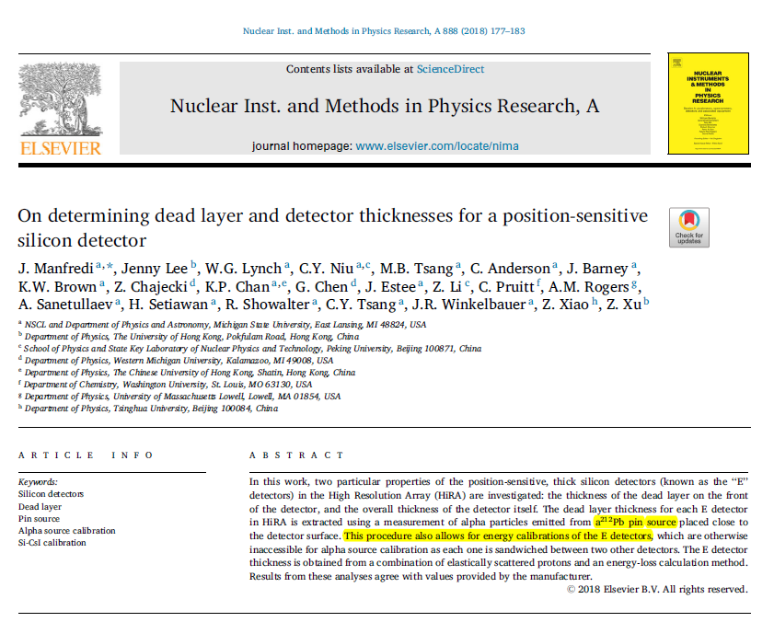
Date: 2018-10-28
Source: https://doi.org/10.1016/j.nima.2017.12.082

Slide 11
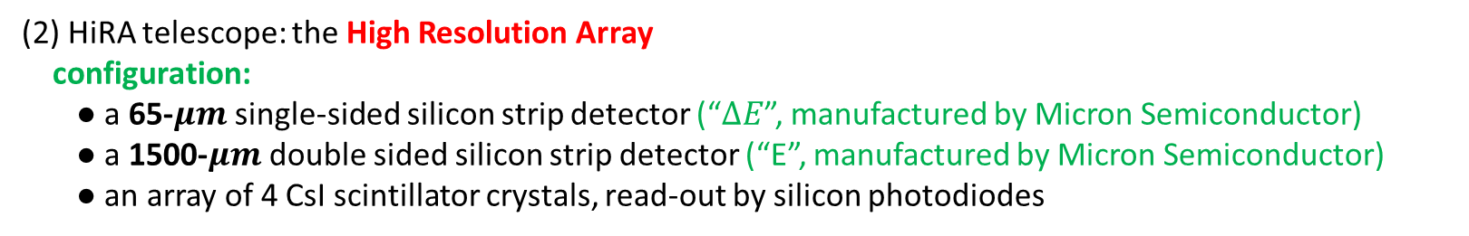
Date: 2018-10-28
Source: https://doi.org/10.1016/j.nima.2017.12.082
1. Introduction
(1) The dead layer on the surface protects the active silicon wafer of the detector.
(2) HiRA telescope: the High Resolution Array
configuration:
● a 65-$μm$ single-sided silicon strip detector (“$∆E$”, manufactured by Micron Semiconductor)
● a 1500-$μm$ double sided silicon strip detector (“E”, manufactured by Micron Semiconductor)
● an array of 4 CsI scintillator crystals, read-out by silicon photodiodes
(3) At the front of each telescope: a thin mylar foil pretecting the sensitive silicon detectors, and also completing a Faraday cage around the detectors to minimize the noise.
a Faraday Cage is just an electronic isolation chamber. Or even more simply it’s a special container that prevents electrical signals or waves from passing through it.

Slide 12
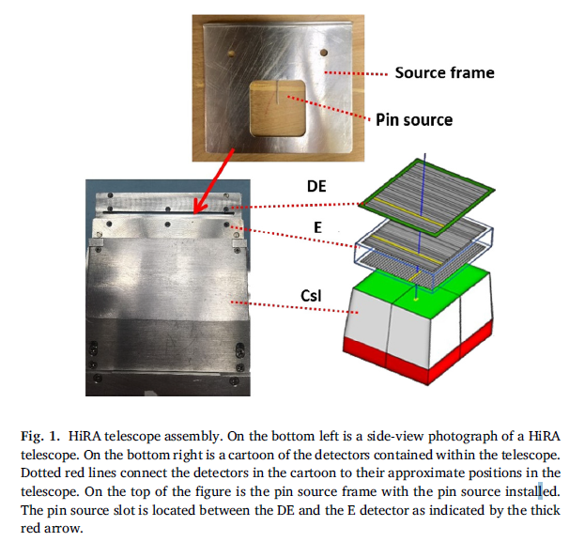
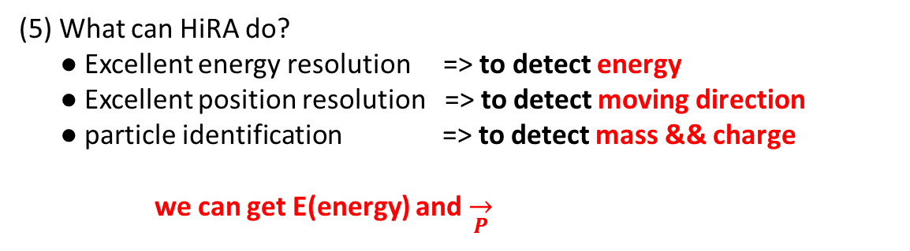
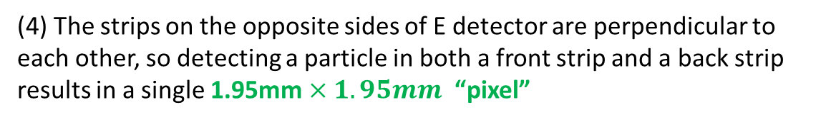
Date: 2018-10-28
Source: https://doi.org/10.1016/j.nima.2017.12.082
(4) The strips on the opposite sides of E detector are perpendicular to each other, so detecting a particle in both a front strip and a back strip results in a single 1.95mm $×1.95mm$ “pixel”
(5) What can HiRA do?
● Excellent energy resolution => to detect energy
● Excellent position resolution => to detect moving direction
● particle identification => to detect mass && charge
we can get E(energy) and $\overset{→}{P}$

Slide 13
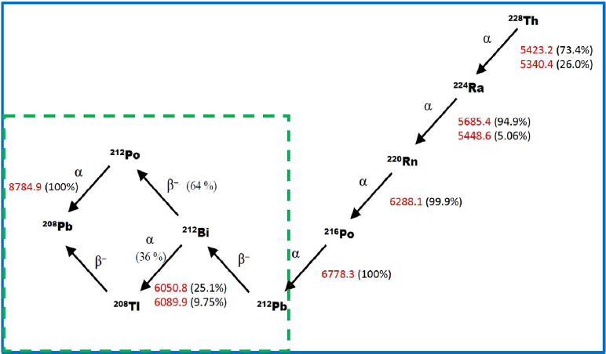
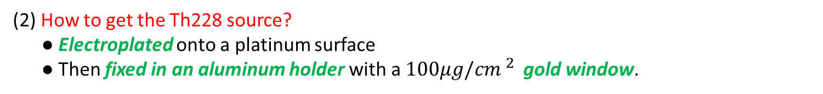
Date: 2018-10-28
Source: https://doi.org/10.1016/j.nima.2017.12.082
2. Dead layer thickness determination
(1) Using Th228 alpha source to calibrate the HiRA E and ∆E detectors. 3 advantages:
● Six clearly separated peaks with energy from about 5 MeV to 9MeV
● Th228 sources of various strengths are commercially available
● Th228 has a relatively long half-life(1.9 year)
(2) How to get the Th228 source?
● Electroplated onto a platinum surface
● Then fixed in an aluminum holder with a $100μg/{cm }^{2 }$ gold window.
(3) Ideally, if an alpha source can be inserted between the ∆E and E detectors,
the E detector can be calibrated without disassembling the HiRA telescope.
(4) The pin source is primarily Pb212 (one of the isotopes from the decay chain
of Th228)
(5) The HiRA telescope was designed so that the pin source mounted in the
frame sits 3.2mm above the surface of the E detector when the frame
is inserted into the slot.

Slide 14
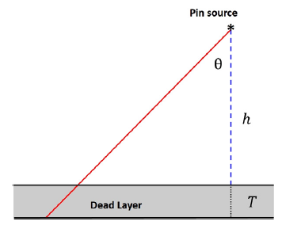
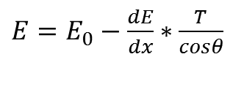

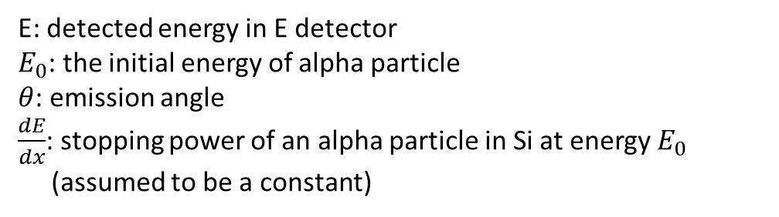
Date: 2018-10-28
Source: https://doi.org/10.1016/j.nima.2017.12.082
(6) The idea of testing the thickness of the dead layer
● The dead layer is the only potential cause of energy loss between the source and active
volume, as alpha particles from the pin do not need to pass through a gold window or
Mylar foil to reach the detector.
● Some assumptions:
<1> Assuming an effective dead layer of pure silicon
<2> Assuming a uniform dead layer, means a constant thickness of the dead layer
<3> Assuming a constant value for energy loss, since the thickness of the dead layer is very small.
● Basic formula used for extraction of T
$E=E_{0}−\frac{dE}{dx}∗\frac{T}{cosθ}$
E: detected energy in E detector
$E_{0}$: the initial energy of alpha particle
$θ$: emission angle
$\frac{dE}{dx}$: stopping power of an alpha particle in Si at energy $E_{0}$
(assumed to be a constant)
Observable quantities: E , $θ$

Slide 15
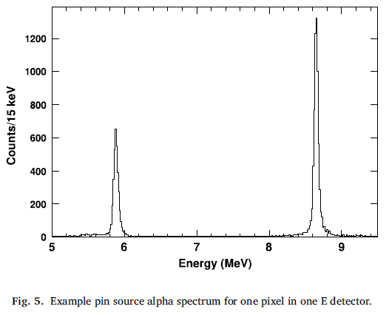
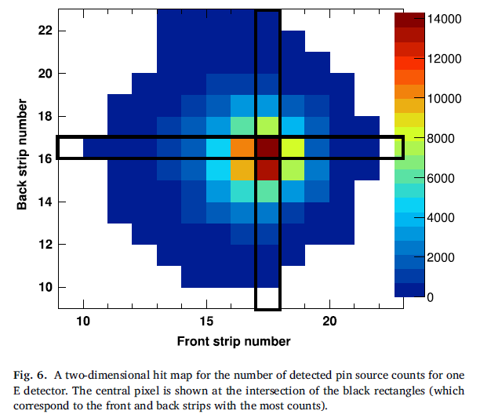
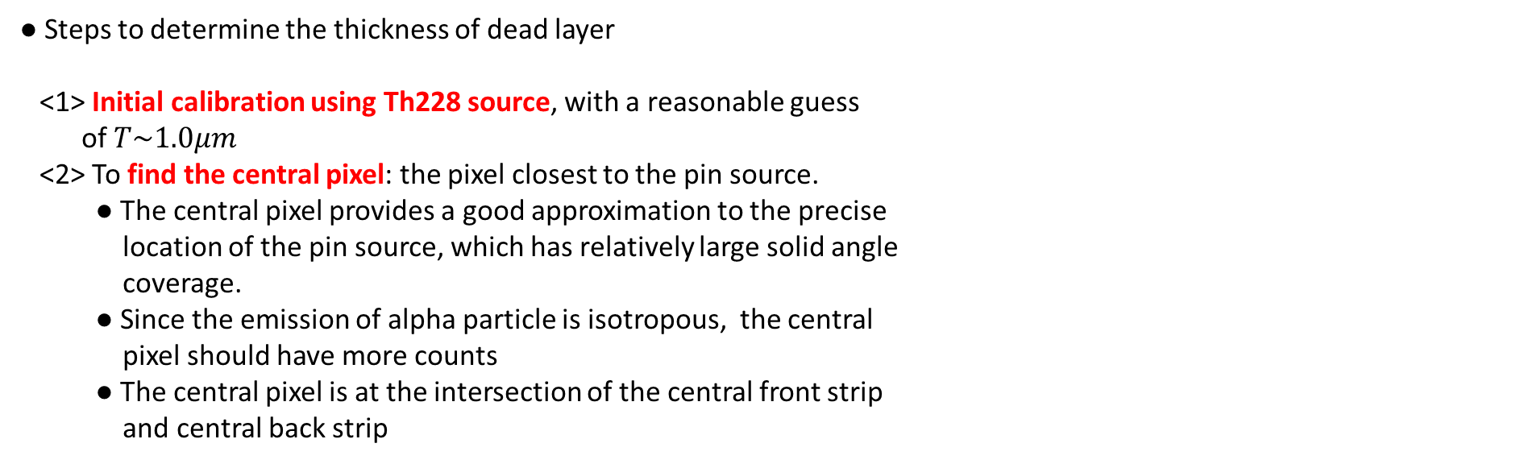
Date: 2018-10-28
Source: https://doi.org/10.1016/j.nima.2017.12.082
Two unresolved peaks: 6.051MeV(25.1%) & 6.090MeV(9.75%)
8.785MeV
● Only two peaks in the pin source data:
6.062 MeV && 8.785MeV
Combined via a weighted sum:
6.062MeV
● Steps to determine the thickness of dead layer
<1> Initial calibration using Th228 source, with a reasonable guess
of $T\sim 1.0μm$
<2> To find the central pixel: the pixel closest to the pin source.
● The central pixel provides a good approximation to the precise
location of the pin source, which has relatively large solid angle
coverage.
● Since the emission of alpha particle is isotropous, the central
pixel should have more counts
● The central pixel is at the intersection of the central front strip
and central back strip

Slide 16
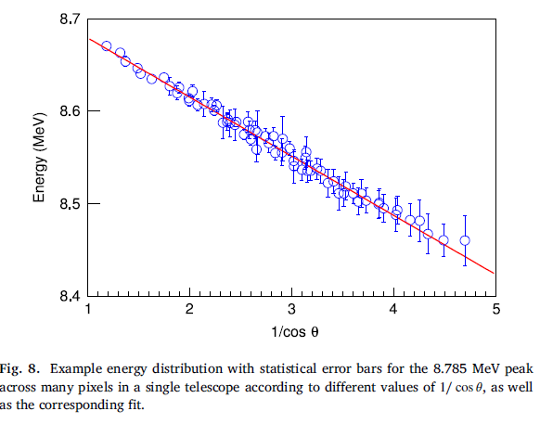

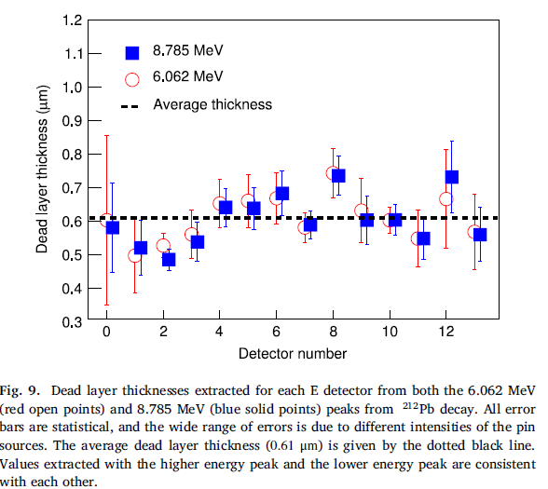

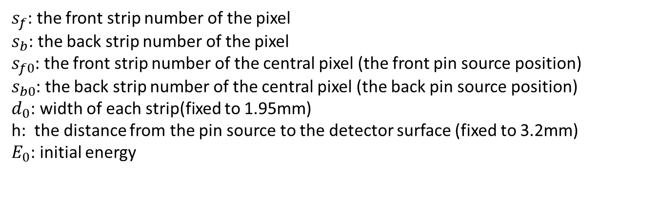
Date: 2018-10-28
Source: https://doi.org/10.1016/j.nima.2017.12.082
<3> Fit for each peak of each pixel
$s_{f}$: the front strip number of the pixel
$s_{b}$: the back strip number of the pixel
$s_{f0}$: the front strip number of the central pixel (the front pin source position)
$s_{b0}$: the back strip number of the central pixel (the back pin source position)
$d_{0}$: width of each strip(fixed to 1.95mm)
h: the distance from the pin source to the detector surface (fixed to 3.2mm)
$E_{0}$: initial energy
$$0.61±0.07μm$$
Only 2 free parameters: T and $E_{0}$

Slide 17
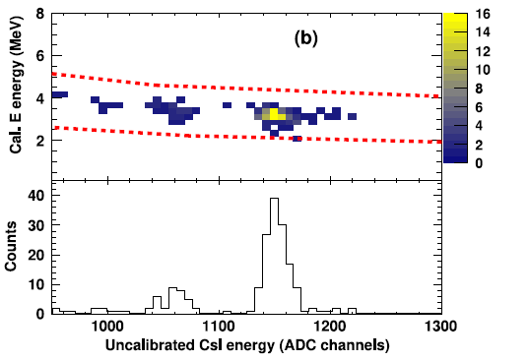
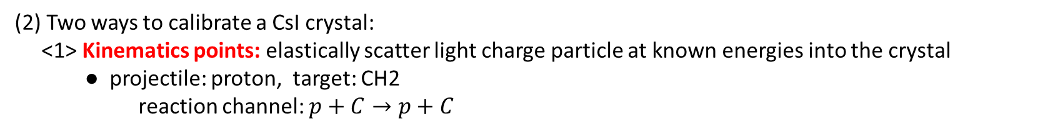
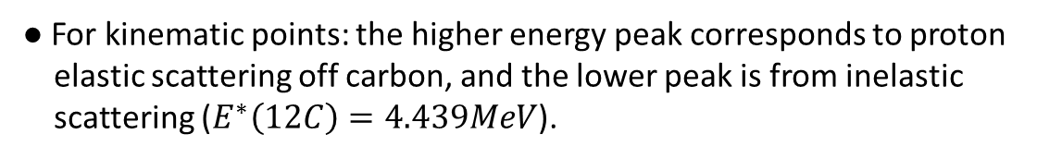
Date: 2018-10-28
Source: https://doi.org/10.1016/j.nima.2017.12.082
3. Si detector thickness determination
(1) Dead layer has a smaller effect on relatively high energy particles that punch through the entire E
detector. In this case, it’s important to understand the overall thickness of E since CsI are typically
calibrated using particles that punch-through the E.
(2) Two ways to calibrate a CsI crystal:
<1> Kinematics points: elastically scatter light charge particle at known energies into the crystal
● projectile: proton, target: CH2
reaction channel: $p+C→p+C$
● In this experiment, since the kinematic relationship between scattering angle and energy is weak,
this results in one elastically scattered proton calibration per crystal.
● For kinematic points: the higher energy peak corresponds to proton
elastic scattering off carbon, and the lower peak is from inelastic
scattering ($E^{∗}\left(12C\right)=4.439MeV$).

Slide 18
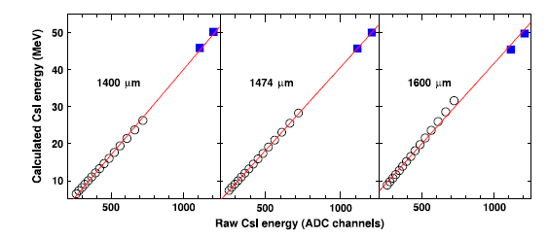
Date: 2018-10-28
Source: https://doi.org/10.1016/j.nima.2017.12.082
<2> ∆E-E points (Energy loss method)
● Two important notes:
* This method relies on the assumption that the CsI detector response is linear at low energy (confired by WMU data)
* Requiring that only data from proton hitting the detector be used.
(3) In this energy range, kinematic points and ∆E-E points should be collinear. Since the ∆E-E points are sensitive to the E thickness, the E thickness can be extracted.
(4) Summarize the idea for Si detector thickness determination
<1>Use kinematic points to constrain the calibration at high energy
<2> ∆E-E points should be linear at low energy and be collinear with
kinematic points
<3> Adjust the E thickness to satisfy the condition in <2>

Slide 20
Scintillator

Slide 21
Date: 2018-10-31
Source: Daniele’s group meeting talk
Mechanism of light production in CsI(Tl) and light response
A few recalls: Mechanism of light production in CsI(Tl).
(alkali halide inorganic crystal)
After ionizing, a free electron is located in the conduction band and a hole is located in the valence band. The electron can return to the valence band emitting a photon (normally not in the visible range).
electron
Conduction band (here electrons are free to move along the crystal)
Pure crystal
Band gap (~10eV)
energy absorption
photon
Forbidden band (an electron cannot be found here)
hole
Valence band (here the electrons are bound to lattice sites)
When the impurity is present, the hole will drift to an activation center and ionize it (because the ionization energy is much less for the activator centers than for a lattice site). When the electron, free to move in the conduction band, encounters the ionized activator, a recombination process takes place. A neutral activator is created in one of its excited states → decay via the emission of an optical photon.
electron
Conduction band (here electrons are free to move along the crystal)
Doped crystal
(impurities are added, Tl or Na)
electron recombination
ionized activator (luminescence center)
Band gap (~10eV)
energy absorption
optical photon
Accessible states are created in the forbidden band
(activator)
hole drift
hole
Valence band (here the electrons are bound to lattice sites)

Slide 22
The interaction of heavy charged particles with the CsI(Tl) occurs mainly via ionization mechanisms (and, in minor quantity, via interactions with nuclei in the lattice).
primary ionization column (high-density of charge carriers)
$$r_{c}≈40nm$$
e-
e-
e-
e-
Incident ionizing particle
e-
The efficiency of light production within the ionization column is limited by quenching effects:
Ideal light response
Quenched light response
$$\frac{dL}{dE}=1$$
$$\frac{dL}{dE}<\frac{1}{2}$$

Slide 23
Furthermore, the light response is not a constant with the particle’s energy. A unified treatment of light response was proposed by Birks for alpha-particles in organic scintillators (J.B. Birks, Scintillation Counters, Pergamon Press, Oxford 1960, p. 93) and is normally applied also in the case of inorganic scintillators.
Scintillation efficiency factor
$$\frac{dL}{dx}=\frac{ℒ{\left|\frac{dE}{dx}\right|}_{e}}{1+kB{\left|\frac{dE}{dx}\right|}_{e}}$$
electronic stopping power
Quenching factor
$$\frac{dL}{dE}=\frac{ℒ}{1+kB{\left|\frac{dE}{dx}\right|}_{e}}$$
This formula can be analytically integrated by considering the following approximation valid for low energy:
$${\left|\frac{dE}{dx}\right|}_{e}∝\frac{AZ^{2}}{E}$$

Slide 24
This leads to the following formulations of the CsI(Tl) light response:
D. Horn et al., Nucl. Instr. Meth A 320 (1992) 273
$$L\left(E,Z,A\right)=a_{0}+a_{1}\left(E−a_{2}AZ^{2}\ln\left(\frac{E+a_{2}AZ^{2}}{a_{2}AZ^{2}}\right)\right)$$
N. Colonna et al., Nucl. Instr. Meth. A 321 (1992) 529
$$L\left(E,Z\right)=c_{1}γ+c_{2}β(e^{−αE}−1)$$
P.F. Mastinu et al., Nucl. Instr. Meth A 338 (1994) 419
$$L\left(E,Z\right)=(\frac{d_{2}}{Z}+d_{4}Z+d_3)\left(E+d_{1}Z\left(e^{−\frac{E}{d_{1}Z}}−1\right)\right)$$
Y. Larochelle et al., Nucl. Instr. Meth. A 348 (1994) 167
$$E\left(L,Z,A\right)=aAZ^{2}L+\left(b+cAZ^{2}\right)L^{1−d\sqrt{AZ^{2}}}$$

Slide 25
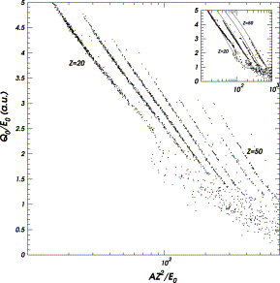
However, the scintillation efficiency dL/dE is not a function of the electronic stopping power only, but rather of a composed set of discrete functions: A. Meyer and R.B. Murray, Phys. Rev. 128 (1962) 98.
The figure, from M. Parlog et al., Nucl. Instr. Meth. A 482 (2002) 674, shows that for the same average stopping power heavier isotopes have a greater light efficiency.

Slide 26
This is the effect of the so-called δ-electrons (or knock-on electrons), i.e. modestly energetic electrons (~1keV) that are scattered outside of the primary ionization column caused by the incident ionizing radiation.
“virgin” region of the crystal
e-
e-
primary ionization column (high-density of charge carriers)
$$r_{c}≈40nm$$
e-
e-
e-
e-
Incident ionizing particle
e-
“virgin” region of the crystal
e-
Knock-on electrons have access to a “virgin” region of the crystal, outside of the highly ionized region, where quenching effects don’t occur. This is a high-efficiency region of the crystal. The Birks formula has to be changed as follows:
$$ℱ\left(E\right)=\frac{{\left(−\frac{dE}{dx}\right)}_{δ}}{{\left(−\frac{dE}{dx}\right)}_{e}}$$
Fractional energy loss. This is the fraction of energy carried off by δ-rays. Non-zero only for $E/A > E_{δ}/A$
$$\frac{dL}{dE}=\left(1−ℱ\left(E\right)\right){\left(\frac{dL}{dE}\right)}_{p}+ℱ\left(E\right){\left(\frac{dL}{dE}\right)}_{δ}$$

Slide 27
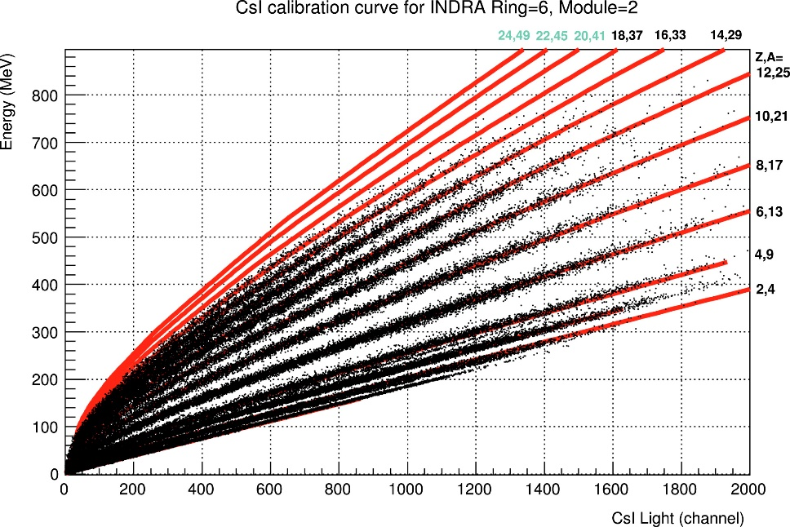
The fractional energy loss is non-zero only when the energy exceed the threshold of delta-ray emission and it is more important for heavier isotopes (since light isotopes have a small efficiency of delta-ray production) and at higher energies. An empirical model for fractional energy loss calculation and its dependency on E/A was first given by Meyer and Murray.
The most recent formulation is by Parlog (Recombination and nuclear quenching model). This leads to an approximate formula:
Fractional energy loss (this is put artificially to 0 for $E/A<a_{2}$)
$$L\left(E\right)=a_{1}E\left[1−a_{2}\frac{AZ^{2}}{E}\ln\left(1+\frac{1}{\frac{a_{2}AZ^{2}}{E}}\right)+\left(a_{2}a_{4}\frac{AZ^{2}}{E}\ln\left(\frac{E+a_{2}AZ^{2}}{a_{3}A+a_{2}AZ^{2}}\right)\right)\right]$$
Threshold of delta-ray production $E_{δ}/A$
Example from O. Lopez et al., Nucl. Instr. Meth. A 884 (2018) 140

Slide 28
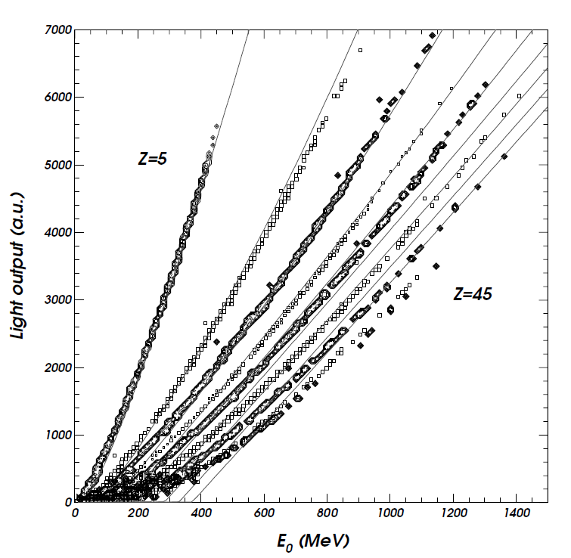
Quality of fit results from the literature
M. Parlog et al., Nucl. Instr. Meth. A 482 (2002) 693
$$L\left(E\right)=a_{1}E\left[1−a_{2}\frac{AZ^{2}}{E}\ln\left(1+\frac{1}{\frac{a_{2}AZ^{2}}{E}}\right)+\left(a_{2}a_{4}\frac{AZ^{2}}{E}\ln\left(\frac{E+a_{2}AZ^{2}}{a_{3}A+a_{2}AZ^{2}}\right)\right)\right]$$
Applied down to Z=5.

Slide 29
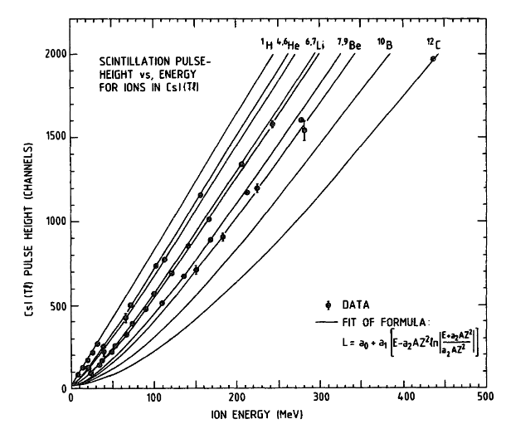
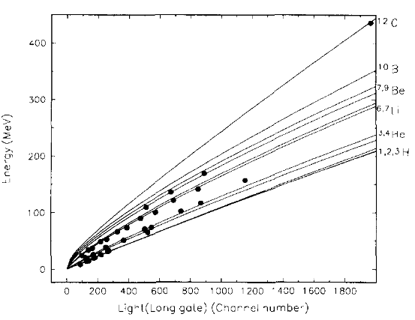
Quality of fit results from the literature
D. Horn et al., Nucl. Instr. Meth A 320 (1992) 273
General formula valid over a range of light ions.
Limited energy range available for protons.
$$L\left(E,Z,A\right)=a_{0}+a_{1}\left(E−a_{2}AZ^{2}\ln\left(\frac{E+a_{2}AZ^{2}}{a_{2}AZ^{2}}\right)\right)$$
Y. Larochelle et al., Nucl. Instr. Meth. A 348 (1994) 167
$$E\left(L,Z,A\right)=aAZ^{2}L+\left(b+cAZ^{2}\right)L^{1−d\sqrt{AZ^{2}}}$$

Slide 30
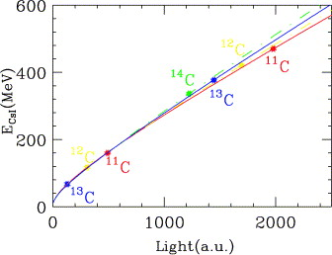
Quality of fit results from the literature
A. Wagner et al., Nucl. Instr. Meth. A 456 (2001) 290
A better fit quality is obtained by fitting isotopes of each Z with an individual empirical formula.
For Z=3 → $E\left(L,Z,A\right)=aAZ^{2}L+b\left(1+cAZ^{2}\right)L^{1−dAZ^{2}}$
For Z=2 → $E\left(L\right)=aL+bA^{c}[1−e^{dL}]$
For Z=1 → $E\left(L\right)=aL+b$
Only 1 calibration point is present for 1H!

Slide 31
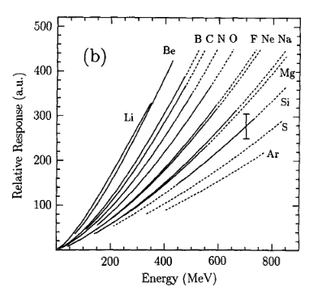
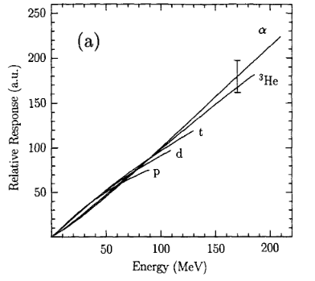
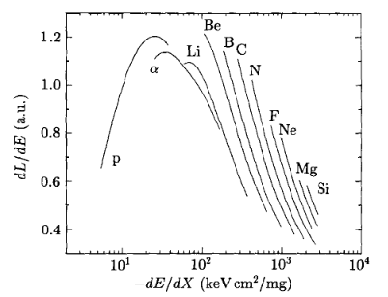
Quality of fit results from the literature
C.J.W. Twenhofel et al., Nucl. Instr. Meth B 51 (1990) 58
Dedicated apparatus to measure light response of light particle exclusively.
Saturation effects observed for Z<=3, more important for Z=1. The onset of this effect is between 20 and 30 keVcm2/mg for Z=1, between 30 and 40 keVcm2/mg for Z=2 and about 70 keVcm2/mg for Z=3.
Saturation effect
$$L\left(E\right)=aZ^{b}E^{c}$$
Separate fits for Z<3 because of saturation effects.

Slide 32
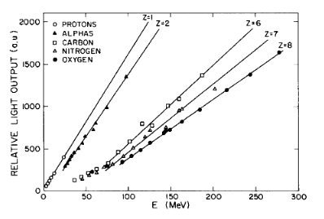
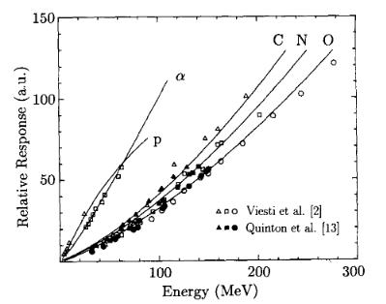
Quality of fit results from the literature
G. Viesti et al., Nucl. Instr. Meth A 252 (1986) 75
Linear fit on Z=1 based on few calibration points. The same data was interpreted in terms of the previously explained saturation effects by Twenhofel et al.

Slide 33
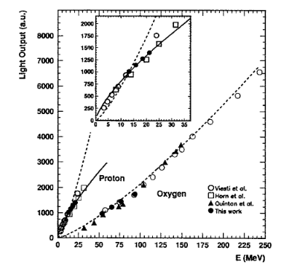
Quality of fit results from the literature
S. Aiello et al., Nucl. Instr. Meth. A 369 (1996) 50-54
Similar saturation effect possibly observed also by Aiello et al.
$$L\left(E\right)=aZ^{b}E^{c}$$
Separate fit for Z=1 because of saturation effects.

Slide 34
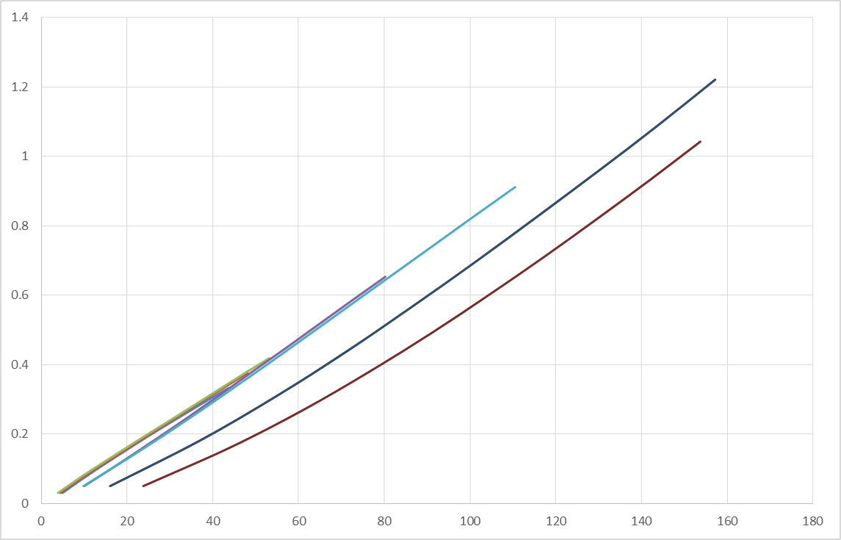
It is clear that very few and fragmentary data is reported in the literature for Z=1 light response in CsI(Tl) (and inorganic scintillators in general).
Since we are interested in proton energy spectra over a wide range of energies (and for the first time we have good quality data of protons in a wide energy range), it is mandatory to explore the possible existence of saturation effects observed in the literature and build a proper fit formula.
6,7Li
7Be
4He
L (V)
3He
p,d,t
E (MeV)

Slide 36
闪烁探测器
● 无机闪烁体：主要用于能量测量。原因：密度大，能量分辨较好。发光衰减时间长(~百纳秒)，光脉冲较宽。
● 有机闪烁体：主要用于时间测量。发光衰减时间短(3~5ns)，材质较轻，对gamma不能全吸收，主能测量计数。
● 荧光和磷光的区别：荧光发光时间在10ns以内，磷光发光时间比荧光长得多

Slide 37
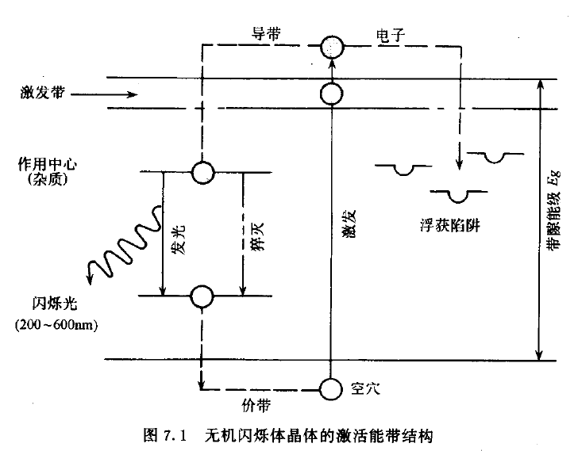
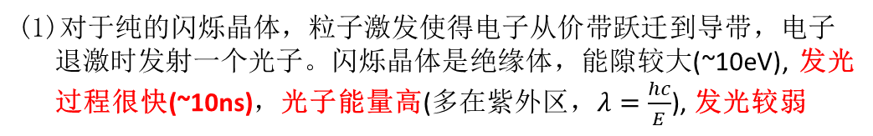
Date: 2018-11-01
Source: 高能所 《粒子探测器于数据获取， Leo <Techniques for Nuclear and Particle Physics Experiment>
无机闪烁体
● 无机闪烁体具有快发光的特点，或者发光成分中有快发光过程 。在闪烁晶体中加入金属或者稀土杂质，如
NaI(Tl), CsI(Tl), 以杂质离子为发光中心，发光衰减时间慢，但发光较强。利用这个特点，可以进行脉冲形状甄别。
● 从能带角度看，无机闪烁晶体是绝缘体。因具有发光快(~10ns)，产额高，波长适合，密度大，价格低的特点而
广泛应用于粒子物理与核物理实验中。
● 无机闪烁体的发光原理
(1)对于纯的闪烁晶体，粒子激发使得电子从价带跃迁到导带，电子
退激时发射一个光子。闪烁晶体是绝缘体，能隙较大(~10eV), 发光
过程很快(~10ns)，光子能量高(多在紫外区，$λ=\frac{hc}{E}$), 发光较弱
(2)在闪烁晶体中加入杂质，在禁带中形成中间能级，且有很宽的寿命分布。部分中间能级的电子在退激过程中发射一个光子，短寿命能级的发光构成荧光，长寿命能级的发光构成磷光。也有无辐射跃迁(即猝灭)。

Slide 38
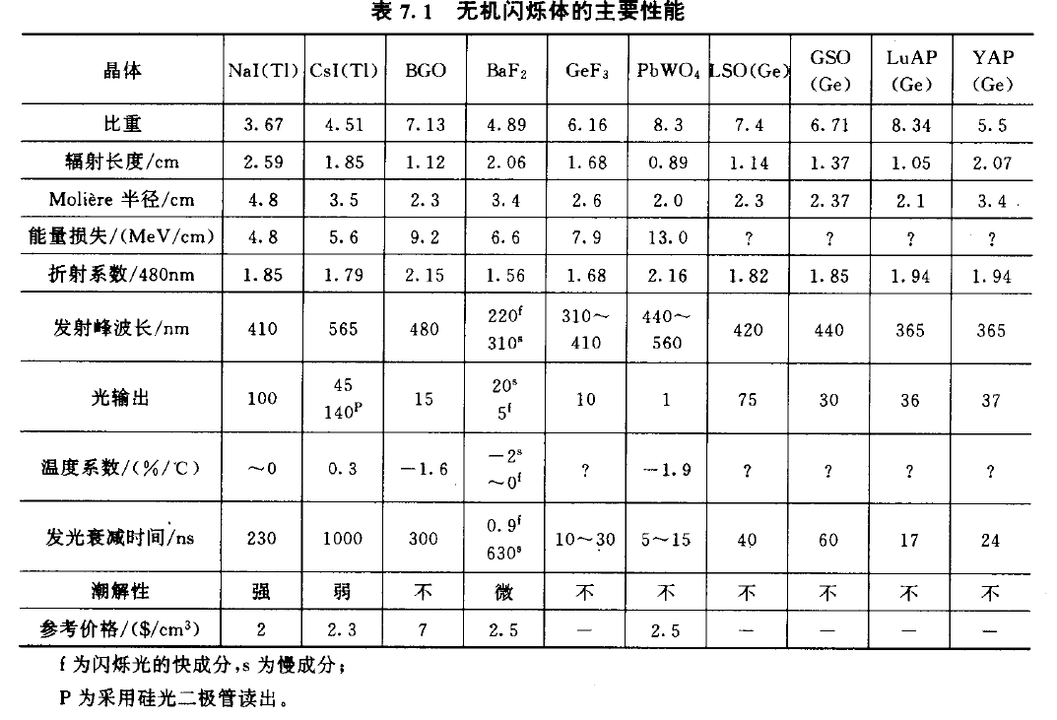
● 无机闪烁体的主要性能

Slide 39
● 能量分辨是无机闪烁体的主要性能。在低能粒子探测中，NaI(Tl), CsI(Tl)对Cs137的662keV gamma
射线的分辨率<4%
● 闪烁体的能量线性
(1) 一般情况下，闪烁体的光输出与沉积能量呈线性关系。但由于quenching effect && saturation effect的存在
使得光响应出现非线性。
(2) Quenching effect 主要发生在重离子的低能端。
(3) Saturation effect 只要发生在p,d,t的高能端
● 发光衰减时间
(1) 闪烁体发光分两个过程，发光增加过程和发光衰减过程。前者与探测器
本身的性能相关，不同粒子差异不大；后者对于不同闪烁体种类，不同
粒子各有不同。与光衰减过程相比，前者可以忽略不计。
(2) 发光衰减时间遵循指数衰减规律
(3) 塑闪、液闪探测器一般使用光电倍增管读出
● 光收集：闪烁体通过反射进入到光探测器接收端的，主要考虑的是侧面的
光反射问题。
(1) 全反射：只收集可全反射的光，光程差小，行成快脉冲输出，对时间测量有利。
(2) 镜面反射：反射效率<95%，多次反射效率不高，只在小尺寸闪烁体上使用。
(3) 漫反射：效率较高，但光程差大，行成宽脉冲，多用于能量测量。

Slide 40
● 无机闪烁体采用漫反射的方法收集光。原因是发光衰减时间长，光脉冲本来就比较宽。
常用的漫反射材料：MgO、Al2O3细粉末，白色涂料，聚四氟乙烯(Teflon)膜

Slide 41

Date: 2018-11-01
Source: 高能所 《粒子探测器于数据获取， Leo <Techniques for Nuclear and Particle Physics Experiment>
Date: 2018-11-02
Source: Digital pulse-shape discrimination of fast neutron and gamma rays
有机闪烁体
● 有机闪烁体包括：有机晶体，有机闪烁液体，塑料闪烁体。发射荧光波长350-500nm，发光衰减时间短，3-5ns
● 有机液闪探测器，也叫“proton recoil detector”. 液闪对快中子有很好的探测效率，因为快中子与质子较大的弹性散射
截面；另外，液闪能很好地区分中子和gamma（脉冲形状甄别）
● 有机闪烁体的发光原理：$π$电子的跃迁
● 有机闪烁体采用镜面反射与全反射混合的方法收集光。既保持了快脉冲输出，又尽可能得到了高的光收集效率。
常用的漫反射材料：铝薄膜（最好是镀铝的塑料薄膜）

Slide 42
脉冲形状甄别（PSD）

Slide 43
Date: 2018-11-05
Source: 高能所 《粒子探测器于数据获取， Leo <Techniques for Nuclear and Particle Physics Experiment>
硅光二极管（PhotoDiode）
● 我们实验中使用的是PIN型的PD(型号S3204-08)，在P层和N层之间制造了一层高阻的I层，改善了时间相应

