Slide 1
Q1：在粒子探测时，信号是如何感应出来的？

Slide 2
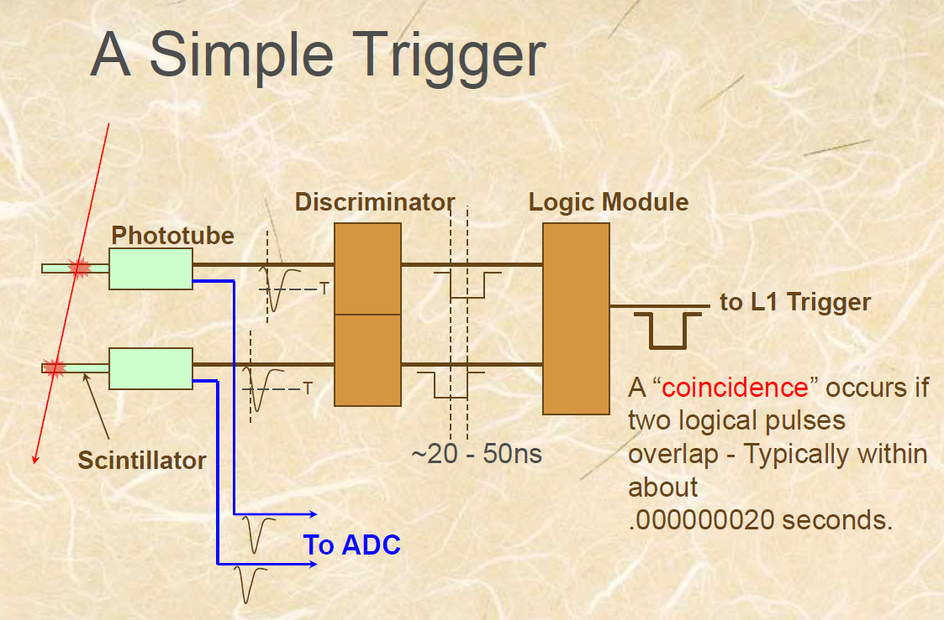
Date: 2018-10-15
Source: google <Data Acquisition Systems for Experimental Nuclear Physics>
Trigger
符合事件：同时发生

Slide 3
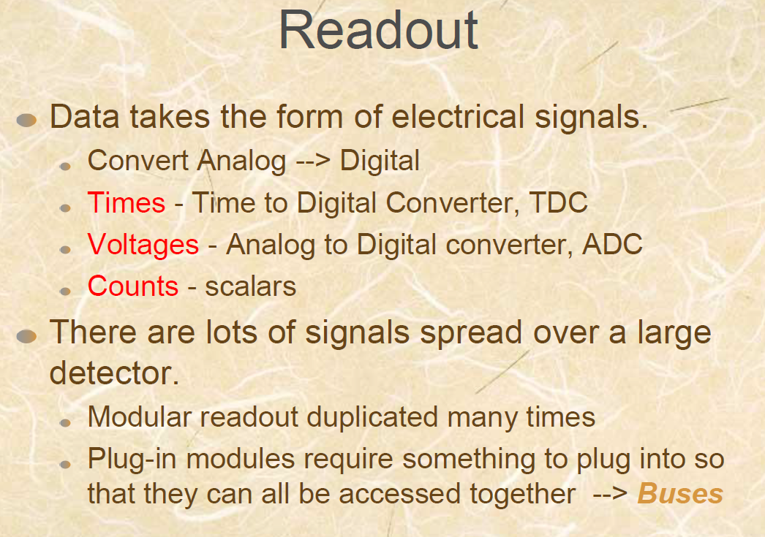
Date: 2018-10-15
Source: google <Data Acquisition Systems for Experimental Nuclear Physics>

Slide 4
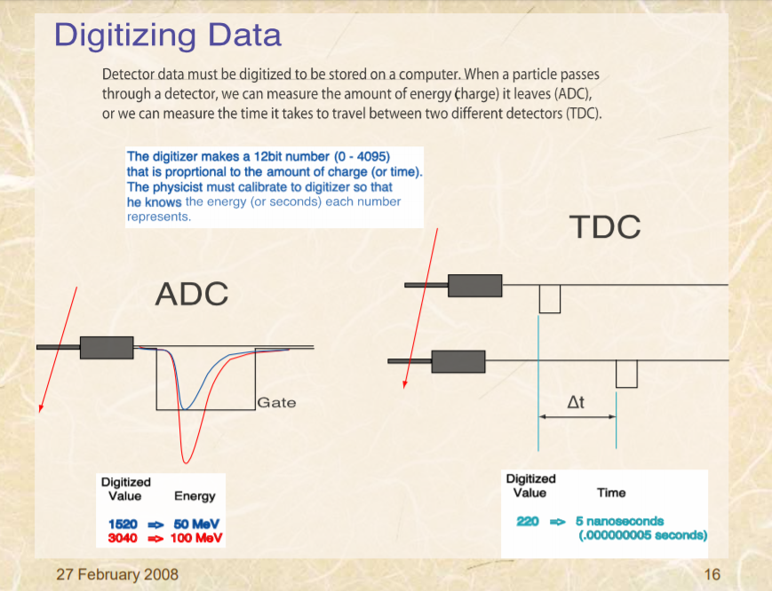
Date: 2018-10-15
Source: google <Data Acquisition Systems for Experimental Nuclear Physics>

Slide 5
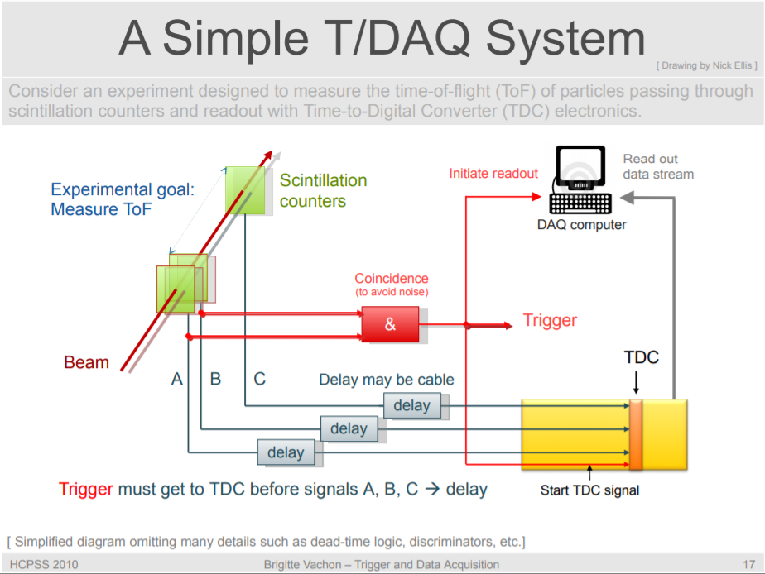
Date: 2018-10-15
Source: google <Trigger and Data Acquisition(I)>
作为时间信号的Trigger:
Trigger信号必须首先进入到TDC

Slide 6
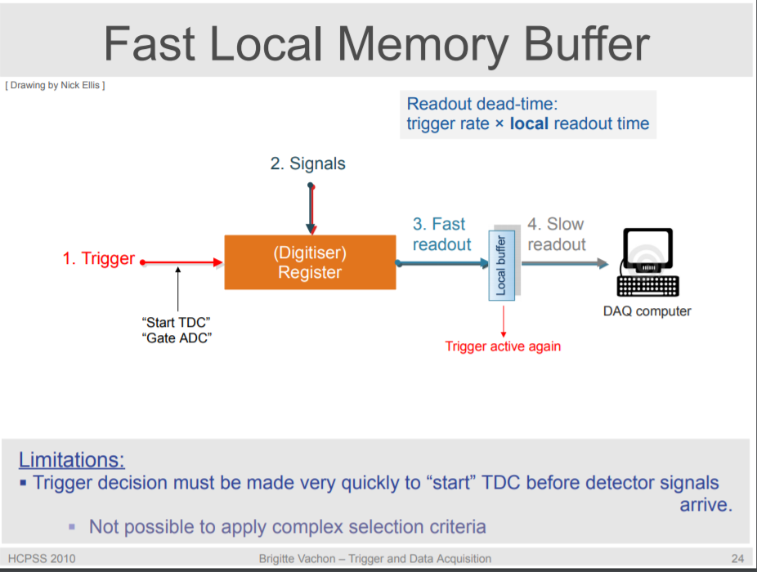
Date: 2018-10-15
Source: google <Trigger and Data Acquisition(I)> “Trigger and data acquisition” CERN, N .Ellis

Slide 8
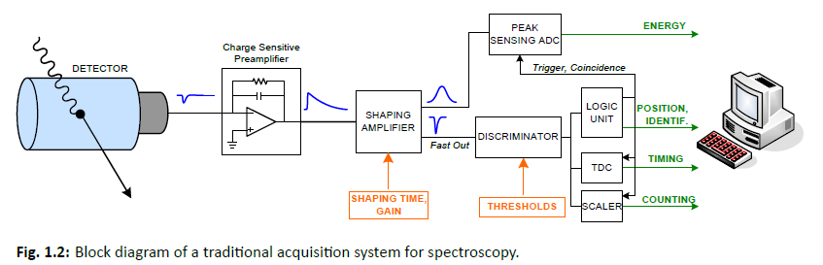
Date: 2018-10-19
Source: CAEN <Digital Pulse Processing in Nuclear Physics>
Each block of the chain has a specific function, which forces the user to manage several individual blocks for the system to successfully extract all the relevant quantities. There is why we need calibrations!
Preamplifier: is a very low noise analog circuit close to the detector, produces
an output signal with a S/N ratio(信噪比) suitable for transimission.

Slide 9

Date: 2018-10-19
Source: CAEN <Digital Pulse Processing in Nuclear Physics>
Charge sensitive preamplifier:
Integrate the signal coming from the detector, converting the charge into voltage amplitude
A charge sensitive preamplifier is composed of a simple capacitor.

Slide 10
Date: 2018-10-19
Source: CAEN <Digital Pulse Processing in Nuclear Physics>

Slide 11
Date: 2018-10-19
Source: CAEN <Digital Pulse Processing in Nuclear Physics>

Slide 12
Date: 2018-10-19
Source: CAEN <Digital Pulse Processing in Nuclear Physics>

Slide 13
Date: 2018-10-19
Source: CAEN <Digital Pulse Processing in Nuclear Physics>

Slide 14
Date:
Source:

Slide 15
Date:
Source:

Slide 16
Date:
Source:

Slide 17
Date:
Source:

Slide 18
Date:
Source:

Slide 19
Date:
Source:

