Slide 2
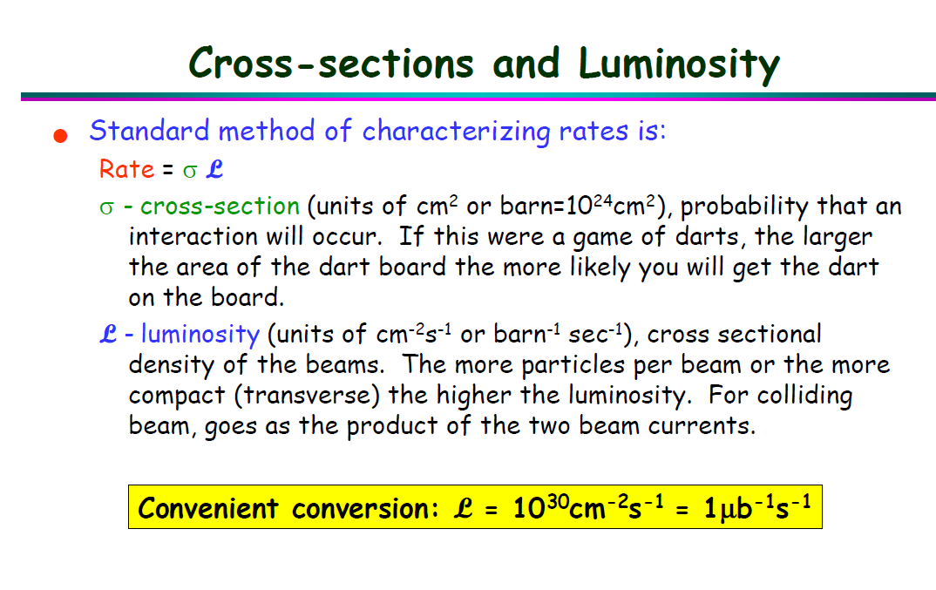
Date: 2018-10-15
Source: google <Triggering in Particle Physics Experiments>

Slide 3
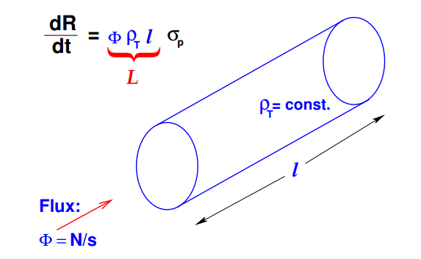
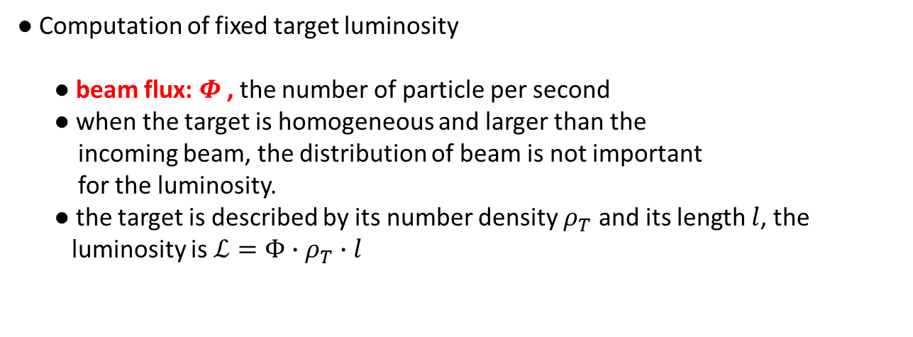
Date: 2018-11-01
Source: https://cds.cern.ch/record/941318/files/p361.pdf
Luminosity
● count rate $\frac{dR}{dt}=ℒ∙σ_{P}$
● Computation of fixed target luminosity
● beam flux: $Φ$, the number of particle per second
● when the target is homogeneous and larger than the
incoming beam, the distribution of beam is not important
for the luminosity.
● the target is described by its number density $ρ_{T}$ and its length $l$, the
luminosity is $ℒ=Φ∙ρ_{T}∙l$
Number of interaction
per beam particle

Slide 4
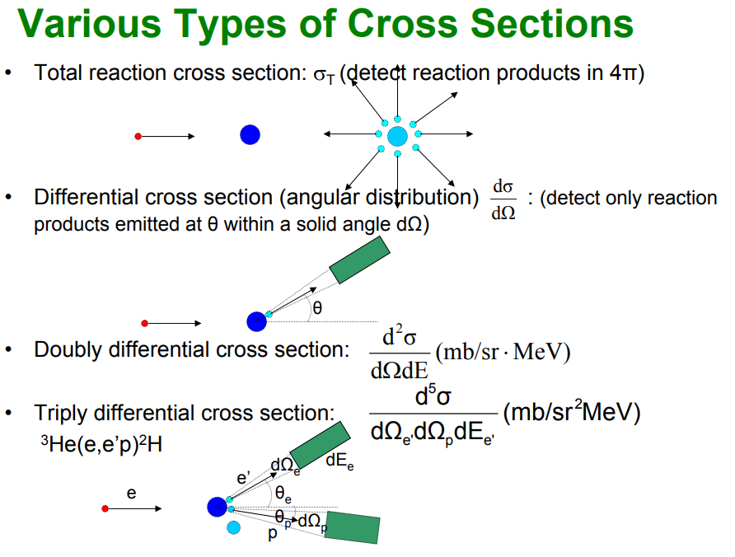
Date: 2018-11-01
Source:https://facultystaff.richmond.edu/~ggilfoyl/research/nuclearCrossSections.pdf
How to measure cross section?
● Types of cross sections

Slide 5
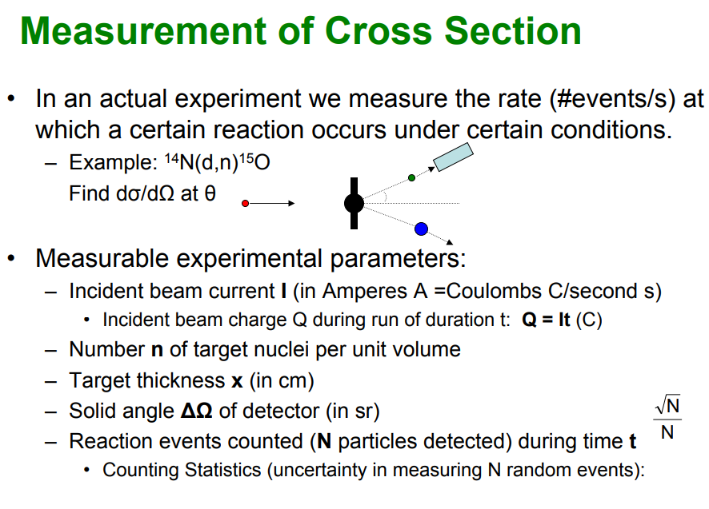
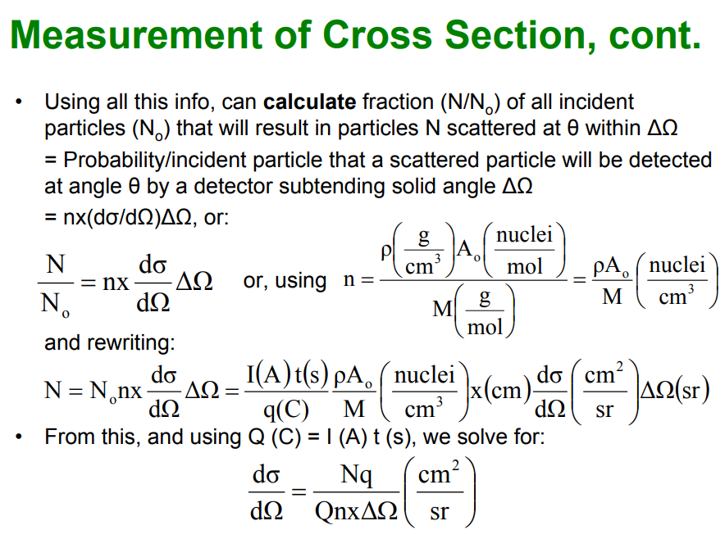
● Measurement of Cross section

Slide 6
Date: 2018-11-06
Source: Talk to Daniele
Some basic concepts
● What is an event ? What is an entry? What is multiplicity?
● event: the results after a fundamental interaction took place between subatomic particles
● an entry: the same as an entry, including particles detected in one trigger period
● multiplicity: the number of particles detected in an entry (within one trigger period)

Slide 8
Date:
Source:

Slide 9
Date:
Source:

Slide 10
Date:
Source:

Slide 11
Date:
Source:

