Slide 1
Q1: How to calibrate the double side SSD in our experiment?
Q2: 电荷重心法

Slide 3
Date: 2018-10-23
Source: https://groups.nscl.msu.edu/hira/05049/LASSA_Calibrations.pdf
Calibration on Silicon Detectors
● Th228, characterized by eight well-known alpha energies, and alpha peak are separated by at least 0.1MeV
● If a dE silicon detector is placed in front of the double sided E silicon detector, the dE detector can be calibrated by 228Th source as discussed above; while pin source is used to calibrate E detector

Slide 4
Date: 2018-10-27
Source: Talk with Daniele
Si-Si-CsI detector data analysis procedures：
1. Energy calibrations of Si detector with alpha source
2. Charge sharing method to determine the position of the hits: if the hit happens between two strips
3. Calibrations of CsI
4. Pixelization
5. Multiplicity analysis
6. Double hit or multi-hit
7. Particle Identification

Slide 5
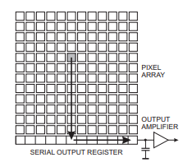
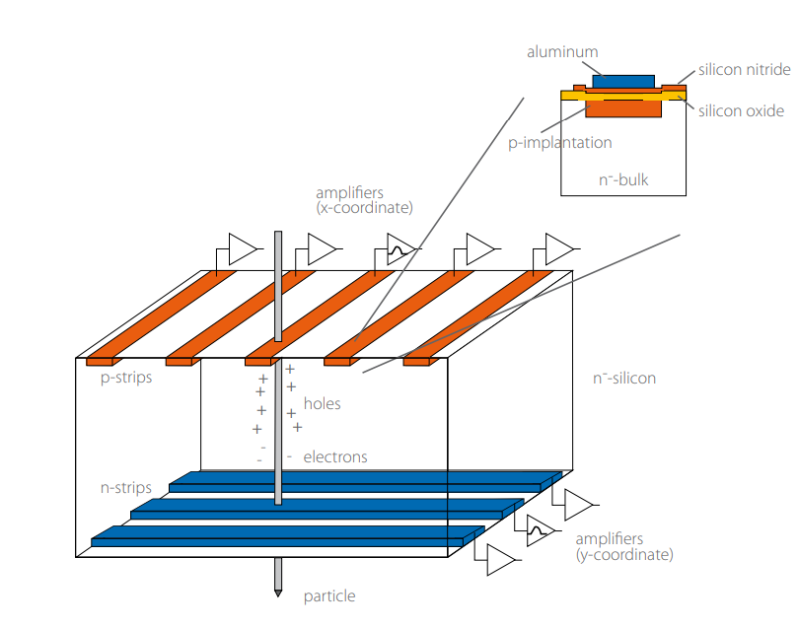
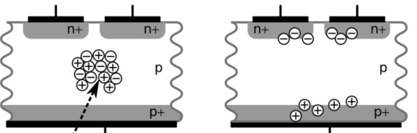
Date: 2018-10-30
Source: Talk with Daniele
Double-sided Silicon Strip Detector
1. What is a “pixel” ?
● Double-sided silicon strip detector can read out signal on both the
sides. The back strips are perpendicular to the front strips. A “pixel”
means the overlap of a font strip and a back strip.
● Double-sided SSD also called “matrix detector”
2. What does a pixel works as a position sensitive detector?
● The position of SSD is determined by the pixel. When charge particle pass
through a SSD, ideally, there will be a same a energy signal on both a front strip
and a back strip, which determines the position of the particle hits the detector.
● Charge sharing effect: means the charge generated by a particle is collected
by two or more than two strips. In this case, we should find the strip with the
largest energy, this is the strip that the particle hitting or the strip nearest to the
hitting point. Then, sum up the energy in the adjacent strips to this strip.
● 对于 Charge sharing，需要采用电荷重心法来处理。

Slide 6
3. What is multiple hit?
(1) Multiple hit means there are multiple particles hits the SSD with one readout period (no need hit
simultaneously). Silicon strip can not assign the hit positions clearly.
(2) 如何筛选出“多击事件”事件呢？
● 在pixelization过程中：当前面某个strip探测到一个能量信号时，原则上需要用这个strip跟
背面的32个strip进行组合，如果背面只有一个strip(考虑charge sharing之后)也同时探测到
信号，并且两个能量信号相同(或接近相同)，那么这两个strip对应的“pixel”就是入射粒
子的位置. 这种情况下，前面和背面总能match上.
● 如果后面不止有一个strip有信号，这种情况下，背面的每个信号会比前面小得多。前面和
背面match不上！ 对于这种“多击事件”，通常我们通常直接扔掉！！

Slide 8
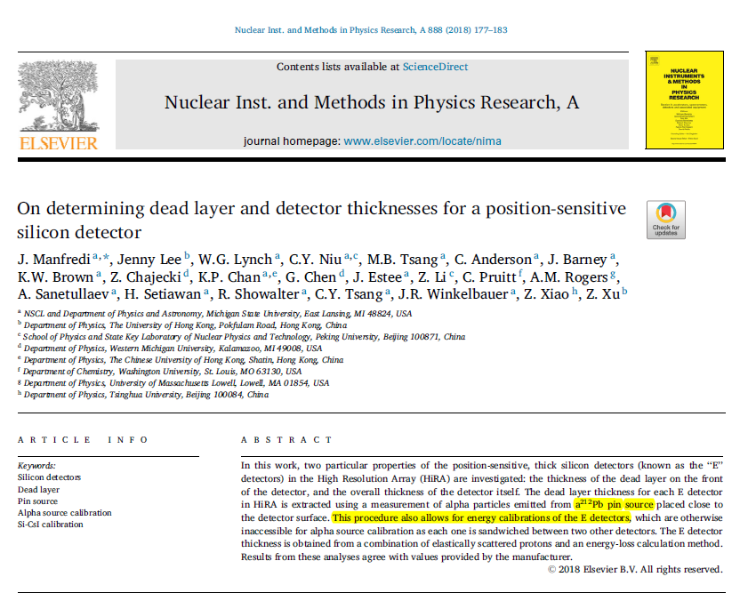
Date: 2018-10-28
Source: https://doi.org/10.1016/j.nima.2017.12.082

Slide 9
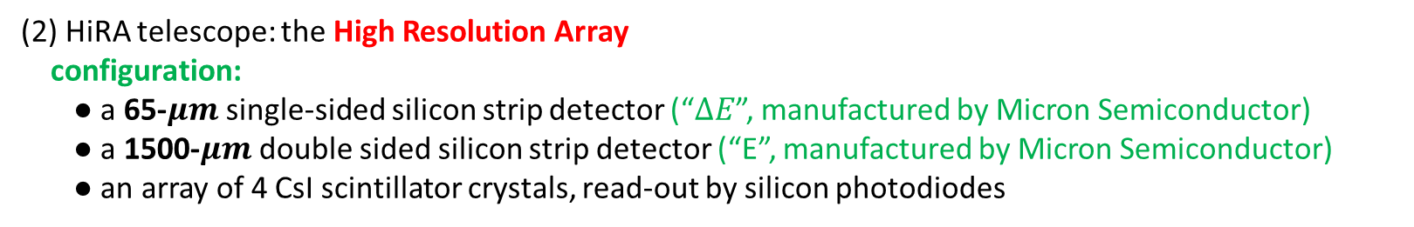
Date: 2018-10-28
Source: https://doi.org/10.1016/j.nima.2017.12.082
1. Introduction
(1) The dead layer on the surface protects the active silicon wafer of the detector.
(2) HiRA telescope: the High Resolution Array
configuration:
● a 65-$μm$ single-sided silicon strip detector (“$∆E$”, manufactured by Micron Semiconductor)
● a 1500-$μm$ double sided silicon strip detector (“E”, manufactured by Micron Semiconductor)
● an array of 4 CsI scintillator crystals, read-out by silicon photodiodes
(3) At the front of each telescope: a thin mylar foil pretecting the sensitive silicon detectors, and also completing a Faraday cage around the detectors to minimize the noise.
a Faraday Cage is just an electronic isolation chamber. Or even more simply it’s a special container that prevents electrical signals or waves from passing through it.

Slide 10
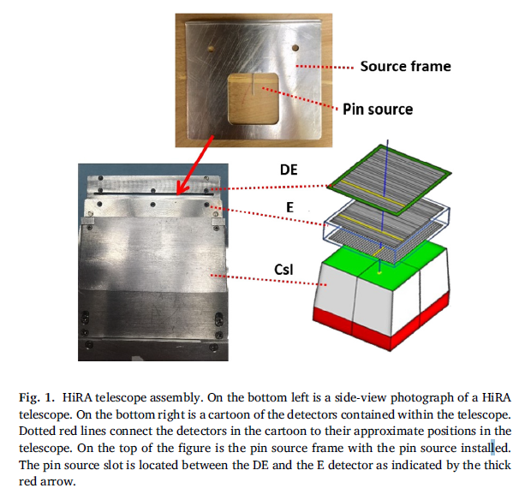

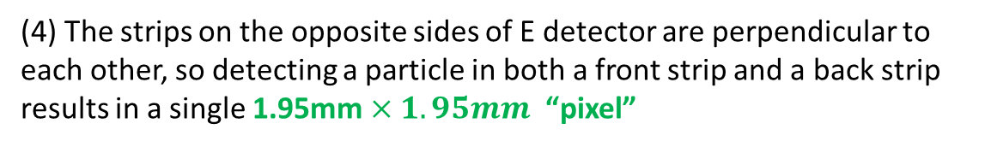
Date: 2018-10-28
Source: https://doi.org/10.1016/j.nima.2017.12.082
(4) The strips on the opposite sides of E detector are perpendicular to each other, so detecting a particle in both a front strip and a back strip results in a single 1.95mm $×1.95mm$ “pixel”
(5) What can HiRA do?
● Excellent energy resolution => to detect energy
● Excellent position resolution => to detect moving direction
● particle identification => to detect mass && charge
we can get E(energy) and $\overset{→}{P}$

Slide 11
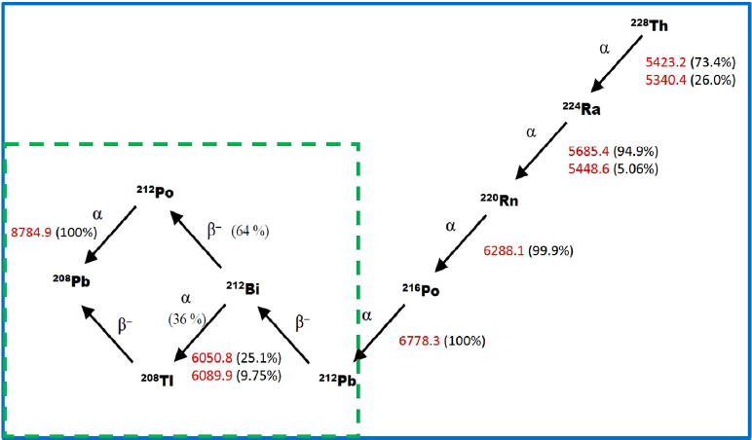
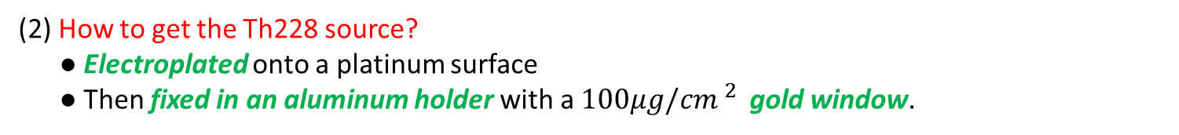
Date: 2018-10-28
Source: https://doi.org/10.1016/j.nima.2017.12.082
2. Dead layer thickness determination
(1) Using Th228 alpha source to calibrate the HiRA E and ∆E detectors. 3 advantages:
● Six clearly separated peaks with energy from about 5 MeV to 9MeV
● Th228 sources of various strengths are commercially available
● Th228 has a relatively long half-life(1.9 year)
(2) How to get the Th228 source?
● Electroplated onto a platinum surface
● Then fixed in an aluminum holder with a $100μg/{cm }^{2 }$ gold window.
(3) Ideally, if an alpha source can be inserted between the ∆E and E detectors,
the E detector can be calibrated without disassembling the HiRA telescope.
(4) The pin source is primarily Pb212 (one of the isotopes from the decay chain
of Th228)
(5) The HiRA telescope was designed so that the pin source mounted in the
frame sits 3.2mm above the surface of the E detector when the frame
is inserted into the slot.

Slide 12
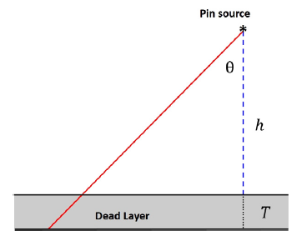
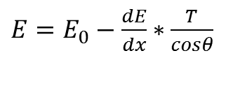

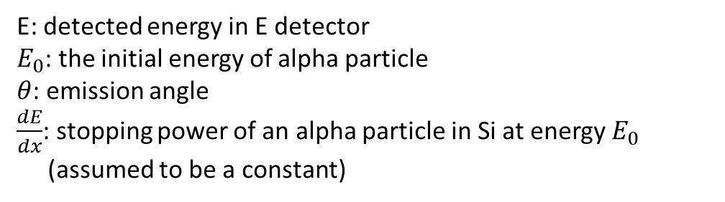
Date: 2018-10-28
Source: https://doi.org/10.1016/j.nima.2017.12.082
(6) The idea of testing the thickness of the dead layer
● The dead layer is the only potential cause of energy loss between the source and active
volume, as alpha particles from the pin do not need to pass through a gold window or
Mylar foil to reach the detector.
● Some assumptions:
<1> Assuming an effective dead layer of pure silicon
<2> Assuming a uniform dead layer, means a constant thickness of the dead layer
<3> Assuming a constant value for energy loss, since the thickness of the dead layer is very small.
● Basic formula used for extraction of T
$E=E_{0}−\frac{dE}{dx}∗\frac{T}{cosθ}$
E: detected energy in E detector
$E_{0}$: the initial energy of alpha particle
$θ$: emission angle
$\frac{dE}{dx}$: stopping power of an alpha particle in Si at energy $E_{0}$
(assumed to be a constant)
Observable quantities: E , $θ$

Slide 13
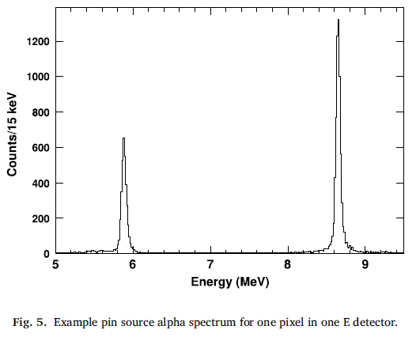
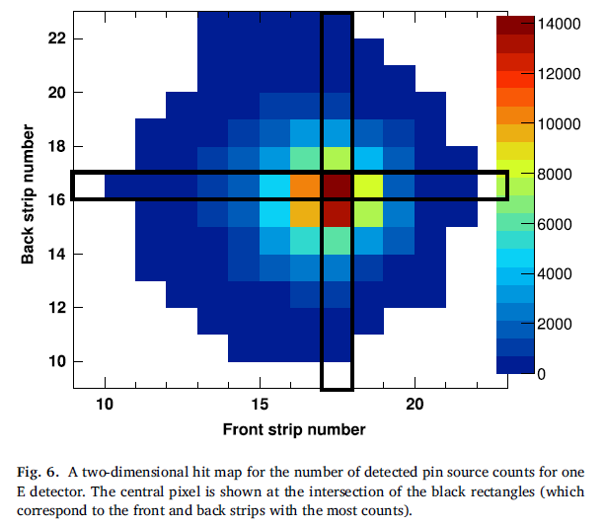
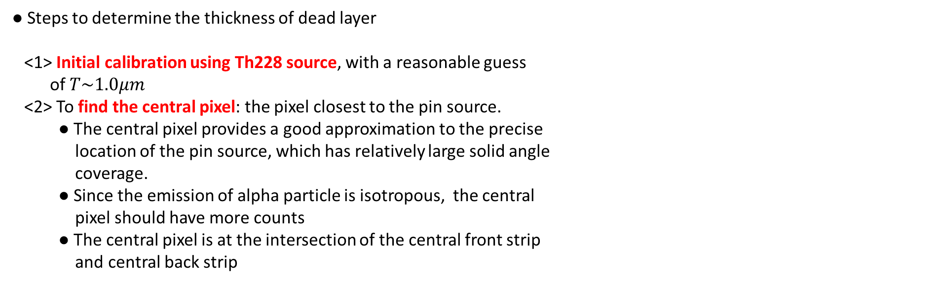
Date: 2018-10-28
Source: https://doi.org/10.1016/j.nima.2017.12.082
Two unresolved peaks: 6.051MeV(25.1%) & 6.090MeV(9.75%)
8.785MeV
● Only two peaks in the pin source data:
6.062 MeV && 8.785MeV
Combined via a weighted sum:
6.062MeV
● Steps to determine the thickness of dead layer
<1> Initial calibration using Th228 source, with a reasonable guess
of $T\sim 1.0μm$
<2> To find the central pixel: the pixel closest to the pin source.
● The central pixel provides a good approximation to the precise
location of the pin source, which has relatively large solid angle
coverage.
● Since the emission of alpha particle is isotropous, the central
pixel should have more counts
● The central pixel is at the intersection of the central front strip
and central back strip

Slide 14
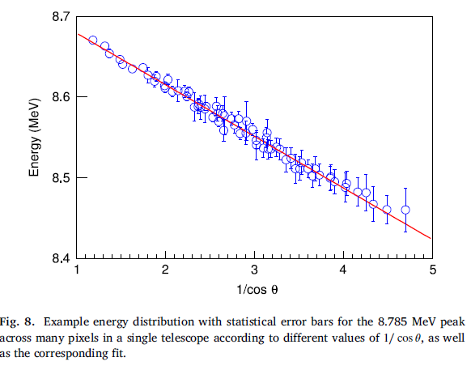

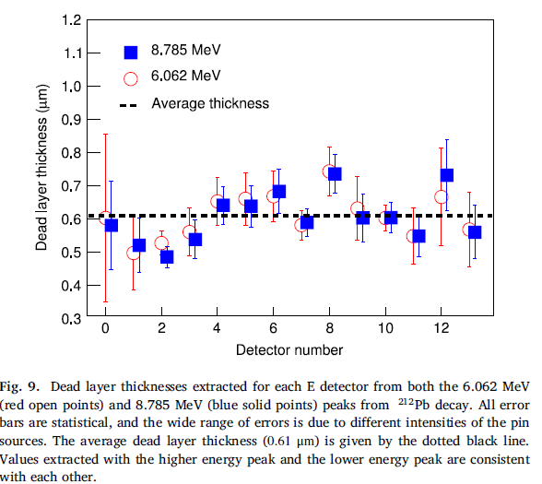

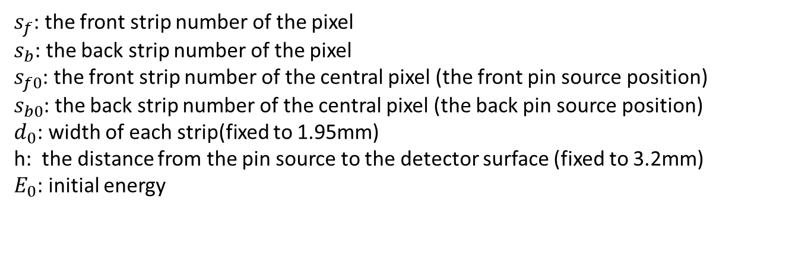
Date: 2018-10-28
Source: https://doi.org/10.1016/j.nima.2017.12.082
<3> Fit for each peak of each pixel
$s_{f}$: the front strip number of the pixel
$s_{b}$: the back strip number of the pixel
$s_{f0}$: the front strip number of the central pixel (the front pin source position)
$s_{b0}$: the back strip number of the central pixel (the back pin source position)
$d_{0}$: width of each strip(fixed to 1.95mm)
h: the distance from the pin source to the detector surface (fixed to 3.2mm)
$E_{0}$: initial energy
$$0.61±0.07μm$$
Only 2 free parameters: T and $E_{0}$

Slide 15
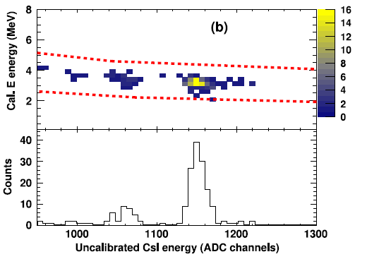
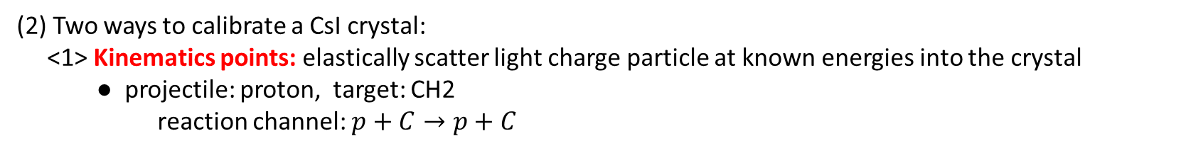
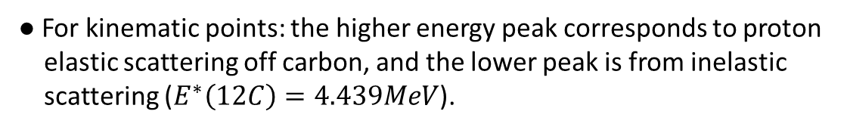
Date: 2018-10-28
Source: https://doi.org/10.1016/j.nima.2017.12.082
3. Si detector thickness determination
(1) Dead layer has a smaller effect on relatively high energy particles that punch through the entire E
detector. In this case, it’s important to understand the overall thickness of E since CsI are typically
calibrated using particles that punch-through the E.
(2) Two ways to calibrate a CsI crystal:
<1> Kinematics points: elastically scatter light charge particle at known energies into the crystal
● projectile: proton, target: CH2
reaction channel: $p+C→p+C$
● In this experiment, since the kinematic relationship between scattering angle and energy is weak,
this results in one elastically scattered proton calibration per crystal.
● For kinematic points: the higher energy peak corresponds to proton
elastic scattering off carbon, and the lower peak is from inelastic
scattering ($E^{∗}\left(12C\right)=4.439MeV$).

Slide 16
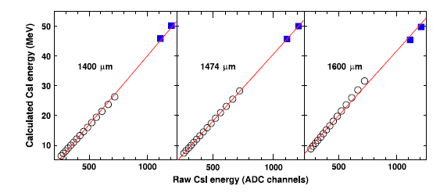
Date: 2018-10-28
Source: https://doi.org/10.1016/j.nima.2017.12.082
<2> ∆E-E points (Energy loss method)
● Two important notes:
* This method relies on the assumption that the CsI detector response is linear at low energy (confired by WMU data)
* Requiring that only data from proton hitting the detector be used.
(3) In this energy range, kinematic points and ∆E-E points should be collinear. Since the ∆E-E points are sensitive to the E thickness, the E thickness can be extracted.
(4) Summarize the idea for Si detector thickness determination
<1>Use kinematic points to constrain the calibration at high energy
<2> ∆E-E points should be linear at low energy and be collinear with
kinematic points
<3> Adjust the E thickness to satisfy the condition in <2>

Slide 17
Date:
Source:

Slide 18
Date:
Source:

