Slide 1
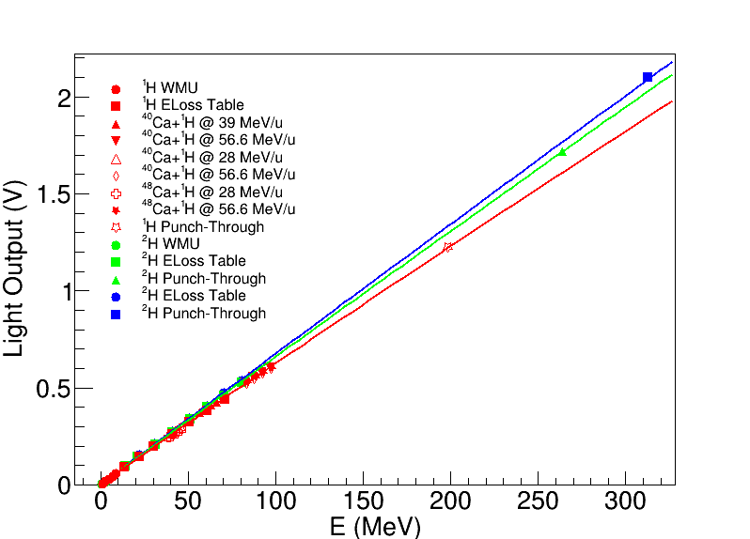
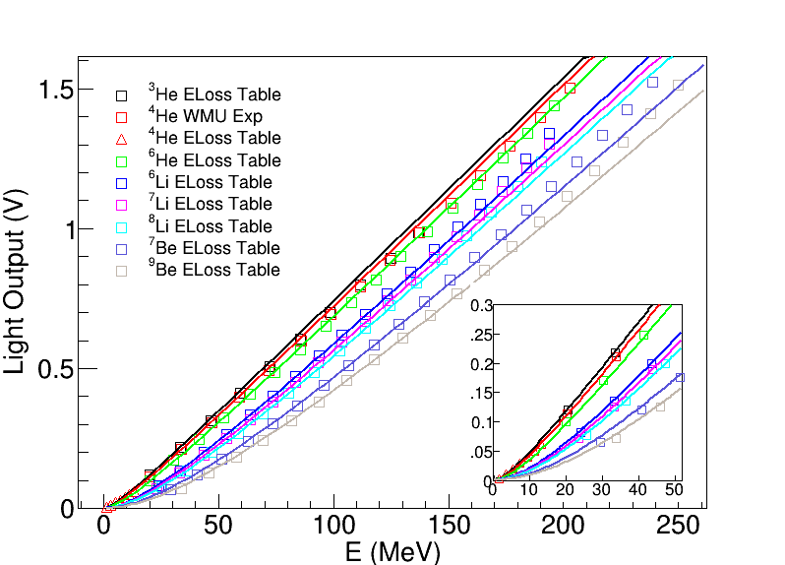
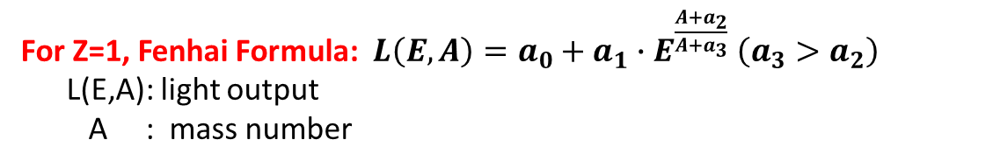
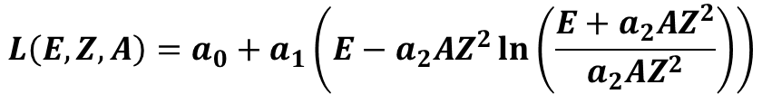
● Formulas used to fit
For Z=1, Fenhai Formula: $L\left(E,A\right)=a_{0}+a_{1}∙E^{\frac{A+a_{2}}{A+a_{3}}} \left(a_{3}>a_{2}\right)$
L(E,A): light output
A : mass number
Results at MSU
For Z>=2, Horn Formula:
D. Horn et al., Nucl. Instr. Meth A 320 (1992) 273
$$L\left(E,Z,A\right)=a_{0}+a_{1}\left(E−a_{2}AZ^{2}\ln\left(\frac{E+a_{2}AZ^{2}}{a_{2}AZ^{2}}\right)\right)$$
Results at MSU

Slide 2
● Useful references
D. Horn et al., Nucl. Instr. Meth A 320 (1992) 273
N. Colonna et al., Nucl. Instr. Meth. A 321 (1992) 529
Y. Larochelle et al., Nucl. Instr. Meth. A 348 (1994) 167
S. Aiello et al., Nucl. Instr. Meth. A 369 (1996) 50-54
G. Viesti et al., Nucl. Instr. Meth A 252 (1986) 75
C.J.W. Twenhofel et al., Nucl. Instr. Meth B 51 (1990) 58

Slide 3
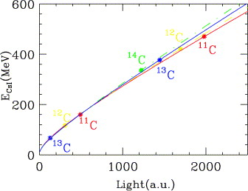
Quality of fit results from the literature
A. Wagner et al., Nucl. Instr. Meth. A 456 (2001) 290
A better fit quality is obtained by fitting isotopes of each Z with an individual empirical formula.
For Z=3 → $E\left(L,Z,A\right)=aAZ^{2}L+b\left(1+cAZ^{2}\right)L^{1−dAZ^{2}}$
For Z=2 → $E\left(L\right)=aL+bA^{c}[1−e^{dL}]$
For Z=1 → $E\left(L\right)=aL+b$
Only 1 calibration point is present for 1H!

