Slide 1
PLSC 14: Interests, Interactions and Institutions
Professor Boliang Zhu

Slide 2
Analytical Framework: Interests, Interactions, and Institutions
The Puzzle: What explains the patterns of world politics?
Analytical framework:
Interests: Actors and preferences
Interactions: Why can’t actors always get what they want?
Institutions: Sets of rules or “rules of the game”
Why do interests, interactions, and institutions matter in international relations?

Slide 3
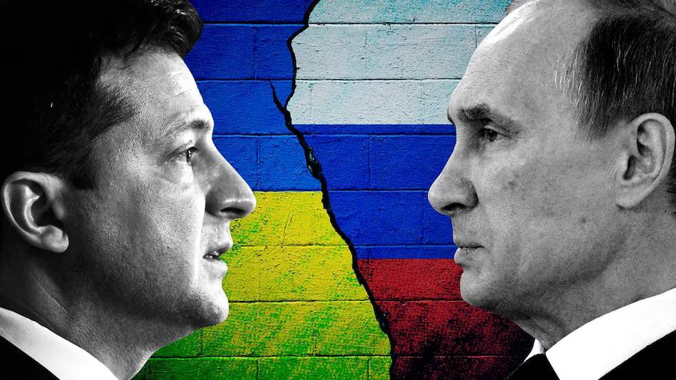
An Example: The Russia–Ukraine War

Slide 4
International System
Anarchy: the absence of a central authority with the ability to make and enforce laws that bind all actors.
No world government
  Lacks overarching authority and enforcement
Self-help -> seek power and security

Slide 5
Interests
Interests: goals that actors have, the outcomes they hope obtain through political action.
  Interests involve actors and preferences.
  Preferences can be ranked.
Actors: individuals or groups of people with common interests
  The basic unit for the analysis of international politics

Slide 6
States and Interests
State: a central authority that has the ability to make and enforce laws, rules, and decisions within a specific territory.
Sovereignty: states have legal and political supremacy within their territorial boundaries.
  Enshrined by the Peace of Westphalia that ended the Thirty Years’ War.
States have national interests, or interests attributed to the state itself, usually security and power.

Slide 7
Power and Security
Power: Ability to get an actor to do something it ordinarily would not do
Security: Process by which actors seek to protect themselves
Forms of power:
  Hard Power : Military force
  Soft Power : All other forms (economic, diplomatic, political, culture)
Ways states use power:
  Coercion: Force or threat of force or adverse consequences
  Structural/Institutional: Institutional rules, norms

Slide 8
Key Categories of Actors & Interests
ACTOR | COMMONLY ASCRIBED INTERESTS | EXAMPLES
States | Security, power, territory, wealth, ideology | United States, Canada, China, Switzerland, India, Uruguay
Politicians | Reelection/retention of office, ideology, policy goals | President of the United States, prime minister of India, Speaker of the U.S. House of Representatives
Firms, industries, or business associations | Wealth, profit | General Motors, Sony, the pharmaceutical industry, National Association of Manufacturers, Business Roundtable
Classes or factors of production | Material well-being, wealth | Capital, labor, land, human capital
Bureaucracies | Budget maximization, influence, policy preferences; often summarized by the adage of “where you stand depends on where you sit” | Department of Defense, Department of Commerce, National Security Council, Ministry of Foreign Affairs
International organizations | As composites of states, they reflect the interests of member states according to their voting power. As organizations, they are assumed to be similar to domestic bureaucracies. | United Nations, International Monetary Fund, Universal Postal Union, Organisation for Economic Co-operation and Development
Nongovernmental organizations, often transnational or international in scope and membership | Moral, ideological, or policy goals; human rights; the environment; religion | Red Cross, Amnesty International, Greenpeace, the Catholic Church

Slide 9
Interactions: Why Can’t Actors Always Get What They Want?
Outcomes depend not just on the choices of one actor but also on the choices of others.
Interactions are the ways in which the choices of two or more actors combine to produce political outcomes.

Slide 10
Interactions: Purposive and Strategic
Two main assumptions in studying interactions:
  Actors behave with the intention of producing a desired result.
  Actors adopt strategies according to what they believe to be the interests and likely actions of others.
Actors: purposive
  Develop strategies that they believe are the best response to the anticipated strategies of others.
Interactions: Strategic
  Each actor’s strategy or plan of action depends on the anticipated strategy of others.

Slide 11
Forms of Interactions
  Cooperation
  Bargaining
  Cooperation and bargaining
    Most interactions require a combination of bargaining and cooperation.

Slide 12
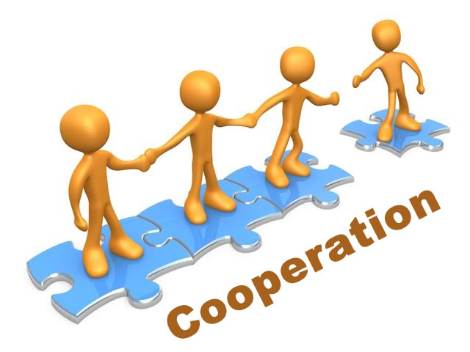
Interactions: Cooperation
Cooperation: an interaction in which two or more actors adopt policies that make at least one actor better off relative to the status quo without making others worse off.
    Pareto optimal.
    Create additional value.
    Benefit the actors who are directly involved, but it may also harm actors who are not involved.

Slide 13
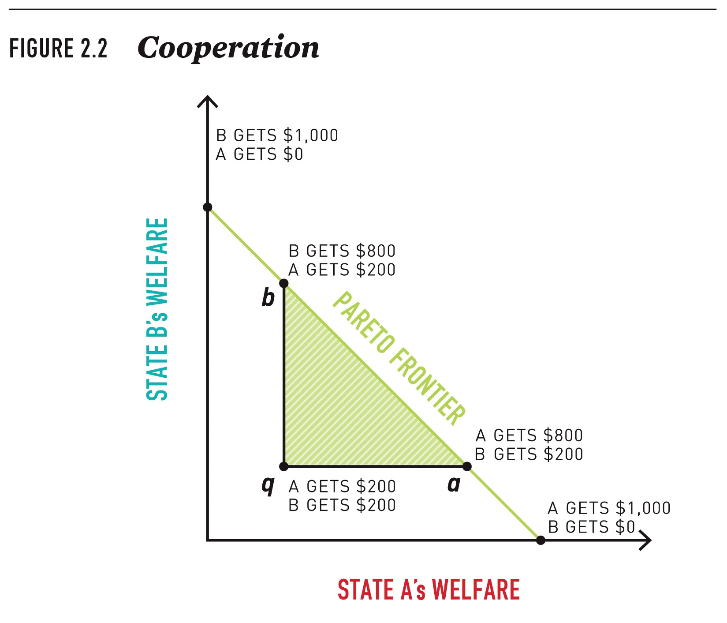
Interactions: Cooperation

Slide 14
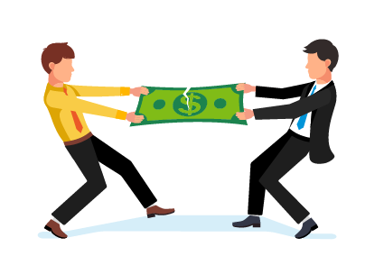
Interactions: Bargaining
Bargaining: an interaction in which two or more actors must decide how to distribute something of value.
Characterized by distributional conflict
  Each actor seeks a greater share of the good at the expense of the other
To reach a bargain, both sides must decide that a deal is better than the alternative.

Slide 15
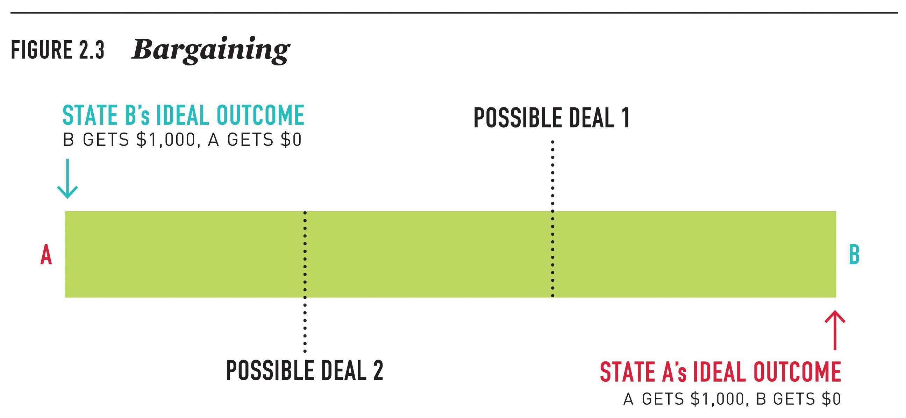
Interactions: Bargaining

Slide 16
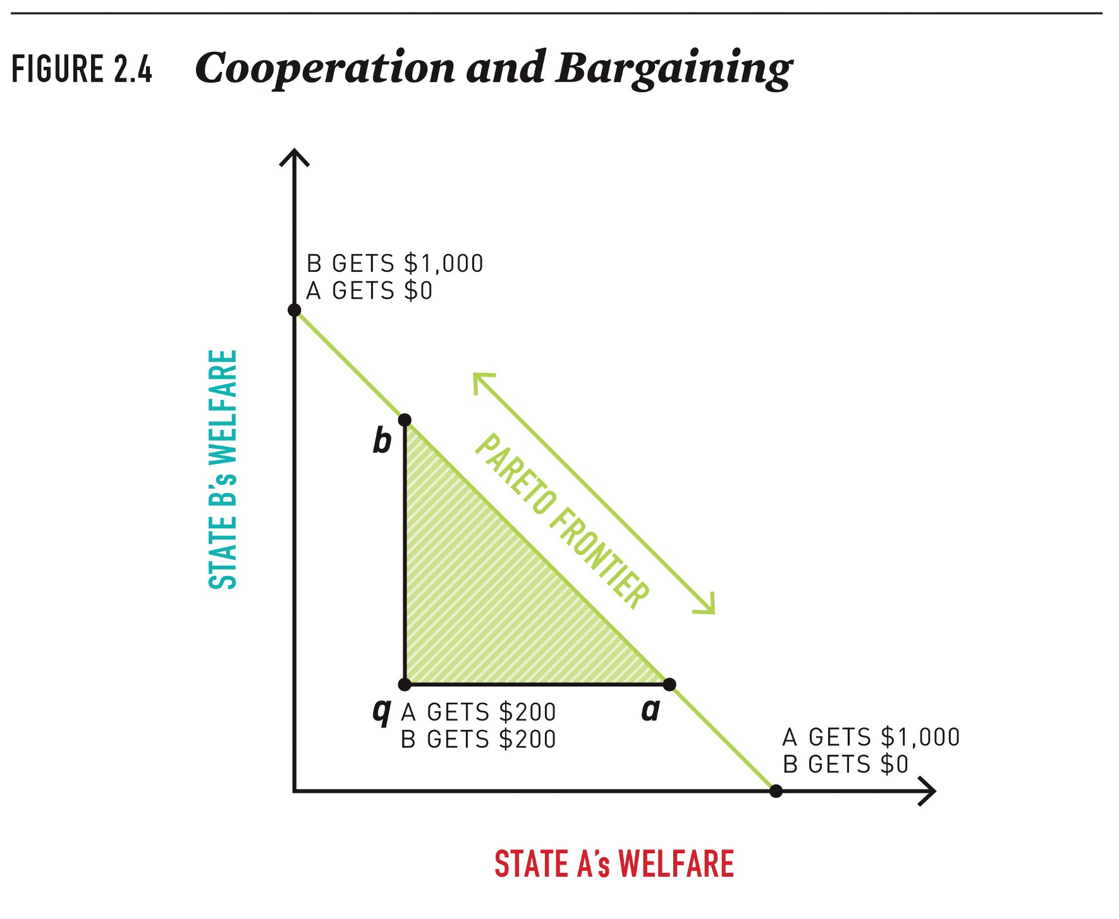
Interactions: Cooperation and Bargaining

Slide 17
When Can Actors Cooperate?
Coordination: A type of cooperative interaction in which actors benefit from all making the same choices and subsequently have no incentive not to comply.
  Cooperation is self sustaining, as no one can benefit by defecting.
  E.g., everybody drives on the left or right side of the road.
Collaboration: A type of cooperative interaction in which actors gain from working together but nonetheless have incentives not to comply with any agreement.
  Exemplified by the Prisoner’s Dilemma

Slide 18
The Prisoners’ Dilemma
Scenario
  Two suspects in a major crime are held in separate cells. There is enough evidence to convict each of them of a minor offense, but not enough evidence to convict either of them of the major crime unless one of them acts as informer against the other (finks). If they both stay quiet, each will be convicted of the minor offense and spend 1 year in prison. If one and only one of them finks, the person will be freed and used as a witness against the other, who will spend 5 years in prison. If they both fink, each will spend 3 years in prison.

Slide 19
The Prisoners’ Dilemma
Components of a strategic game:
  A set of players
  A set of strategies (actions) for each player
    Dominant strategy—a single strategy that always returns a higher payoff than all other strategy choices.
  Preferences over the set of action profiles.
The Prisoners’ Dilemma models
  a situation in where there are gains from cooperation but each has an incentive to “free ride” whatever the other player does.

Slide 20
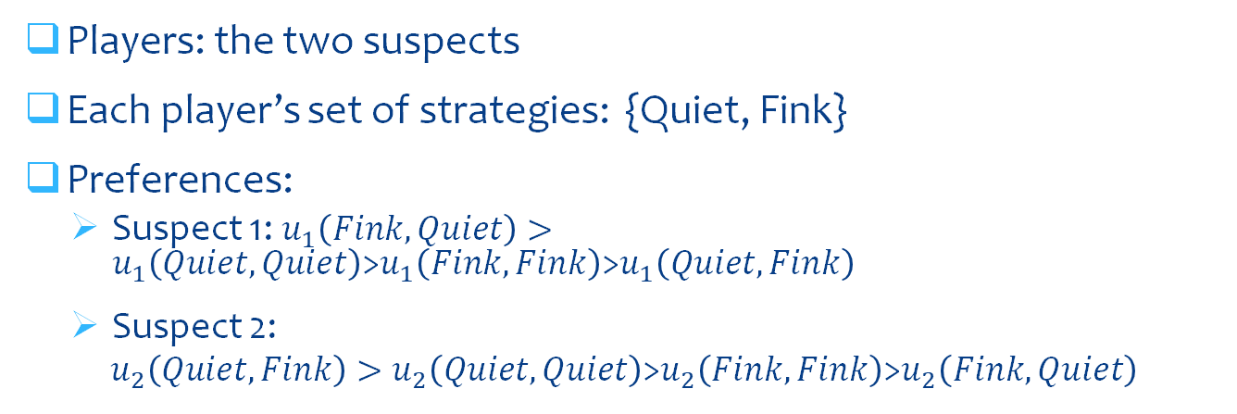
The Prisoners’ Dilemma
 | Suspect 2
Suspect 1 |  | Quiet | Fink
 | Quiet | (1, 1) | (5, 0)
 | Fink | (0, 5) | (3, 3)
Players: the two suspects
Each player’s set of strategies: {Quiet, Fink}
Preferences:
  Suspect 1: $u_{1}\left(Fink, Quiet\right)>u_{1}\left(Quiet, Quiet\right)$>$u_{1}\left(Fink, Fink\right)$>$u_{1}\left(Quiet,Fink\right)$
  Suspect 2:
  $u_{2}\left(Quiet, Fink\right)>u_{2}\left(Quiet, Quiet\right)$>$u_{2}\left(Fink, Fink\right)$>$u_{2}\left(Fink, Quiet\right)$

Slide 21
The Prisoners’ Dilemma
 | Suspect 2
Suspect 1 |  | Quiet | Fink
 | Quiet | (1, 1) | (5, 0)
 | Fink | (0, 5) | *(3, 3)*
The outcome: (Fink, Fink).
Two important characteristics:
  Nash equilibrium
    An outcome at which neither player has an incentive to change strategies unilaterally.
  Pareto suboptimal
    An outcome is Pareto optimal when no single actor can be made better off without at the same time making another actor worse off.

Slide 22
The Prisoners’ Dilemma
 | Player 2
Player 1 |  | A | B
 | A | (15, 1) | (2, 2)
 | B | (3, 4) | (0, 8)

Slide 23
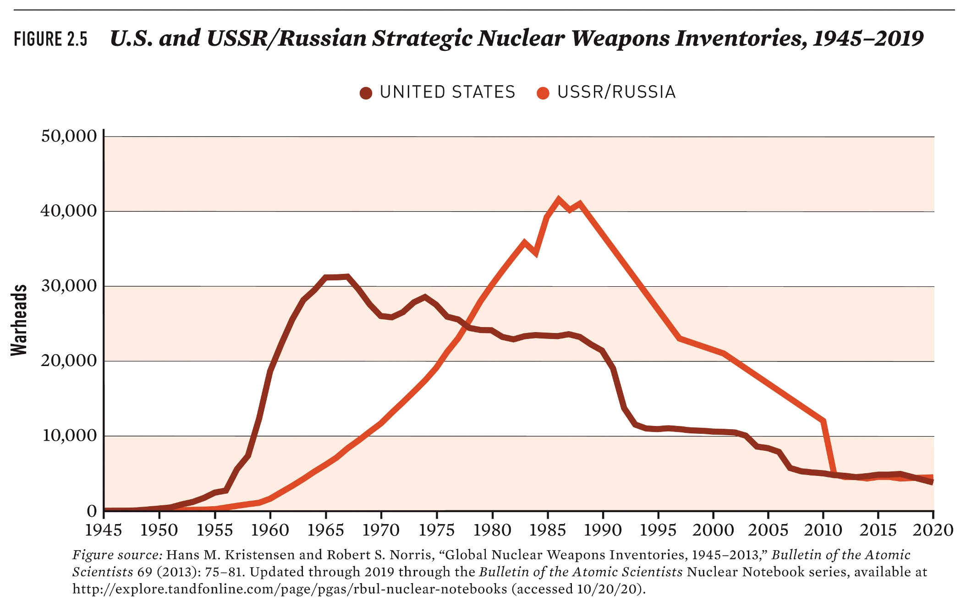
A Prisoner’s Dilemma

Slide 24
A Prisoners’ Dilemma
 | USSR/Russia
US |  | Build | Stop
 | Build | (Build, Build) | (Build, Stop)
 | Stop | (Stop, Build) | (Stop, Stop)

Slide 25
Collaboration Problems and Public Goods
Characteristics of Goods
  Non-excludability
    The property of a good whereby a person cannot be prevented from using it.
  Non-rivalry
    The property of a good whereby a person’s consumption of the good does not prevent other people’s consumption of the good.
Public goods: nonexcludable and nonrival
  E.g., national defense, fresh air
Private goods: excludable and rival
  E.g., personal computers, cars

Slide 26
Collaboration Problems & Public Goods
Collective action problems: Obstacles to cooperation that occur when actors have incentives to collaborate but each acts with the expectation that others will pay the costs of cooperation.
Free Riding: The failure to contribute to a public good while benefiting from the contributions of others.
  Free-rider: a person who received the benefit of a good but avoids paying for it.
Because of people’s incentives to free ride, collaboration unlikely to occur even when large group of people have common interests.

Slide 27
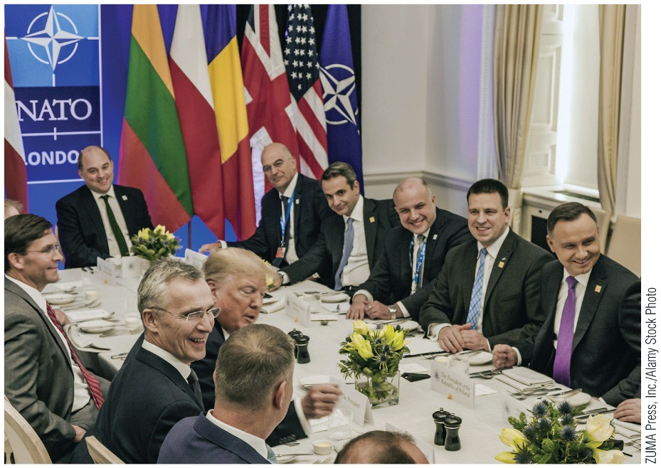
Collaboration Problems and Public Goods – NATO

Slide 28
Numbers, Iteration, Linkage, and Information
Numbers: The more actors, the more difficult it is to compromise.
Iteration, linkage, & reciprocity:
  Iteration: repeated interactions with the same partners.
  Linkage: The linking of cooperation on one issue to interactions on a second issue.
  Reciprocal punishment (tit-for-tat)
Information can help actors determine what to do.

Slide 29
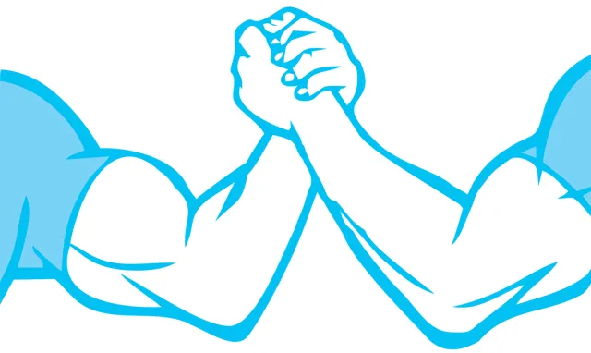
Who Wins and Who Loses in Bargaining?
Bargaining creates winners and losers.
What determines the outcome of bargaining?
Power is the ability of Actor A to get Actor B to do something that B would otherwise not do; the ability to get the other side to make concessions and to avoid having to make concessions oneself.
  Power is sometimes an interest, or an end in itself.
  Sometimes, power is a set of circumstances that structure or constrain choice.

Slide 30
Bargaining Power
Reversion outcome: The outcome that occurs when no bargain is achieved or the status quo.
  The actor who would be more satisfied with the reversion outcome generally has less incentive to make concessions.
Coercion: A strategy of imposing or threatening to impose costs on other actors in order to induce a change in their behavior.
  Military force
  Economic sanctions

Slide 31
Bargaining Power
Outside options: the alternatives to bargaining with a specific actor.
  The reversion outcome is the next-best alternative for the party with the outside option.
Agenda setting: actions taken before or during bargaining that make the reversion outcome more favorable for one party.
  Can be a source of leverage, as the party that acts first can alter the choices available to others.

Slide 32
Institutions: Do Rules Matter in World Politics?
Institutions: Sets of rules (known and shared by the relevant community) that structure interactions in specific ways.
  Formal institutions: established, codified systems that govern behavior through explicit rules and regulations.
    E.g., treaties, international organizations
  Informal institutions: unwritten, socially shared rules, norms, and conventions that influence behavior
    E.g., human rights, global environmental protection

Slide 33
How Do Institutions Affect Cooperation?
Enforcement or punishment is used by institutions to promote cooperation.
  International institutions generally lack the capacity to impose punishment on states.
Self-enforcing agreements (no incentives to defect)
International institutions facilitate cooperation by:
  Setting standards of behavior
  Verifying compliance
  Reducing the costs of joint decision making
  Resolving disputes

Slide 34
How Do Institutions Affect Cooperation?
Setting standards of behavior:
  Help to determine if an actor has violated the agreement.
  Help ensure parties’ adherence to agreed upon standards.
Verifying compliance.
  Self-reported or regulated
  Allow for participating states to “check up” on each other’s compliance.

Slide 35
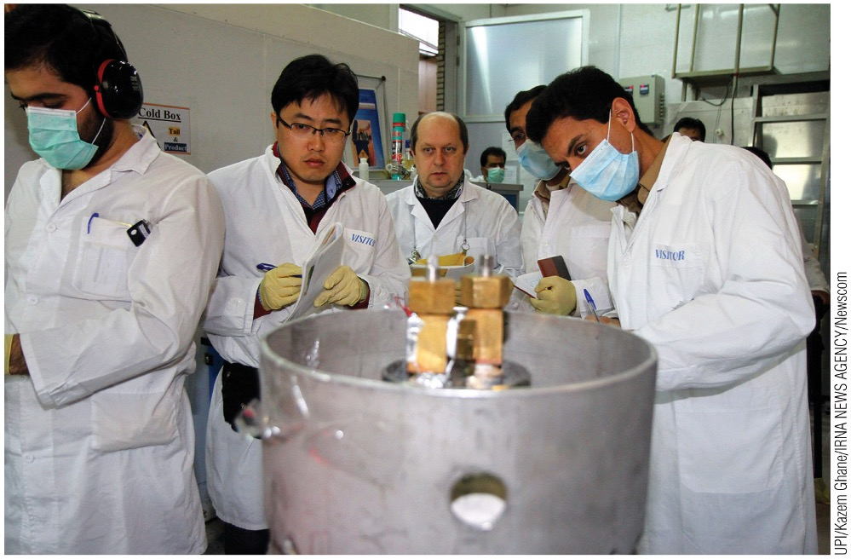
International Atomic Energy Agency (IAEA)
IAEA inspectors examine Iran’s uranium enrichment facilities to verify compliance

Slide 36
How Do Institutions Affect Cooperation?
Joint decision-making costs are high without standards.
  Political institutions, or the rules of the political game, define how joint decisions are made.
  International institutions reduce joint decision-making costs by establishing how issues are addressed.
Resolving disputes: mechanisms without enforcement.
  Provide mechanisms for dispute resolution
  But, lack the power to enforce their rulings

Slide 37
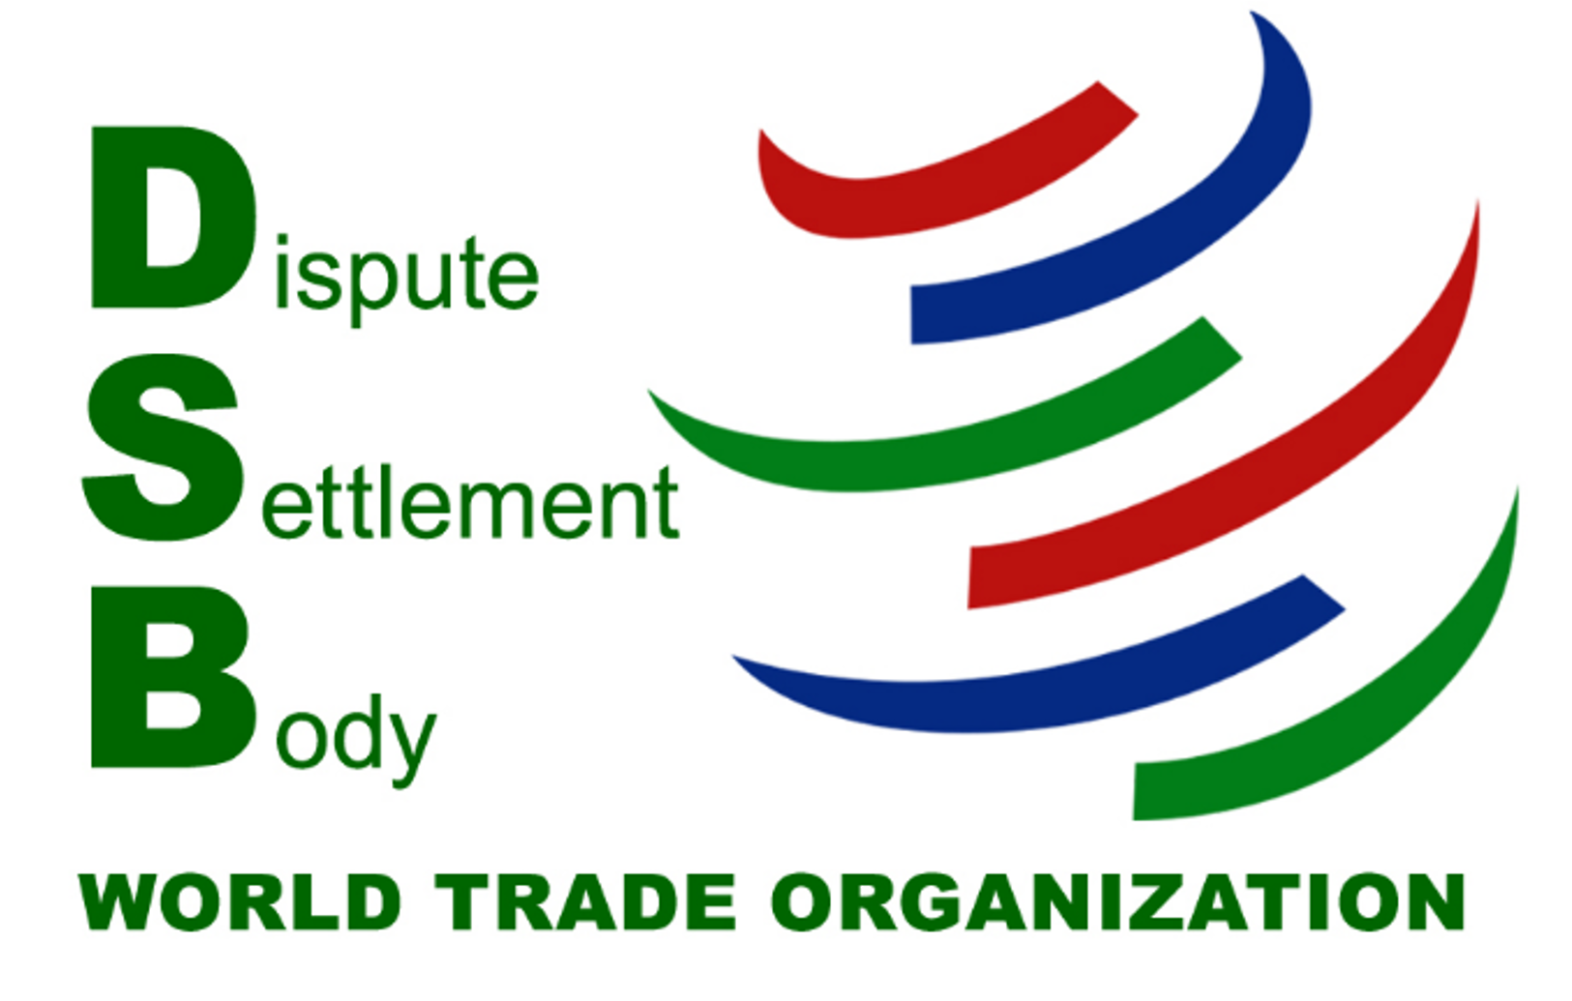
WTO’s Dispute Settlement Mechanism

Slide 38
Who Do Institutions Benefit?
Institutions can have biases.
  A product of the cooperation and bargaining that brought them into being.
  Winners got to write the rules or, at least, having a disproportionate say over the rules.
  E.g., the UN Security Council, IMF
Most states follow the rules most of the time.
  Facilitate cooperation that would have been unlikely without institutions.
  Less costly to use existing institutions, even if imperfect, than to establish new ones.

Slide 39
Analytical Framework: Recap
Interests = foundation of politics
Cooperation and bargaining = strategic interaction
Institutions = rules that constrain and enable interaction
  Not neutral
  Actors struggle to tilt them in their favor

