Slide 1
PLSC 14: Realism, Liberalism & Constructivism
Professor Boliang Zhu

Slide 2
What Is a Theory?
A logically consistent set of statements that explains a phenomenon of interest.
  Specify the factors that play a role in causing the events.
  How how these pieces fit together, making sense of the puzzle.
Theories help us to describe, predict, and prescribe.
  Describe events by identifying which factors are important.
  Predict by offering a sense of how the world works and suggesting how a change in one factor will lead to changes in behavior and outcomes.
  Prescribe policy responses by identifying what must be changed to foster better outcomes.

Slide 3
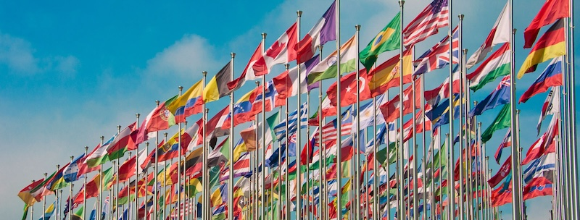
Grand IR Theories
Realism
Liberalism
Constructivism

Slide 4
Realism
Two key assumptions about the international system:
  States are the dominant actors.
  Anarchy shapes the interests and interactions that matter in world politics.
Constant fear of one another in a self-help system.
  Look out for its own survival and security.
  Seek security and power.
    Maximize power both externally and internally.

Slide 5
Realism
Security dilemma
  When state A improves its military capabilities to enhance it own security, it typically undermines others’ security.
Anarchy + Uncertainty → Self-Help → Power Maximization → Security Dilemmas
  IR is fraught with conflict.
  International cooperation is unlikely.
  International organizations are ineffective.
Only when states have common enemies can they trust each other & cooperate.
  As soon as the common enemy is gone, the cooperation is expected to end

Slide 6
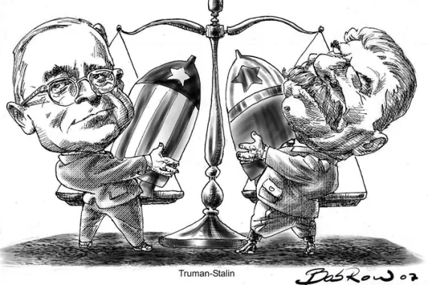
Realism
Stability can be achieved.
If states achieve equality of power with each other, then war is unlikely because neither side expects to win if they attack.
Balance of Power
  Internal balancing: build up their own capabilities to check dangerous concentrations of power
  External balancing: aggregate their capabilities with other states in alliances.
Peace, but not harmony.
  E.g., the Cold War
Truman and Stalin

Slide 7
Types of Realism
Classical Realism: Focuses on the idea that human nature is inherently evil.
Neorealism: Most common.
Offensive Realism: All states are constantly trying to dominate other states.
Defensive Realism: A few try to dominate, but most seek to maintain the status quo.

Slide 8
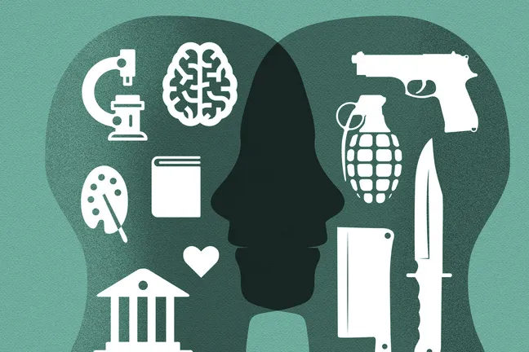
Classical Realism
Focuses on human nature
  Takes a pessimistic view of human nature—inherently evil, self-interested, and inclined toward conflict.
  Emphasizes the immutability of human nature—doomed to war due to its relentless quest for power.
War is seen as a reflection of state-based aggression—a byproduct of human nature in an anarchic international system.
Human nature?

Slide 9
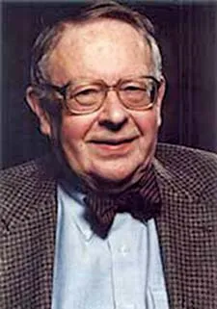
Neorealism
Waltz (1979): Theory of International Politics
  States as rational unitary actors maximize power and security.
  The structure of international system, or the distribution of power, shapes state behavior.
  Bipolarity is better and more stable than multipolarity.
    Bipolarity (two rivals/hegemons)
      Keep track of each other
    Multipolarity: (three or more great powers)
      “dangers are diffused, responsibilities unclear, and definitions of vital interests easily obscured.”
Hegemonic Stability Theory
Kenneth Waltz (1924–2013)

Slide 10
Classical Realism vs Neorealism
Feature | Classical Realism | Neorealism
Main Focus | Human nature and the inherent flaws of people. | The structure of the international system.
View of Anarchy | A condition that allows human selfishness to show. | The defining feature of world politics that forces states to protect themselves.
Why States Seek Power | Power is a goal in itself because humans naturally crave domination. | Power is a tool for survival in an unsafe, anarchic world.
View of Domestic Politics | Matters a lot; the type of regime and leadership quality change foreign policy. | Ignored or treated as secondary; all states act similarly based on system pressures.
Cause of War | Aggressive human leaders and the lust for power. | The security dilemma and fear caused by a lack of a global police.

Slide 11
Defensive Realism
Van Evera (1999): Causes of War.
Adds a key variable: the offense-defense balance.
  “prevailing technologies or geographical circumstances often favor defense, seized resources do not cumulate easily with those already possessed by the metropole, dominoes do not fall, and power is difficult to project at a distance.”
Rationality + a strategic balance => uphold the status quo much more often; balancing is the appropriate choice.
  Relatively rare occurrence of interstate war.

Slide 12
Offensive Realism
Mearsheimer (2001): The Tragedy of Great Power Politics.
  Great powers inherently posses some offensive military capability.
  States never can be certain about others’ intensions.
Power maximization to obtain higher relative standing as the norm among great powers.
Great powers seek to enhance power and vie for regional hegemony.
This process ultimately constrained only by the stopping power of water.
  War is to be expected.

Slide 13
Liberalism
Anarchy as an inconvenience rather than an existential threat.
  The pattern of interdependence shapes state behavior.
Uncertainty about others’ intentions
  But, easy to signal one’s type.
Many different types of actors
  E.g., individuals, firms, int’l organizations, and states.

Slide 14
Liberalism
Governments’ interests come from within, rather than viewing states as unitary actors.
  Interplay of domestic actors operating within domestic political institutions.
States prioritize maximizing wealth rather than power.
Power can increase wealth, but there is sometimes a tradeoff, depending on what the state values as wealth.
Generally optimistic about the possibilities for cooperation.
  See many areas where actors have common interests, forming the basis for cooperation.
  E.g., avoiding conflict, profitable economic exchanges, and environmental protection.

Slide 15
Different Types of Liberalism
Neoliberal institutionalism: International institutions help promote cooperation.
Commercial peace theory: economic interdependence has pacifying effects.
Democratic Peace: democratic institutions and norms influence state behavior.

Slide 16

Neoliberal Institutionalism
Keohance (1984): After Hegemony.
International system could remain stable in the absence of a hegemon.
International institutions facilitate cooperation between states (see Week 1 lecture slides)
  Reduce transaction costs
  Provide Information
  Enable interlinkages of issues
  Facilitate the principle of reciprocity
  Extend the shadow of the future (iteration)
  Resolve disputes
Robert Keohance

Slide 17
Commercial Peace Theory
States seek to maximize wealth.
Market openness, trade, and capital flows contribute to economic development and wealth creation.
Economic interdependence increases the opportunity cost of war, as it disrupts normal economic activities.
  More to lose when fighting a war with an economic partner.
  Domestic groups are incentivized to lobby against war.
The globalization of finance and the rise of multinational corporations make conquest for economic purposes counterproductive.

Slide 18
Democratic Peace Theory
Monadic: democracies are in general more peaceful.
Dyadic: democracies do not go to war against each other.
Explanations:
  Accountability: democratic leaders more likely to be punished by declaring wars that harm the people.
  Democratic institutions and processes make it easier to overcome informational problems.
    More transparent.
    Better able to send credible signals in crises.
    Adhere to mutual respect and nonviolence in their dealings with one another.

Slide 19
Constructivism
Wendt (1999): Social Theory of International Politics.
International institutions can be effective, even transformative.
De-emphasizes the material sources of interests (e.g., wealth).
Focuses on the role of nonmaterial factors, such as ideas, culture, and norms.
What actors want is shaped by their culture, prevailing ideas, and identity, or their conception of who they are—not fixed or predetermined.
  A state may forgo certain weapons if a large number of countries decide that using them is barbaric.

Slide 20
Constructivism
Institutions embody the rules appropriate for behavior, thereby exerting a profound effect on actions and observed outcomes.
See significant potential for changes or even fundamental transformation in world politics as norms and values can change.
International system is not foreordained by the condition of anarchy.
The conscious efforts of activists can alter state behavior by promoting new norms.

Slide 21
Realism, Liberalism & Constructivism

