Slide 1
Automated lane change (ALC)

Slide 2
Features
Automated lane change
Base: Level-of-dynamics learning and mapping to predefined profiles
Advanced: driver classification without environmental conditions and mapping to predefined profiles
AdvancedPlus: driver classification also considering environmental conditions and mapping to predefined profiles

Slide 3
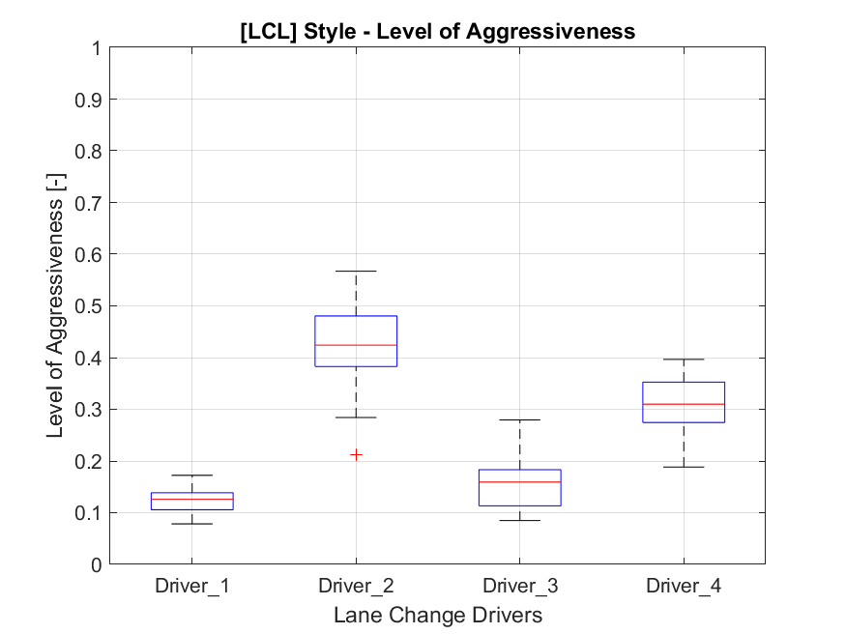
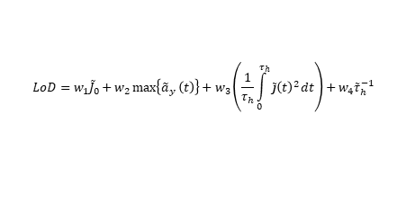
Automated Lane Change - Base
Personalization within One Driving
Lane change cutting
Based on indicator and approval button
Based on relative lateral acceleration with a constant threshold
Level of dynamics
Based on ego kinematic quantities
Entire lane change as one maneuver
0-1 continuous range discretized into 3-5 subclasses
Excluding environmental condition quantities
Online learning
Available in the vehicle
Moving average
Outlier detection based on longitudinal acceleration
ADAS reproduction
Map learng LoA to predefined lane change profiles
Param set 1
Param set 2
Param set 3
$$LoD=w_{1}{\tilde{J}}_{0}+w_{2}\max\left\{{\tilde{a}}_{y} \left(t\right)\right\}+w_{3}\left(\frac{1}{τ_{h}}\int_{0}^{τ_{h}}{\tilde{j}{\left(t\right)}^{2}}dt\right)+w_{4}{\tilde{τ}}_{h}^{−1}$$
Param set 4
Param set 5

Slide 4
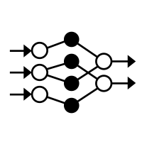
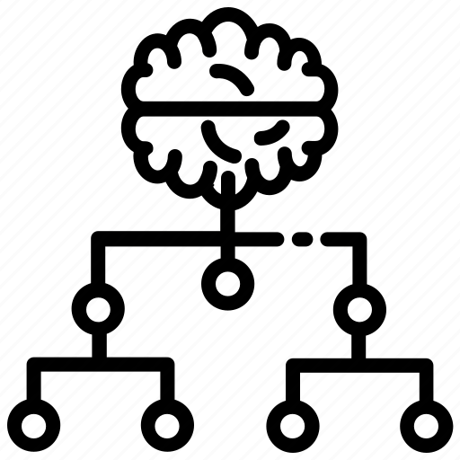
Automated Lane Change - Advanced
Personalization within One Driving
Lane change cutting
With AI trained via endurance data
Maneuver subsegments cut with AI (initial, first half wave, settling)
Driver classification
Multidimensional classification based on maneuver subsegments
AI classification algorithm
Excluding environmental condition quantities
Online learning
Classification through continuous observation
ADAS reproduction
Map the class to predefined lane change profiles with multiple parameter sets
p1 | p2 | p3 | p4
p5 | p6 | p7 | p8
P9 | p10 | p11 | p12
p13 | p14 | p15 | p16
Init dynamics
Transition dynamics
Init
Transition
Settling
Settling dynamics

Slide 5
Automated Lane Change – AdvancedPlus (with context info)
Personalization within One Driving
Lane change cutting
With AI trained via endurance data
Maneuver subsegments cut with AI (initial, first half wave, settling)
Scenario classifiction
Based on context information
Classify actual scenario
Produce environmental condition quantities
Driver classification
Multidimensional classification based on maneuver subsegments
AI classification algorithm
Including environmental condition quantities
ADAS reproduction
Map learnt class to predefined lane change profiles

