Slide 1
ALC personalization base

Slide 2
Generic structure proposal
Personalized lane change concept
Context information
Driver inputs (HMI)
Feedback to the driver
Environmental information
Knowledge model
Driver information
Level of aggressiveness definition
Learning engine
Pattern proposal
Driver classification
database
Corridor information
ADAS
Parameter classes
Vehicle Motion and Control
Vehicle sensor data

Slide 3
Level of aggressiveness definition
Personalized lane change concept
Lane change detection
(lane change ongoing)
Trajectory recording
(with kinematic quantities)
Ring buffer
Outlier detection
Level of aggressiveness calculation
Convergence evaluation
Current proposal
Rough estimation based on indicators
Accurate detection based on relative lateral acceleration to the lane
Recording
Lane change +/- 5secs
Trajectory to target lane in Frenet-frame (available in the camera system)
Lateral acceleration of the ego vehicle
Outliers
Longitudinal acceleration
TTC
Velocity
Time horizon overflow
Road type
…
Calculation
Weighted sum of most characteristic dynamic values of the lane change maneuver
Next slide…

Slide 4
Level of aggressiveness definition / Convergence evaluation
Personalized lane change concept
Level of aggressiveness (LOA ☺ ) is calculated for one given lane change
Cumulated value (e.g. averaged through a given time)
Considerations:
Level of aggressiveness will vary even in the case of one driver from time to time; this can happen during one driving cycle!
Convergence is not yet proven even when environmental conditions are the same (however this is expected).
Correlation of level of aggressiveness on higher level can be determined: typcial road sections (e.g. where a driver drives every day), weather conditions, time of the day…etc. Also, different road types (2x2 or 2x3 lane highways) can influence the LOA.
Proposal:
Have recording windows when environmental conditions are not expected to be changed
Consider context information and have matrix like averaging of LOA
Also consider standard deviation: decide on its absolute value

Slide 5
Driver classification
Personalized lane change concept
A predefined set of driver profiles (e.g. 5pcs) are prepared in terms of Motion Planning and Control parameter sets
The profiles also mean a range of LOA
The driver LOA is mapped to the profile LOA ranges
This way, the actual driver is classified
Note 1: technically this also enables selecting the driver profile via HMI manually and activate it.
Note 2: once driver classification happened, the profile selection must also be communicated & approved by HMI

Slide 6
About the level of aggressiveness calculation

Slide 7
Vehicle trajectory comparison between dynamic and comfort
About the level of aggressiveness calculation
Intentional comfort lane changes (left)
Intentional dynamic lane changes (left)

Slide 8
Lane change kinematic features
Personalized lane change concept
Two aspects here:
Dynamic and comfort lane change can be distinguished based on maximum lateral acceleration (left plot) or the integrated jerk (based on right plot)
Initial behaviour is a different type of „dynamics”: initial jerk may be high, still the rest of the trajectory can be smooth.

Slide 9
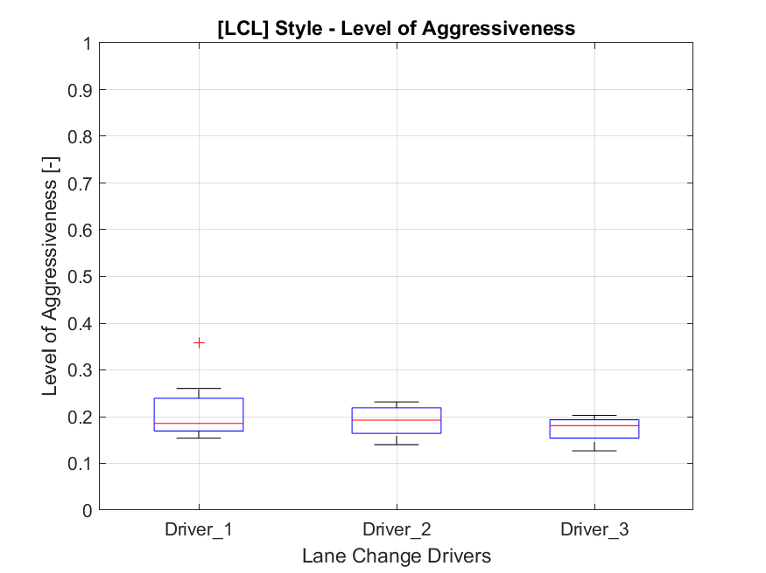
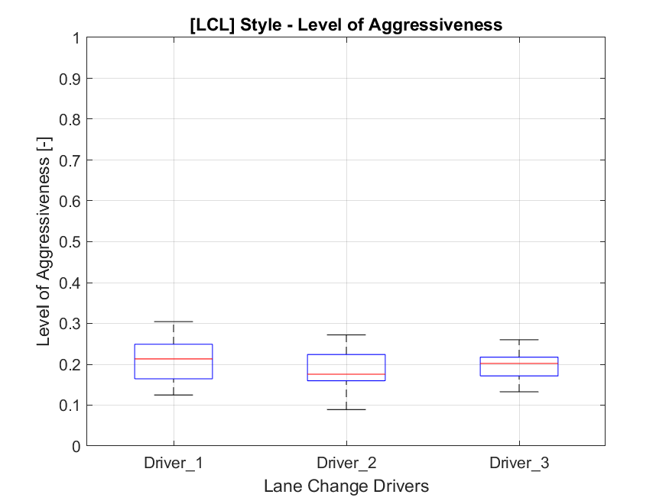
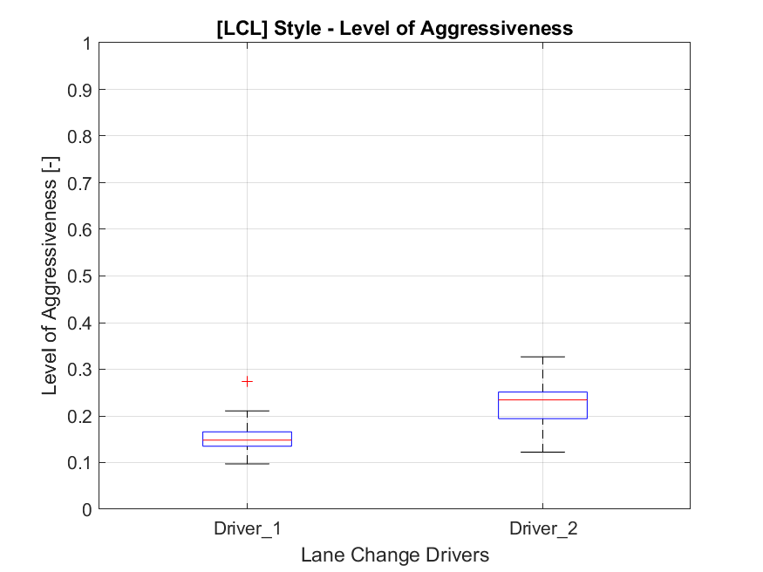
Level of aggressiveness – comfort driving on different road sections
Personalized lane change concept
M7 (Gyuri, Samu, IG)
2x3 lane highway (130kph)
M6 (Gyuri, Samu, IG)
2x2 lane highway (130kph)
M6 (Samu, IG)
2x2 lane highway (130kph)

Slide 10
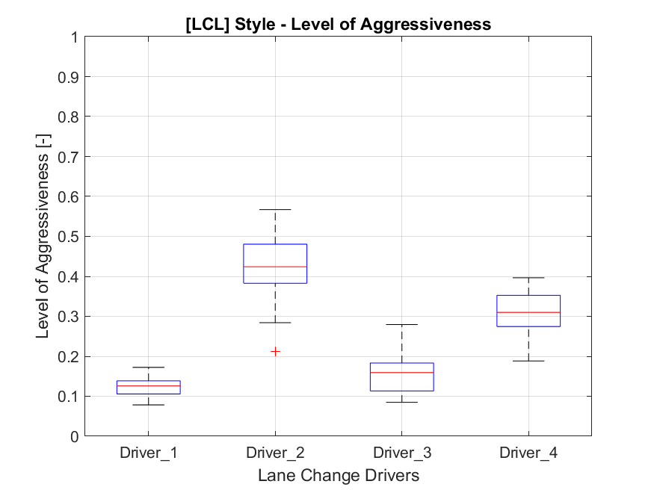
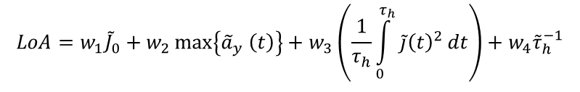
Vehicle trajectory comparison between dynamic and comfort
About the level of aggressiveness calculation
$$LoA=w_{1}{\tilde{J}}_{0}+w_{2}\max\left\{{\tilde{a}}_{y} \left(t\right)\right\}+w_{3}\left(\frac{1}{τ_{h}}\int_{0}^{τ_{h}}{\tilde{j}{\left(t\right)}^{2}}dt\right)+w_{4}{\tilde{τ}}_{h}^{−1}$$
On the diagram on the right dynamic – comfort comparison can be seen. Two drivers.

