Slide 1
2016 History Fair Presentation:
Exploration, Encounter, Exchange
Prepared by Peggy Lee
Topic
The Silk Road
Question
What positive and negative impacts did China have on the Roman Empire through the Silk Road exchange?
Thesis statement
Although the Silk Road exchange brought convenience and satisfaction to people in the Roman Empire, it encouraged the spread of diseases and the illegal use of gunpowder.

Slide 2
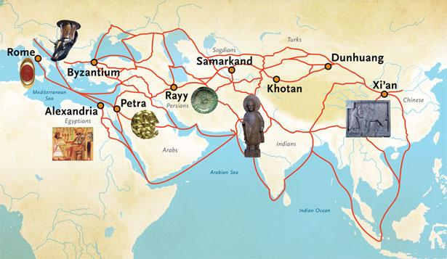
Background-based visual #1
Image source: www.penn.museum.com
This map shows the main route of the Silk Route Exchange between China and the Roman Empire from 114 BCE to 1450 CE. Because products from either places were “transferred from the caravans of one people to those of another”, the two countries did not each other very well until Marcus Aurelius’ voyage in 166. Aside from goods, religions and living techniques were also shared (The First Contact Between Rome and China).

Slide 3
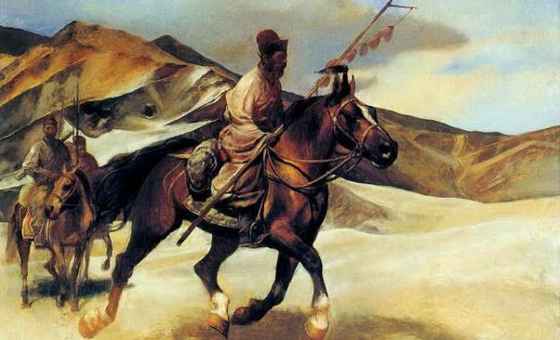
Background-based visual #2
Image source: www.baike.com
During the Han Dynasty, while Emperor Wudi was annoyed by the Huns, who liked to invade the northern borders of the Han Empire, the people of Da Yuezhi was in war with the Huns, who killed the king of Da Yuezhi and turned his head into a goblet. Wanting to kill the Huns together with the people of Da Yuezhi he sent Zhang Qian as a diplomatic envoy to the Western Regions. The route he took was later known as the Silk Road (Journey of Zhang Qian).

Slide 4
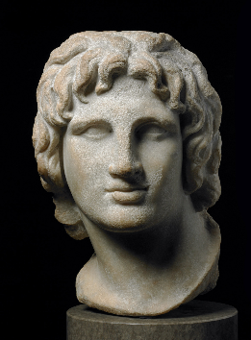
Background-based visual #3
Image source: www.britishmuseum.tumblr.com
The above is a sculpture of Alexander the Great of Rome. Of the lands he conquered, Alexandria, Khujand of Tajikistan, Samarkand became major the trading cities of the Silk Road exchange (Alexander the Great Biography).

Slide 5
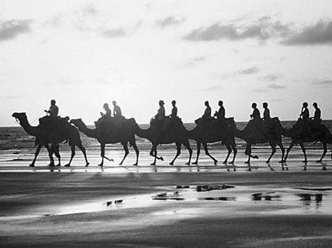
Evidence-based visual #1
Image source: www.kaleidoscope.cultural-china.com
In this picture, Mongol merchants “braved the crossing of Mountains and deserts to bring gunpowder West along the Silk Road, changing the face of warfare”. This advance in technology caused random invasions within the empire and injured a lot of innocent people (Gunpowder Trade).
.

Slide 6
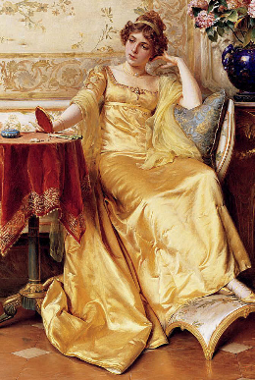
Evidence-based visual #2
Image source: www.confuciusmag.com
Silk was a valuable material back in that time period and only nobles, church officials and women of the upper class were able to afford it. By the posture of this women, we can infer that she was very satisfied with her silk gown (Rome's Eastern Trade).

Slide 7
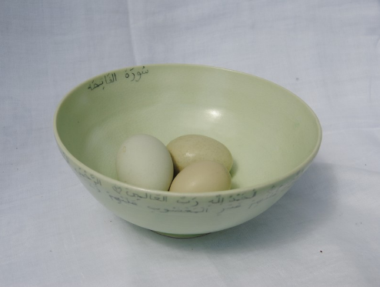
Evidence-based visual #3
Image source: www.silkroadceramics.com
This picture shows an example of the ceramics and potteries that were used by the Romans during and after the exchange. This made the lives of the Romans more convenient by allowing them to organize small objects (Silk Road: Dialogue, Diversity and Development).

Slide 8
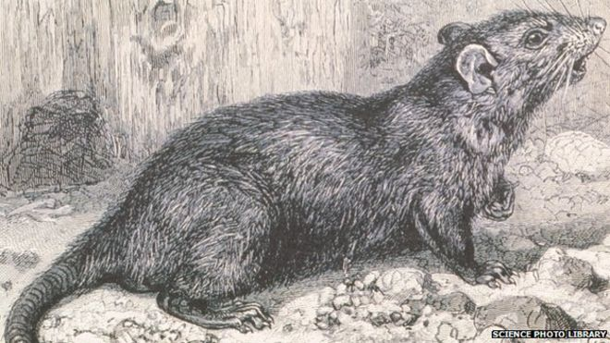
Evidence-based visual #4
Image source: www.bbc.com
This picture illustrates a rat found in a cabin in the 14th century. Historians believe that diseases causing the Black Death were caused by rats. As goods were brought up the ships, they crawled into the cabins, bringing Chinese diseases to European countries (The Silk Road: Trade and the Black Death in Europe).

Slide 9
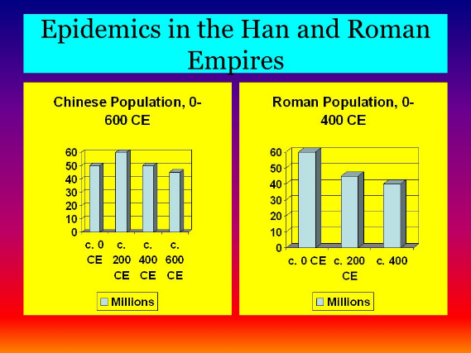
Concluding visual #1
Image source: www.slideplayer.com
These charts show the comparison of the Chinese and Roman populations affected by epidemics from 0 to 400 CE. Before the exchange, the number of diseased Romans was half of what’s shown above (About The Silk Road).

Slide 10
Works Cited
About The Silk Road. Silk Road: Dialogue, Diversity and Development
Alexander the Great Biography. Bio, 2016. Web. 23 Mar 2016.
Gunpowder trade. Culturas China, 2016. Web. 23 Mar 2016.
Journey of Zhang Qian. History World, 2014. Web. 23 Mar 2016.
Rome's Eastern Trade. Depts Washington, 2015. Web. 23 Mar 2016.
Silk Road Chronology. Silk-Road, 2000. Web. 23 Mar 2016.
The First Contact Between Rome and China. Silk Road, 2000. Web. 23
Mar 2016.
The Silk Road: Trade and the Black Death in Europe. The Ancient
Standard, 2016. Web. 23 Mar 2016.

